Slide 1

Chapter 11 Getting Started with GUI Programming
Chapter 8 Inheri
tance and Polymorphism
Chapter 9 Abstract Classes and Interfaces
Chapter 11 Getting Started with GUI Programming
Chapter 12 Event
-
Driven Programming
Chapter 13 Creating User Interfaces
Chapter 14 Applets, Images, Audio

Slide 2
Objectives
To distinguish simple GUI components (§11.2).
To describe the Java GUI API hierarchy (§11.3).
To create user interfaces using frames, panels, and simple UI components (§11.4).
To understand the role of layout managers (§11.5).
To use the FlowLayout, GridLayout, and BorderLayout managers to layout components in a container (§11.5).
To specify colors and fonts using the Color and Font classes (§11.6-11.7).
To use JPanel as subcontainers (§11.8).
To paint graphics using the paintComponent method on a panel (§11.9).
To draw strings, lines, rectangles, ovals, arcs, and polygons using the drawing methods in the Graphics class (§11.9).

Slide 3
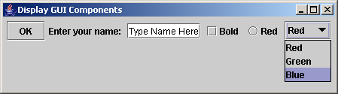
Creating GUI Objects
// Create a button with text OK
JButton jbtOK = new JButton("OK");
// Create a label with text "Enter your name: "
JLabel jlblName = new JLabel("Enter your name: ");
// Create a text field with text "Type Name Here"
JTextField jtfName = new JTextField("Type Name Here");
// Create a check box with text bold
JCheckBox jchkBold = new JCheckBox("Bold");
// Create a radio button with text red
JRadioButton jrbRed = new JRadioButton("Red");
// Create a combo box with choices red, green, and blue
JComboBox jcboColor = new JComboBox(new String[]{"Red",
"Green", "Blue"});
Label
Text field
Check Box
Radio Button
Button
Combo Box

Slide 4
Swing vs. AWT
So why do the GUI component classes have a prefix J? Instead of JButton, why not name it simply Button? In fact, there is a class already named Button in the java.awt package.
When Java was introduced, the GUI classes were bundled in a library known as the Abstract Windows Toolkit (AWT). For every platform on which Java runs, the AWT components are automatically mapped to the platform-specific components through their respective agents, known as peers. AWT is fine for developing simple graphical user interfaces, but not for developing comprehensive GUI projects. Besides, AWT is prone to platform-specific bugs because its peer-based approach relies heavily on the underlying platform. With the release of Java 2, the AWT user-interface components were replaced by a more robust, versatile, and flexible library known as Swing components. Swing components are painted directly on canvases using Java code, except for components that are subclasses of java.awt.Window or java.awt.Panel, which must be drawn using native GUI on a specific platform. Swing components are less dependent on the target platform and use less of the native GUI resource. For this reason, Swing components that don’t rely on native GUI are referred to as lightweight components, and AWT components are referred to as heavyweight components.

Slide 5
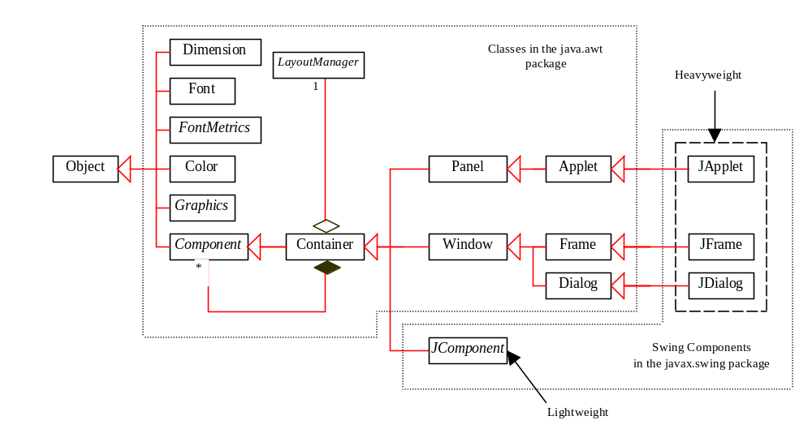
GUI Class Hierarchy (Swing)

Slide 6
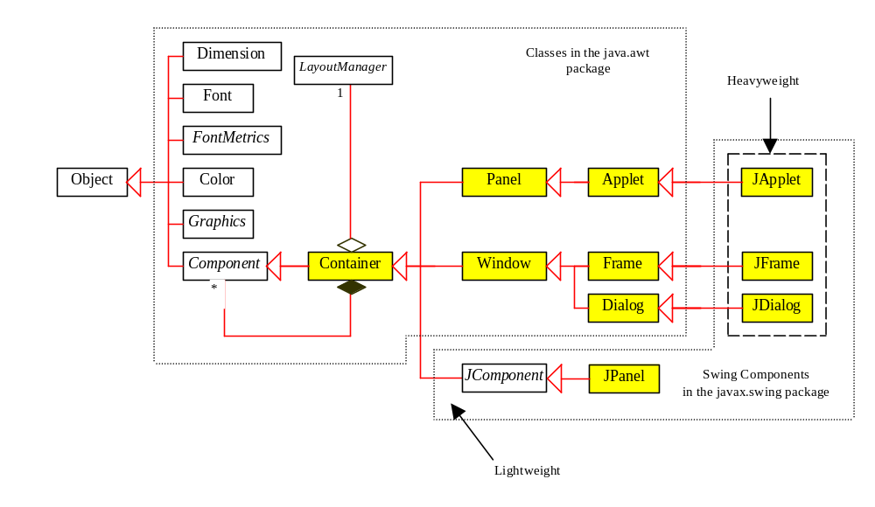
Container Classes
Container classes can contain other GUI components.

Slide 7
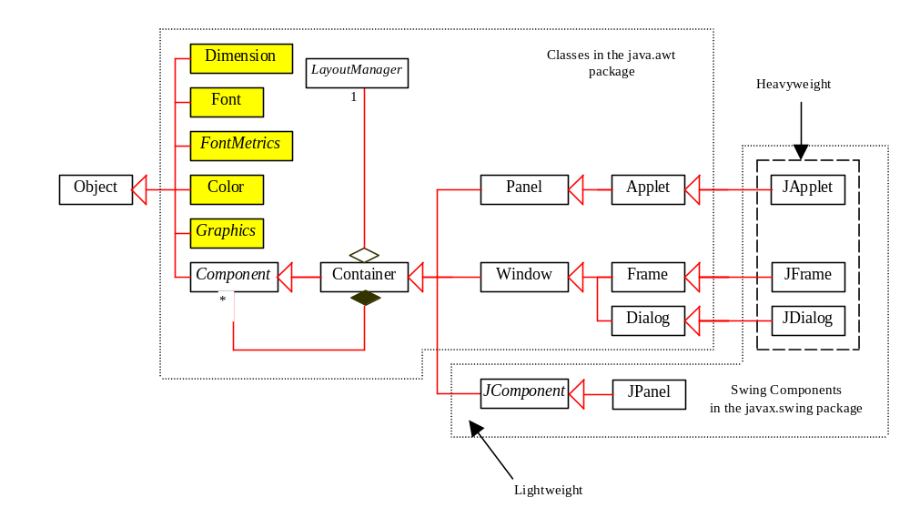
GUI Helper Classes
The helper classes are not subclasses of Component. They are used to describe the properties of GUI components such as graphics context, colors, fonts, and dimension.

Slide 8
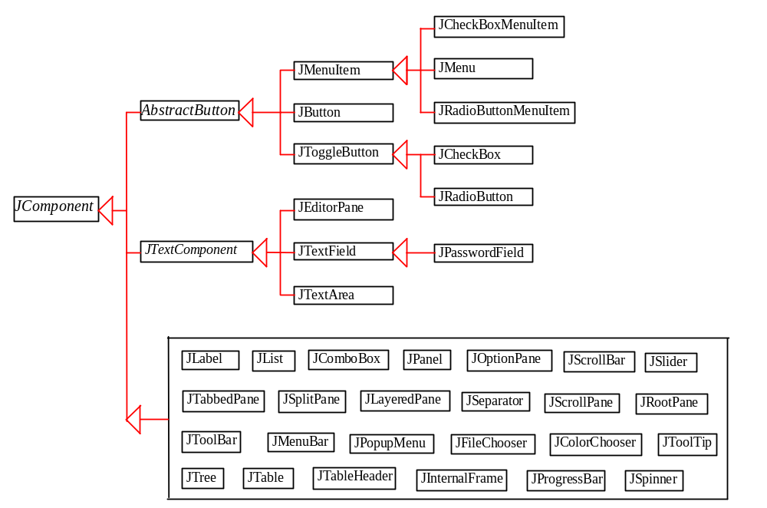
Swing GUI Components

Slide 9
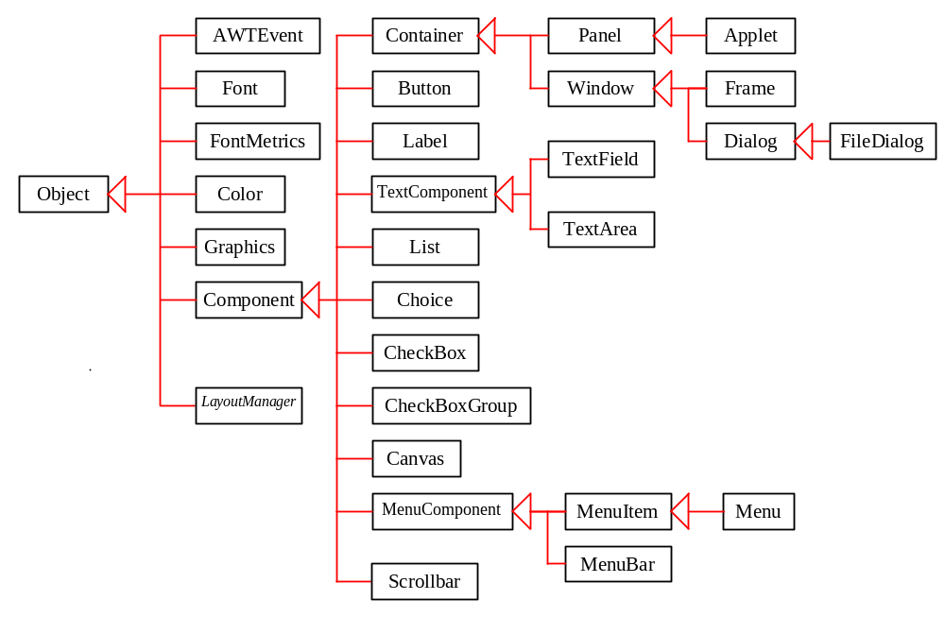
AWT (Optional)

Slide 10
Frames
Frame is a window that is not contained inside another window. Frame is the basis to contain other user interface components in Java GUI applications.
The Frame class can be used to create windows.
For Swing GUI programs, use JFrame class to create widows.

Slide 11
Creating Frames
  import javax.swing.*;
  public class MyFrame {
  public static void main(String[] args) {
  JFrame frame = new JFrame("Test Frame");
  frame.setSize(400, 300);
  frame.setVisible(true);
  frame.setDefaultCloseOperation(
  JFrame.EXIT_ON_CLOSE);
  }
}

Slide 12
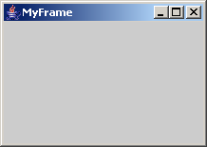
Adding Components into a Frame
// Add a button into the frame
frame.getContentPane().add(
new JButton("OK"));
Title bar
Content pane
MyFrameWithComponents

Slide 13
NOTE
The content pane is a subclass of Container. The statement in the preceding slide can be replaced by the following two lines:
  Container container = frame.getContentPane();
  container.add(new JButton("OK"));
You may wonder how a Container object is created. It is created when a JFrame object is created. A JFrame object uses the content pane to hold components in the frame.

Slide 14
Layout Managers
Java’s layout managers provide a level of abstraction to automatically map your user interface on all window systems.
The UI components are placed in containers. Each container has a layout manager to arrange the UI components within the container.
Layout managers are set in containers using the setLayout(LayoutManager) method in a container.

Slide 15
Kinds of Layout Managers
FlowLayout (Chapter 11)
GridLayout (Chapter 11)
BorderLayout (Chapter 11)
Several other layout managers will be introduced in Chapter 23, “Containers, Layout Managers, and Borders”

Slide 16
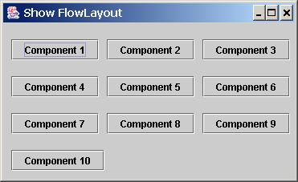
Example 11.1
Testing the FlowLayout Manager
The components are arranged in the container from left to right in the order in which they were added. When one row becomes filled, a new row is started.
ShowFlowLayout

Slide 17
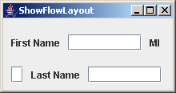
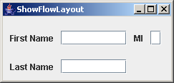
Example 11.1
(New) Testing the FlowLayout Manager
Write a program that adds three labels and text fields into the content pane of a frame with a FlowLayout manager.

Slide 18
FlowLayout Constructors
public FlowLayout(int align, int hGap, int vGap)
Constructs a new FlowLayout with a specified alignment, horizontal gap, and vertical gap. The gaps are the distances in
pixel between components.
public FlowLayout(int alignment)
Constructs a new FlowLayout with a specified alignment and a default gap of five pixels for both horizontal and vertical.
public FlowLayout()
Constructs a new FlowLayout with a default
center alignment and a default gap of five pixels
for both horizontal and vertical.

Slide 19
Example 11.2
Testing the GridLayout Manager
The GridLayout manager arranges components
in a grid (matrix) formation with the number of
rows and columns defined by the constructor. The components are placed in the grid from left to right starting with the first row, then the second, and so on.
ShowGridLayout

Slide 20
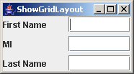
Example 11.2
(New) Testing the GridLayout Manager
Rewrite the program in the preceding example using a GridLayout manager instead of a FlowLayout manager to display the labels and text fields.
ShowGridLayout

Slide 21
GridLayout Constructors
public GridLayout(int rows,
int columns)
Constructs a new GridLayout with the specified number of rows and columns.
public GridLayout(int rows, int columns, int hGap, int vGap)
Constructs a new GridLayout with the
specified number of rows and columns,
along with specified horizontal and
vertical gaps between components.

Slide 22
Example 11.3
Testing the BorderLayout Manager
The BorderLayout manager divides the container into five areas: East, South, West, North, and Center. Components are added to a BorderLayout by using the add method.
add(Component, constraint), where constraint is BorderLayout.EAST, BorderLayout.SOUTH, BorderLayout.WEST, BorderLayout.NORTH, or BorderLayout.CENTER.
ShowBorderLayout

Slide 23
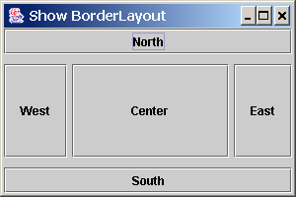
Example 11.3, cont.
ShowBorderLayout

Slide 24
The Color Class
You can set colors for GUI components by using the java.awt.Color class. Colors are made of red, green, and blue components, each of which is represented by a byte value that describes its intensity, ranging from 0 (darkest shade) to 255 (lightest shade). This is known as the RGB model.
  Color c = new Color(r, g, b);
r, g, and b specify a color by its red, green, and blue components.
Example:
  Color c = new Color(228, 100, 255);

Slide 25
Standard Colors
Thirteen standard colors (black, blue, cyan, darkGray, gray, green, lightGray, magenta, orange, pink, red, white, yellow) are defined as constants in java.awt.Color.
The standard color names are constants, but they are named as variables with lowercase for the first word and uppercase for the first letters of subsequent words. Thus the color names violate the Java naming convention. Since JDK 1.4, you can also use the new constants: BLACK, BLUE, CYAN, DARK_GRAY, GRAY, GREEN, LIGHT_GRAY, MAGENTA, ORANGE, PINK, RED, WHITE, and YELLOW.

Slide 26
Setting Colors
You can use the following methods to set the component’s background and foreground colors:
  setBackground(Color c)
  setForeground(Color c)
Example:
  jbt.setBackground(Color.yellow);
  jbt.setForeground(Color.red);

Slide 27
The Font Class
Font Names
  Standard font names that are supported in all platforms are: SansSerif, Serif, Monospaced, Dialog, or DialogInput.
Font Style
  Font.PLAIN (0), Font.BOLD (1), Font.ITALIC (2), and Font.BOLD + Font.ITALIC (3)
Font myFont = Font(name, style, size);
Example:
  Font myFont = new Font("SansSerif ", Font.BOLD, 16);
  Font myFont = new Font("Serif", Font.BOLD+Font.ITALIC, 12);
  JButton jbtOK = new JButton("OK“);
  jbtOK.setFont(myFont);

Slide 28
Using Panels as Sub-Containers
Panels act as sub-containers for grouping user interface components.
It is recommended that you place the user interface components in panels and place the panels in a frame. You can also place panels in a panel.
To add a component to JFrame, you actually add it to the content pane of JFrame. To add a component to a panel, you add it directly to the panel using the add method.

Slide 29
Creating a JPanel
You can use new JPanel() to create a panel with a default FlowLayout manager or new JPanel(LayoutManager) to create a panel with the specified layout manager. Use the add(Component) method to add a component to the panel. For example,
JPanel p = new JPanel();
p.add(new JButton("OK"));

Slide 30
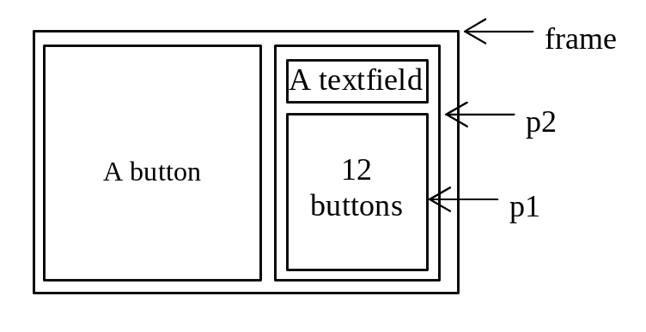
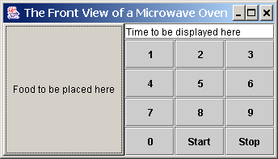
Example 11.4 Testing Panels
This example uses panels to organize components. The program creates a user interface for a Microwave oven.
TestPanels

Slide 31
Drawing on Panels
JPanel can be used to draw graphics (including text) and enable user interaction.
To draw in a panel, you create a new class that extends JPanel and override the paintComponent method to tell the panel how to draw things. You can then display strings, draw geometric shapes, and view images on the panel.

Slide 32
The paintComponent Method
The paintComponent method is defined in JComponent, and its header is as follows:
  protected void paintComponent(Graphics g)
The Graphics object g is created automatically by the JVM for every visible GUI component. This object controls how information is drawn. You can use various drawing methods defined in the Graphics class to draw strings and geometric figures. For example, you can draw a string using the following method in the Graphics class:
  public void drawString(String string, int x, int y)

Slide 33
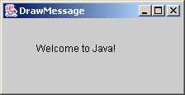
Drawing on Panels, cont.
public class DrawMessage extends JPanel {
/** Main method */
public static void main(String[] args) {
JFrame frame = new JFrame("DrawMessage");
frame.getContentPane().add(new DrawMessage());
frame.setDefaultCloseOperation(JFrame.EXIT_ON_CLOSE);
frame.setSize(300, 200);
frame.setVisible(true);
}
/** Paint the message */
protected void paintComponent(Graphics g) {
super.paintComponent(g);
g.drawString("Welcome to Java!", 40, 40);
}
}
(40, 40)
Run

Slide 34
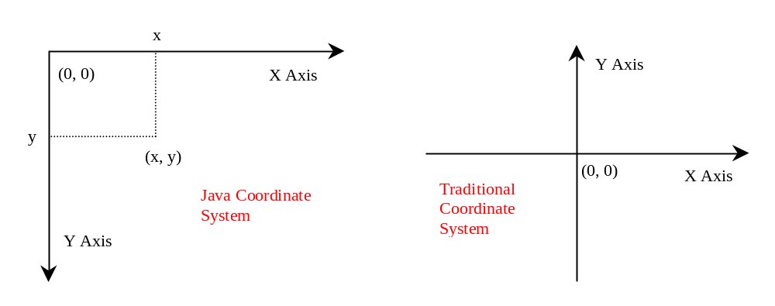
Java Coordinate System

Slide 35
Drawing Geometric Figures
Drawing Lines
Drawing Rectangles
Drawing Ovals
Drawing Arcs
Drawing Polygons

Slide 36
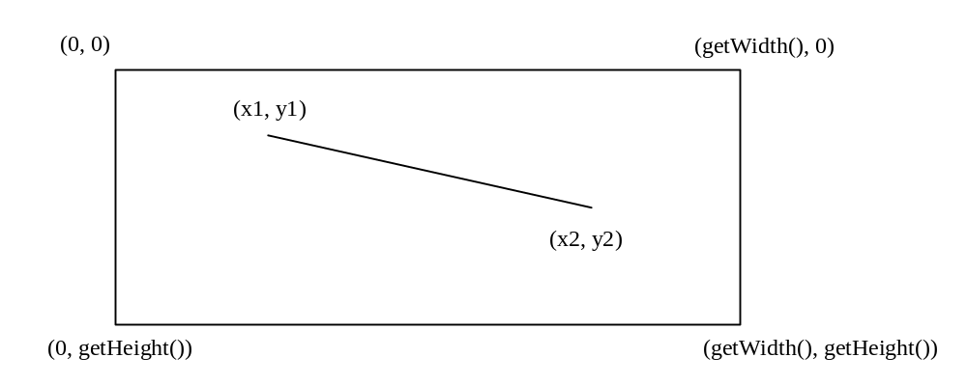
Drawing Lines
drawLine(int x1, int y1, int x2, int y2);

Slide 37
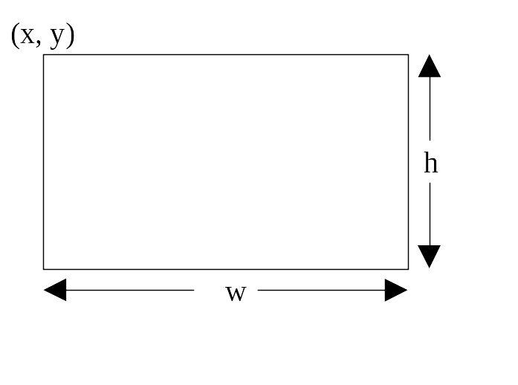
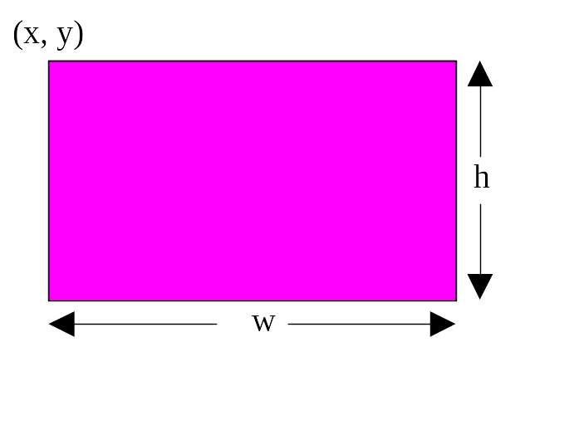
Drawing Rectangles
drawRect(int x, int y, int w, int h);
fillRect(int x, int y, int w, int h);
DrawRectangles

Slide 38
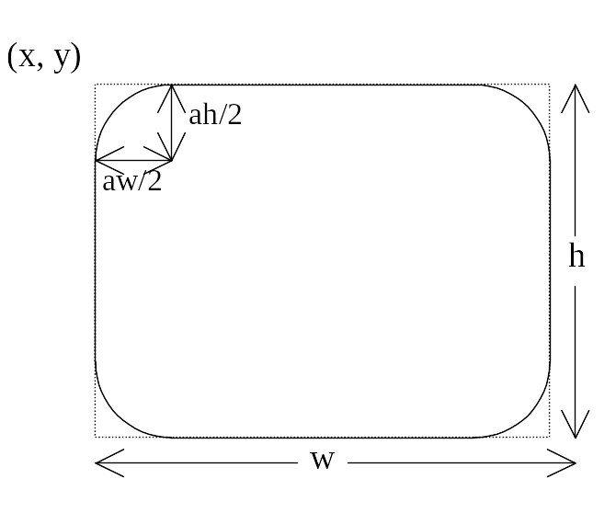
Drawing Rounded Rectangles
drawRoundRect(int x, int y, int w, int h, int aw, int ah);
fillRoundRect(int x, int y, int w, int h, int aw, int ah);

Slide 39
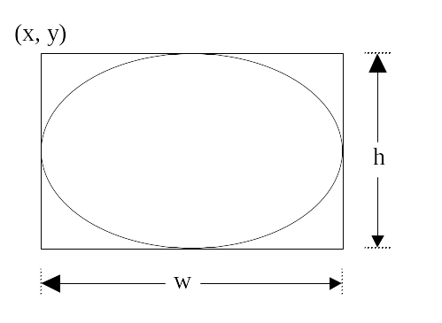
Drawing Ovals
drawOval(int x, int y, int w, int h);
fillOval(int x, int y, int w, int h);
DrawOvals

Slide 40
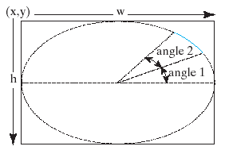
Drawing Arcs
drawArc(int x, int y, int w, int h, int angle1, int angle2);
fillArc(int x, int y, int w, int h, int angle1, int angle2);
Angles are in degree

Slide 41
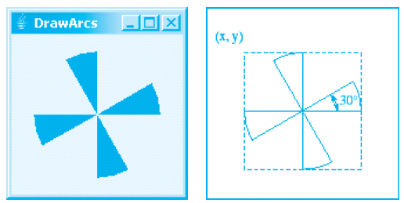
Drawing Arcs Example
DrawArcs

Slide 42
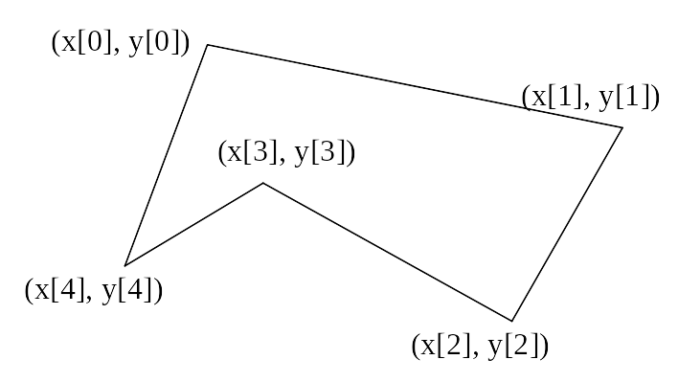
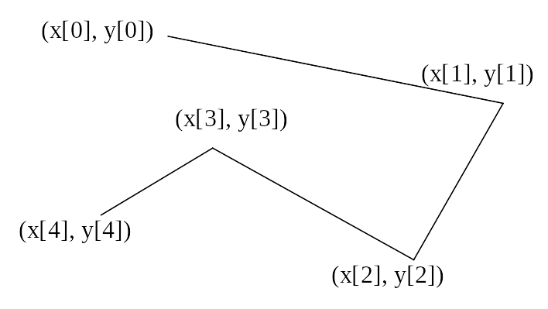
Drawing Polygons and Polylines
int[] x = {40, 70, 60, 45, 20};
int[] y = {20, 40, 80, 45, 60};
g.drawPolygon(x, y, x.length);
g.drawPolyline(x, y, x.length);

Slide 43
Drawing Polygons Using the Polygon Class
Polygon polygon = new Polygon();
polygon.addPoint(40, 59);
polygon.addPoint(40, 100);
polygon.addPoint(10, 100);
g.drawPolygon(polygon);

Slide 44
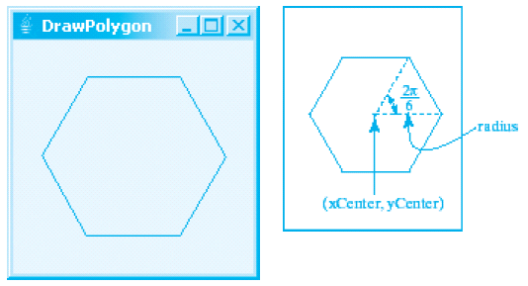
Drawing Polygons Example
DrawPolygon

