Slide 1
Chapter 1: Databases Systems
Instructor: Dr. Weiyin Hong

Slide 2

In this chapter, you will learn:
From File system to Database
What is DBMS?
Why database design is important?

Slide 3
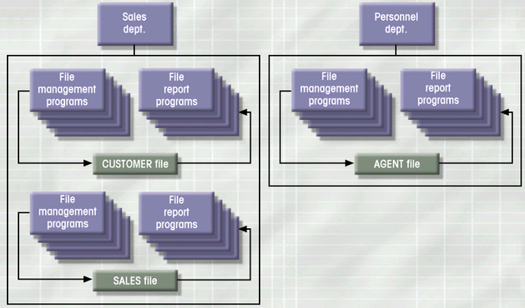
Simple File System
Notes:
Data processing specialist (DP)
What could be problems of such a file system?

Slide 4
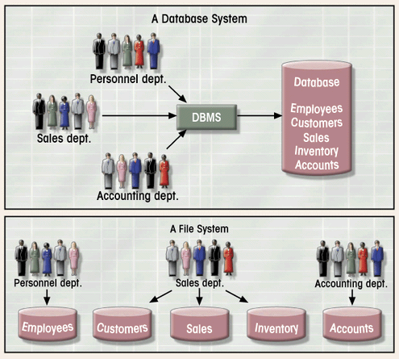
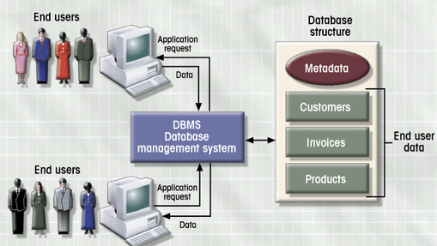
Database vs. File Systems

Slide 5
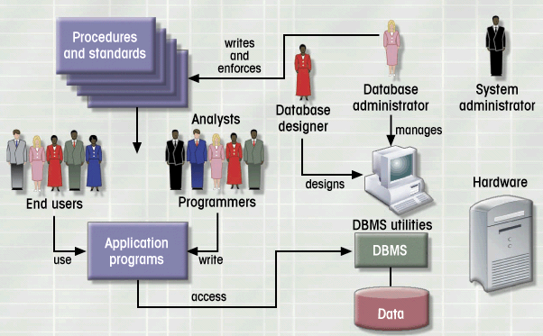
Database System Environment

Slide 6
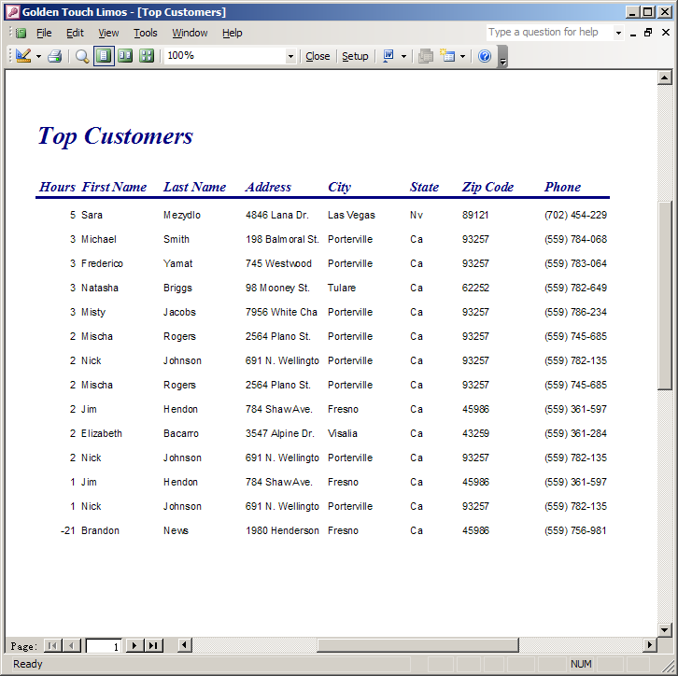
File Terminology
File
  Collection of related records
Field
  Group of characters with specific meaning
Record
  Logically connected fields that describe a person, place, or thing
Data
  Raw Facts
Notes:
Create a table in ACCESS. Enter 2 rows of data.

Slide 7
File System Critique
File System Data Management
  Requires extensive programming in third-generation language (3GL)
  Time consuming
  Makes ad hoc queries impossible
  Leads to islands of information

Slide 8

File System Critique (con’t.)
Structural Dependence
  Change in file structure requires modification of related programs
Data Dependence
  Change in file’s data characteristics requires modification of data access programs
  Must tell program what to do and how
  Makes file systems cumbersome from programming and data management views

Slide 9
File System Critique (con’t.)
Data Redundancy
  Different and conflicting versions of same data
    Data inconsistency
      Lack of data integrity
  Results of uncontrolled data redundancy
    Data anomalies
      Modification
      Insertion
      Deletion

Slide 10
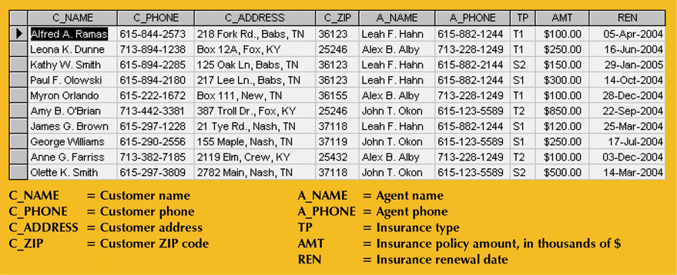
File System Critique (con’t.)

Slide 11
Database Systems
A database is a shared, integrated computer structure that houses a collection of:
  Data
  Metadata (data about data)

Slide 12
Advantages of Database Systems
Provides advantages over file system management approach
  Stores data structures, relationships, and access paths
  Eliminates inconsistency, data anomalies, data dependency, and structural dependency problems

Slide 13
Database System Types
Single-user vs. Multi-user Database
  Desktop
  Workgroup
  Enterprise
Centralized vs. Distributed
Use
  Production or transactional
  Decision support or data warehouse

Slide 14
DBMS
What does DBMS do?
  Manages database structure
  Control access to data
  Contains query language
DBMS major functions
  Data dictionary management
  Multi-user access control
  Backup and recovery management
  Data integrity management
  Database language (DDL, DML) and application interfaces

Slide 15
Database Design
Good applications can’t overcome bad database design
The existence of a DBMS does not guarantee good data management, nor does it ensure that the database will be able to generate correct and timely information
Ultimately, the end user and the designer decide what data will be stored in the database.

