Slide 1

Chapter 12: Data Warehouse
Instructor: Weiyin Hong

Slide 2

In this chapter, you will learn..
What is DSS and its components
How operational data and decision support data differ
What are data warehouse and data mart
What is star schema and how is it constructed
What is data mining and what role does it play in decision support

Slide 3
Decision Support Systems
A decision support system (DSS) is an arrangement of computerized tools used to assist managerial decision making within a business.

Slide 4
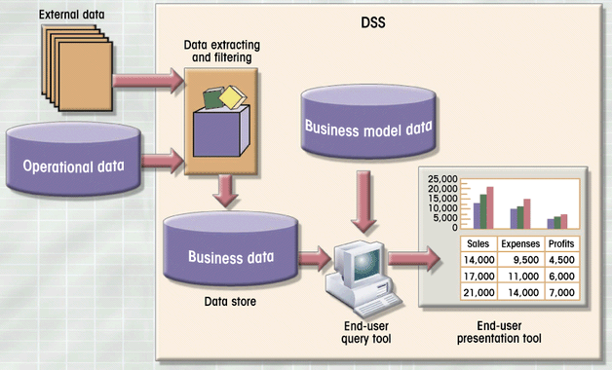
DSS Components

Slide 5
Four Components of DSS
The data store component is basically a DSS database (also called Data Warehouse).
The data extraction and filtering component is used to extract and validate the data taken from the operational database and the external data sources.
The end user query tool is used by the data analyst to create the queries that access the database.
The end user presentation tool is used by the data analyst to organize and present the data.

Slide 6
Operational Data vs. Decision Support Data
Most operational data are stored in a relational database in which the structures tend to be highly normalized.
The operational data storage is optimized to support transactions that represent daily operations.
Whereas operational data capture daily business transactions, DSS data give tactical and strategic business meaning to the operational data.

Slide 7
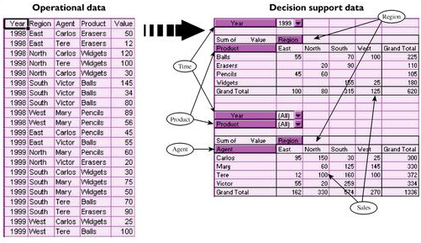
Transforming Operational Data into DSS data

Slide 8
DSS vs. Operational Data: Three Main Areas
Time span
  Operational data represent current (atomic) transactions.
  DSS data tend to cover a longer time frame.
Granularity
  Operational data represent specific transactions that occur at a given time.
  DSS data must be presented at different levels of aggregation.
Dimensionality
  Operational data focus on representing atomic transactions.
  DSS data can be analyzed from multiple dimensions.

Slide 9
Data Warehouse
The Data Warehouse is an integrated, subject-oriented, time-variant, non-volatile database that provides support for decision making.

Slide 10
Data Warehouse Characteristics
Integrated
  The Data Warehouse is a centralized, consolidated database that integrates data retrieved from the entire organization.
Subject-Oriented
  The Data Warehouse data is arranged and optimized to provide answers to questions coming from diverse functional areas within a company.

Slide 11
Data Warehouse Characteristics
Time Variant
  The Warehouse data represent the flow of data through time. It can even contain projected data.
Non-Volatile
  Once data enter the Data Warehouse, they are never removed.
  The Data Warehouse is always growing.

Slide 12
Data Mart
Single-subject data warehouse subset
Decision support to small group
Can be test for exploring potential benefits of Data warehouses
Address local or departmental problems

Slide 13
Star Schemas
Is a data-modeling technique
Maps multidimensional decision support into relational database
Yield model for multidimensional data analysis while preserving relational structure of operational DB

Slide 14
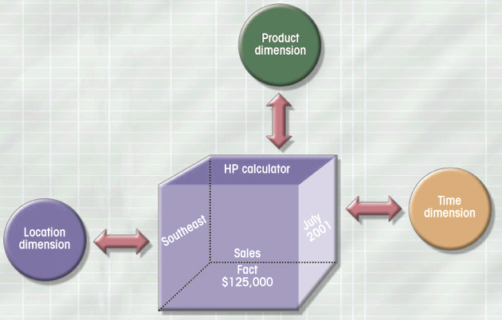
Dimensions of Data

Slide 15
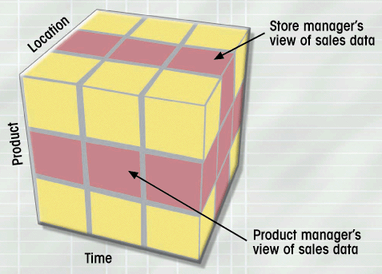
Slice and Dice View of Sales

Slide 16
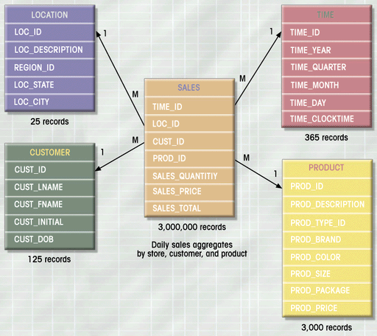
Star Schema for Sales
By default, the fact table’s primary key is always formed by combining the foreign keys pointing to each dimension table to which it is related.

Slide 17
Star Schema Components
Facts (e.g. Sales)
  Facts are numeric measurements (values) that represent a specific business aspect or activity.
Dimensions (e.g. Location, Product, Time)
  Dimensions are qualifying characteristics that provide additional perspectives to a given fact.
Attributes (e.g. State, City, Store.. for the “Location” Attribute)
  Each dimension table contains attributes. Attributes are often used to search, filter, or classify facts.

Slide 18
Star Schema Representation
Facts and dimensions represented by physical tables in data warehouse DB
Fact table related to each dimension table (M:1)
Fact and dimension tables related by foreign keys
Subject to the primary/foreign key constraints

Slide 19
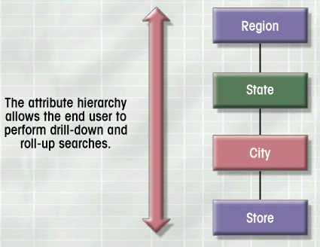
Attribute Hierachies

Slide 20
Data Mining
A proactive knowledge-discovery process
Seeks to discover unknown data characteristics
Automatically searches data for anomalies and relationships

Slide 21
Data Mining Tools
Analyze data
Uncover problems or opportunities
Form computer models based on findings
Predict business behavior with models
Require minimal end-user intervention

Slide 22
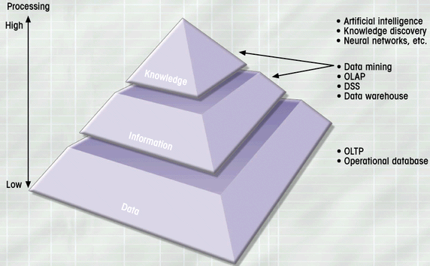
Extraction of Knowledge from Data

Slide 23
Example of Data Mining Findings
65 percent of customers who didn’t use a particular credit card in the last six months are 88 percept likely to cancel that account.
82 percent of customers who bought a new TV 27 inches or larger are 90 percent likely to buy an entertainment center within the next four weeks.
If age<30 and income <=25,000 and credit rating <3 and credit amount > 25,000, then the minimum loan term is 10 years.

Slide 24
Data Mining Products
Clementine
  http://www.spss.com/spssbi/clementine/
DB2 Intelligent Miner
  http://www-3.ibm.com/software/data/iminer/

