Slide 1
Chapter 2: Data Models
Instructor: Dr. Weiyin Hong

Slide 2
Database Models
Conceptual models: logical nature of data representation
  One-to-one (1:1)
  One-to-many (1:M)
  Many-to-many (M:N)
Implementation models: emphasis on how the data are represented in the database
  Hierarchical
  Network
  Relational

Slide 3
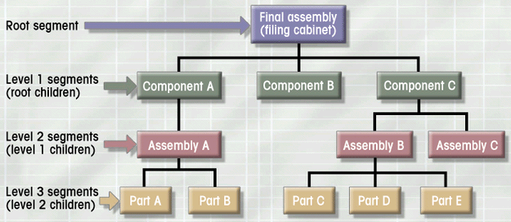
Hierarchical Database Model
Represented by an upside down tree which is defined by path that traces parent segments to child segments, beginning from the left Each parent can have many children
Each child has only one parent
Notes:
Triggered by the Apollo project of North American Rockwell company, based on the recognition that the many smaller parts would come together as components of still larger components, and so on.
The joint effort of Rockwell & IBM results in what’s called “Information Management System” (IMS).

Slide 4
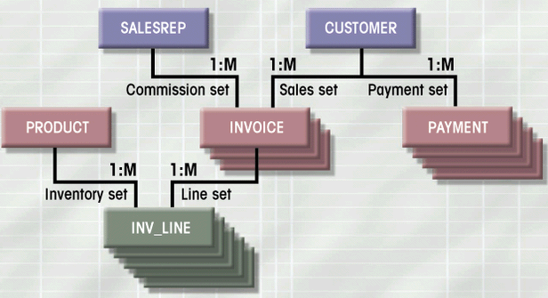
Network Database Model
Each child can have multiple parents
Structural dependence

Slide 5
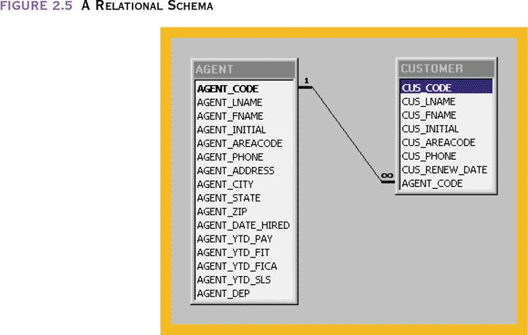
Relational Database Model
A collection of tables for data storage
Tables are a series of row/column intersections
Tables related by sharing common entity characteristic(s)

Slide 6
Relational Database Model
Advantages
  Structural independence (not navigational)
  Improved conceptual simplicity
  Easier database design, implementation, management, and use
  Ad hoc query capability with SQL
  Powerful database management system
Disadvantages
  Substantial hardware and system software overhead
  Poor design and implementation is made easy
  May promote “islands of information” problems

Slide 7
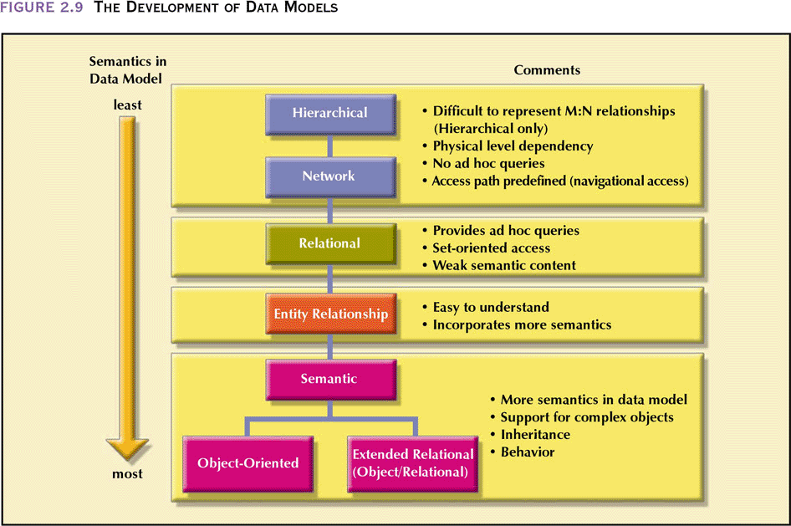
The Development of Data Models

