Slide 1
Chapter 3: The Relational Database Model
Instructor: Weiyin Hong

Slide 2
In this chapter, you will learn:
Entities
Attributes
Tables and their characteristics
Keys
Integrity rules
Data dictionary, and the system catalog
Index

Slide 3

Entity
An entity is a person, place, event, or thing for which we intend to collect data.
  Students
  Faculty
  Employees
  Houses
  Cars
  Books
  DVDs
Notes:
UNLV is not an entity.

Slide 4

Attributes
Each entity has certain characteristics known as attributes.
# of Bedrooms
Square Feet
Year Built
# of Bathrooms
# of Stories
Patio?
Lot Size
Swimming Pool
Notes:
UNLV is not an entity.

Slide 5
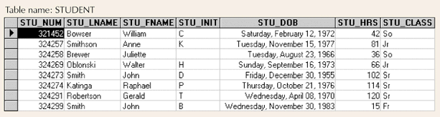
Tables
Holds related entities or entity set
Also called relations (E.F. Codd)
Comprised of rows and columns

Slide 6
Table Characteristics
Two-dimensional structure with rows and columns
Rows (tuples) represent single entity
Columns represent attributes
Row/column intersection represents single value
Tables must have an attribute to uniquely identify each row

Slide 7
Table Characteristics (con’t)
Column values all have same data format
  Numeric
  Character/Text
  Date
  Logical
Each column has range of values called attribute domain
Order of the rows and columns is immaterial to the DBMS

Slide 8
Keys
One or more attributes that determine other attributes
  Key attribute(s)
  Composite key.
The key’s role is based on a concept known as determination, which is used in the definition of functional dependence.
  A → B (The attribute B is functionally dependent on A if A determines B)
Notes:
Use Problem 7-11 in Chapter 1 for illustration.

Slide 9
Different Types of Keys
Superkey
  Uniquely identifies each entity
Candidate key
  Minimal superkey
Primary key
  Candidate key to uniquely identify all other attributes in a given row
Secondary key
  Used only for data retrieval (may NOT be unique)
Foreign key
  Values must match primary key in another table

Slide 10
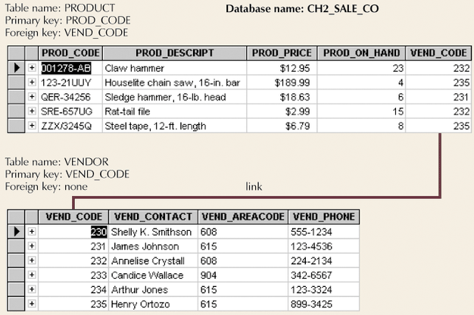
Sample Relational Database

Slide 11
Integrity Rules
Entity integrity
  Ensures all entities are unique
  Each entity has unique key
Referential integrity
  Foreign key must match primary key values or have null value
  Makes it impossible to delete row whose primary key has mandatory matching foreign key values in another table

Slide 12
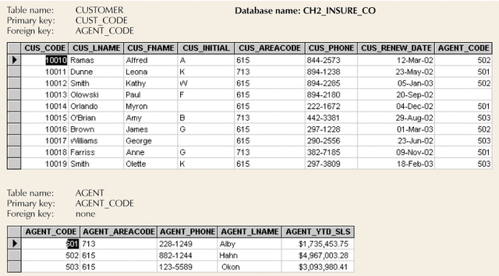
An Illustration of Integrity Rules

Slide 13
Data Dictionary and System Catalog
Data dictionary
  Provides detailed account of all tables found within database
  Metadata
  Attribute names and characteristics
System catalog
  Detailed data dictionary
  System-created database
  Stores database characteristics and contents
  Tables can be queried just like any other tables
  Automatically produces database documentation

Slide 14
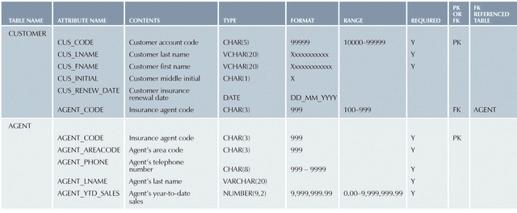
A Sample Data Dictionary
Homonyms: the use of the same attribute name to label different attributes
Synonym: the use of a different name to describe the same attribute

Slide 15
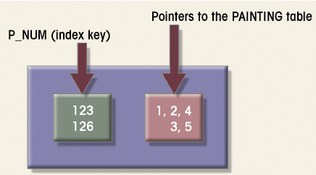
Indexes
An index is composed of an index key and a set of pointers

