Slide 1
Chapter 4: Entity-Relationship Modeling
Instructor: Dr. Weiyin Hong

Slide 2
Basic Modeling Concepts
Models
  “Description or analogy used to visualize something that cannot be directly observed” Webster’s Dictionary
Data Model
  Relatively simple representation of complex real-world data structures
Art and science
Good judgment coupled with powerful design tools

Slide 3
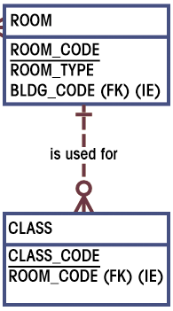
The ERD Components
ERD Maps E-R model
  Chen
  Crow’s Foot
Entities
  Corresponds to entire table, not row
  Represented by rectangle
Attributes
  Corresponds to columns in tables
  Listed in the rectangle (with P.K. underlined)
Relationships
  Reflected by P.K. and F.K. pairs
  Represented by lines among entities (with bars and crow’s foot symbols specifying details)

Slide 4
4-Steps to Get You an ERD
Identify entities through narrative description (nouns)
Identify relationships among the entities (1:1; 1:M; M:N)
Specify attributes within each entity
Check/specify all the details

Slide 5
1. Identify Entities through Narrative Description
Rules of thumb
  Catch nouns in the description
  Determine whether you want to collect any information about that object
    If “Yes”, keep it as a potential entity
    If “No”, leave it out

Slide 6
2. Identify Relationships among Entities
There are only three types of relationships
  1:1 – Rare, mostly in the special case of Supertype/Subtype relationship
  1:M – Most common
  M:N – Quite common, once identified, needs to be broken down into two pairs of 1:M relationships

Slide 7

2. Identify Relationships
1:1

Slide 8


2. Identify Relationships
1:M

Slide 9






2. Identify Relationships
M:N

Slide 10
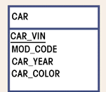
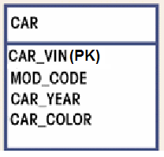
3. Identify Attributes
Primary keys underlined
Alternatively, put (PK) next to the primary key(s)

Slide 11
3. Attributes (con’t)
Attributes | Simple | Composite*
Characteristics | Can’t be subdivided | Can be subdivided into additional attributes
Example | Age, Sex, Marital status | Address into street, city, zip
* Don’t get confused with the Composite Key

Slide 12
3. Attributes (con’t)
Attributes | Single-valued | Multivalued
Characteristics | Can have only a single value | Can have many values
Example | Person has only one social security number | Person may have several college degrees

Slide 13
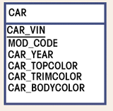
3. How to handle multivalued attributes?
The relational DBMS cannot implement multivalued attributes.
Possible courses of action for the designer
  Within the original entity, create several new attributes, one for each of the original multivalued attribute’s components.

Slide 14
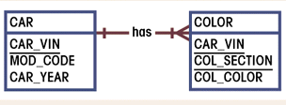
3. How to handle multivalued attributes? (con’t)
  Create a new entity composed of the original multivalued attribute’s components.

Slide 15
3. Attributes (con’t)
Attributes | Derived
Characteristics | Can be derived with algorithm
Example Actions | Age can be derived from date of birth If the derived attribute is often queried upon, then keep it in the table. If the derived attribute is not visited very often, then do not have to keep it in the table.

Slide 16
4. Detailed Specification of Relationships
Connectivity vs. Cardinality
Relationship Participation
  Optional vs. Mandatory
Relationship Strength
  Existence dependence; Weak entities
Relationship Degree
  Unary; Binary; Ternary
Composite Entity
Super/Subtype Entities

Slide 17
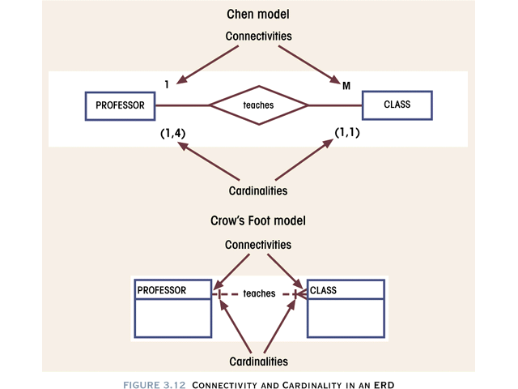
4.1. Connectivity vs. Cardinality
Connectivity describes relationship classification (1:1, 1:M, M:N)
Cardinality expresses number of entity occurrences associated with one occurrence of related entity
Cardinalities are established by very concise statements known as business rules. Not all business rules can be represented in an E-R diagram.

Slide 18
4.2. Relationship Participation
Optional
  Entity occurrence does not require a corresponding occurrence in related entity
  Shown by drawing a small circle on side of optional entity on ERD
Mandatory
  Entity occurrence requires corresponding occurrence in related entity
  If no optionality symbol is shown on ERD, it is mandatory

Slide 19
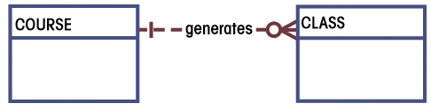
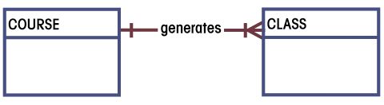
4.2. Relationship Participation
CLASS is Optional to COURSE
CLASS and COURSE in a Mandatory Relationship.

Slide 20
4.3. Relationship Strength
Existence Dependency
  If an entity’s existence depends on the existence of one or more other entities, it is said to be existence-dependent.
  e.g. CLASS is existence-dependent on COURSE
  The order in which the tables are created and loaded is very important.

Slide 21
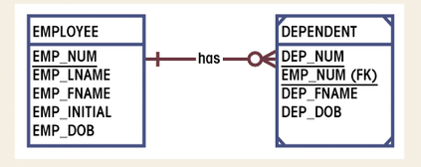
4.3. Relationship Strength
Weak Entity
  Existence-dependent on another entity
  Has primary key that is partially or totally derived from parent entity

Slide 22
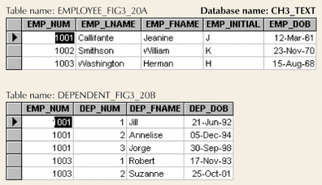
4.3. Relationship Strength

Slide 23
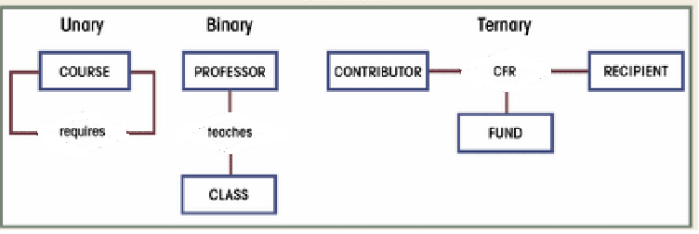
4.4. Relationship Degree
Indicates number of associated entities
Unary
  Single entity
  Recursive Relationship
Binary
  Two entities associated
Ternary
  Three entities associated

Slide 24
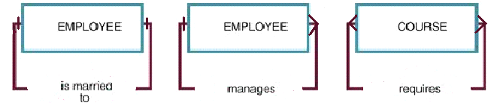
4.4. Recursive Entities
Recursive Entities
  A recursive entity is one in which a relationship can exist between occurrences of the same entity set.
  A recursive entity is found within a unary relationship.

Slide 25
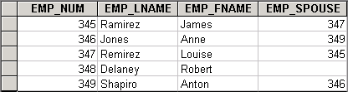
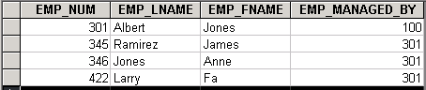
4.4. Implementing Recursive Relationship
1:1
1:M

Slide 26
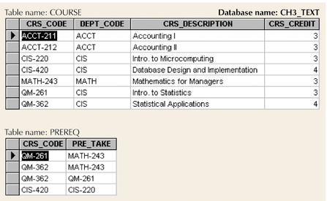
4.4 Implementing Recursive Relationship (con’t)
M:N

Slide 27
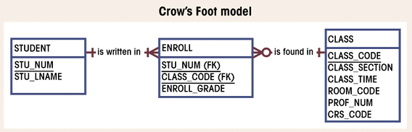
4.5. Composite Entities
A Used to ‘bridge’ between M:N relationships
Composite entity composed of primary keys of each entity needing connection
Composite entity may (and normally DO!) contain additional attributes

Slide 28
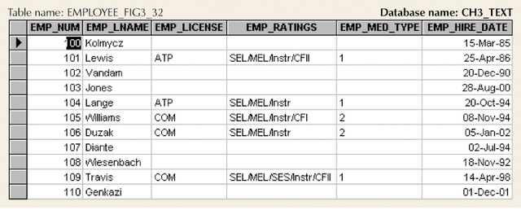
4.6. Supertypes & Subtypes
-- Why do we need supertypes & subtypes?
-- Null values resulting from unique attributes.

Slide 29
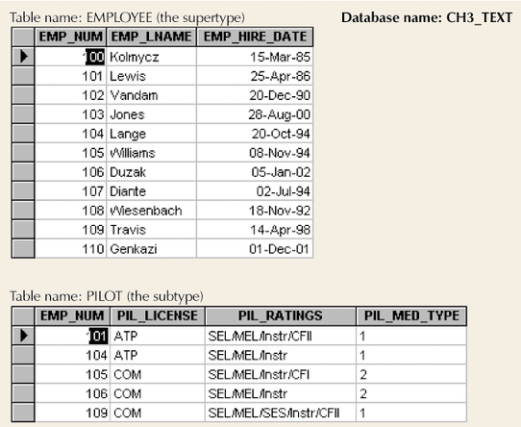
4.6. Implementation of Supertype & Subtype

Slide 30
4.6. Supertypes & Subtypes
The supertype contains the shared attributes
The subtype contains the unique attributes.
A subtype entity inherits its attributes and its relationships from the supertype entity.
The generalization hierarchy depicts the parent-child relationship.

Slide 31
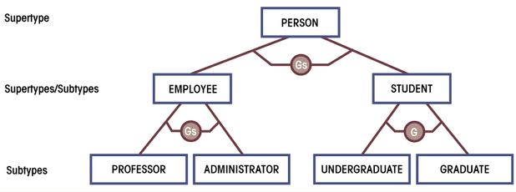
4.6. A Generalization Hierarchy
“G” – Non-overlapping; “Gs” – Overlapping.
The supertype and its subtype(s) maintain a 1:1 relationship.

Slide 32
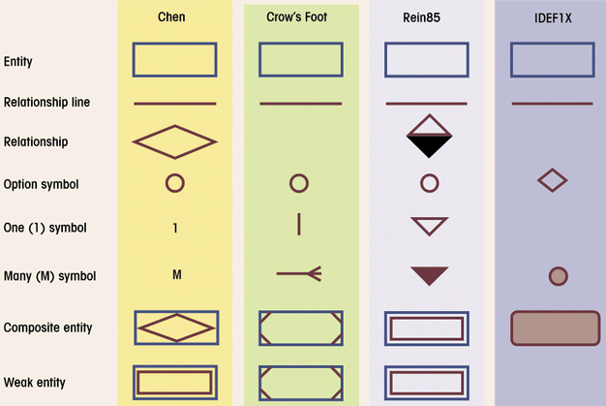
Comparison of E-R Modeling Symbols

Slide 33
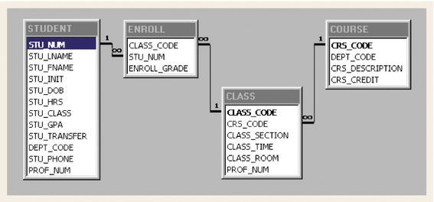
Relational Schema – Not an ERD!

Slide 34
Key Summary:
Rules of Inserting Foreign Keys
Converting any E-R model to a set of tables in a database requires following specific rules that govern such a conversion.
  1:1
  1:M (Weak entity)
  M:N

Slide 35
General Rules for FK: 1:1
1:1 Relationship
If both entities are in a mandatory participation in the relationship and they do not participate in other relationships, it is most likely that the two entities should be part of the same entity.
If we decide to use two tables to present the two entities:
General Rules: Put Foreign Key in the strong entity or in the most frequently accessed entity or in the entity selected by the semantics of the problem.
PROFESSOR (PROF_NUM, PROF_NAME, PC_NUM)
PC (PC_NUM, PC_BRAND, PC_MEM, PC_CPU, PC_HD)

Slide 36
Example: 1:1 Relationship
PROFESSOR
Is in
ROOM
❶
PRO_CODE | PRO_NAME | ROM_CODE
MIS002 | Jerry Chang | B344
ACC098 | Albert Lee | A123
MIS007 | Weiyin Hong | B312
❷
PRO_CODE | PRO_NAME
MIS002 | Jerry Chang
ACC098 | Albert Lee
MIS007 | Weiyin Hong
ROM_CODE | ROM_LOC
B312 | Beam Hall
B344 | Beam Hall
A123 | FEH
ROM_CODE | ROM_LOC | PRO_CODE
B312 | Beam Hall | MIS007
B344 | Beam Hall | MIS002
A123 | FEH | ACC098

Slide 37
General Rules for FK: 1:M
1:M Relationship
General Rules: Create the foreign key by putting the primary key of the “1” in the table of the “M”.
GALLERY (GAL_NUM, GAL_OWNER, GAL_RATE)
PAINTING (PTNG_NUM, PTNG_TITLE, PTNG_PRICE, GAL_NUM)

Slide 38
General Rules for FK: Weak Entities
Weak Entity (foreign key located in the weak entity)
General Rules: Put the key of the parent table (strong entity) in the weak entity.
CAR (CAR_NUM, CAR_MODEL, CAR_YEAR)
COLOR (CAR_NUM, CAR_SECTION, COLOR)

Slide 39
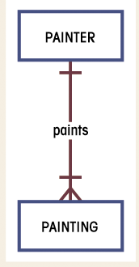
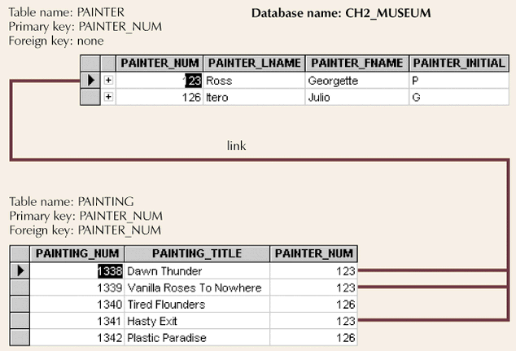
Example: 1:M Relationship

Slide 40
General Rules for FK: M:N
M:N Relationship
General Rules: Convert the M:N relationship to a composite (bridge) entity consisting of (at least) the parent tables’ primary keys.
STUDENT (STU_NUM, STU_NAME)
CLASS (CLS_CODE, CLS_TIME, ROM_CODE)
ENROLL (CLS_CODE, STU_NUM, GRADE)

Slide 41
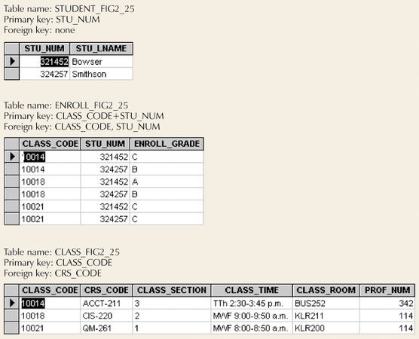
Example: M:N Relationship (2 pairs of 1:M Relationships)
Composite Entity

Slide 42
Challenge of Database Design: Conflicting Goals
Conflicting Goals
  Design standards (design elegance)
  Processing speed
  Information requirements
Design Considerations
  Security
  Performance
  Shared access
  Integrity

