Slide 1
Chapter 4: E-R Modeling (case)
Instructor: Weiyin Hong

Slide 2
Developing an E-R Diagram
Iterative Process
  Step1: General narrative of organizational operations developed
  Step2: Basic E-R Model graphically depicted and reviewed
  Step3: Modifications made to incorporate newly discovered E-R components
Repeat process until designers and users agree E-R Diagram complete

Slide 3
Tiny College Database (1)
Tiny College (TC) is divided into several schools. Each school is administered by a dean. A 1:1 relationship exists between DEAN and SCHOOL.
Each dean is a member of a group of administrators (ADMINISTRATOR). Deans also hold professorial rank and may teach a class (PROFESSOR). Administrators and professors are also Employees.

Slide 4
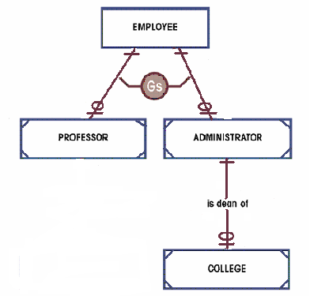
Supertype & Subtype

Slide 5

Tiny College Database (1)
Given Tiny College’s operational environment, the professional characteristics of its administrators and professors are identical.
None of the other employees are required to have such academic attributes.

Slide 6
NOTE
The existence of 1:1 relationship often indicates a misidentification of attributes as entities, so take particular care in evaluating the need for such 1:1 relationship.
  The 1:1 relationship between PROFESSOR and EMPLOYEE is properly defined by the nature of the super/subtype relationship.
  On the other hand, the 1:1 DEAN relationship can be easily eliminated by storing the dean’s attributes in the SCHOOL entity.

Slide 7
Tiny College Database (2)
Each school is composed of several departments.
The smallest number of departments operated by a school is one, and the largest number of departments is indeterminate (N).
Each department belongs to only a single school.

Slide 8
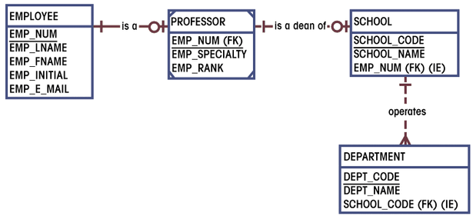
Tiny College Database (2)

Slide 9
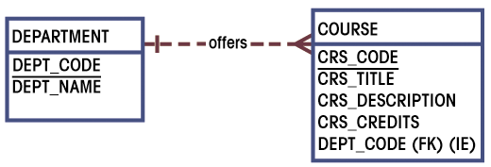
Tiny College Database (3)
Each department offers several courses.

Slide 10
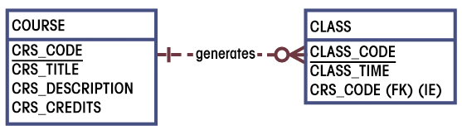
Tiny College Database (4)
A department may offer several sections (classes) of the same course.
A 1:M relationship exists between COURSE and CLASS.
CLASS is optional to COURSE

Slide 11
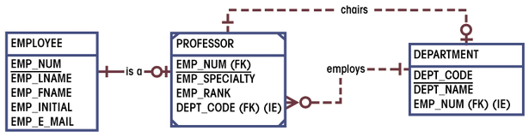
Tiny College Database (5)
Each department has many professors assigned to it.
One of those professors chairs the department. Only one of the professors can chair the department.
DEPARTMENT is optional to PROFESSOR in the “chairs” relationship.

Slide 12
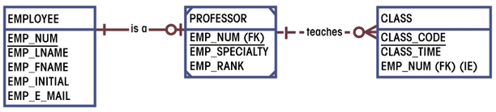
Tiny College Database (6)
Each professor may teach up to four classes, each one a section of a course.
A professor may also be on a research contract and teach no classes.
Business rules: A professor can teach up to 4 classes.

Slide 13
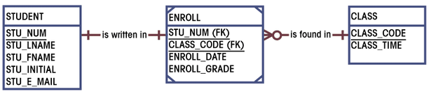
Tiny College Database (7)
A student may enroll in several classes, but she/he takes each class only once during any given enrollment period.
Each student may enroll in up to six classes and each class may have up to 35 students in it.
STUDENT is optional to CLASS.
Business rules: ??

Slide 14
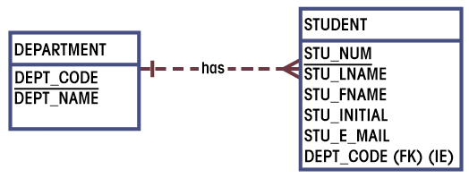
Tiny College Database (8)
Each department has several students whose major is offered by that department.
Each student has only a single major and associated with a single department.

Slide 15
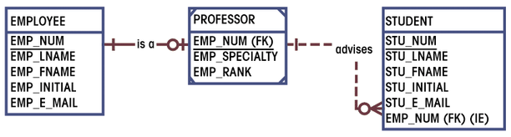
Tiny College Database (9)
Each student has an advisor in his or her department; each advisor counsels several students.
An advisor is also a professor, but not all professors advise students.

Slide 16
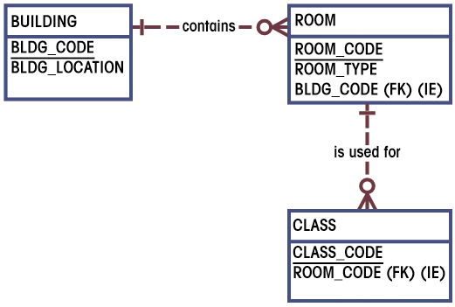
Tiny College Database (10)
A class is taught in a room.
Each room is located in a building.
Some buildings do not contain (class) rooms.
Some rooms do not have classes scheduled.

Slide 17
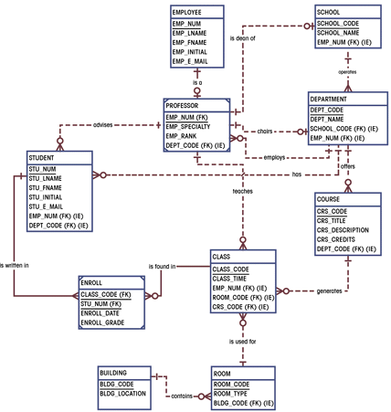
Complete ERD for Tiny College

Slide 18
Summary
Entities
Relationships
Should be discovered by querying the end user extensively.
Connectivity & Cardinality
Entity Attributes
Attributes and domains should be displayed in the ERD. However, they are often omitted in the ERD to avoid crowding the diagram.
Final Model

