Slide 1
Chapter 5: Normalization of Database Tables
Instructor: Weiyin Hong

Slide 2
In this chapter, you will learn:
What normalization is and what role it plays in database design
Partial dependency & Transitive dependency
About the normal forms 1NF, 2NF, 3NF, BCNF, and 4NF
How normal forms can be transformed from lower normal forms to higher normal forms
That some situations require denormalization to generate information efficiently

Slide 3
What is Normalization?
Normalization is process for assigning attributes to entities
  Reduces data redundancies
  Helps eliminate data anomalies
  Produces controlled redundancies to link tables

Slide 4
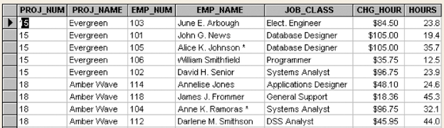
Table in 1NF
Prime (Key) Attributes
CHARGE (PROJ_NUM, EMP_NUM, PROJ_NAME, EMP_NAME,
JOB_CLASS, CHG_HOUR, HOURS)
Non-Prime Attributes

Slide 5
1NF
All the key attributes are defined.
There are no repeating groups in the table.
All attributes are dependent on the primary key.

Slide 6
Dependency Diagram
PROJ_NUM
PROJ_NAME
EMP_NUM
EMP_NAME
JOB_CLASS
CHG_HOUR
HOURS
  Partial dependency
  Transitive
  dependency
  Partial dependency
  PROJ_NUM, EMP_NUM → PROJ_NAME, EMP_NAME, JOB_CLASS, CHG_HOUR, HOURS
  PROJ_NUM → PROJ_NAME
  EMP_NUM → EMP_NAME, JOB_CLASS, CHG_HOUR
  JOB_CLASS → CHG_HOUR

Slide 7
Dependency Diagram
Desirable dependencies based on primary key (above the diagram)
Less desirable dependencies (below the diagram):
  Partial dependencies (based on part of composite primary key)
  Transitive dependencies (one nonprime attribute depends on another nonprime attribute)

Slide 8
2NF Definition
A table is in 2NF if:
  It is in 1NF and
  It includes no partial dependencies; that is, no attribute is dependent on only a portion of the primary key.
  (It is still possible for a table in 2NF to exhibit transitive dependency; that is, one or more attributes may be functionally dependent on non-key attributes.)

Slide 9
Conversion to 2NF
Start with 1NF format:
  Write each key component on separate line
  Write original key on last line
  Each component is new table
  Write dependent attributes after each key
PROJECT (PROJ_NUM, PROJ_NAME)
EMPLOYEE (EMP_NUM, EMP_NAME, JOB_CLASS, CHG_HOUR)
ASSIGN (PROJ_NUM, EMP_NUM, HOURS)

Slide 10
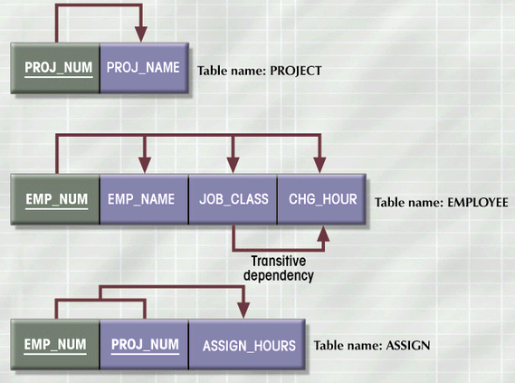
2NF Conversion Results

Slide 11
3NF Definition
A table is in 3NF if:
  It is in 2NF and
  It contains no transitive dependencies.

Slide 12
Conversion to 3NF
Create separate tables to eliminate transitive functional dependencies.
PROJECT (PROJ_NUM, PROJ_NAME)
ASSIGN (PROJ_NUM, EMP_NUM, HOURS)
EMPLOYEE (EMP_NUM, EMP_NAME, JOB_CLASS)
JOB (JOB_CLASS, CHG_HOUR)

Slide 13
Additional Concerns (1)
Add JOB_CODE as primary key for JOB:
  JOB_CODE → JOB_CLASS, CHG_HOUR
Naming conventions:
  CHG_HOUR → JOB_CHG_HOUR
  JOB_CLASS → JOB_DESCRIPTION
  HOURS → ASSIGN_HOURS
Add JOB_CHG_HOUR into the ASSIGN table for historical change of the job charges.
Add derived attribute ASSIGN_CHARGE into the ASSIGN table:
  ASSIGN_CHARGE = ASSIGN_HOURS * ASSIGN_CHG_HOUR
PROJECT (PROJ_NUM, PROJ_NAME)
ASSIGN (PROJ_NUM, EMP_NUM, ASSIGN_HOURS, JOB_CHG_HOUR, ASSIGN_CHARGE)
EMPLOYEE (EMP_NUM, EMP_NAME, JOB_CLASS)
JOB (JOB_CODE, JOB_DESCRIPTION; JOB_CHG_HOUR)

Slide 14
Additional Concerns (2)
Keep atomicity
  EMP_NAME → EMP_LNAME, EMP_FNAME, EMP_INITIAL
Add additional attributes
  EMP_HIREDATE, EMP_SSN, EMP_SALARY => EMPLOYEE
  ASSIGN_DATE => ASSIGN
Manager of a project
  PROJECT (PROJ_NUM, PROJ_NAME, EMP_NUM)
Add ASSIGN_NUM
  ASSIGN (ASSIGN_NUM, PROJ_NUM, EMP_NUM, …)
    One employee works twice on a project, or plays different roles.
    Auto number supported by DBMS
    More precise and greater flexibility
    Price paid? – less control!

Slide 15
Revised Table Structure
PROJECT (PROJ_NUM, PROJ_NAME, EMP_NUM)
ASSIGN (ASSIGN_NUM, PROJ_NUM, EMP_NUM, ASSIGN_HOURS, JOB_CHG_HOUR, ASSIGN_CHARGE, ASSIGN_DATE)
EMPLOYEE (EMP_NUM, EMP_LNAME, EMP_FNAME, EMP_INITIAL, EMP_HIREDATE, EMP_SSN, JOB_CODE)
JOB (JOB_CODE, JOB_DESCRIPTION, JOB_CHG_HOUR)

Slide 16
BOYCE-CODD Normal Form (BCNF)
BCNF is a special case of 3NF.
A table is in Boyce-Codd normal form (BCNF) if every determinant in the table is a candidate key.
  A determinant is any attribute whose value determines other values within a row.
If a table contains only one candidate key, the 3NF and the BCNF are equivalent.

Slide 17
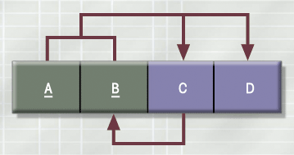
A Table That Is In 3NF But Not In BCNF
A nonkey attribute is the determinant of a key attribute!
  A + B → C, D
  C → B (This dependency is NOT transitive!)

Slide 18
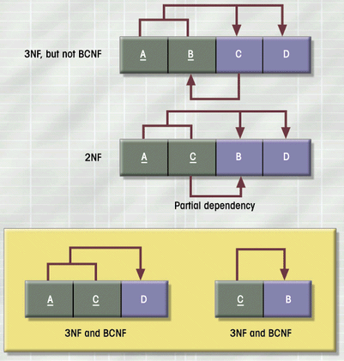
Decomposition to BCNF
?

Slide 19
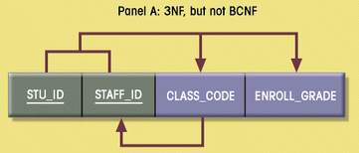
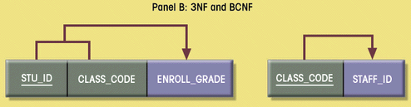
Sample Data for a BCNF Conversion

Slide 20
4NF (Higher-level Normal Form)
Multivalued dependency – e.g., one value of STU_NUM can have many values of Major, and many values of Hobby.
STU_NUM | STU_MAJOR | STU_HOBBY
100 | MIS | Swimming
100 | Accounting | Swimming
100 | MIS | Tennis
100 | Accounting | Tennis
150 | Math | Jogging

Slide 21
4NF Definition
A table is in 4NF if it is in 3NF and has no multiple sets of multivalued dependencies.
STU_NUM | STU_MAJOR
100 | MIS
100 | Accounting
150 | Math
STU_NUM | STU_HOBBY
100 | Swimming
100 | Tennis
150 | Jogging

Slide 22
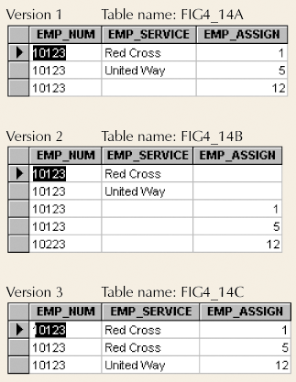
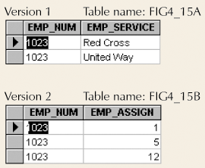
4NF (Higher-level Normal Form)
Set of Tables in 4NF
Set of tables with
Multivalued Dependencies

Slide 23
Normalization and Database Design
Normalization should be part of the design process
E-R Diagram provides macro view
Normalization provides micro view of entities
  Focuses on characteristics of specific entities
  May yield additional entities
Difficult to separate normalization from E-R diagramming
Business rules must be determined

Slide 24
Denormalization
Normalization is one of many database design goals
Normalized table requirements
  Additional processing
  Loss of system speed
Normalization purity is difficult to sustain due to conflict in:
  Design efficiency
  Information requirements
  Processing speed
Denormalization

Slide 25
Denormalization (Example)
Processing
Speed
?
Data
Anomalies
Shall we produce a separate table: ZIP (ZIP_CODE, CITY), to remove the transitive dependency in a customer address table?
What if you are in the business of producing mailing lists?

Slide 26
Denormalization – Remember!
Unnormalized tables defects:
  Data updates less efficient
  Indexing more cumbersome
  Difficult for creating views
Use denormalization cautiously.

