Slide 1

Chapter 7:
Advanced SQL
Instructor: Dr. Weiyin Hong

Slide 2

In this chapter, you will learn…
Relational Set Operators
  Union, Intersect, Minus (Difference) (7.1)
  Join (Cross, Old-style, Natural, Outer) (7.2)
SQL Subqueries
  Where (7.3.1)
  In (7.3.2)
  Having (7.3.3)
  From (7.3.5)
  Attribute List / Select (7.3.6)
SQL Functions
  Date: SYSDATE (7.4.1)
  Numeric: ROUND (7.4.2)
  String: ||; UPPER/LOWER; SUBSTR, LENGTH (7.4.3)

Slide 3
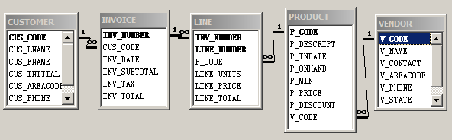
Ch07_SaleCo2.mdb

Slide 4
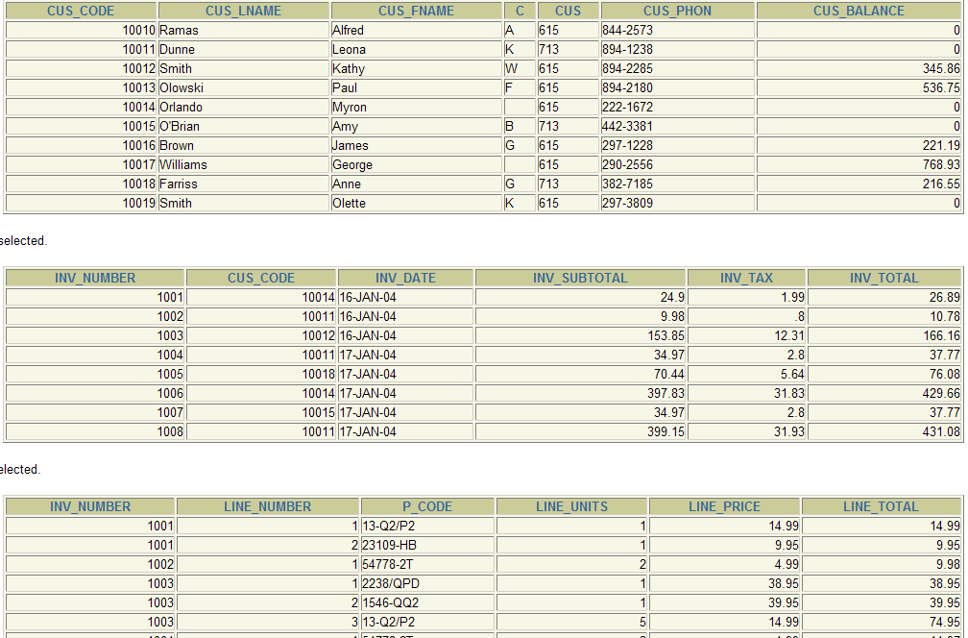
SELECT Subqueries
CUSTOMER
INVOICE
LINE

Slide 5
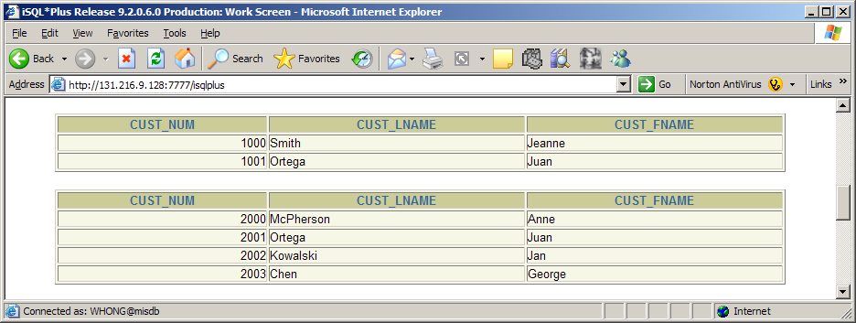
Relational Set Operators
UNION, INTERSECT, MINUS requires UNION-compatible tables
Customer_1
Customer_2

Slide 6
UNION
Yield a unique set of records
Compare:
SELECT * FROM CUSTOMER_1
UNION
SELECT * FROM CUSTOMER_2;
SELECT CUST_LNAME, CUST_FNAME FROM CUSTOMER_1
UNION
SELECT CUST_LNAME, CUST_FNAME FROM CUSTOMER_2;

Slide 7
INTERSECT
Return rows that appear in both tables.
SELECT CUST_LNAME, CUST_FNAME FROM CUSTOMER_1
INTERSECT
SELECT CUST_LNAME, CUST_FNAME FROM CUSTOMER_2;
SELECT CUST_NUM FROM CUSTOMER_1 WHERE CUST_LNAME = 'Smith'
INTERSECT
SELECT DISTINCT CUST_NUM FROM INVOICE_1;
Return customers whose last name is ‘Smith’ and who have made purchases.

Slide 8
MINUS
Return rows that appear in the first set but not in the second.
Compare:
SELECT CUST_LNAME, CUST_FNAME FROM CUSTOMER_1
MINUS
SELECT CUST_LNAME, CUST_FNAME FROM CUSTOMER_2;
SELECT CUST_LNAME, CUST_FNAME FROM CUSTOMER_2
MINUS
SELECT CUST_LNAME, CUST_FNAME FROM CUSTOMER_1;

Slide 9
JOIN
Cross JOIN: returns the Cartesian product
  CROSS
Inner JOIN: returns only the rows with matching values
  Old-Style
  NATURAL
Outer JOIN: returns rows with matching as well as unmatched values
  LEFT
  RIGHT
  FULL

Slide 10
CROSS JOIN
SELECT * FROM PRODUCT, VENDOR;
SELECT * FROM PRODUCT CROSS JOIN VENDOR;

Slide 11
INNER JOIN
Old-Style JOIN: return rows that meet the join condition in the WHERE clause
SELECT *
FROM PRODUCT, VENDOR
WHERE PRODUCT.V_CODE = VENDOR.V_CODE;
Natural JOIN: the matching columns must have the same names and similar data types.
SELECT *
FROM PRODUCT NATURAL JOIN VENDOR;

Slide 12
OUTER JOIN
LEFT JOIN | Return rows with matching values and all rows from the left table with unmatched values. | SELECT * FROM PRODUCT LEFT OUTER JOIN VENDOR ON PRODUCT.V_CODE = VENDOR.V_CODE;
RIGHT JOIN | Return rows with matching values and all rows from the right table with unmatched values. | SELECT * FROM PRODUCT RIGHT OUTER JOIN VENDOR ON PRODUCT.V_CODE = VENDOR.V_CODE;
FULL JOIN | Return rows with matching values and all rows from the both table with unmatched values. | SELECT * FROM PRODUCT FULL OUTER JOIN VENDOR ON PRODUCT.V_CODE = VENDOR.V_CODE;

Slide 13
SQL SUBQUERIES
It is often necessary to process data based on other processed data.
The concept of “SET”
SELECT syntax will return a SET of data, which can be further utilized in other SELECT syntax as part of the clause.
SELECT syntax will return a SET of data, which can also be used in INSERT, UPDATE, DELETE.

Slide 14
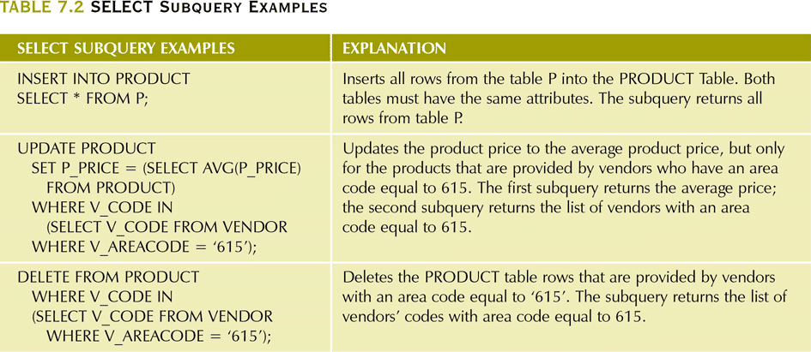
INSERT, UPDATE, DELETE

Slide 15
WHERE Subqueries
SELECT P_CODE, P_PRICE
FROM PRODUCT
WHERE P_PRICE > = (SELECT AVG(P_PRICE) FROM PRODUCT);
SELECT V_NAME, V_CONTACT, V_AREACODE, V_PHONE
FROM PRODUCT NATURAL JOIN VENDOR
WHERE P_CODE = (SELECT P_CODE FROM PRODUCT WHERE P_DESCRIPT = 'Claw hammer');
SELECT syntax needs to return a single value
If the operator is “=”, “>=”, “<=”, or “<>”.

Slide 16
IN Subqueries
SELECT DISTINCT V_NAME, V_CONTACT, V_AREACODE, V_PHONE
FROM PRODUCT NATURAL JOIN VENDOR
WHERE P_CODE IN (SELECT P_CODE FROM PRODUCT
WHERE P_DESCRIPT LIKE '%hammer%'
OR P_DESCRIPT LIKE '%saw%');
SELECT syntax can return either a set or
a single value If the operator is “IN”.

Slide 17
HAVING Subqueries
List all products with the total quantity sold greater than the average quantity sold for all products.
SELECT AVG(LINE_UNITS) FROM LINE;
SELECT SUM(LINE_UNITS)/(COUNT(DISTINCT P_CODE)) FROM LINE;
SELECT P_CODE, SUM(LINE_UNITS)
FROM LINE
GROUP BY P_CODE;
SELECT P_CODE, SUM(LINE_UNITS)
FROM LINE
GROUP BY P_CODE
HAVING SUM(LINE_UNITS) >
(SELECT SUM(LINE_UNITS)/(COUNT(DISTINCT P_CODE)) FROM LINE);

Slide 18
FROM Subqueries
Because the output of a SELECT statement is another table (a “virtual” table), you could use a SELECT subquery in the FROM clause.
SELECT INVOICE.CUS_CODE FROM INVOICE NATURAL JOIN LINE
WHERE P_CODE = '13-Q2/P2';
SELECT INVOICE.CUS_CODE FROM INVOICE NATURAL JOIN LINE
WHERE P_CODE = '23109-HB';
SELECT DISTINCT CUSTOMER.CUS_CODE, CUSTOMER.CUS_LNAME
FROM CUSTOMER,
(SELECT INVOICE.CUS_CODE FROM INVOICE NATURAL JOIN LINE
WHERE P_CODE = '13-Q2/P2') CP1,
(SELECT INVOICE.CUS_CODE FROM INVOICE NATURAL JOIN LINE
WHERE P_CODE = '23109-HB') CP2
WHERE CUSTOMER.CUS_CODE = CP1.CUS_CODE
AND CUSTOMER.CUS_CODE = CP2.CUS_CODE;

Slide 19
ATTRIBUTE LIST Subqueries
A subquery in the attribute list much return one single value, otherwise an error code is raised.
SELECT P_CODE, P_PRICE,
(SELECT AVG(P_PRICE) FROM PRODUCT) AS AVG_PRICE,
P_PRICE - (SELECT AVG(P_PRICE) FROM PRODUCT) AS DIFFERENCE
FROM PRODUCT;

Slide 20
SQL DATE FUNCTIONS
SYSDATE: returns today’s date
INSERT INTO INVOICE
VALUES ('1009', '10011', SYSDATE, 22.55, 1.58, 24.13);

Slide 21
SQL NUMERIC FUNCTIONS
ROUND: rounds a value to a specified precision (number of digits).
ROUND (numeric value, p) p=precision
SELECT P_CODE, P_PRICE,
ROUND(P_PRICE, 1) AS PRICE1,
ROUND(P_PRICE, 0) AS PRICE0
FROM PRODUCT;

Slide 22
SQL STRING FUNCTIONS
||: concatenates data from two different character columns and returns a single column.
strg_value || strg_value
SELECT CUS_LNAME || ',' || CUS_FNAME AS CUSTOMERS_NAME
FROM CUSTOMER;

Slide 23
SQL STRING FUNCTIONS
UPPER/LOWER: returns a string in all capitals or all lowercase.
UPPER(strg_value)
LOWER(strg_value)
SELECT UPPER(CUS_LNAME) || ',' || UPPER(CUS_FNAME) AS NAME
FROM CUSTOMER;
SELECT LOWER(CUS_LNAME) || ',' || LOWER(CUS_FNAME) AS NAME
FROM CUSTOMER;

Slide 24
SQL STRING FUNCTIONS
SUBSTR: returns a substring or part of a given string parameter.
SUBSTR(strg_value, p, l)
p=start position, l=length of characters
SELECT SUBSTR(CUS_FNAME, 1, 1) || '.' || CUS_LNAME
AS NAME
FROM CUSTOMER;
SELECT SUBSTR(CUS_LNAME, 1, 3) || '-' || SUBSTR(CUS_PHONE,5,4)
AS CODE
FROM CUSTOMER;

Slide 25
SQL STRING FUNCTIONS
LENGTH: returns the number of characters in a string value.
LENGTH(strg_value)
SELECT CUS_LNAME, LENGTH(CUS_LNAME) AS NAMESIZE
FROM CUSTOMER
ORDER BY NAMESIZE;

