Slide 1
Chapter 8: Database Design
Instructor: Weiyin Hong

Slide 2

In this chapter, you will learn:
That successful database design must reflect the information system of which the database is a part
Database Life Cycle (DBLC)
Database Design Strategies

Slide 3

Information System
Provides data collection, storage, and retrieval
Components include:
  Database(s)
  Application programs
  Administrative procedures

Slide 4
Information System
System Analysis
  Establishes need and extent of an information system
Systems development
  Process of creating information system
Database development
  Process of database design and implementation
  Creation of database models
  Implementation
    Creating storage structure
    Loading data into database
    Providing for data management

Slide 5
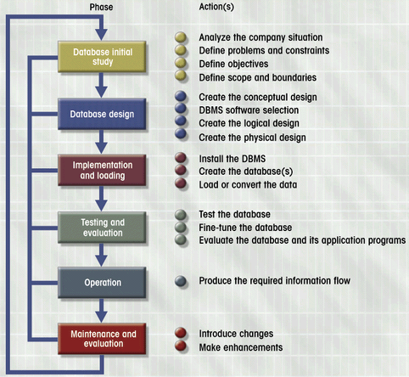
Database Lifecycle (DBLC)

Slide 6
Phase 1: Database Initial Study
Purposes
  Analyze company situation
  Define problems and constraints
  Define objectives
  Define scope and boundaries
    Scope – Extent of the design, based on the operational requirements.
    Boundaries – External limits to the system, e.g., budget, hardware, and software.

Slide 7
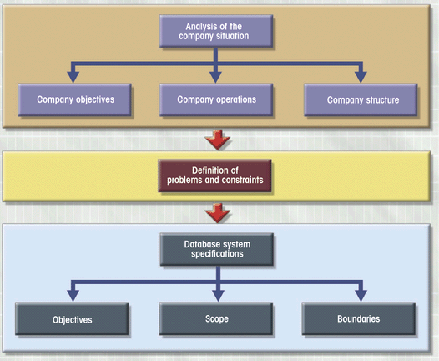
Phase 1: Initial Study Activities

Slide 8
Phase 2: Database Design
Most Critical DBLC phase
Focus on data requirements
Sub-phases
Conceptual
Design
Software
Selection
Logical
Design
Physical
Design
DBMS
independent
DBMS
dependent
Hardware
dependent

Slide 9
2.1. Conceptual Design
Data modeling creates abstract data structure to represent real-world items
High level of abstraction
Four steps
  Data analysis and requirements
  Entity relationship modeling (ERD) and normalization
  Data model verification
  Distributed database design

Slide 10

2.1.1 Data analysis and requirements
Focus on:
  Information needs
  Information users
  Information sources
Data sources
  Developing and gathering end-user data views
  Direct observation of current system
  Interfacing with systems design group
Business rules

Slide 11
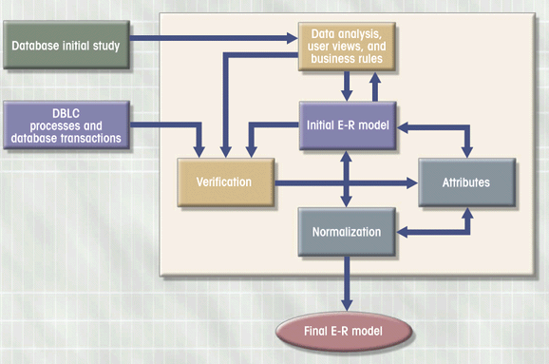
2.1.2 ER Modeling and Normalization

Slide 12
2.1.2 The designers must make decisions about: (e.g.)
The treatment of multivalued attributes
Adding derived attributes to satisfy processing requirements
The placement of foreign keys in 1:1 relationships
Standard naming conventions

Slide 13
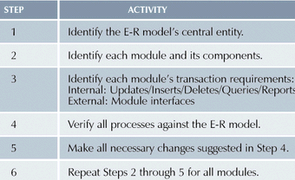
2.1.3 Data Model Verification Steps

Slide 14
2.1.4. Distributed Database Design
Design portions in different physical locations
  e.g., a retail process and a warehouse storage process are very likely to be found in different physical locations.
Development of data distribution and allocation strategies

Slide 15
2.2. DBMS Software Selection
DBMS: DB2, SQL Server, Oracle, IMS, Informix, Access, Ingress
Factors affecting purchasing decision
  Cost
  DBMS features and tools
  Underlying model
  Portability
  DBMS hardware requirements

Slide 16
2.3. Logical Design
Translates conceptual design into internal model for a selected DBMS
Design components
  Tables
  Indexes
  Views
  Transactions
  Access authorities
  Others

Slide 17
2.4. Physical Design
Selection of data storage and access characteristics
  Very technical
  More important in older hierarchical and network models
Becomes more complex for distributed systems
Designers favor software that hides physical details

Slide 18
Phase 3: Implementation and Loading
Creation of end-user tables
Data loaded into tables
Other issues
  Performance
  Security
  Backup and recovery
  Company standards
  Concurrency controls

Slide 19
Phase 4: Testing and Evaluation
Database is tested and fine-tuned for performance, integrity, concurrent access, and security constraints
Done in parallel with application programming
Actions taken if tests fail
  Fine-tuning based on reference manuals
  Modification of physical design
  Modification of logical design
  Upgrade or change DBMS software or hardware

Slide 20
Phase 5: Operation
Database considered operational
Starts process of system evaluation
Unforeseen problems may surface
Demand for change is constant

Slide 21
Phase 6: Maintenance and Evaluation
Preventative maintenance (back up)
Corrective maintenance (recovery)
Adaptive maintenance (enhancing performance, adding attributes or entities)
Assignment of access permissions
Generation of database access statistics to monitor performance
Periodic security audits based on system-generated statistics
Periodic system usage summaries

Slide 22
DB Design Strategies
Top-down
  1) Identify data sets
  2) Define data elements
Bottom-up
  1) Identify data elements
  2) Group them into data sets
Even if a primarily top-down approach is selected, the normalization process that revises existing table structure is a bottom-up technique.
ER models constitutes a top-down process, even if the selection of attributes and entities can be described as bottom-up.

Slide 23
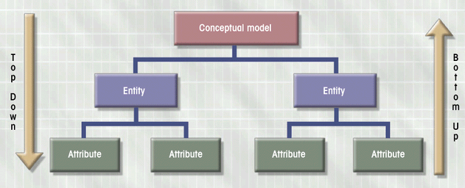
Top-Down vs. Bottom-Up

Slide 24
Centralized vs. Decentralized Design
Depending on scope and size of the system, the DB design can follow two very different design philosophies:
  Centralized design
    Typical of simple databases
    Conducted by single person or small team
  Decentralized design
    Larger numbers of entities and complex relations
    Spread across multiple sites
    Developed by teams

