Slide 1

Team 1 Rocks!
Wesley Segafredo
David Lewis
Scott Nordeen
Jacob Truman

Slide 2
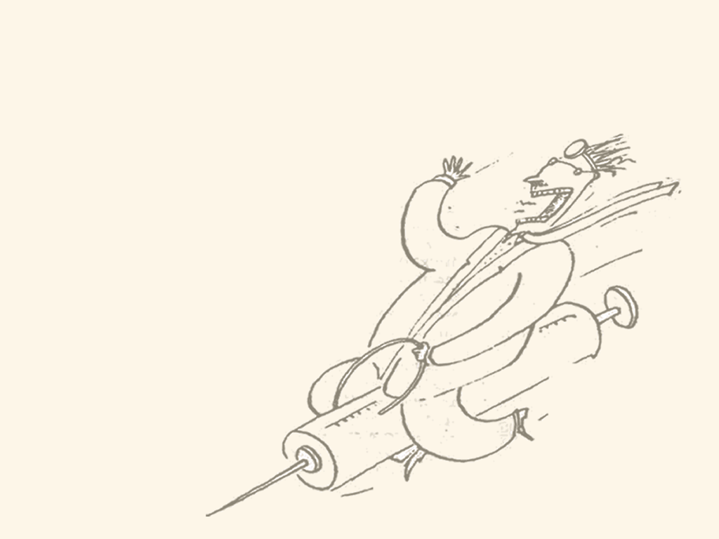
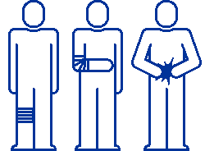
Company Introduction
College Medical Center (CMC)
Hospital management organization

Slide 3

Database Purpose
Centralization of data
Uniformity
Complex tables

Slide 4
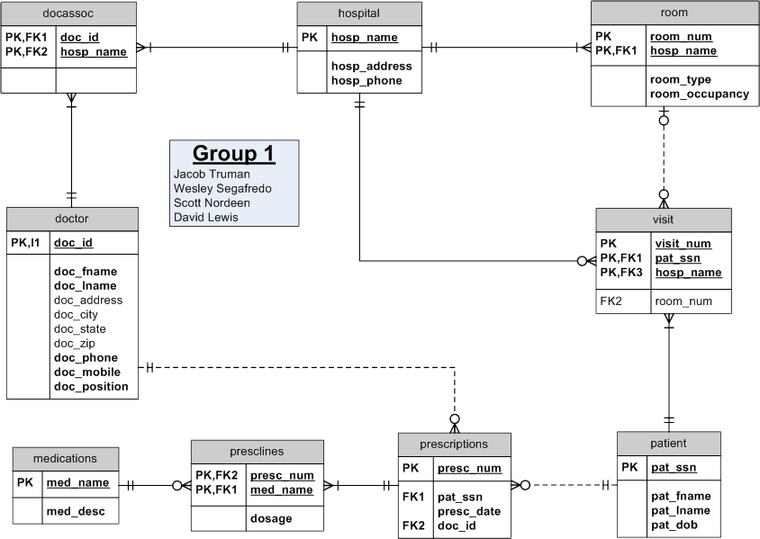

ERD

Slide 5
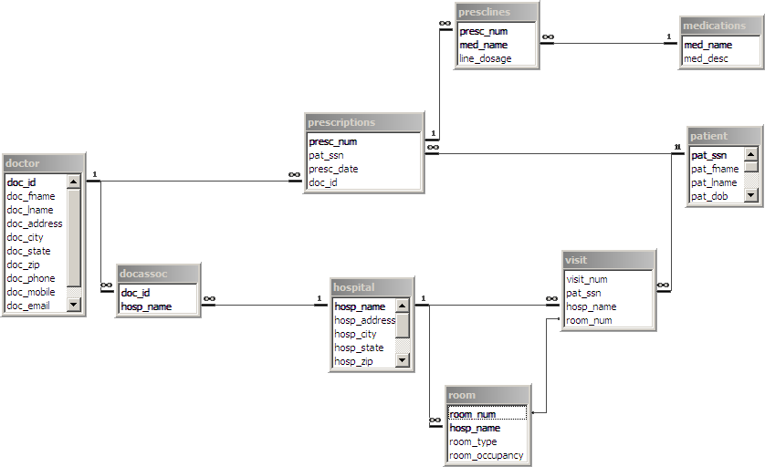
Table Relationships

Slide 6
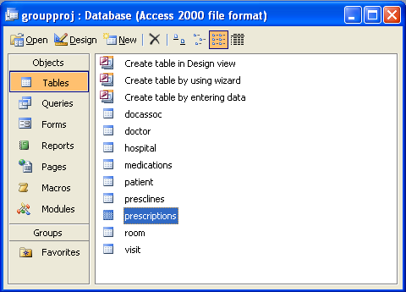
Hospital Tracking System
Hospitals
Doctors
Patients
Prescriptions
Medication

Slide 7
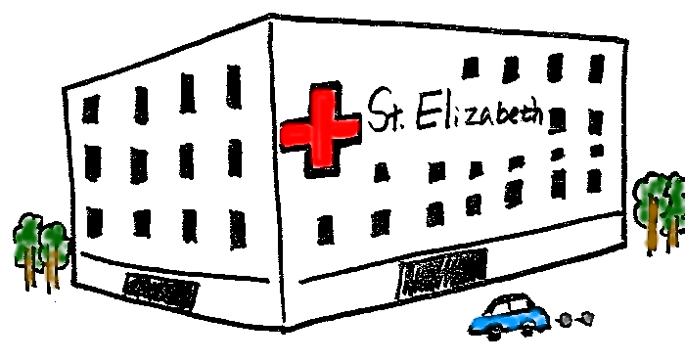

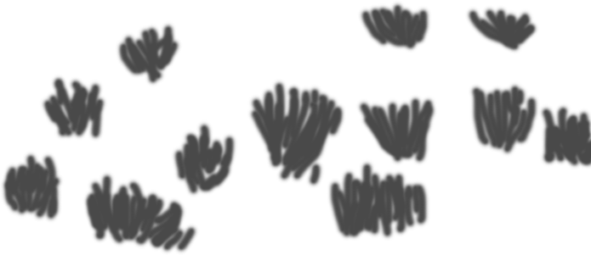

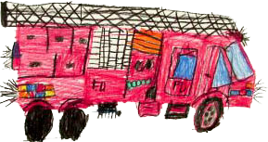
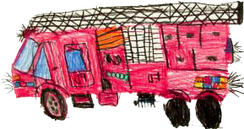
Hospitals
[hospital] table to track info for hospitals in the area
More hospitals to be added as demand rises
[room] table to track room info in each hospital

Slide 8
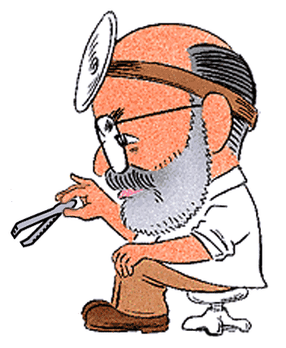
Doctors
[doctor] table to track doctors info
Doctors may work at multiple hospitals
[docassoc] table to track their associations to hospitals

Slide 9
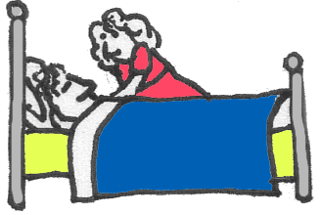
Patient
[patient] table to track patients info
Table to track their associations with
[visit] table to track
  Patient hospital visits
  Hospital room if applicable

Slide 10

Prescriptions
[prescription] table tracks:
  patient prescriptions
  doctor that prescribed
[presclines] table tracks medication(s) to prescriptions

Slide 11

Medications
Table to track different medications doctors can prescribe

Slide 12
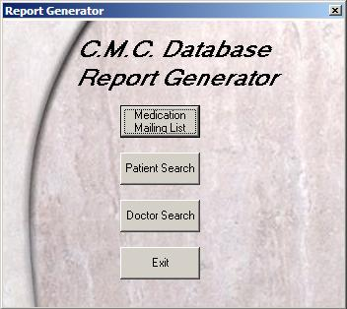
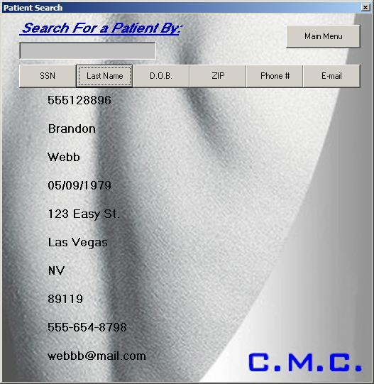
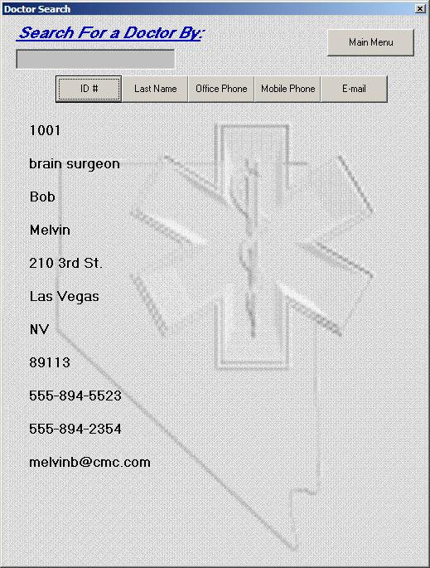
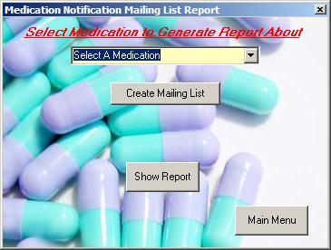
Reporting Functions

Slide 13
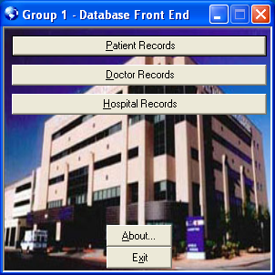
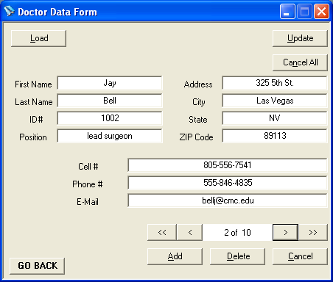
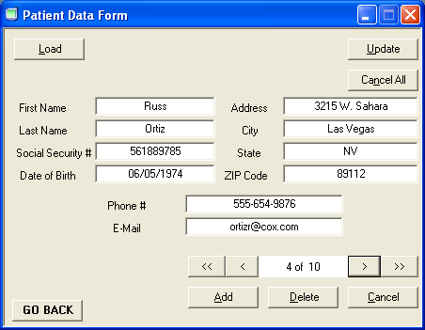
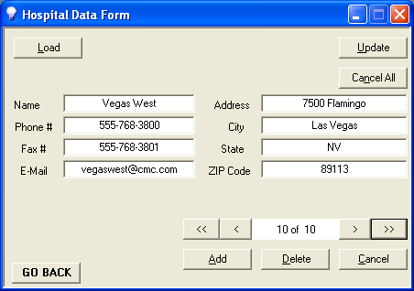
Database Front End

Slide 14
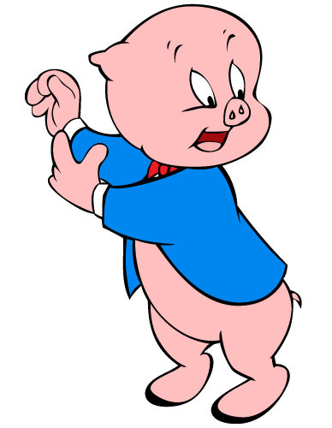
Conclusion
That’s all folks!

