Slide 1
Chapter 3 (partial):
Relational Algebra
Instructor: Dr. Hong

Slide 2
Relational Database Operators
Relational algebra determines table manipulations
Relational operators
  UNION
  INTERSECT
  DIFFERENCE
  PRODUCT
  SELECT
  PROJECT
  JOIN
  DIVIDE

Slide 3
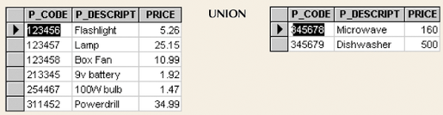
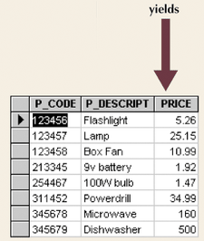
Union
Combines all rows from two tables that are union compatible
Two or more tables share the same columns and domains.

Slide 4
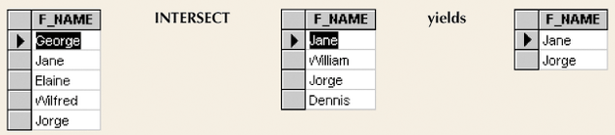
Intersect
Yields rows that appear in both tables

Slide 5
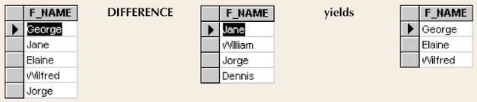
Difference
Yields rows not found in other tables

Slide 6
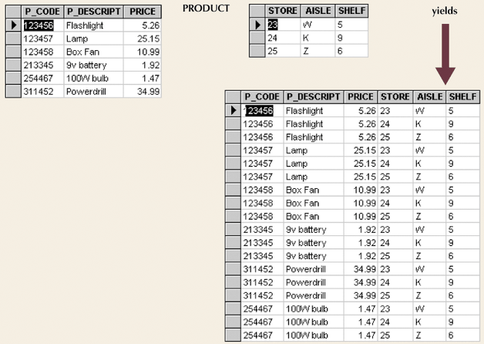
Product
Yields all possible pairs from two tables

Slide 7
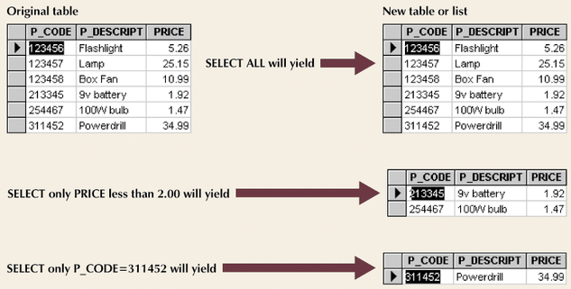
Select
Yields a subset of rows based on specified criterion

Slide 8
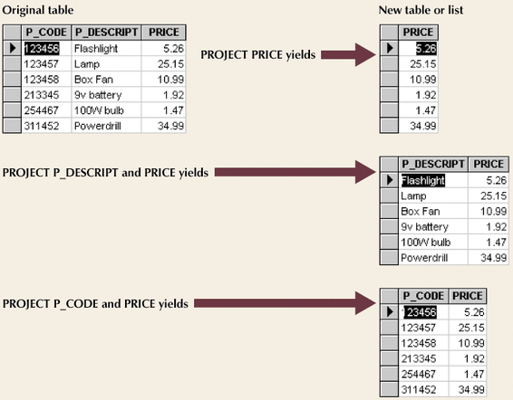
Project
Yields all values for selected attributes

Slide 9
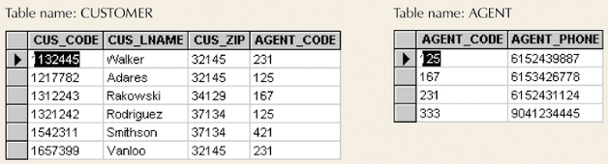
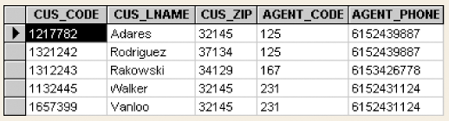
Join
Information from two or more tables is combined

Slide 10
Natural Join Process
Links tables by selecting rows with common values in common attribute(s)
Three-stage process
  Product creates one table
  Select yields appropriate rows
  Project yields single copy of each attribute to eliminate duplicate columns

Slide 11
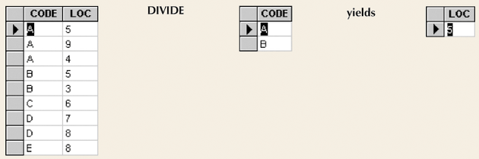
Divide
Requires user of single-column table and two-column tables

