Slide 1
Chapter 10
Introduction to
MAN and WAN

Slide 2
Learning Objectives (I)
Distinguish local area networks, metropolitan area networks, and wide area networks from each other
Identify the characteristics of metropolitan area networks, and explain how they compare and contrast with wide area and local area networks
Describe how circuit-switched, datagram packet-switched, and virtual circuit packet-switched networks work
Identify the differences between a connection-oriented network and a connectionless network, and give an example of each

Slide 3
Learning Objectives (II)
Describe the differences between centralized routing and distributed routing, and cite the advantages and disadvantages of each
Describe the differences between static routing and adaptive routing, and cite the advantages and disadvantages of each
Document the main characteristics of flooding, and use hop count and hop limit in a simple example
Discuss the basic concepts of network congestion, including quality of service

Slide 4
MAN Basics
Borrow technologies from LANs and WANs.
Support:
  high-speed disaster recovery systems, real-time transaction backup systems, interconnections between corporate data centers and Internet service providers, and government, business, medicine, and education high-speed interconnections
Almost exclusively fiber optic systems.
Very high transfer speeds.
Recover from network faults very quickly.
Often a ring topology.
Some MANs can be provisioned dynamically.

Slide 5
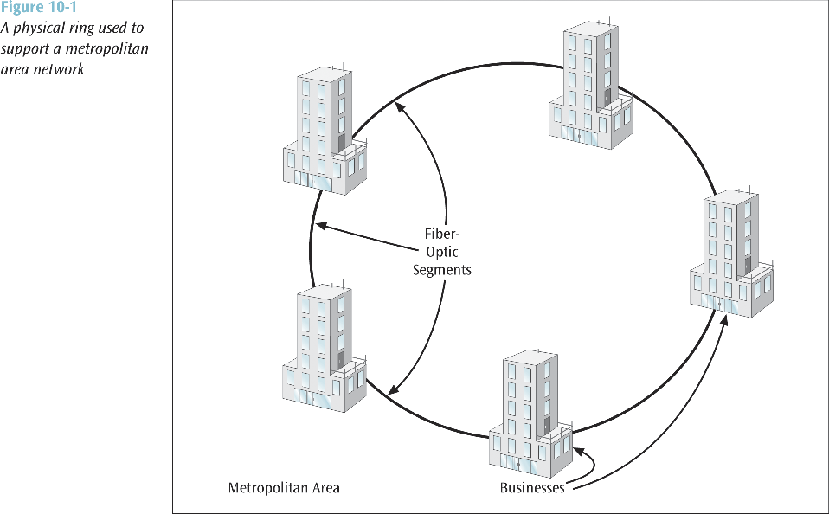

Slide 6
SONET vs. Ethernet
Most MANs are SONET network built of multiple rings (for failover purposes)
SONET:
  Well-proven but complex, fairly expensive, and cannot be provisioned dynamically
  Based upon T-1 rates and does not fit nicely into 1 Mbps, 10 Mbps, 100 Mbps, 1000 Mbps chunks, like Ethernet systems do
Ethernet MANs generally have high failover times

Slide 7
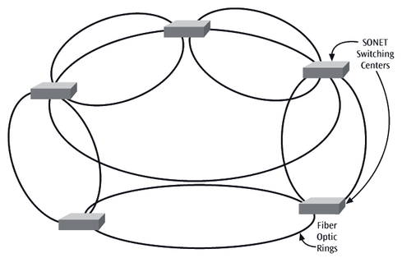
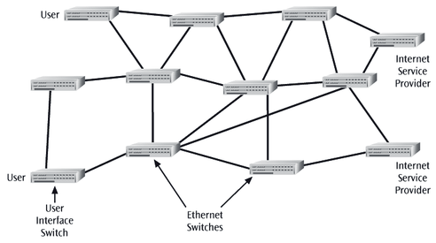
SONET MAN
Ethernet MAN

Slide 8
WAN Basics
WANs used to be characterized with slow, noisy lines
Today WANs are very high speed with very low error rates
WANs often follow a mesh topology
Station: device that interfaces a user to a network
Node: device that allows one or more stations to access the physical network
  A transfer point for passing information through a network
  Is often a computer, router, or telephone switch
Communications network, or physical network: underlying connection of nodes and telecommunication links

Slide 9
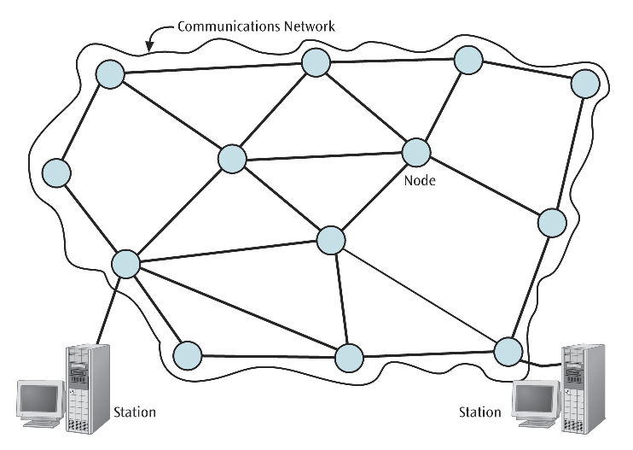

Slide 10
Types of Network Structures
Circuit-switched network – Network in which a dedicated circuit is established between sender and receiver
  All data passes over this circuit
  Telephone system is a common example
  Connection is dedicated until one party or another terminates the connection
Packet-switched network -Network in which all data messages are transmitted using fixed-sized packages, called packets
  More efficient use of a telecommunications line since packets from multiple sources can share the medium.
  One form of packet switched network is the datagram
  With a datagram, each packet is on its own and may follow its own path
  Virtual circuit creates a logical path through the subnet
    All packets from one connection follow this path
Broadcast network – old LAN technology used in WAN.
  A workstation transmits its data and all other workstations “connected” to the network hear the data. Only the workstation(s) with the proper address will accept the data.

Slide 11
Connection-oriented vs. Connectionless
A network application can be either connection-oriented or connectionless.
Connection-oriented
  requires both sender and receiver to create a connection before any data is transferred.
  Applications such as large file transfers and sensitive transactions such as banking and business are typically connection-oriented.
  can operate over both a circuit-switched network or a packet-switched network.
Connectionless
  does not create a connection first but simply sends the data. Electronic mail is a common example.
  can operate over both a circuit-switched network or a packet-switched network but a packet-switched network may be more efficient.

Slide 12
Application Examples
Circuit-
switched
Packet-
switched
FTP with
modem
FTP on
LAN
Connection-
oriented
E-mail
with modem
E-mail
on LAN
Connectionless

Slide 13
Routing
Each node in a WAN is a router that:
  Accepts an input packet
  Examines the destination address
  Forwards the packet on to a particular telecommunications line
How does a router decide which line to transmit on?
  Router must select one transmission line that will best provide a path to the destination in an optimal manner
  Often many possible routes exist between sender and receiver
The communications network with its nodes and telecommunication links is essentially a weighted network graph
The edges, or telecommunication links, between nodes, have a cost associated with them
  Could be a delay cost, queue size cost, limiting speed, or simply a dollar amount for using that link

Slide 14
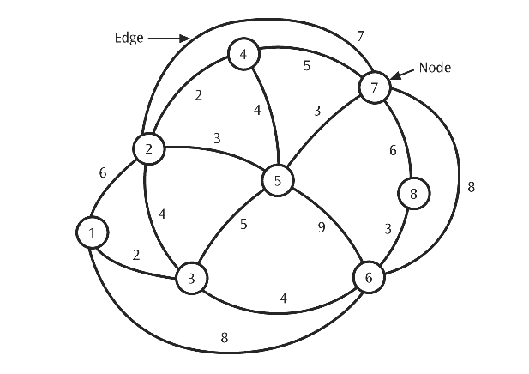

Slide 15
Routing Decision
The routing method, or algorithm should be:
  Optimal, so the least cost can be found
  Fair, so all packets are treated equally
  Robust, in case link or node failures occur and the network has to reroute traffic
  Not too robust so that the chosen paths do not oscillate too quickly between troubled spots
Dijkstra’s least cost algorithm finds all possible paths between two locations.
  By identifying all possible paths, it also identifies the least cost path.
  The algorithm can be applied to determine the least cost path between any pair of nodes.

Slide 16
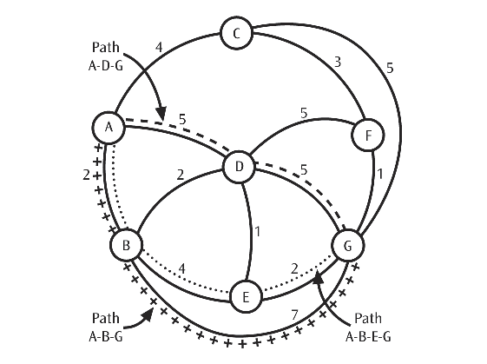

Slide 17
Flooding
When a packet arrives at a node, the node sends a copy of the packet out to every link except the link the packet arrived on
Traffic grows very quickly when every node floods the packet
To limit uncontrolled growth, each packet has a hop count
  Every time a packet hops, its hop count is incremented
  When a packet’s hop count equals a global hop limit, the packet is discarded

Slide 18
Centralized Routing
One routing table is kept at a “central” node
Whenever a node needs a routing decision, the central node is consulted
To survive central node failure, the routing table should be kept at a backup location
The central node should be designed to support a high amount of traffic consisting of routing requests

Slide 19
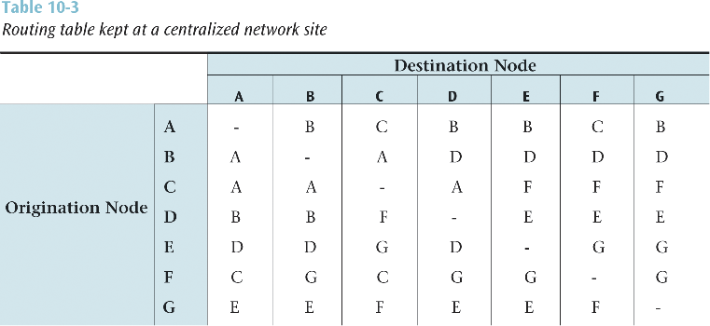

Slide 20
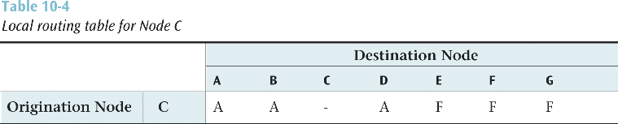
Distributed Routing
Each node maintains its own routing table
No central site holds a global table
Somehow each node has to share information with other nodes so that the individual routing tables can be created
Possible problem: individual routing tables holding inaccurate information

Slide 21
Adaptive Routing vs. Static Routing
With adaptive routing, routing tables can change to reflect changes in the network
Static routing:
  Does not allow the routing tables to change
  Is simpler but does not adapt to network congestion or failures

Slide 22
Routing Examples
Routing Information Protocol (RIP):
  First routing protocol used on the Internet
  Form of distance vector routing
  Was adaptive and distributed
    Each node kept its own table and exchanged routing information with its neighbors
Open Shortest Path First (OSPF):
  Second routing protocol used on the Internet
  A form of link state routing
  It too was adaptive and distributed
    However, more complicated and performed much better than RIP

Slide 23
Network Congestion
When a network or a part of a network becomes so saturated with data packets that packet transfer is noticeably impeded, network congestion occurs
What can cause network congestion?
  Node and link failures
  High amounts of traffic
  Improper network planning
When serious congestion occurs, buffers overflow and packets are lost
What can we do to reduce or eliminate network congestion?
  An application can observe its own traffic and notice if packets are disappearing
  If so, there may be congestion
    This is called implicit congestion control
  The network can inform its applications that congestion has occurred and the applications can take action
    This is called explicit congestion control

Slide 24
Congestion Avoidance
Before making a connection, user requests how much bandwidth is needed, or if connection needs to be real-time
Network checks to see if it can satisfy user request
If user request can be satisfied, connection is established
If a user does not need a high bandwidth or real-time, a simpler, cheaper connection is created
Asynchronous transfer mode is a very good example of this (Chapter Twelve)

