Slide 1
Chapter 11
The Internet

Slide 2
Learning Objectives
Discuss the responsibilities of the Internet Protocol (IP) and how IP can be used to create a connection between networks
Discuss the responsibilities of the Transmission Control Protocol (TCP) and how it can be used to create a reliable, end-to-end network connection
Identify the relationships between TCP/IP and the protocols ICMP, UDP, ARP, DHCP, and NAT, and tunneling protocols
Cite the basic features of HTML, Dynamic HTML, and XML, and describe how they differ from each other
Describe the responsibility of the Domain Name System and how it converts a URL into a dotted decimal IP address
Describe the major Internet applications and services
Discuss the business advantages of the World Wide Web
Recognize that the Internet is constantly evolving and that IPv6 and Internet2 demonstrate that evolution

Slide 3
Internet
Today’s present Internet is a vast collection of thousands of networks and their attached devices
Internet began as the Arpanet during the 1960s
One high-speed backbone connected several university, government, and research sites
Backbone was capable of supporting 56 kbps transmission speeds and eventually became financed by the National Science Foundation (NSF)

Slide 4
History of Internet
1969: | ARPANET started by the US Department of Defense as a network of four computers
1981: | NSF funds development of CSNET access BITNET established
1983: | ARPANET split into two networks (MILNET and Reduced-ARPANET)
1987: | NSF funds development of new high-speed network (NSFNET)
1989: | Tim Berners-Lee at CERN proposes Internet Protocols CSNET merges with BITNET
1990: | NSFNET replaces ARPANET
1991: | CERN releases World Wide Web
1995: | NSFNET reverts to research network
1996: | Work on Internet2 begins
1998: | ICANN established to regulate IP addresses

Slide 5
Protocols (I)
To support the Internet and all its services, many protocols are necessary
  Internet Protocol (IP)
  Transmission Control Protocol (TCP)
  Address Resolution Protocol (ARP)
  Dynamic Host Configuration Protocol (DHCP)
  Network Address Translation (NAT)

Slide 6
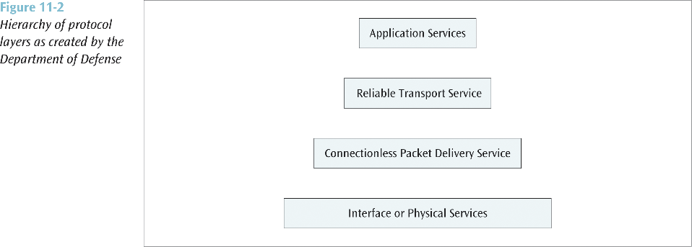
Protocols (II)
The Internet model
  An application, such as e-mail, resides at the highest layer
  A transport protocol, such as TCP, resides at the transport layer
  The Internet Protocol (IP) resides at the Internet or network layer
  A particular media and its framing resides at the network access (or data link) layer

Slide 7
Internet Protocol (IP)
IP prepares a packet for transmission across the Internet
The IP header is encapsulated onto a transport data packet
The IP packet is then passed to the next layer where further network information is encapsulated onto it
Using IP, a router:
  Makes routing decision based on the destination address
  May have to fragment the datagram into smaller datagrams (very rare) using Fragment Offset
  May determine that current datagram has been hopping around the network too long and delete it (Time to Live)

Slide 8
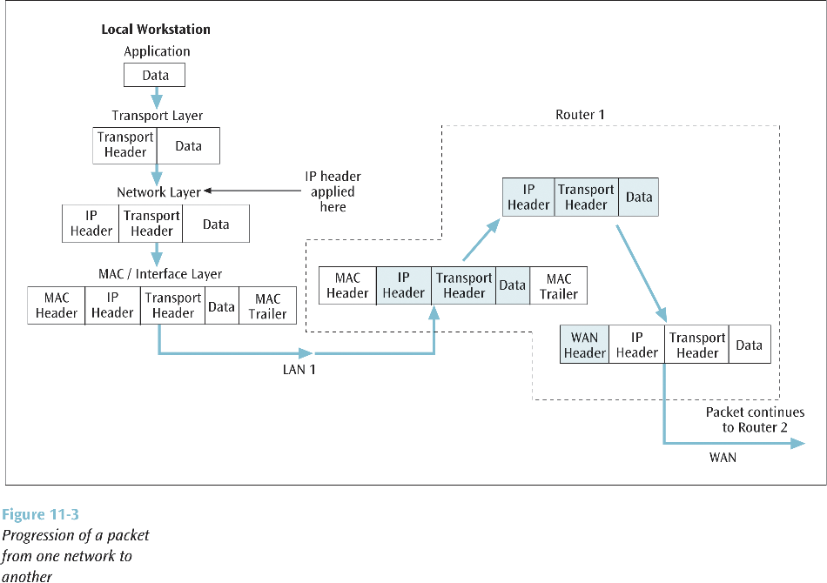

Slide 9
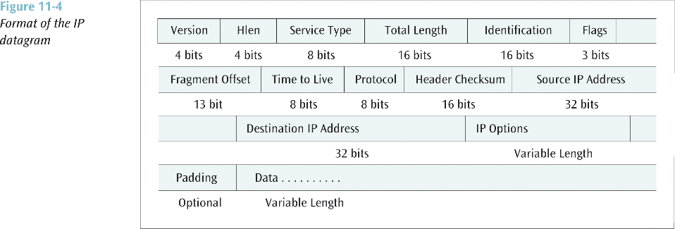

Slide 10
Transmission Control Protocol (TCP)
The TCP layer creates a connection between sender and receiver using port numbers
Port number identifies a particular application on a particular device (IP address)
TCP can multiplex multiple connections (using port numbers) over a single IP line
The TCP layer can ensure that the receiver is not overrun with data (end-to-end flow control) using the Window field
TCP can perform end-to-end error correction (Checksum)
TCP allows for the sending of high priority data (Urgent Pointer)

Slide 11
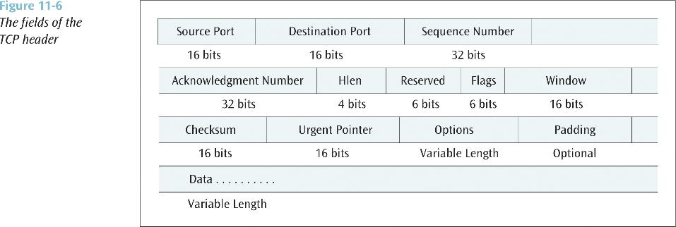

Slide 12
ICMP, UDP, ARP
ICMP, which is used by routers and nodes, performs the error reporting for the Internet Protocol
  ICMP reports errors such as:
    Invalid IP address
    Invalid port address
    If packet has hopped too many times
User Datagram Protocol
  A transport layer protocol used in place of TCP
  Where TCP supports a connection-oriented application, UDP is used with connectionless applications
  UDP also encapsulates a header onto an application packet but the header is much simpler than TCP
Address Resolution Protocol
  When an IP packet has traversed the Internet and encounters the destination LAN, how does the packet find the destination workstation?
  Even though the destination workstation may have an IP address, a LAN does not use IP addresses to deliver frames
  A LAN uses the MAC layer address
  ARP translates an IP address into a MAC layer address so a frame can be delivered to the proper workstation

Slide 13
DHCP
An IP address can be assigned to a workstation permanently (static assignment) or dynamically
Dynamic IP address assignment is a more efficient use of scarce IP addresses
When a DHCP client issues an IP request, the DHCP server looks in its static table
  If no entry exists, the server selects an IP address from an available pool
Address assigned by the DHCP server is temporary
Part of agreement includes a specific period of time
If no time period specified, the default is one hour
DHCP clients may negotiate for a renewal before the time period expires

Slide 14
NAT
NAT lets a router represent an entire local area network to the Internet as a single IP address
  Thus all traffic leaving this LAN appears as originating from a global IP address
  All traffic coming into this LAN uses this global IP address
This security feature allows a LAN to hide all the workstation IP addresses from the Internet
Since outside world cannot see into the LAN, you do not need to use registered IP addresses on the inside LAN
We can use the following blocks of addresses for private use:
  10.0.0.0 – 10.255.255.255
  172.16.0.0 – 172.31.255.255
  192.168.0.0 – 192.168.255.255
When a user on inside sends a packet to the outside, the NAT interface changes the user’s inside address to the global IP address
  This change is stored in a cache
When the response comes back, the NAT looks in the cache and switches the addresses back
No cache entry? The packet is dropped UNLESS:
  NAT has a service table of fixed IP address mappings
  This service table allows packets to originate from the outside

Slide 15
Tunneling Protocols & Virtual Private Networks (VPNs)
The Internet is not normally a secure system
If a person wants to use the Internet to access a corporate computer system, how can a secure connection be created?
  One possibility: Creating a virtual private network (VPN)
A VPN creates a secure connection through the Internet by using a tunneling protocol

Slide 16
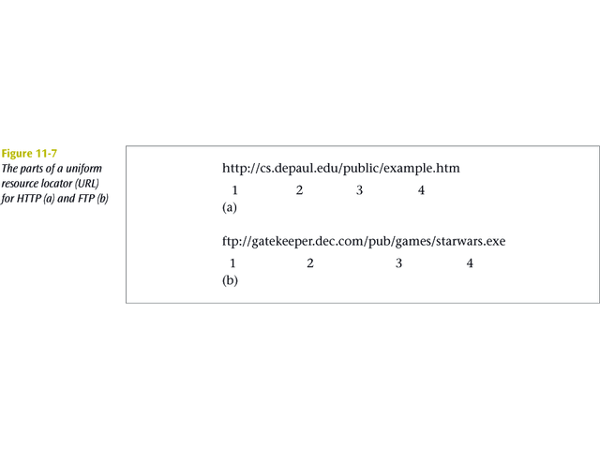
Locating a Document on the Internet
Every document on the Internet has a unique uniform resource locator (URL)
All URLs consist of four parts:
  1. Service type
  2. Host or domain name
  3. Directory or subdirectory information
  4. Filename

Slide 17
Domain Name System (DNS)
A large, distributed database of URLs and IP addresses
The first operation performed by DNS is to query a local database for URL/IP address information
If the local server does not recognize the address, the server at the next level will be queried
Eventually the root server for URL/IP addresses will be queried
If root server has the answer, results are returned
If root server recognizes domain name but not the extension in front of the domain name, the root server will query the server at the domain name’s location
When the domain’s server returns results, they are passed back through the chain of servers (and their caches)

Slide 18
IP Addresses
All devices connected to the Internet have a 32-bit IP address associated with it
Think of the IP address as a logical address (possibly temporary), while the 48-bit address on every NIC is the physical, or permanent address
Computers, networks and routers use the 32-bit binary address, but a more readable form is the dotted decimal notation
  1000 0000 1001 1100 0000 1110 0000 0111
  128.156.14.7
There are basically four types of IP addresses:
  Classes A, B, C and D
A particular class address has a unique network address size and a unique host address size

Slide 19
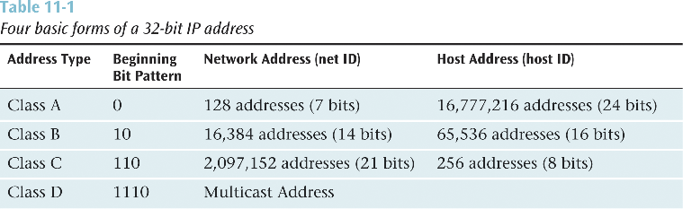
1000 0000.
1001 1100.
00001 110.
0000 0111
128.
156.
14.
7
When you examine the first decimal value in the dotted decimal notation:
  All Class A addresses are in the range 0 - 127
  All Class B addresses are in the range 128 - 191
  All Class C addresses are in the range 192 - 223

Slide 20
IP Subnet Masking
Sometimes you have a large number of IP addresses to manage
By using subnet masking, you can break the host ID portion of the address into a subnet ID and host ID
  For example, the subnet mask 255.255.255.0 applied to a class B address will break the host ID (normally 16 bits) into an 8-bit subnet ID and an 8-bit host ID

Slide 21
Internet Services
Electronic mail
File transfer protocol (FTP)
Remote login (Telnet)
Internet telephony
Listservs
Usenet
Streaming audio and video
Instant messaging

Slide 22
Electronic Mail
E-mail programs can create, send, receive, and store e-mails, as well as reply to, forward, and attach non-text files
Multipurpose Internet Mail Extension (MIME) is used to send e-mail attachments
Simple Mail Transfer Protocol (SMTP) is used to transmit e-mail messages
Post Office Protocol version 3 (POP3) and Internet Message Access Protocol (IMAP) are used to hold and later retrieve e-mail messages

Slide 23
FTP
FTP used to transfer files across the Internet
User can upload or download a file
The URL for an FTP site begins with ftp://…
Three most common ways to access an FTP site are:
  Through a browser
  Using a canned FTP program
  Issuing FTP commands at a text-based command prompt

Slide 24
Telnet
Allows a user to remotely login to a distant computer site
User usually needs a login and password to remove computer site
User saves money on long distance telephone charges

Slide 25
Internet Telephony (I)
Voice Over IP is the transfer of voice signals using a packet switched network and the IP protocol
VoIP can be internal to a company (private VoIP) or can be external using the Internet
VoIP consumes many resources and may not always work well, but can be cost effective in certain situations
Three basic ways to make a telephone call using VoIP:
  PC to PC using sound cards and headsets (or speakers and microphone)
  PC to telephone (need a gateway to convert IP addresses to telephone numbers)
  Telephone to telephone (need gateways)

Slide 26
Internet Telephony (II)
Three functions necessary to support voice over IP:
  Voice must be digitized (PCM, 64 kbps, fairly standard)
  64 kbps voice must be compressed
  Once the voice is compressed, the data must be transmitted
How can we transport compressed voice?
H.323 - Created in 1996 by ITU-T
  Actually, H.323 created for a wide range of applications both audio and video and not for TCP/IP networks
Session Initiation Protocol (SIP) - Created by IETF specifically for supporting the transfer of voice over the Internet
  Many feel SIP will surpass H.323
ENUM: A protocol that supports VoIP
  Converts telephone numbers to fully qualified domain name addresses
  For example, the telephone number 312 555-1212 will be converted to 2.1.2.1.5.5.5.2.1.3.1.e164.arpa

Slide 27
Listservs
A popular software program used to create and manage Internet mailing lists
When an individual sends an e-mail to a listserv, the listserv sends a copy of the message to all listserv members
Listservs can be useful business tools for individuals trying to follow a particular area of study

Slide 28
Usenet
A voluntary set of rules for passing messages and maintaining newsgroups
A newsgroup is the Internet equivalent of an electronic bulletin board system
Thousands of Usenet groups exist on virtually any topic

Slide 29
Streaming Audio and Video
The continuous download of a compressed audio or video file, which can be heard or viewed on the user’s workstation
Real-time Protocol (RTP) and Real Time Streaming Protocol (RTSP) support streaming audio and video
Streaming audio and video consume a large amount of network resources

Slide 30
Instant Messaging
Allows a user to see if people are currently logged in on the network and then send short messages in real time
Consumes less resources than e-mail, and faster
Numerous Internet service providers such as America Online, Yahoo!, and Microsoft MSN offer instant messaging

Slide 31
The Internet and Business
e-Commerce: the buying and selling of goods and services via the Internet
Many agree that e-commerce consists of four major areas:
  e-retailing
  Electronic Data Interchange (EDI)
  Micro-marketing
  Electronic security

Slide 32
Cookies and State Information
A cookie is data created by a web server that is stored on the hard drive of a user’s workstation
This state information is used to track a user’s activity and to predict future needs
Information on previous viewing habits stored in a cookie can also be used by other web sites to provide customized content
Many consider cookies to be an invasion of privacy

Slide 33
Intranets and Extranets
Intranet:
  A TCP/IP network inside a company that allow employees to access the company’s information resources through an Internet-like interface
When an intranet is extended outside the corporate walls to include suppliers, customers, or other external agents, the intranet becomes an extranet

Slide 34
The Future of the Internet
Various Internet committees are constantly working on new and improved protocols
Examples include:
  Internet Printing Protocol
  Internet fax
  Extensions to FTP
  Common Name Resolution Protocol
  WWW Distributed Authoring and Versioning

Slide 35
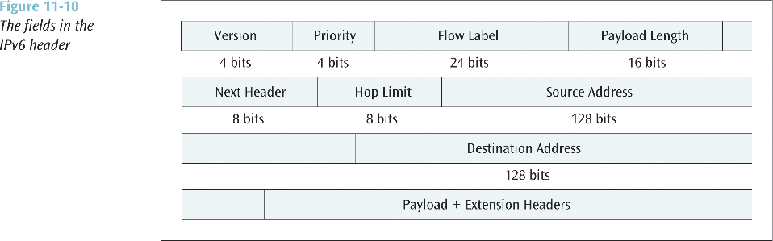
IPv6
The next version of the Internet Protocol
Main features include:
  Simpler header
  128-bit IP addresses
  Priority levels and quality of service parameters
  No fragmentation

Slide 36
Internet2
A new form of the Internet is being developed by a number of businesses and universities
Internet2 will support very high speed data streams
Applications might include:
  Digital library services
  Tele-immersion
  Virtual laboratories

