Slide 1
Chapter 12
Telecommunications Systems

Slide 2
Learning Objectives (I)
Identify the basic elements of a telephone system, and discuss the limitations of telephone signals
Differentiate between the composition of the telephone companies before and after the 1984 Modified Final Judgment
Describe the difference between a local exchange carrier and an interexchange carrier and the services they offer
Differentiate between the role of the local telephone company before and after the Telecommunications Act of 1996
List the types of leased lines that are available and their basic characteristics

Slide 3
Learning Objectives (II)
Outline the features of ISDN and distinguish a basic rate interface from a primary rate interface
List the basic characteristics of frame relay, such as permanent virtual circuits, committed information rate, and switched virtual circuits
Identify the main characteristics of Asynchronous Transfer Mode, including the roles of the virtual path connection and the virtual channel connection, the importance of the classes of service available, and ATM’s advantages and disadvantages
Identify the main characteristics of digital subscriber line, and recognize the difference between a symmetric system and an asymmetric system

Slide 4
Introduction
Basic Telephone Systems
Leased Line Services
ISDN
Frame Relay
ATM
DSL
CTI

Slide 5
Basic Telephone Systems (I)
POTS is the ‘plain old telephone system’
Transmit voice at bandwidth less than 4000 Hz
Two 4000 Hz channels required for telephone conversation
A 4000 Hz analog signal can only carry 33,600 bps, while a 4000 Hz digital signal can carry about 56,000 bps
Higher frequency needed for faster transmission.
POTS cannot deliver faster signals

Slide 6
Basic Telephone Systems (II)
Local loop runs from the central office to your home or business
Central office houses the switching equipment and provides a local dial tone on your telephone
Central office passes your long distance call off to a long distance provider
The country is divided into a few hundred local access transport areas (LATAs)
long distance call goes from one LATA to another, handled by a long distance telephone company
Local call stays within a LATA, handled by a local telephone company

Slide 7
Basic Telephone Systems (III)
Trunk runs between central offices and other telephone company switching centers
Trunk is usually digital, high speed, and carries multiple telephone circuits
Trunk is typically a 4-wire circuit, while a telephone line is a 2-wire circuit
Trunk is not associated with a single telephone number like a line is
A telephone number consists of an area code, an exchange, and a subscriber extension
The area code and exchange must start with the digits 2-9 to separate them from long distance and operator services

Slide 8
History
Modified Final Judgment of 1984 made AT&T split off the local telephone companies from the long distance company
  Regional Bells (baby bells) service local phone.
  Started with 7, only 4 remained
Telecommunications Act of 1996 opened up the local telephone market to competitors
  Cable TV companies (cable telephony), long distance telephone companies, or anyone that wanted to start a local telephone company could offer local telephone service

Slide 9
PBX
Private branch exchange (PBX) - common internal phone switching system for medium to large-sized businesses.
Provides advanced intelligent features to users, such as:
  4-digit, special prefixes for WATS, FX, etc. (private dialing plans)
  PBX collects dialed digits and intelligently decides how to route this call for lowest cost
Additional advanced features:
  Voice mail
  Routes incoming calls to the best station set (automatic call distribution)
  Provides recorded messages and responds to touch-tone requests (automated attendant)
  Access to database storage and retrieval (interactive voice response)
  VoIP

Slide 10
Automated Attendant
Plays a recorded greeting and offers a set of options
Lets the caller enter an extension directly (touch tone or voice) and bypass an “operator”
Forwards the caller to a human operator if the caller does not have a touch tone phone
Available as an option on a PBX

Slide 11
Automatic Call Distributor
Automatic Call Distributor: perhaps you’ve experienced this when you call a business, are told all operators / technicians / support staff etc. are busy, and that your call will be answered in the order it was received
Used in systems where incoming calling volume is large, such as customer service, help desk, order entry, credit authorization, reservations, and catalog sales
Early systems used hunt groups
  Original systems routed call to first operator in line (kept person very busy!)
Modern systems perform more advanced functions, such as:
  Prioritize the calls
  Route calls to appropriate agent based on the skill set of the agent
  If all agents busy, deliver call to waiting queue and play appropriate message (like how long they may have to wait)
  Forward calls to another call center, or perform automatic return call

Slide 12
Interactive Voice Response
IVR is similar to AA EXCEPT:
  IVR incorporates a connection to a database (on a mainframe or server)
  IVR allows caller to access and/or modify database information
  IVR can also perform fax on demand
Common examples of IVR include:
  Calling your bank to inquire about an account balance
  University online registration system
  Brokerage firm taking routine orders from investors
  Investment fund taking routine requests for new account applications
  A company providing employees with info about their benefit plans

Slide 13
T-1 Line
A digital, synchronous TDM stream used by businesses and telephone companies
Always on and always transmitting
Support up to 24 simultaneous channels. These channels can be either voice or data (PBX support)
Can be provisioned as a single channel delivering 1.544 Mbps of data (LAN to ISP connection)
Can order a ¼ T-1 or a ½ T-1
  T-1 constantly transmits 8000 frames per second
  Each frame consists of one byte from each of the 24 channels, plus 1 sync bit (8 * 24 + 1 = 193 bits)
  8000 frames per second * 193 bits per frame = 1.544 Mbps
  If a channel is used for voice, each byte is one byte of PCM-encoded voice
  If a channel is used for data, each byte contains 7 bits of data and 1 bit of control information (7 * 8000 = 56 Kbps)

Slide 14
ISDN
A leased service that provides a digital telephone or data connection into a home or business
Can have a digital telephone line and a 64 Kbps data line, or one 128 Kbps data line
Basic rate interface (BRI) for homes and small businesses
  Consists of two B channels and one D channel
  One B channel carry 64 Kbps of data or PCM-encoded voice.
  D channel is 16 Kbps and carries signaling information
  The B channels are dialable, and the D channel can be always on
  The 2 B channels can be combined for a 128 Kbps data channel
Primary rate interface (PRI) for larger businesses
  Used by larger businesses and contains 23 B channels and one 64 Kbps D channel
  Essentially equivalent to a T-1, but with ISDN the 23 channels are dialable!
  Appropriate ISDN modems / multiplexors are necessary to support this service

Slide 15
Frame Relay (I)
High-speed (45 Mbps) connection for data transfer between two points either locally or over long distances
A business connect itself to the local frame relay port through a high-speed line
The frame relay network transmits the data to the other side
Permanent virtual circuit (PVC) is a connection between two endpoints
PVCs are created by the provider of the frame relay service
The high-speed line, the port, and the PVC should all be chosen to support a desired transmission speed
The user and frame relay service agree upon a committed information rate (CIR)
  The CIR states that if the customer stays within a specified data rate (standard rate plus a burst rate) the frame relay provider will guarantee delivery of 99.99% of the frames
  The burst rate cannot be exceeded for longer than 2 seconds

Slide 16
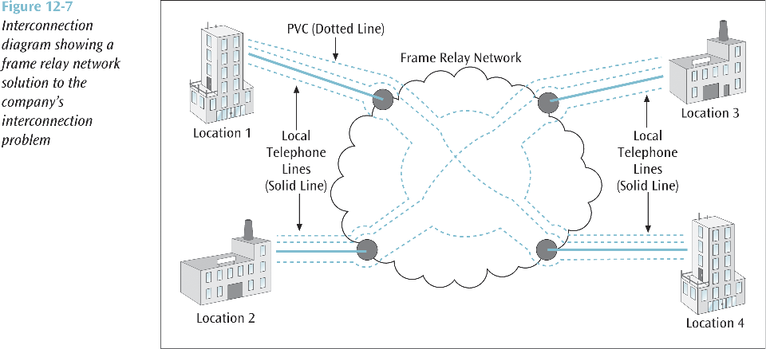

Slide 17
Frame Relay (II)
Frame Relay vs. the Internet
  Frame relay has many advantages over the Internet, including guaranteed throughput and minimum delay as well as better security
  Internet has the advantage of being practically everywhere
    Cheaper and simpler to create connections (no PVCs necessary)
    Internet tunnels (VPNs) are also attractive
Voice over Frame Relay (VoFR)
  Frame relay is also capable of supporting voice communications
    High transfer speeds adequately support the needs of interactive voice
  If a company requires multiple voice circuits, frame relay is an interesting solution
Frame Relay Switched Virtual Circuits
  Frame relay can also provide switched virtual circuits (SVC)
  An SVC can be created dynamically by the customer
  Good for short-term connections, but more expensive

Slide 18
ATM
Very high-speed packet delivery service, capable of speeds up to 622 Mbps (in 53-byte cells)
Able to offer various classes of service (QoS)
  constant bit rate service for a high-speed, continuous connection
  A less demanding service is variable bit rate (VBR)
    VBR can also support real time applications, as well as non-real time applications, but do not demand a constant bit stream
  Available bit rate (ABR) is used for bursty traffic that does not need to be transmitted immediately. ABR traffic may be held up until a transmission opening is available
  Unspecified bit rate (UBR) is for lower rate traffic that may get held up, and may even be discarded part way through transmission if congestion occurs

Slide 19
DSL
Provide very high data transfer rates over standard telephone lines
  Less than half the telephone lines in the U.S. are capable of supporting DSL
  Has to be a DSL provider in your region
DSL, depending on the type of service, is capable of transmission speeds from 100s of kilobits into single-digit megabits
A subscriber cannot be more than 5.5 kilometers (2-3 miles) from the DSL central office
A DSL service can be symmetric, or asymmetric
The DSL provider uses a DSL access multiplexer (DSLAM) to split off the individual DSL lines into homes and businesses
A user needs a splitter to separate the POTS line from the DSL line, and then a DSL modem to convert the DSL signals into a form recognized by the computer

Slide 20
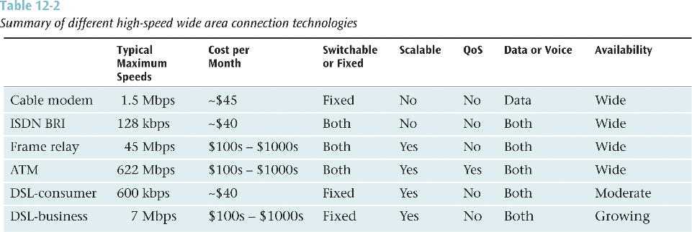

Slide 21
CTI
Combines traditional voice networks with modern computer networks.
Can also integrate voice cabling with data cabling.
CTI applications could include the following:
  Unified messaging
  Interactive voice response
  Integrated voice recognition and response
  Fax processing and fax-back
  Text-to-speech and speech-to-text conversions
  Third party call control
  PBX Graphic User Interface
  Call filtering
  Customized menuing systems

