Slide 1
Chapter 13
Network Security

Slide 2
Learning Objectives (I)
Recognize the basic forms of system attacks
Recognize the concepts underlying physical protection measures
Cite the techniques used to control access to computers and networks
Cite the strengths and weaknesses of passwords
Cite the techniques used to make data secure
Explain the difference between a substitution-based cipher and a transposition-based cipher

Slide 3
Learning Objectives (II)
Outline the basic features of public key cryptography, Advanced Encryption Standard, digital signatures, and the public key infrastructure
Cite the techniques used to secure communications
Recognize the importance of a firewall, and be able to describe the two basic types of firewall protection
Recognize the techniques used to secure wireless communications
List the advantages to a business of having a security policy

Slide 4
Standard system attacks (I)
Two leading forms of attacks the last few years:
  Exploiting known operating system vulnerabilities
  Exploiting known vulnerabilities in application software
For both of these, software company issues a patch
Patch may fix it, or introduce even more holes
Either way, bad guys find new holes and exploit
Very common way to attack vulnerability is via e-mail attachment
  You open the attachment and launch the virus
Second common way to attack is to simply scan your computer ports while you are connected to the Internet (either dial-up or non-dial-up)
  If you have an open port, hacker will download malicious software to your machine

Slide 5
Standard system attacks (II)
Denial of service attacks, or distributed denial of service attacks, bombard a computer site with so many messages that the site is incapable of answering valid requests.
In e-mail bombing, a user sends an excessive amount of unwanted e-mail to someone.
Spoofing is when a user creates a packet that appears to be something else or from someone else.
Smurfing is a nasty technique in which a program attacks a network by exploiting IP broadcast addressing operations.
Ping storm is a condition in which the Internet Ping program is used to send a flood of packets to a server.
Trojan Horse is a malicious piece of code hidden inside a seemingly harmless piece of code.
Stealing, guessing, and intercepting passwords is also a tried and true form of attack.

Slide 6
Physical Protection
Physical Protection:
  Protection from environmental damage such as floods, earthquakes, and heat
  Physical security such as locking rooms, locking down computers, keyboards, and other devices
  Electrical protection from power surges
  Noise protection from placing computers away from devices that generate electromagnetic interference
Surveillance: Proper placement of security cameras can deter theft and vandalism
  Cameras can also provide a record of activities
Intrusion detection is a field of study in which specialists try to:
  Prevent intrusion
  Determine if a computer system has been violated

Slide 7
Controlling Access
Controlling Access:
  Deciding who has access to what
  Limiting time of day access
  Limiting day of week access
  Limiting access from a location, such as not allowing a user to use a remote login during certain periods or any time

Slide 8
Passwords and ID Systems
Passwords are the most common form of security and the most abused
Simple rules help support safe passwords, including:
  Change your password often
  Pick a good, random password (minimum 8 characters, mixed symbols)
  Don’t share passwords or write them down
  Don’t select names and familiar objects as passwords
Many new forms of “passwords” are emerging (biometrics):
  Fingerprints
  Face prints
  Retina scans and iris scans
  Voice prints
  Ear prints

Slide 9
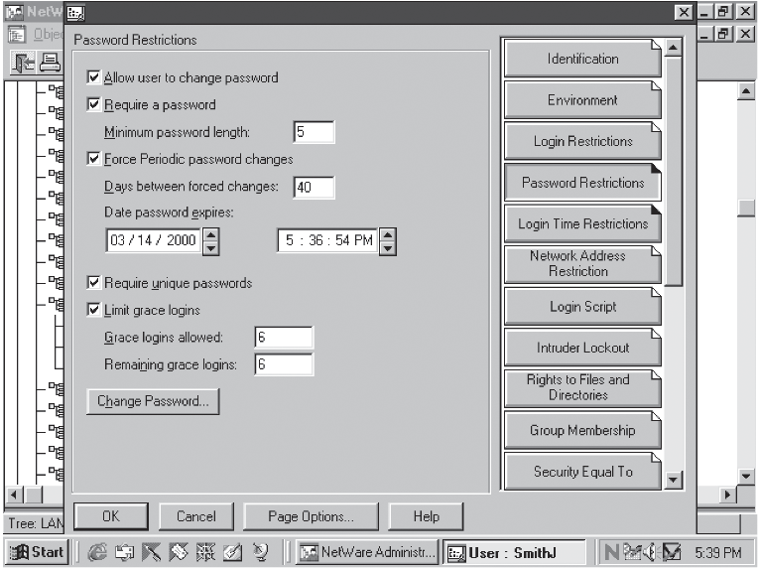

Slide 10
Access Rights
Two basic questions to access right: who and how?
Who do you give access right to? No one, group of users, entire set of users?
How does a user or group of users have access? Read, write, delete, print, copy, execute?
Most network operating systems have a powerful system for assigning access rights

Slide 11
Auditing
Creating a computer or paper audit can help detect wrongdoing
Auditing can also be used as a deterrent
Many network operating systems allow the administrator to audit most types of transactions
Many types of criminals have been caught because of computer-based audits

Slide 12
Encryption and Decryption
Cryptography is the study of creating and using encryption and decryption techniques.
Plaintext is the data before any encryption has been performed.
Ciphertext is the data after encryption has been performed.
The key is the unique piece of information that is used to create ciphertext and decrypt the ciphertext back into plaintext.
  Monoalphabetic Substitution-based Ciphers
  Polyalphabetic Substitution-based Ciphers
  Transposition-based Ciphers

Slide 13
Public Key Cryptography
Very powerful encryption technique in which two keys are used:
  First key (public key) encrypts message
  Second key (private key) decrypts message
Not possible to deduce one key from the other
Not possible to break the code given to the public key
If you want someone to send you secure data, give them your public key, you keep the private key
Secure sockets layer on Internet is a common example of public key cryptography

Slide 14
Encryption Standards
Data Encryption Standard (DES)
  Take a 64-bit block of data and subjected it to 16 levels of encryption
  The choice of encryption performed at each of the 16 levels depends on the 56-bit key applied
Triple-DES
  Data encrypted using DES three times: the first time by the first key, the second time by a second key, and the third time by the first key again. (Can also have 3 unique keys.)
  CPU intensive
Advanced Encryption Standard (AES)
  Selected by the U.S. government to replace DES
  National Institute of Standards and Technology selected the algorithm Rijndael (pronounced rain-doll) in October 2000 as the basis for AES
  More elegant mathematical formulas, requires only one pass, and was designed to be fast, unbreakable, and able to support even the smallest computing device

Slide 15
Digital Signatures
Document to be signed is sent through a complex mathematical computation that generates a hash
Hash is encoded with the owner’s private key
To prove future ownership, hash is:
  Decoded using owner’s public key
  Compared with a current hash of the document
If the two hashes agree, the document belongs to the owner
U.S. has just approved legislation to accept digitally signed documents as legal proof

Slide 16
Public Key Infrastructure (I)
Combination of encryption techniques, software, and services that involves all the necessary pieces to support digital certificates, certificate authorities, and public key generation, storage, and management
A digital certificate is an electronic document that establishes your credentials when you are performing transactions
A digital certificate contains your name, serial number, expiration dates, copy of your public key, and digital signature of certificate-issuing authority
Certificates are usually kept in a registry so other users may check them for authenticity
Certificates are issued by a certificate authority (CA). A CA is either specialized software on a company network or a trusted third party

Slide 17
Public Key Infrastructure (II)
Let’s say you want to order something over the Internet
  The web site wants to make sure you are legit, so the web server requests your browser to sign the order with your private key (obtained from your certificate)
  The web server then requests your certificate from the third party CA, validates that certificate by verifying third party’s signature, then uses that certificate to validate the signature on your order
  The user can do the same procedure to make sure the web server is not a bogus operation
A certificate revocation list is used to “deactivate” a user’s certificate
Applications that could benefit from PKI:
  World Wide Web transactions
  Virtual private networks
  Electronic mail
  Client-server applications
  Banking transactions

Slide 18
Steganography
The art and science of hiding information inside other, seemingly ordinary messages or documents
Unlike sending an encrypted message, you do not know when steganography is hiding a secret message within a document
Examples include creating a watermark over an image or taking “random” pixels from an image and replacing them with the hidden data

Slide 19
Viruses
There are many different types of viruses, such as parasitic, boot sector, stealth, polymorphic, and macro.
  A Trojan Horse virus is a destructive piece of code that hides inside a harmless looking piece of code.
  Sending an e-mail with a destructive attachment is a form of a Trojan Horse virus.
Guarding against viruses
  Signature-based scanners look for particular virus patterns or signatures and alert the user.
  Terminate-and-stay-resident programs run in the background constantly watching for viruses and their actions.
  Multi-level generic scanning is a combination of antivirus techniques including intelligent checksum analysis and expert system analysis
  Update OS (Windows) patches & virus definitions file

Slide 20
Firewalls
A system or combination of systems that supports an access control policy between two networks
A firewall can limit the types of transactions that enter a system, as well as the types of transactions that leave a system
Firewalls can be programmed to stop certain types or ranges of IP addresses, as well as certain types of TCP port numbers (applications)
Packet filter: firewall that is essentially a router and has been programmed to filter out or allow to pass certain IP addresses or TCP port numbers
Proxy server: more advanced firewall that acts as a doorman into a corporate network
  Any external transaction that requests something from the corporate network must enter through the proxy server
  More advanced but make external access slower

Slide 21
Wireless Security
How do you make a wireless LAN secure?
WEP (Wired Equivalency Protocol) was the first security protocol used with wireless LANs
  It had weak 40-bit static keys and was too easy to break
WPA (Wi-Fi Protected Access) replaced WEP.
  Major improvement including dynamic key encryption and mutual authentication for wireless clients
Both of these should eventually give way to a new protocol created by the IEEE - IEEE 802.11i
802.11i allows the keys, the encryption algorithms, and negotiation to be dynamically assigned
Also, AES encryption based on the Rijndael algorithm with 128-, 192-, or 256-bit keys is incorporated

Slide 22
Security Policy Design Issues
What is the company’s desired level of security?
How much money is the company willing to invest in security?
If the company is serious about restricting access through an Internet link, what about restricting access through all other entry ways?
Company must have a well-designed security policy

