Slide 1
Chapter 14
Network Design and Management

Slide 2
Learning Objectives (I)
Recognize the systems development life cycle, and define each of its phases
Explain the importance of creating one or more connectivity maps
Outline the differences among technical, financial, operational, and time feasibility
Create a cost-benefit analysis incorporating the time value of money
Explain why performing capacity planning and traffic analysis is difficult
Describe the steps involved in performing a baseline study

Slide 3
Learning Objectives (II)
Discuss the importance of a network administrator and the skills required for that position
Calculate component and system reliability and availability
Recognize the basic hardware and software network diagnostic tools
Describe the importance of a help desk with respect to managing network operations
List the main features of the Simple Network Management Protocol (SNMP), and distinguish between a manager and an agent
Describe the use of the Remote Network Monitoring (RMON) protocol and its relationship to SNMP

Slide 4
SDLC
SDLC involves several phases. These phases are often:
  Planning
    Identify problems, opportunities, and objectives.
  Analysis
    Determine information requirements.
  Design
    Design the system that was recommended and approved at the end of the analysis phase.
  Implementation
    The system is installed and preparations are made to move from the old system to the new system.
  Maintenance
    The longest phase, involves the ongoing maintenance of the project.

Slide 5
Network Modeling
When updating or creating a new computer system, the analyst will create a set of models for both the existing system (if there is one) and the proposed system
Network models can either demonstrate the current state of the network or can model the desired computer network
A series of connectivity maps are network modeling tools that depict the various locations involved over a wide and local areas and the interconnections between those locations
Wide area connectivity map shows the big picture of geographic locations of network facilities
External users and mobile users can be identified, as well as the locations primary to a business

Slide 6
Network Modeling
To identify each connection between sites:
  d = distance of the connection (usually shown in either miles or kilometers)
  s = security level (high, medium, low, or none)
  du = duplexity (full duplex, half duplex, or simplex)
  dr = data rate desired (in bps)
  l = latency, or acceptable delay time across the network (usually in milliseconds, or ms)
  QoS = Quality of Service (CBR - constant bit rate, VBR - variable bit rate, ABR - available bit rate, UBR - unreliable bit rate, or none)

Slide 7
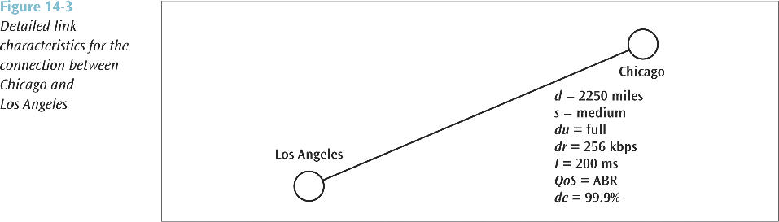
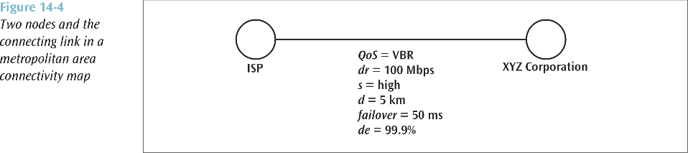
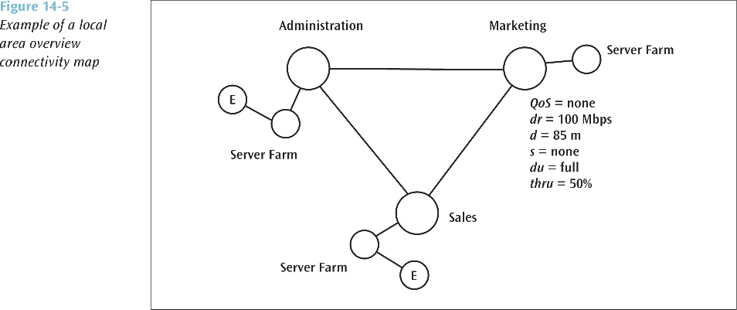

Slide 8
Feasibility Studies
There are a number of ways to determine if a proposed system is going to be feasible:
  Technically feasible: proposed system can be created and implemented using currently existing technology
  Financially feasible: proposed system can be built given the company’s current financial ability
  Operationally feasible: system operates as designed and implemented
  Time feasible: system can be constructed in an agreed upon time frame
Payback analysis: good technique to use to determine financial feasibility
  To calculate, you must know all expenses that will be incurred to create and maintain the system, as well as all possible income derived from the system
You must also be aware of the time value of money (a dollar today is worth more than one dollar promised a year from now because the dollar can be invested)

Slide 9
Capacity Planning
Capacity planning involves trying to determine the amount of network bandwidth necessary to support an application or a set of applications
A number of techniques exist for performing capacity planning, including linear projection, computer simulation, benchmarking, and analytical modeling
Techniques for performing capacity planning
  Linear projection involves predicting one or more network capacities based on the current network parameters and multiplying by some constant
  Computer simulation involves modeling an existing system or proposed system using a computer-based simulation tool
  Benchmarking involves generating system statistics under a controlled environment and then comparing those statistics against known measurements
  Analytical modeling involves the creation of mathematical equations to calculate various network values

Slide 10
Creating a Baseline
Collect information on number and type of system nodes, including workstations, routers, bridges, switches, hubs, and servers
Create an up-to-date roadmap of all nodes along with model numbers, serial numbers and any address information such as IP or Ethernet addresses
Collect information on operational protocols used throughout the system
List all network applications, including the number, type and utilization level
Create a fairly extensive list of statistics: average network utilization, peak network utilization, average frame size, peak frame size, average frames per second, peak frames per second, total network collisions, network collisions per second, total runts, total jabbers, total CRC errors, and nodes with highest percentage of utilization.

Slide 11
Network Administrator Skills
Computer skills
People skills
Management skills
Financial planning skills
Knowledge of statistics
Speaking and writing skills

Slide 12
Useable Statistics
Properly generated statistics can be an invaluable aid to demonstrating current system demands and predicting future needs.
  Mean time between failures (MTBF) is the average time a device or system will operate before it fails.
  Mean time to repair (MTTR) is the average time necessary to repair a failure within the computer system.
  Availability is the probability that a particular component or system will be available during a fixed time period.
  Reliability is the probability that a particular component or system will be operational for the duration of a transmission.

Slide 13
Managing Operations
Simple Network Management Protocol (SNMP) is an industry standard designed to manage network components from a remote location
  Currently in version 3, SNMP supports agents, managers, and the Management Information Base (MIB)
  A managed element has management software, called an agent, running in it.
  A second object, the SNMP manager, controls the operations of a managed element and maintains a database of information about all managed elements
  A manager can query an agent to return current operating values, or can instruct an agent to perform a particular action
  The Management Information Base (MIB) is a collection of information that is organized hierarchically and describes the operating parameters of all managed agents

Slide 14
Network Diagnostic Tools
To assist a network support person, a number of diagnostic tools are available:
  Electrical testers
  Cable testers
  Network testers
  Protocol analyzers

