Slide 1
Chapter 2
Fundamentals of
Data and Signals

Slide 2
Learning Objectives (I)
Distinguish between data and signals
Cite the advantages of digital data and signals over analog data and signals
Identify the three basic components of a signal
Discuss the bandwidth of a signal and how it relates to data transfer speed
Identify signal strength and attenuation and how they are related
Outline the basic characteristics of transmitting digital data with digital signals, analog data with digital signals, digital data with analog signals, and analog data with analog signals

Slide 3
Learning Objectives (II)
List and draw diagrams of the basic digital encoding techniques, including the advantages and disadvantages of each Identify the different modulation techniques and describe their advantages, disadvantages, and uses
Identify the different modulation techniques and describe their advantages, disadvantages, and uses
Identify the two most common digitization techniques and describe their advantages and disadvantages
Discuss the characteristics and importance of spread spectrum encoding techniques
Identify the different data codes and how they are used in communication systems

Slide 4
Introduction
Data are entities that convey meaning
Signals are the electric or electromagnetic encoding of data
Computer networks and data/voice communication systems transmit signals
Data and signals can be analog or digital

Slide 5
Why are we interested?
Layer 1 of the OSI model is all about the physical transmission of signals over media
Point-to-point transmission of data across nodes:
  Specifies the type of connection and the signals that pass through it
  Signals can be analog or digital, broadband or baseband
  The capacity (throughput) of the network depends on the type of cabling used

Slide 6
Waveforms
Analog
Digital
0
Time
Time
1

Slide 7
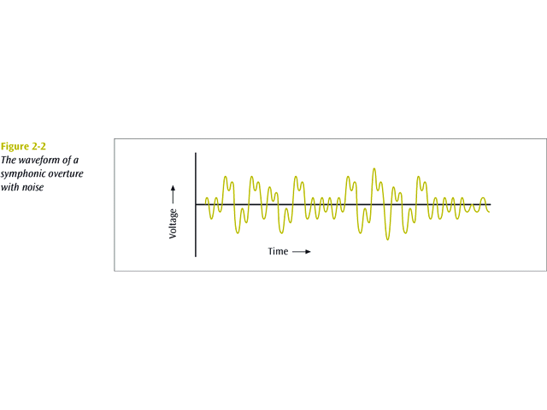
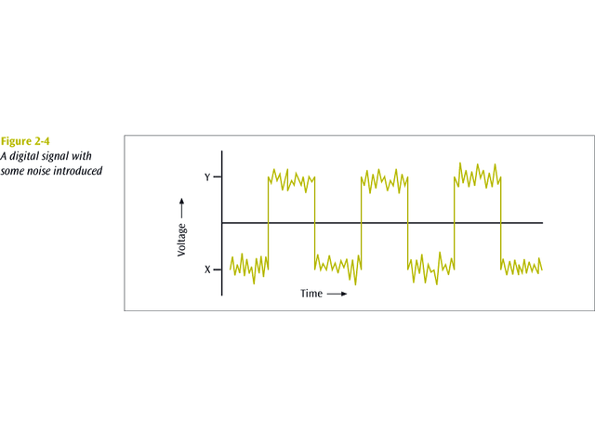
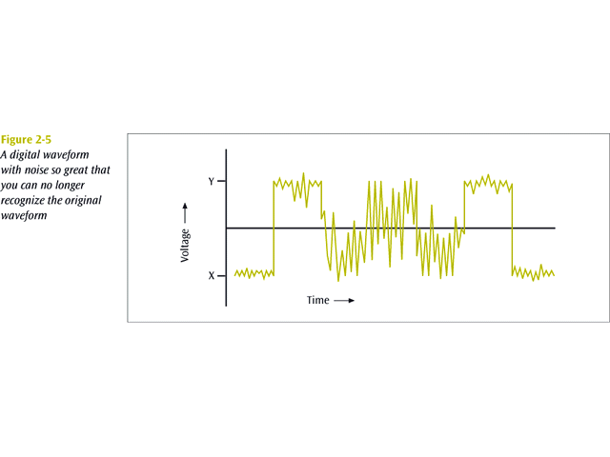
Noises

Slide 8
Wave properties
Amplitude:
  The “height” of the wave above (or below) a central point, often measured in volts (V)
Frequency:
  The number of waves that pass a given point per second, measured in Hertz (Hz)
Wavelength:
  The distance from the start to the end of the wave, measured in meters (m)
Phase:
  Position of the waveform at a given time, measured in degrees of shift (o)

Slide 9
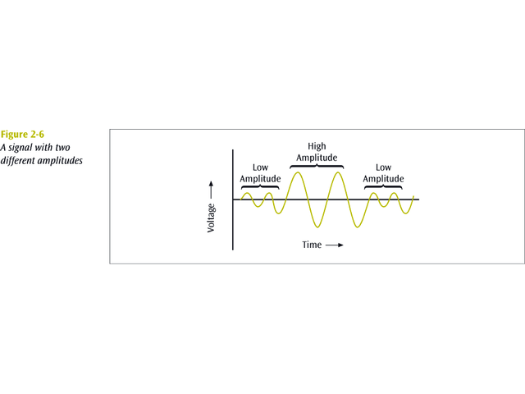
Amplitude

Slide 10
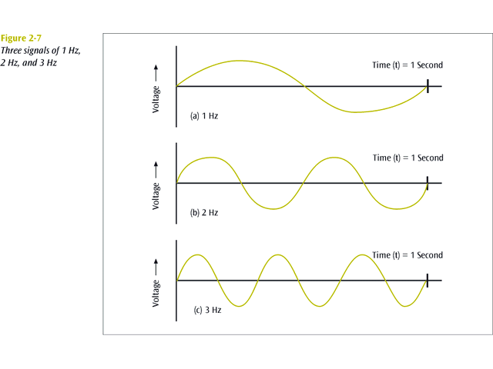
Frequency (I)

Slide 11
Frequency (II)
The frequency is the number of times a signal makes a complete cycle within a given time frame.
Spectrum - The range of frequencies that a signal spans from minimum to maximum.
Bandwidth - The absolute value of the difference between the lowest and highest frequencies of a signal.

Slide 12
Frequency (III)
For example, consider an average voice:
  The average voice has a frequency range of roughly 300 Hz to 3100 Hz.
  The spectrum would thus be 300 - 3100 Hz
  The bandwidth would be 2800 Hz

Slide 13
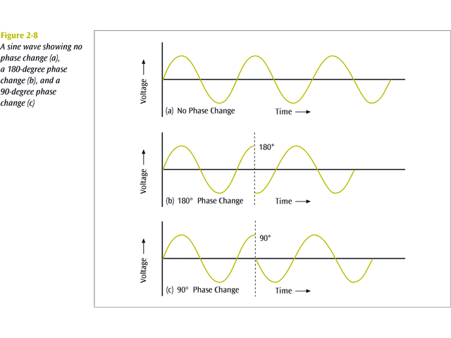
Phase (I)

Slide 14
Phase (II)
The phase of a signal is the position of the waveform relative to a given moment of time or relative to time zero.
A change in phase can be any number of angles between 0 and 360 degrees.
Phase changes often occur on common angles, such as 45, 90, 135, etc.

Slide 15
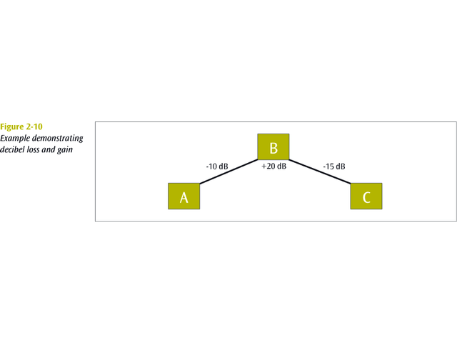
Signal Strength
All signals experience loss (attenuation).
Attenuation is denoted as a decibel (dB) loss.
Decibel losses (and gains) are additive.

Slide 16
Data to Signal
Signal
Digital
Analog
NRZ-L
NRZ-I
Manchester
Differential Manchester
Bipolar-AMI
Amplitude modulation
Frequency modulation
Phase modulation
Digital
Spread spectrum technology
Data
Pulse code modulation
Delta modulation
Analog
Modulate data onto different frequencies

Slide 17
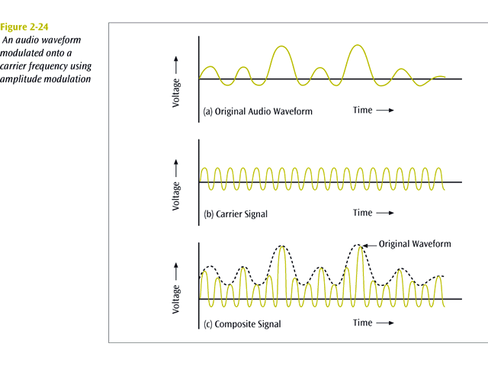
Analog data-analog signals

Slide 18
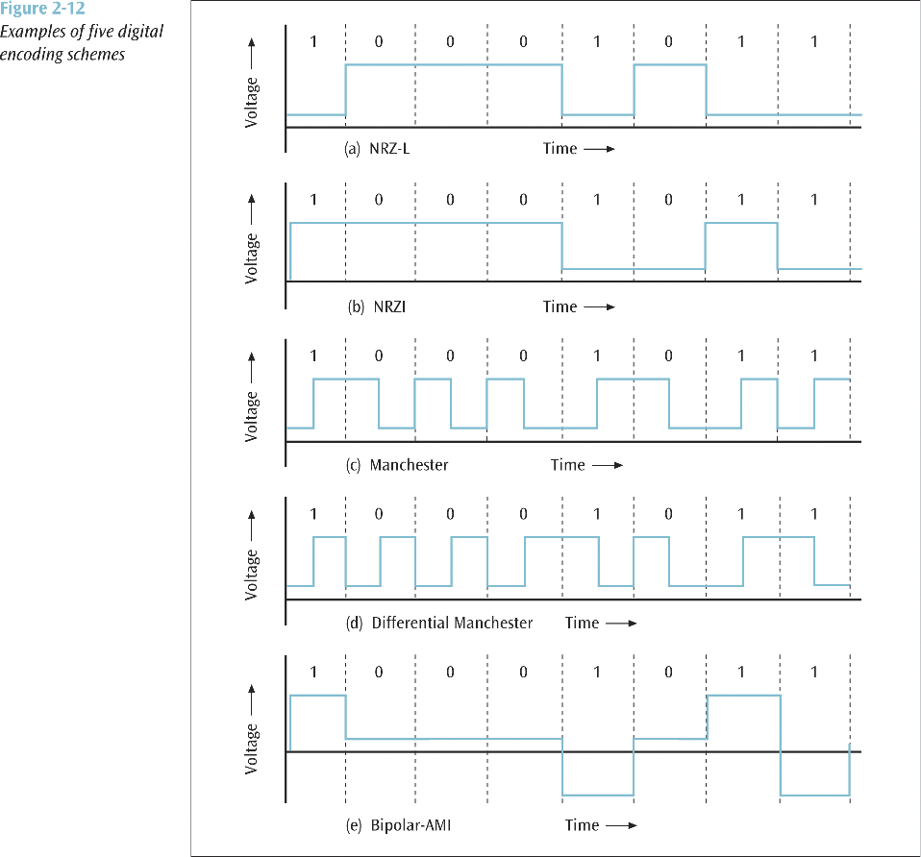

Slide 19
NRZ-L
Digital 1s are represented as one voltage (amplitude), while digital 0s are represented as another:
  Cheap to implement
  Check for voltage of each bit
  A long series of 1s or 0s produces a flat, unchanging voltage level (produces synchronization problems)

Slide 20
NRZI
Digital 1s are represented by a voltage change (high-to-low, or low-to-high), while 0s are represented as a continuation of the same voltage level:
  Even cheaper to implement (only check for changes)
  A long series of 0s produces a flat, unchanging voltage level

Slide 21
Manchester encoding
Digital 1s are represented by a midway voltage change from low to high, while 0s are represented as midway voltage changes from high to low
  Hardware has to work twice as fast to detect changes
  Baud rate (number of signal changes) is twice bits per second rate

Slide 22
Differential Manchester
Digital 0s are represented by a voltage change (high-to-low, or low-to-high) at the beginning of the bit as well as a midway voltage change, while 1s are represented as a continuation of the same voltage level at the beginning, followed by a midway voltage change

Slide 23
Bipolar-AMI
Three voltage level
  0 transmitted as 0 voltage
  1 transmitted as either +1 or –1 voltage
    Alternating between the two
Disadvantages
  Long string of 0s
  Hardware capable to recognize + & - voltages

Slide 24
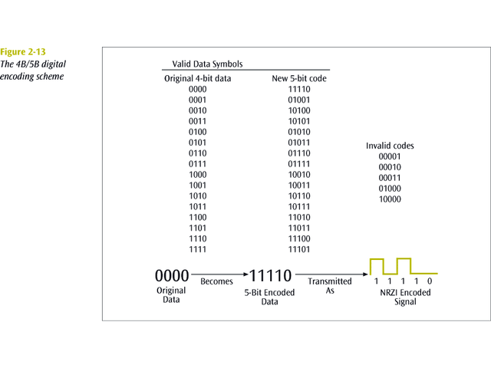
4B/5B Digital Encoding
Encoding technique that converts four bits of data into five-bit quantities.
  The five-bit quantities are unique in that no five-bit code has more than 2 consecutive zeroes.
  The five-bit code is then transmitted using an NRZ-I encoded signal.

Slide 25
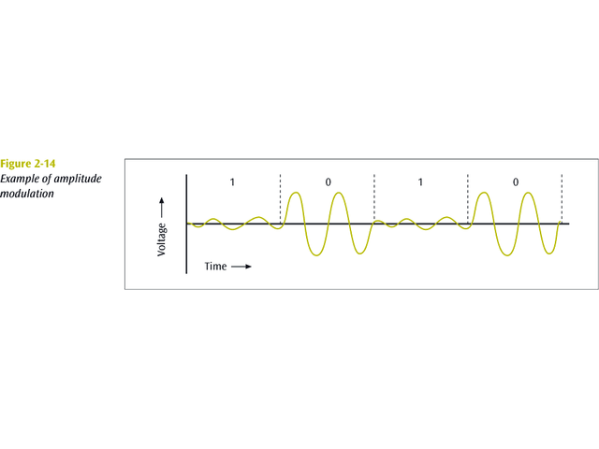
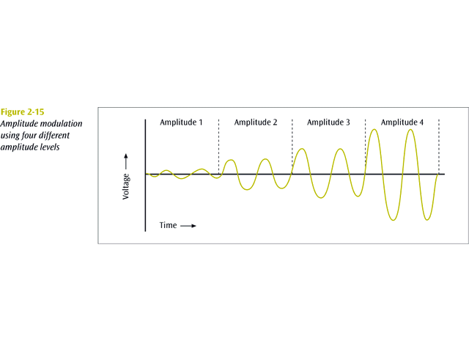
Amplitude Shift Keying
One amplitude encodes a 0 while another amplitude encodes a 1 (amplitude modulation).

Slide 26
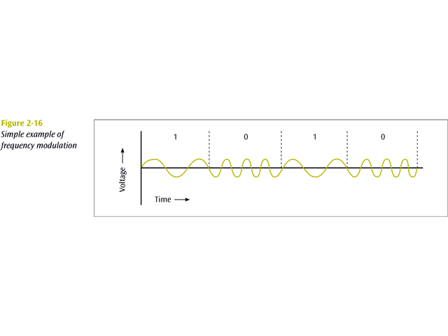
Frequency Shift Keying
One frequency encodes a 0 while another frequency encodes a 1 (frequency modulation).

Slide 27
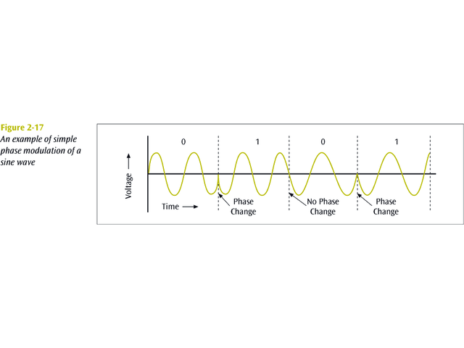
Phase Shift Keying
One phase change encodes a 0 while another phase change encodes a 1 (phase modulation).

Slide 28
Quadrature phase modulation
Four different phase angles are used, namely:
  45 degrees
  135 degrees
  225 degrees
  315 degrees

Slide 29
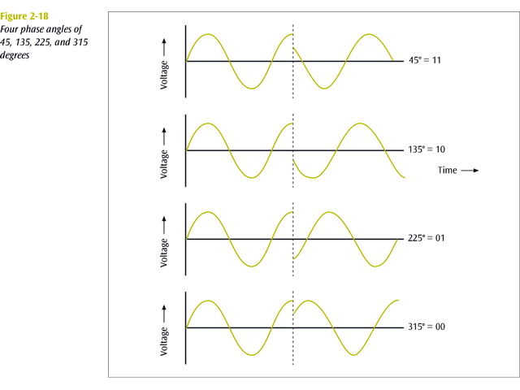

Slide 30
Quadrature Amplitude Modulation
In this technology, 12 different phases are combined with two different amplitudes.
Since only 4 phase angles have 2 different amplitudes, there are a total of 16 combinations.
With 16 signal combinations, each baud equals 4 bits of information.

Slide 31
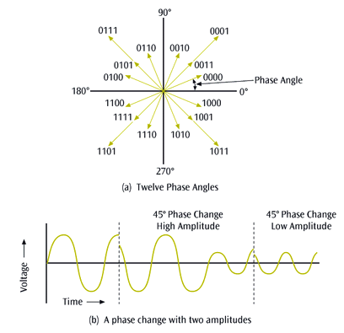

Slide 32
How do you send more data
Manipulate one or more of the main four properties (amplitude, frequency, wavelength, or phase) to denote multiple bits
  The most common (because it’s cheaper) is amplitude, or frequency
Shannon’s Law allows you to calculate the maximum data transfer rate (p56):
  S(f) = f . log2(1 + W / N) bps

Slide 33
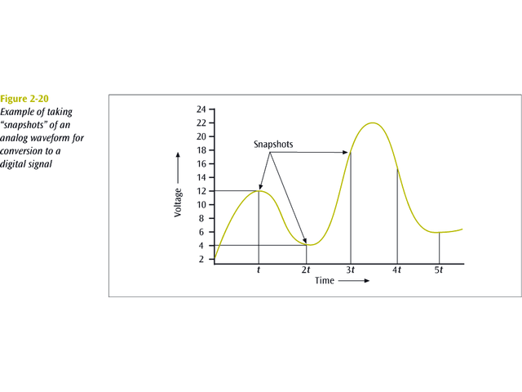
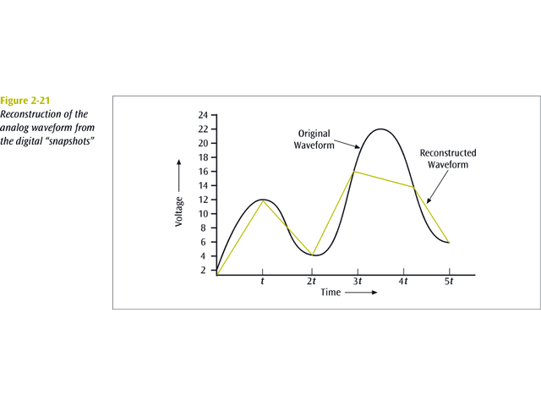
Pulse Code Modulation (I)
The analog waveform is sampled at specific intervals and the “snapshots” are converted to binary values.
Used by telephone systems.

Slide 34
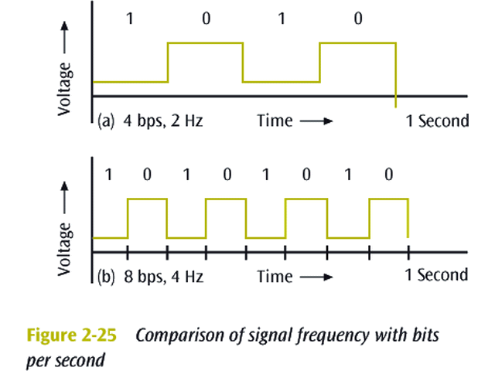
Pulse Code Modulation (II)
How fast do you have to sample an input source to get a fairly accurate representation?
  Nyquist says 2 x bandwidth
  Thus, to digitize the human voice (4000 Hz), you need to sample at 8000 sample per second

Slide 35
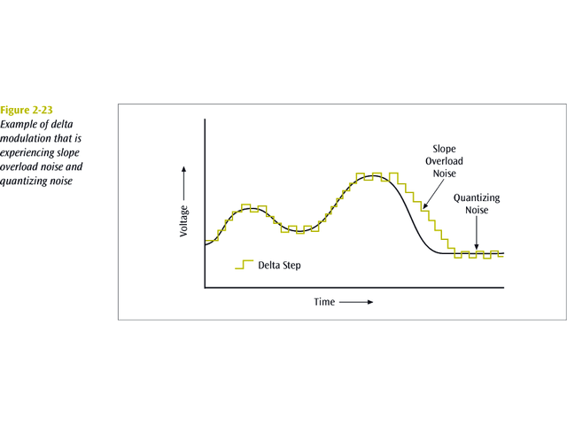
Delta Modulation
An analog waveform is tracked, using a binary 1 to represent a rise in voltage, and a 0 to represent a drop.

Slide 36
Spread Spectrum Technology
A secure encoding technique that uses multiple frequencies or codes to transmit data.
Two basic spread spectrum technologies:
  Frequency hopping spread spectrum
  Direct sequence spread spectrum

Slide 37
Data Codes
The set of all textual characters or symbols and their corresponding binary patterns is called a data code.
There are two basic data code sets plus a third code set that has interesting characteristics:
  EBCDIC
  ASCII
  Unicode

