Slide 1
Chapter 3
The Media: Conducted and Wireless

Slide 2
Learning Objectives (I)
Outline the characteristics of twisted pair wire, including the advantages and disadvantages
Outline the differences among Category 1, 2, 3, 4, 5, 5e, 6, and 7 twisted pair wire
Explain when shielded twisted pair wire works better than unshielded twisted pair wire
Outline the characteristics, advantages, and disadvantages of coaxial cable and fiber-optic cable
Outline the characteristics of satellite microwave systems, including the advantages and disadvantages as well as the differences among low-Earth-orbit, middle-Earth-orbit, geosynchronous orbit, and highly elliptical Earth orbit satellites

Slide 3
Learning Objectives (II)
Describe the basics of cellular telephones, including all the current generations of cellular systems
Outline the characteristics of short-range transmissions, including Bluetooth
Describe the characteristics, advantages, and disadvantages of Wireless Application Protocol (WAP), broadband wireless systems, and various wireless local area network transmission techniques
Apply the media selection criteria of cost, speed, right-of-way, distance and expandability, environment, and security to various media in a particular application

Slide 4
Media
The world of computer networks and data communications would not exist if there were no medium by which to transfer data
The “media” is the substance through which the signal passes
The two major categories of media are:
  Conducted (guided) media
    The message flows through a physical media
  Wireless (unguided) media
    The message is broadcast through space

Slide 5
Conducted media
Twisted pair wire (UTP):
  Insulated pairs of wires, twisted to minimize electromagnetic interference between wires
Coaxial cable:
  Wire with a copper core and an outer cylindrical shell for insulation
Fiber optic cable:
  High speed streams of light pulses from lasers or LEDs carried inside hair-thin strands of glass or plastic

Slide 6
Twisted Pair Wire
Two or more pairs of single conductor wires that have been twisted around each other.
Twisted pair wire is classified by category
  Category 1 through Category 7
    NOTE: Categories 2 and 4 are obsolete
Twisting the wires helps to eliminate electromagnetic interference between the two wires.
Shielding can further help to eliminate interference.

Slide 7
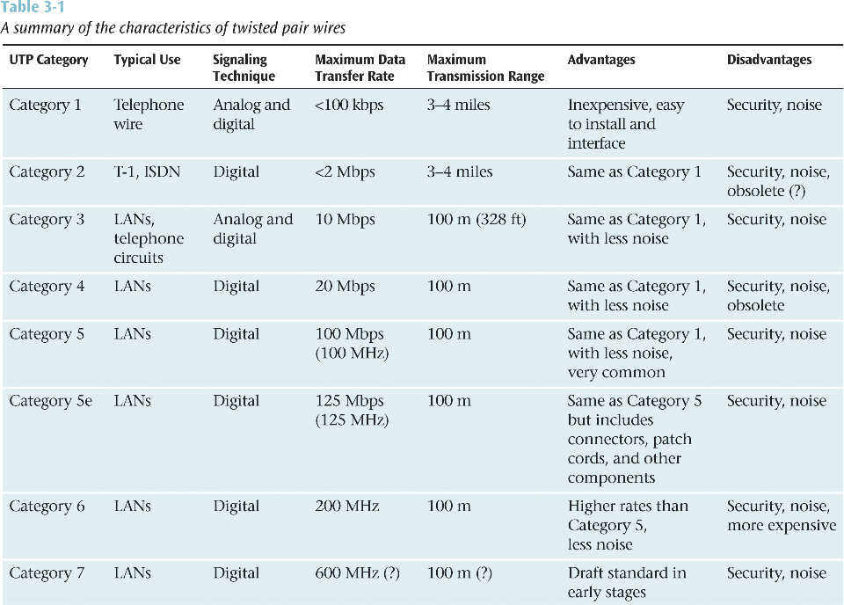

Slide 8
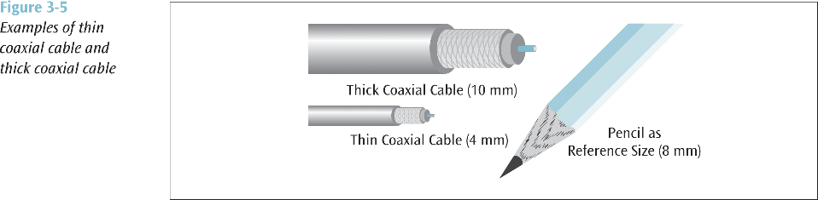
Coaxial Cable
A single wire wrapped in a foam insulation surrounded by a braided metal shield, then covered in a plastic jacket. Cable can be thick or thin.
  Baseband coaxial technology uses digital signaling (DC) in which the cable carries only one channel of digital data.
  Broadband coaxial technology transmits analog signals (RF) and is capable of supporting multiple channels of data.

Slide 9
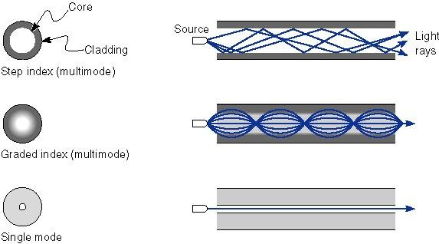
Fiber Optic Cable
A thin glass cable approximately a little thicker than a human hair surrounded by a plastic coating and packaged into an insulated cable.
A photo diode or laser generates pulses of light which travel down the fiber optic cable and are received by a photo receptor.

Slide 10
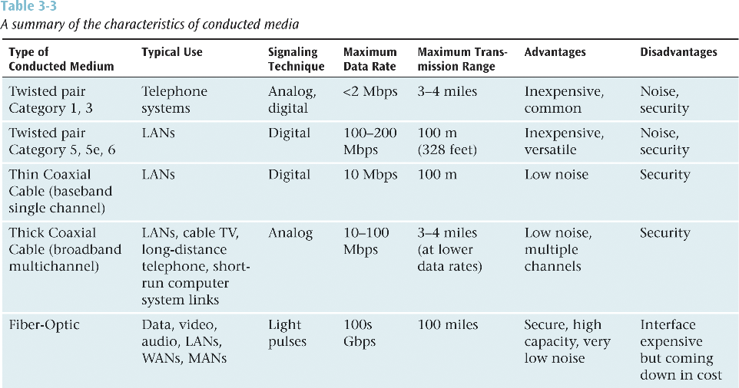

Slide 11
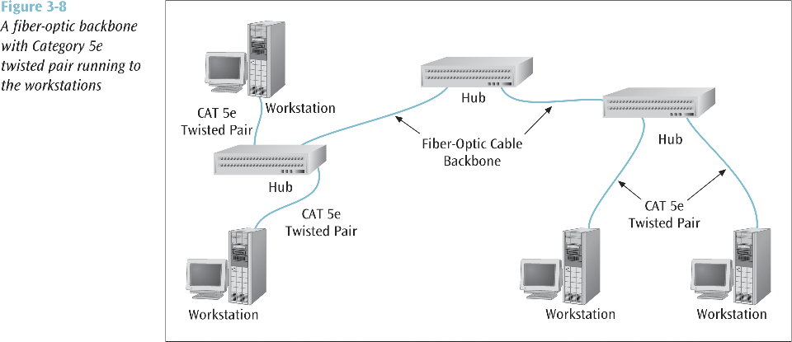
Mixing Media

Slide 12
Wireless Media
Radio, satellite transmissions, and infrared light are all different forms of electromagnetic waves used to transmit data
Radio:
  Uses same basic principles of standard radio transmission
Microwave:
  Extremely high frequency radio communication beam transmitted on direct line-of-sight path
Infrared:
  Low frequency light waves carry data through the air on direct line-of-sight path

Slide 13
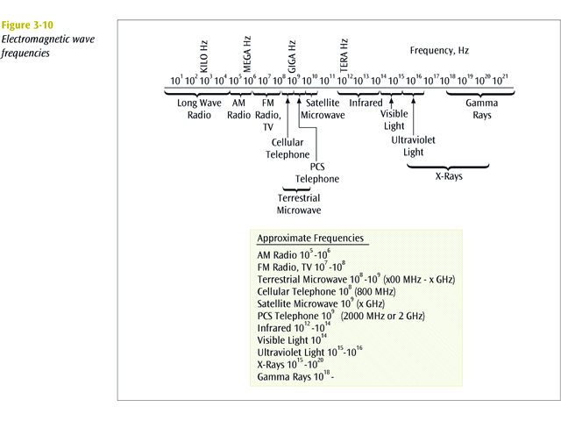

Slide 14
Terrestrial microwave
Land-based line-of-sight transmission
  Max. 20-30 miles between towers
  Transmits data at 100s of millions of bits per second (100Mbps+)
  Popular with telephone companies and business-to-business transactions

Slide 15
Satellite microwave
Similar to terrestrial microwave, except signals are stronger, and traverse from a ground station to an orbiting satellite:
Satellites can be classified by how far out into orbit each one is (LEO, MEO, GEO, and HEO)

Slide 16
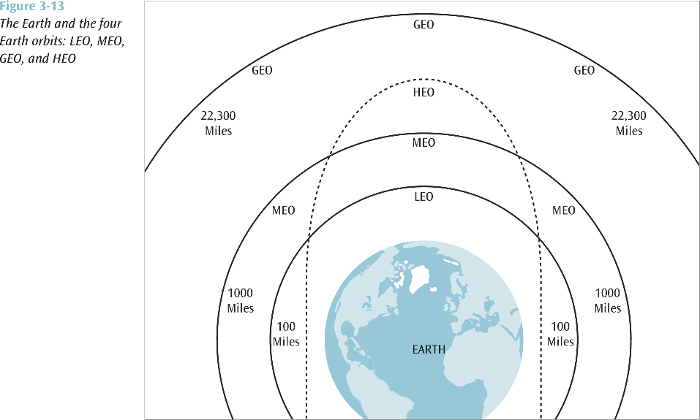

Slide 17
Uses
LEO (Low Earth Orbit) - 100 miles to 1000 miles
  Used for pagers, wireless e-mail, special mobile telephones, spying, videoconferencing
MEO (Middle Earth Orbit) - 1000 to 22,300 miles
  Used for GPS (global positioning systems) and government
GEO (Geosynchronous Orbit) - 22,300 miles
  Always over the same position on earth (usually over the equator)
  Used for weather, television, and government operations
HEO (Highly Elliptical Orbit)
  Used by the military for spying and by scientific organizations for photographing celestial bodies
  When satellite is far out into space, it takes photos
  When satellite is close to earth, it transmits data

Slide 18
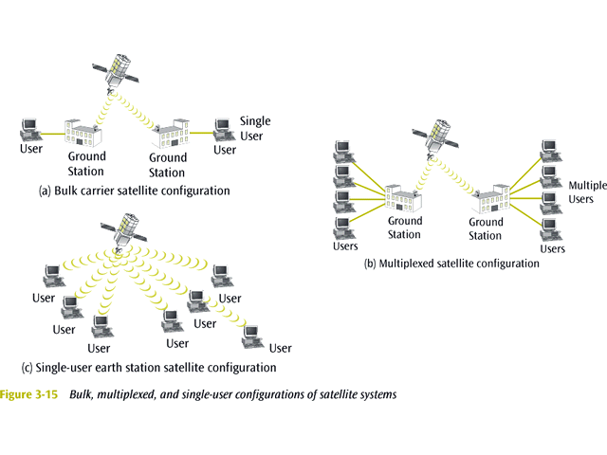
Satellite Microwave
Satellite microwave can also be classified by its configuration:
  Bulk carrier configuration
  Multiplexed configuration
  Single-user earth station configuration (e.g. VSAT)

Slide 19
Cellular Telephones
Wireless telephone service
  Also called mobile telephone, cell phone, and PCS
To support multiple users in a metropolitan area (market), the market is broken into cells
Each cell has its own transmission tower and set of assignable channels

Slide 20
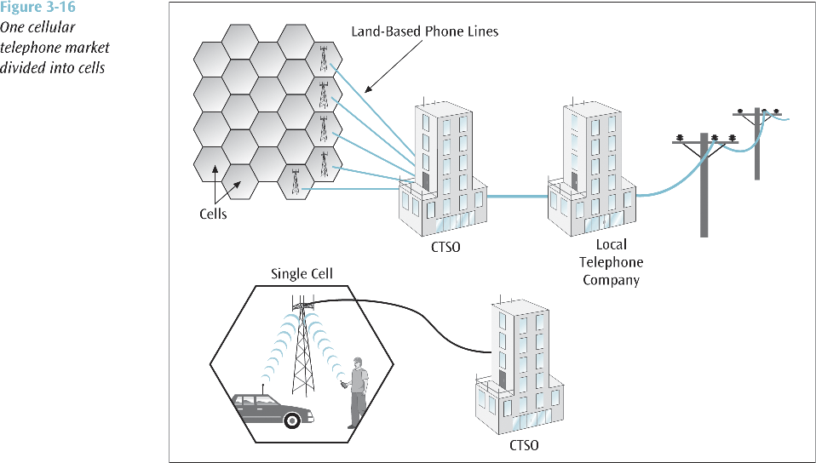

Slide 21
Types of service (I)
1st Generation
AMPS (Advanced Mobile Phone Service) - first popular mobile phone service
  Uses analog signals and dynamically assigned frequency division multiplexing
D-AMPS (Digital Advanced Mobile Phone Service) - applies digital time division multiplexing on top of AMPS
2nd Generation
PCS (Personal Communication Systems) - all-digital mobile phone service
2nd generation PCS phones came in three technologies:
  TDMA - Time division multiple access
  CDMA - Code division multiple access
  GSM - Global system for mobile communications

Slide 22
Types of service (II)
2.5 Generation
GPRS (General Packet Radio Service) – now used by AT&T Wireless, Cingular Wireless, and T-Mobile (formerly VoiceStream) in their GSM networks
  Can transmit data at 30 kbps to 40 kbps
CDMA2000 1xRTT (one carrier radio - transmission technology) – used by Verizon Wireless, Alltel, U.S. Cellular, and Sprint PCS
  50 kbps to 75 kbps
IDEN technology – used by Nextel
Future
GPRS should eventually be replaced with EDGE 110
  130 kbps possibly followed by WCDMA at 200 kbps – 300 kbps
1xRTT should eventually be replaced with 1xEVDO at 300 – 400 kbps and 1xEVDV at 150 Kbps to 250 kbps

Slide 23
Cellular Digital Packet Data
Technology that supports a wireless connection for the transfer of computer data from a mobile location to public telephone network and the Internet
  Can be used in conjunction with mobile telephones and laptop computers
  All digital transfer
  Relatively slow at 19,200 bps
Emergency services make use of CDPD

Slide 24
Infrared Transmissions
Special transmissions that use a focused ray of light in the infrared frequency range
Very common with remote control devices
Can also be used for device-to-device transfers, such as PDA to computer

Slide 25
WAP
Wireless application protocol allows wireless devices such as mobile telephones, PDAs, pagers, and two-way radios to access the Internet
  Designed to work with small screens and with limited interactive controls
  Incorporates Wireless Markup Language (WML) which is used to specify the format and presentation of text on the screen
WAP may be used for applications such as:
  Travel directions, Sports scores, E-mail, Online address, books, Traffic alerts, Banking, News
Short-comings of WAP include slow speeds, security, and a very small user interface

Slide 26
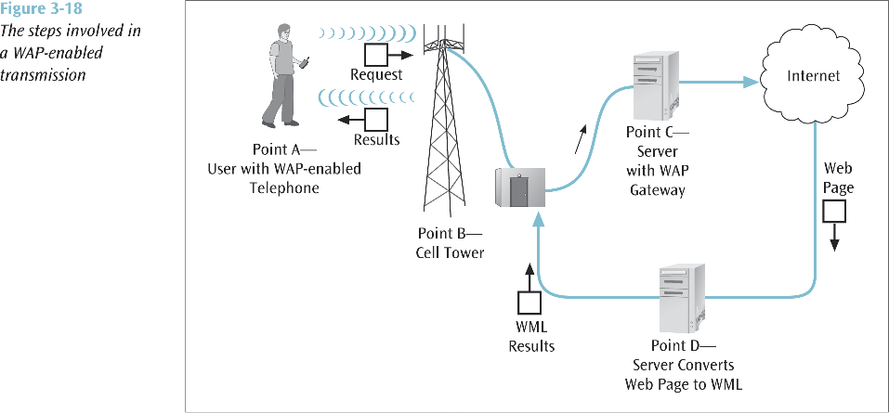

Slide 27
Broadband Wireless Systems
Delivers Internet services into homes and businesses.
Designed to bypass the local loop telephone line.
Transmits voice, data and video over high frequency radio signals.
Two basic technologies:
  Multichannel multipoint distribution service (MMDS) – supports digital data, video, Internet access, millions bps, 2.5 GHz, 30-35 miles
  Local multipoint distribution service (LMDS) – digital data, video, Internet access, millions bps, 28 GHz – 30 GHz, but only a few miles

Slide 28
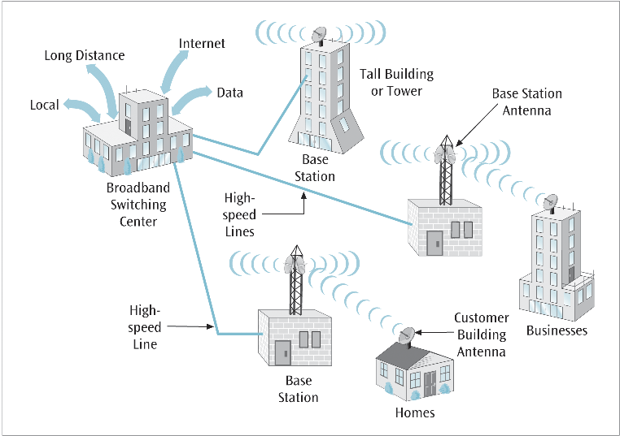

Slide 29
Bluetooth
Radio Frequency specification for short-range, point-to-multipoint voice and data transfer:
  Can transmit through solid, non-metal objects
  Typical link range is from 10 cm to 10 m, but can be extended to 100 m by increasing the power
Will enable users to connect to a wide range of computing and telecommunication devices without the need of connecting cables
Typical uses include phones and pagers, modems, LAN access devices, headsets, notebooks, desktop computers, and PDAs

Slide 30
Wireless LAN (IEEE 802.11)
Transmits data between workstations and local area networks using high speed radio frequencies
  More on this in Chapter 7 (LANs)
    IEEE 802.11 (older 2 Mbps)
    IEEE 802.11b (11 Mbps, 2.4 GHz)
    IEEE 802.11a (54 Mbps, 5 GHz, in 2002)
    IEEE 802.11g (54 Mbps, 2.4 GHz, in 2002)
    HiperLAN/2 (European standard, 54 Mbps in 5 GHz band)

Slide 31
Free Space Optics
Uses lasers, or more economical infrared transmitting devices
Line of sight between buildings
Typically short distances, such as across the street
Newer auto-tracking systems keep lasers aligned when buildings shake from wind and traffic
Current FSO speeds go from T-3 (45 Mbps) up to OC-48 (2.5 Gbps) with faster systems in the lab
Major weakness is fog
Typical FSO has link margin of about 20 dB
Under perfect conditions, air reduces system’s power by approx 1 dB/km
Heavy fog can cause a loss of 400 db/km (rendering 20 dB systems to 50 meters)
Scintillation is also a problem (especially in hot weather)

Slide 32
Ultra-wideband
Not limited to fixed bandwidth
  Broadcasts over wide range of frequencies simultaneously
  Many of these frequencies are used by other sources
  Uses such low power that it “should not” interfere with these other sources
Can achieve speeds up to 100 Mbps (unshared) but for small distances such as wireless LANs
Proponents say UWB gets something for nothing since it shares frequencies with other sources
Opponents say too much interference
Cell phone industry very against UWB because CDMA most susceptible to interference
GPS may also be affected
One solution may be have two types of systems
  Indoor (stronger)
  Outdoor (1/10 the power)

Slide 33
Media Selection Criteria (I)
Cost:
  Initial cost - What does a particular type of medium cost to purchase? To install?
  Maintenance/support cost
  ROI (return on investment) - If one medium is cheaper to purchase and install but is not cost effective, where is the savings?
Speed:
  Propagation speed: time to send first bit across the medium
    Depends upon the medium
    Airwaves and fiber are speed of light
    Copper wire is two thirds the speed of light
  Data transfer speed: the time to transmit the remaining bits in the message
    Measured in bits per second

Slide 34
Media Selection Criteria (II)
Distance and expandability
  Can this choice of medium be expanded easily?
  What is needed to extend the distance? A repeater? An amplifier?
  How much noise is introduced with this expansion?
Environment:
  Is the intended environment electromagnetically noisy? If so, should you use shielding? Or fiber?
  If using wireless, are there other wireless signals that can interfere?
  Will the microwave or free space optics be affected by bad weather?
Security:
  Is the medium going to be carrying secure data? Should you worry about wiretapping?
  Encryption of the signal/data can help, but may not be the perfect solution

