Slide 1
Chapter 4
Making Connections

Slide 2
Learning Objectives (I)
Identify a standard modem and cite its basic operating characteristics
Discuss the advantages of the newer digital modems and recognize why they do not achieve the high transfer speeds as advertised
List the alternatives to traditional modems, including T1 modems, cable modems, IDSN modems, and DSL modems.
Recognize the uses of a modem pool and its advantages and disadvantages
List the four components of all interface standards

Slide 3
Learning Objectives (II)
Discuss the basic operations of the EIA-232F interface standard
Cite the advantages of FireWire, Universal Serial Bus, SCSI, iSCSI, InfiniBand, and Fibre Channel interface standards
Outline the characteristics of asynchronous and synchronous data link interfaces
Recognize the difference between half duplex, full duplex, and simplex connections
Identify the operating characteristics of terminal-to-mainframe connections and why they are unique from other types of computer connections

Slide 4
Introduction
Examine the interface between a computer and a device. This interface occurs at the physical layer:
  Modems (Analog, digital, cable), ISDN, DSL
Interface standards define modes of transmission:
  Serial/parallel
  Simplex/duplex
  Asynchronous/synchronous
  Point-to-point/multi-point

Slide 5
Dial-up Modems
Use combinations of amplitude, frequency, and phase modulation to achieve high data rates
Connection negotiation is the ability of a modem to automatically fall forward or fallback to faster or slower speeds, respectively
Modems can support numerous security features including blacklisting, callback security, and backdoor entry with password protection
Self-testing (loop-back) is the the ability of a modem to test itself and its connection

Slide 6
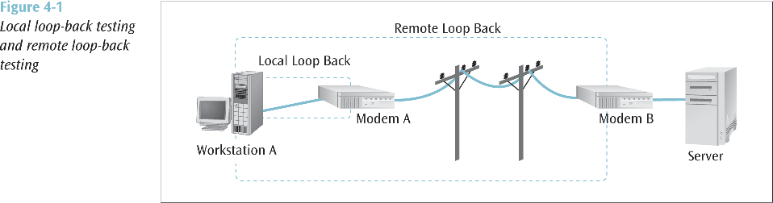

Slide 7
Modem Standards (I)
V.22
  1200-2400 baud/bps
V.32
  9600 bps (2400 baud at QAM)
  V.32bis uses TCM to achieve up to 14.4 Kbps
V.34
  Carries the nickname “V.Fast”
  Uses rates above the 2400 baud, up to 28.8 Kbps
  V.34bis uses TCM to achieve up to 33.6 Kbps

Slide 8
Modem Standards (II)
V.42
  Error correction and data compression capabilities increase throughput
  V.42bis uses Lempel-Ziv encoding and attains 3.5:1 to 4:1
  V.42bis compression can be added to almost any modem standard effectively tripling the data rate, e.g.,
    V.32, 9600 + data compression = 38.4 Kbps
    V.34, 28800 + data compression = 115.6 Kbps

Slide 9
Modem Standards (III)
V.70
  Digital Simultaneous Voice and Data (DSVD) sends data and digitally-encoded voice over an analog line
  Typically uses V.32bis or V.34 modulation up to 33.6 Kbps
V.90
  Uses PCM (V.pcm) for downstream speeds of 56K, although upstream speed is maximum 33.6 Kbps
  Replaces (1998) the competing K56flex and x2 “standards”
V.92
  Newer (2001) standard which allows QuickConnect, Modem On-Hold, and maximum upstream speed of 48 Kbps (under ideal conditions)

Slide 10
The 56k Digital modem
A 56k modem (56,000 bps) achieves this speed through digital signaling as opposed to analog signaling used on all other modems
  A 56k modem would actually achieve 64k except:
    Local loop is still analog, thus analog signaling
    Analog to digital conversion at local modem introduces noise/error
  Combined, these shortcomings drop the speed to at best 56k
A 56k modem does not achieve 56k either
  FCC will not let the modem transmit at power level necessary to support 56k
  Best is approximately 53k
  Actual speeds will be dependent on number of modulations (analog-digital) required, and the presence of noise on the line
  Recent tests found 56K modems to connect at less than 40 Kbps 18% of the time, 40-50 Kbps 80% of the time, and 50+ Kbps only 2 % of the time

Slide 11
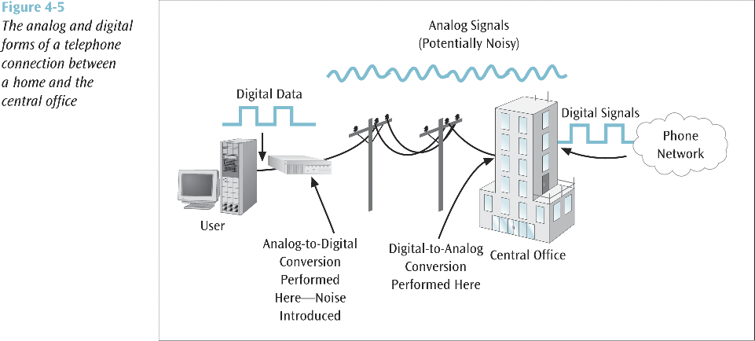

Slide 12
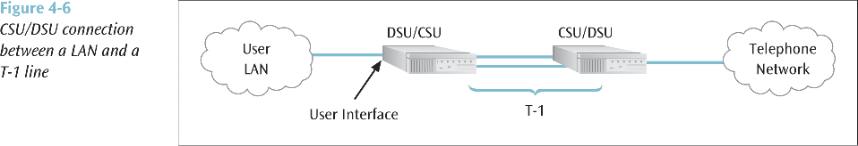
Alternatives: T1
A T-1 line is a digital service offered by telephone companies and can transfer data as fast as 1.544 Mbps (both voice and computer data)
To support a T-1 service, a channel service unit / data service unit (CSU/DSU) is required at the end of the connection

Slide 13
Alternatives: Cable Modem
Cable modems allow high speed access to wide area networks such as the Internet
Most cable modems are external devices that connect to the personal computer through a common Ethernet card
Cable modems can provide data transfer speeds between 500 Kbps and 2.5 Mbps
A few cable modem services require a telephone line for the upstream connection

Slide 14
Alternatives: ISDN and DSL
ISDN modems support ISDN connections. ISDN is an all-digital service capable of supporting data and voice, with data speeds up to 128 Kbps
DSL modems support digital subscriber line service
  Quickly growing in popularity
  Provides high-speed service between homes and Internet service providers

Slide 15
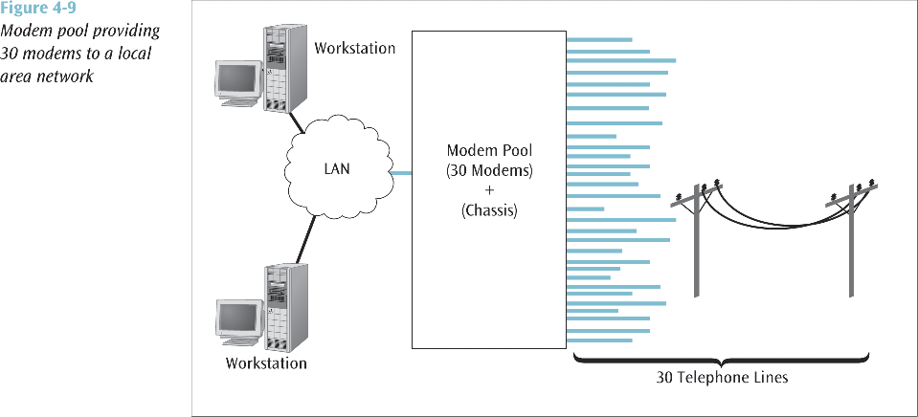
Modem Pools
A relatively inexpensive technique that allows multiple workstations to access a modem without placing a separate modem on each workstation
Modem pools can also be used to allow external users to dial into a business or corporate network via a modem in the modem pool

Slide 16
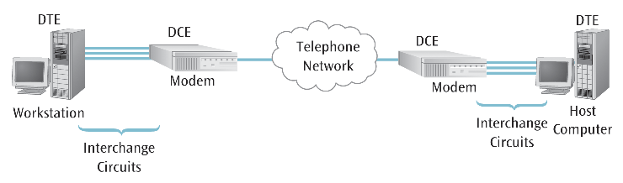
DCEs and DTEs
Communication circuits can be defined in terms of the devices that are designed to transmit signals on a circuit, and the destination
  DCE - Data communicating equipment:
    The device that forwards the signals being sent along a particular circuit, e.g., a Modem
  DTE – Data terminating equipment:
    The device to which the signal is being directed, e.g., a computer

Slide 17
Standards Organizations
International Telecommunications Union (ITU) (formerly CCITT)
Electronics Industries Association (EIA)
Institute for Electrical and Electronics Engineers (IEEE)
International Organization for Standards (ISO)
American National Standards Institute (ANSI)

Slide 18
Interface Standards
Electrical:
  Voltages, line capacitance, and other electrical characteristics
Mechanical:
  Connector or plug description
Functional:
  Function of each pin or circuit that is used in a particular interface
Procedural:
  How the particular circuits are used to perform an operation
    For example, the functional component may describe two circuits, Request to Send and Clear to Send
    The procedural component describes how those two circuits are used so that the DTE can transfer data to the DCE

Slide 19
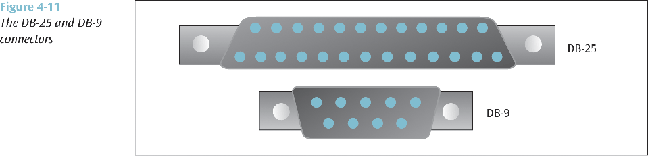
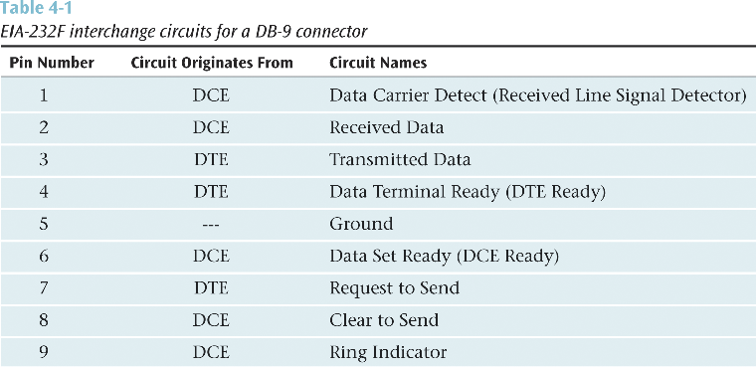

Slide 20
EIA-232F and RS-232
Older interface standard designed to connect a device such as a modem to a computer or terminal
Originally RS-232
  Has gone through many revisions
Electrical component is defined by V.28
Mechanical component is defined by ISO 2110
Functional and procedural components are defined by V.24

Slide 21
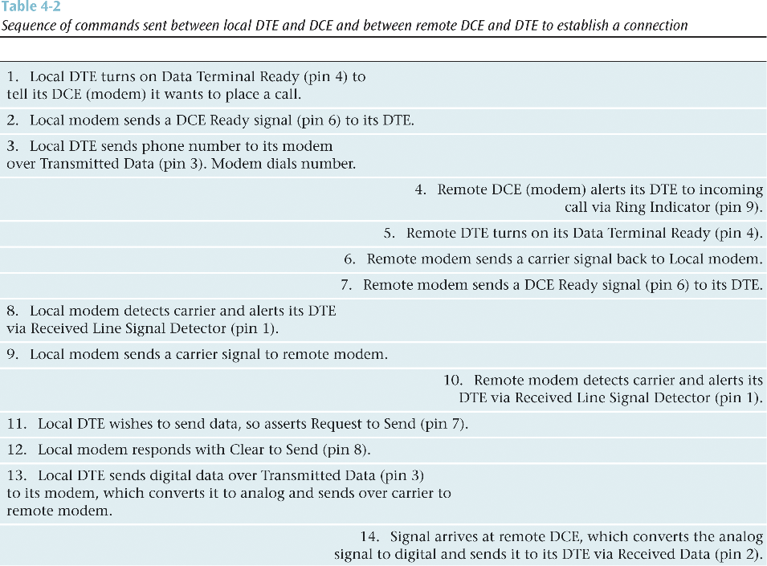

Slide 22
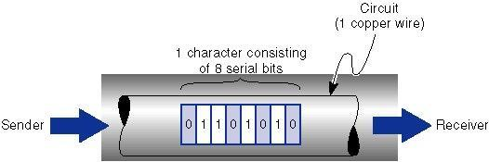
Serial

Slide 23
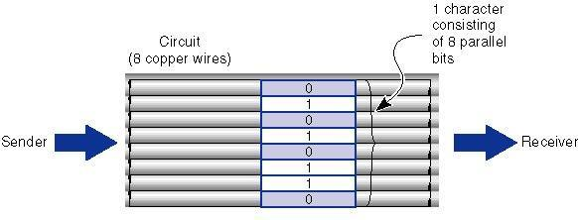
Parallel

Slide 24
X.21
Another interface standard designed to replace aging RS-232
Currently popular in Europe and with ISDN connections
Each circuit in the X.21 standard can contain many different signals
Since each circuit can transmit different signals
  Combination of signals on the four circuits is much larger than if each circuit performed only a single function

Slide 25
RAID
Redundant array of independent disks - collection of techniques for interfacing multiple hard disk drives to a computer
RAID-0 - data is broken into pieces and each piece is stored on a different disk drive (striping)
RAID-1 - data is stored on at least two disk drives in duplicate (disk mirroring)
RAID-3 - data is redundantly stored across multiple disk drives
  Error-checking information is kept on a separate disk
RAID-5 - data is broken in pieces (stripes) and stored across three or more disks
  Error-checking information is stored along with the striped data

Slide 26
High Speed Protocols
FireWire:
Bus that connects peripheral devices such as wireless modems and high speed digital video cameras to microcomputers at 400 Mbps
  Designated as IEEE 1394
  Supports asynchronous connections and isochronous connections
    Provides guaranteed data transport at a pre-determined rate
Universal Serial Bus (USB):
Modern standard for interconnecting modems and other peripheral devices to microcomputers
Supports plug and play
Can daisychain multiple devices
Like Firewire, USB is a high speed connection (USB 1.0 is only 12 Mbps, but USB 2.0 is 480 Mbps)

Slide 27
SCSI and iSCSI
SCSI (small computer system interface) - technique for interfacing a computer to high-speed devices such as disk drives, CDs, and DVDs
Need appropriate SCSI adapters, interconnecting cables, and software
iSCSI (Internet SCSI) - technique for interfacing disk storage to a computer via the Internet
  It looks like the disk storage is down the hall, but it could be anywhere on the Internet

Slide 28
InfiniBand and Fibre Channel
InfiniBand - a serial connection or bus that can carry multiple channels of data at the same time with speeds up to billions of bits per second
  More than just a single bus, InfiniBand is a network of high-speed links and switches
Fibre Channel - similar to InfiniBand, but limited to the interconnection of 126 devices

Slide 29
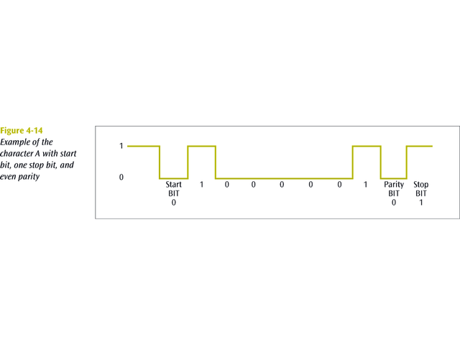
Asynchronous Connections
A type of connection defined at the data link layer
No “clocking signal” to say when a frame starts or ends, so, how does the receiver know when a frame starts or ends?
  Add a Start bit, while a Stop bit is added to the end of the frame
  An optional parity bit can be added to the frame which can be used to detect errors
Used in slower, cheaper equipment, because of start/stop overhead

Slide 30
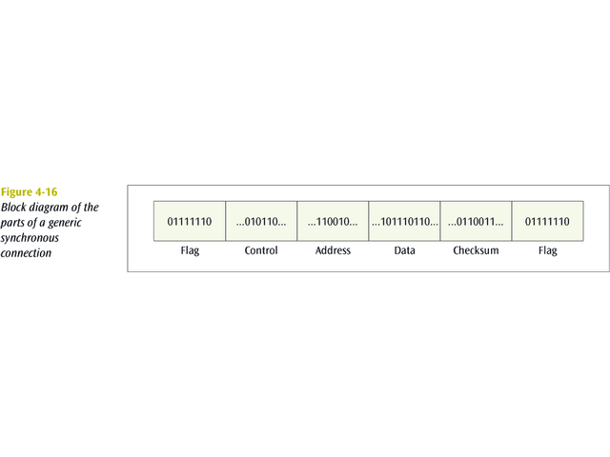
Synchronous Connections
A second type of connection defined at the data link layer
A synchronous connection creates a large package (frame) that consists of header and trailer flags, control information, optional address information, error detection code (checksum), and the data
A synchronous connection is more elaborate but transfers data in a more efficient manner

Slide 31
Data flow
Circuits can be designed to permit data to flow in one or both directions:
  Simplex
    One-way transmission
  Half-duplex
    Two-way communication link, but only one system can “talk” at a time
  Full duplex
    Transmit in both directions simultaneously

Slide 32
Terminal-to-Mainframe (I)
A point-to-point connection is a direct, unshared connection between a terminal and a mainframe computer.
A multipoint connection is a shared connection between multiple terminals and a mainframe computer.
The mainframe is called the primary, and each terminal is called a secondary.

Slide 33
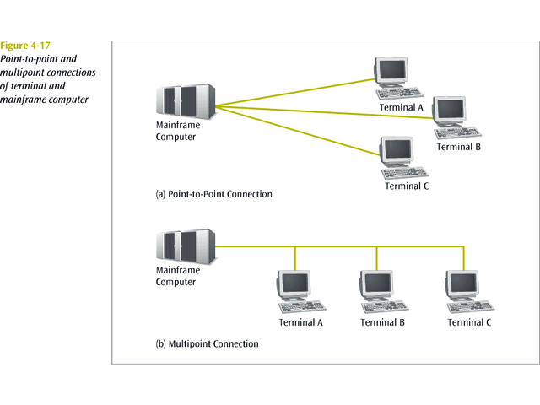

Slide 34
Terminal-to-Mainframe (II)
To allow a terminal to transmit data to a mainframe, the mainframe must poll the terminal.
Two basic forms of polling include roll-call polling and hub polling.
In roll-call polling, the mainframe polls each terminal in a round-robin fashion.
In hub polling, the mainframe polls the first terminal, and this terminal passes the poll onto the next terminal.

Slide 35
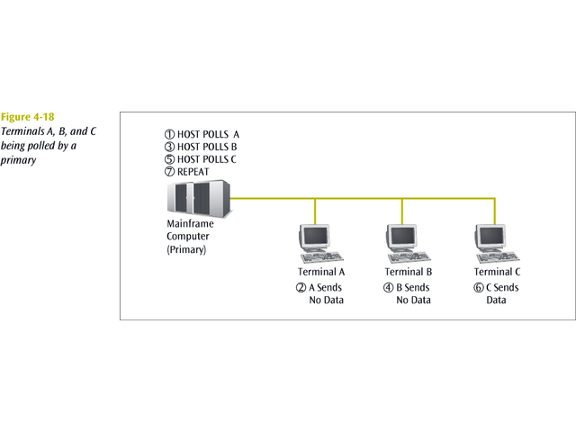

Slide 36
Summary
Modems use modulation techniques to transmit signals across analog circuits:
  Modern modems (V.90+) make use PCM and the digital telephones now in place, but rarely reach their maximum transmission speeds
Signal transmissions can be described in terms of standards and modes:
  Transmission standards define the electrical/mechanical and functional/procedural characteristics of the transmission
  Modes of transmission include serial/parallel, simplex/duplex, asynchronous/synchronous, point-to-point/multi-point

