Slide 1
Chapter 5
Multiplexing: Sharing a Medium

Slide 2
Learning Objectives
Describe frequency division multiplexing and list its applications, advantages, and disadvantages
Describe synchronous time division multiplexing and list its applications, advantages, and disadvantages
Outline the basic multiplexing characteristics of both T1 and ISDN telephone systems
Describe statistical time division multiplexing and list its applications, advantages, and disadvantages
Cite the main characteristics of dense wavelength division multiplexing and its advantages and disadvantages
Describe the basic characteristics of discrete multitone
Cite the main characteristics of code division multiplexing and its advantages and disadvantages
Apply a multiplexing technique to an example business situation

Slide 3
Introduction
Under the simplest conditions, a medium can carry only one signal at any moment in time
For multiple signals to share one medium, the medium must somehow be divided, giving each signal a portion of the total bandwidth.
The current techniques that can accomplish this include:
  frequency division multiplexing
  time division multiplexing
  wavelength division multiplexing.

Slide 4
Frequency Division Multiplexing
Assignment of non-overlapping frequency ranges to signal on a medium. All signals are transmitted at the same time, each using different frequencies.
  A multiplexor accepts inputs and assigns frequencies to each device.
  The multiplexor is attached to a high-speed communications line.
  A corresponding multiplexor, or demultiplexor, is on the end of the high-speed line and separates the multiplexed signals.
  Analog signaling is used to transmit signals.
  Used in broadcast radio and television, cable television, and the AMPS cellular phone systems.
  More susceptible to noise.

Slide 5
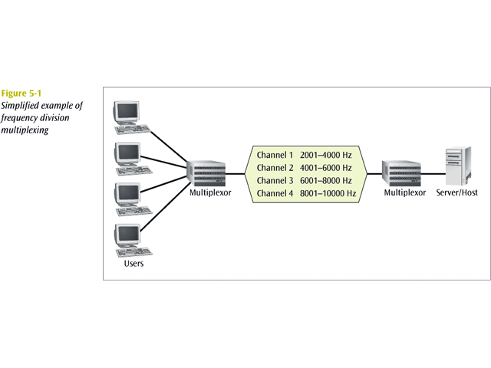

Slide 6
Time Division Multiplexing
Sharing of the signal is accomplished by dividing available transmission time on a medium among users.
Digital signaling.
Two basic forms:
  Synchronous time division multiplexing, and
  Statistical, or asynchronous, time division multiplexing.

Slide 7
Synchronous Time
Division Multiplexing
The multiplexor accepts input from attached devices in a round-robin fashion and transmit the data in a never ending pattern.
  For devices that generate data at a faster rate than other devices, the multiplexor must either:
    sample the incoming data stream from that device more often than it samples the other devices, or
    buffer the faster incoming stream.
  For devices that has nothing to transmit, the multiplexor insert a piece of data from that device into the multiplexed stream.
  T1, ISDN, and SONET/SDH are common examples of synchronous time division multiplexing.

Slide 8
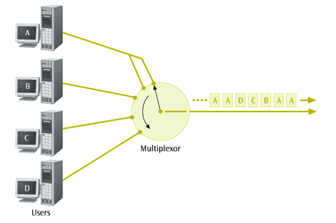

Slide 9
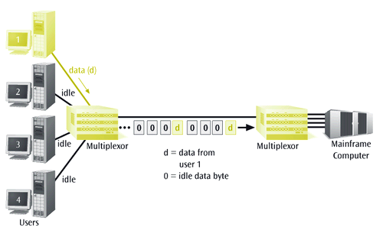

Slide 10
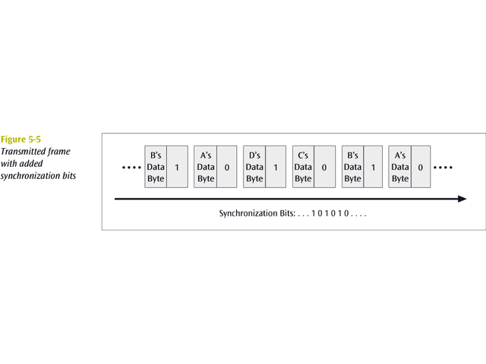
Synchronization
The transmitting multiplexor insert alternating 1s and 0s into the data stream for the receiver to synchronize with incoming data stream.

Slide 11
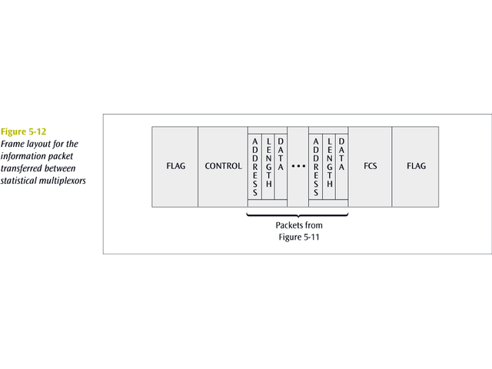
Statistical Time
Division Multiplexing
Transmits only the data from active workstations.
No space is wasted on the multiplexed stream.
Accepts the incoming data streams and creates a frame containing only the data to be transmitted.
  An address is included to identify each piece of data.
  A length is also included if the data is of variable size.
  The transmitted frame contains a collection of data groups.

Slide 12
Wavelength Division Multiplexing
Wavelength division multiplexing multiplexes multiple data streams onto a single fiber optic line.
Different wavelength lasers (called lambdas) transmit the multiple signals.
Each signal carried on the fiber can be transmitted at a different rate from the other signals.
Dense wavelength division multiplexing combines many (30, 40, 50, 60, more?) onto one fiber
Coarse wavelength division multiplexing combines only a few lambdas

Slide 13
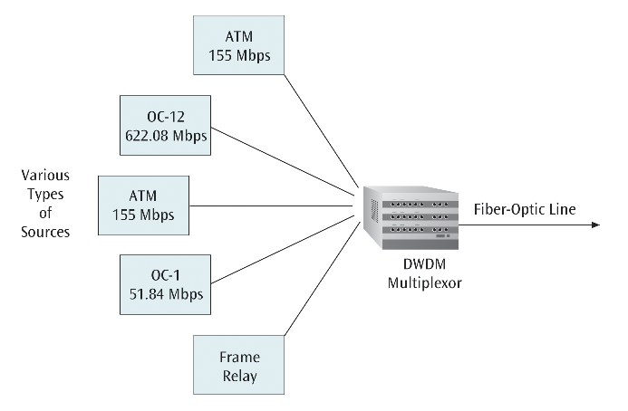

Slide 14
Discrete Multitone (DMT)
A multiplexing technique commonly found in digital subscriber line (DSL) systems
DMT combines hundreds of different signals, or subchannels, into one stream
Each subchannel is quadrature amplitude modulated
  recall - eight phase angles, four with double amplitudes
Theoretically, 256 subchannels, each transmitting 60 kbps, yields 15.36 Mbps
  Unfortunately, there is noise

Slide 15
Code Division Multiplexing
Also known as code division multiple access
Advanced technique that allows multiple devices to transmit on the same frequencies at the same time.
Each mobile device is assigned a unique 64-bit code (Chip spreading code).
  To send a binary 1, mobile device transmits the unique code
  To send a binary 0, mobile device transmits the inverse of code
Receiver gets summed signal, multiplies it by receiver code, adds up the resulting values
  Interprets as a binary 1 if sum is near +64
  Interprets as a binary 0 if sum is near –64

Slide 16
