Slide 1
Chapter 6
Errors, Error Detection, and Error Control

Slide 2
Learning Objectives
Identify the different types of noise commonly found in computer networks
Specify the different error prevention techniques and be able to apply an error prevention technique to a type of noise
Compare the different error detection techniques in terms of efficiency and efficacy
Perform simple parity and longitudinal parity calculations, and enumerate their strengths and weaknesses
Cite the advantages of cyclic redundancy checksum, and specify what types of errors cyclic redundancy checksum will detect
Differentiate the three basic forms of error control, and describe under what circumstances each may be used
Follow an example of stop-and-wait ARQ, go-back-N ARQ, and selective-reject ARQ.

Slide 3
Introduction
All transmitted signals will contain some rate of error (>0%)
Popular error control methods include:
  Parity bits (add a 1 or 0 to the end of each seven bits)
  Longitudinal redundancy checking (LRC)
  Polynomial checking

Slide 4
What’s an “error”?
Human errors:
  Incorrect IP address assignment, or subnet mask, etc., etc.
Network errors:
  Lost data
  Corrupted data (received, but garbled)

Slide 5
Line Noise and Distortion Errors
Source
Likely cause
Line outage
Storm, accident
White noise
Movement of electrons
Impulse noise
Random spikes of power
Cross-talk
Guardbands, wires too close
Echo
Reflective feedback
Jitter
Timing irregularities
Delay distortion
Propagation speed
Attenuation
Wires too long

Slide 6
Error Prevention
To prevent errors from happening, several techniques may be applied:
  Proper shielding of cables to reduce interference
  Telephone line conditioning or equalization
  Replacing older media and equipment with new, possibly digital components
  Proper use of digital repeaters and analog amplifiers
  Observe the stated capacities of the media

Slide 7
Error Detection Methods
The only way to do error detection and correction is to send extra data with each message
Two common error detection methods:
  Parity checking
    Simple parity
    Longitudinal parity
  Polynomial Checking
    Cyclic redundancy checksum (CRC)

Slide 8
Simple Parity
Add an additional bit to each byte in the message:
  Even parity causes the sum of all bits (including the parity bit) to be even
  Odd parity causes the sum of all bits to be odd
1
Even parity
0
1
0
1
0
1
0
0
Odd parity

Slide 9
Example
Letter
7-bit ASCII
Parity bit
D
1
0
0
0
1
0
0
1
A
1
0
0
0
0
0
1
1
T
1
0
1
0
1
0
0
0
A
1
0
0
0
0
0
1
1

Slide 10
Longitudinal Parity
Add block check character (BCC) to the end of the message:
  Perform odd parity checking on the block of bits for each character in the message
0
1
0
1
0
1
0
0
1
0
0
1
1
1
0
1
BCC
0
0
1
1
0
1
1
1

Slide 11
Example
Letter
7-bit ASCII
Parity bit
D
1
0
0
0
1
0
0
1
A
1
0
0
0
0
0
1
1
T
1
0
1
0
1
0
0
0
A
1
0
0
0
0
0
1
1
BCC
1
1
0
1
1
1
1
1

Slide 12
Parity Checks
Both simple parity and longitudinal parity do not catch all errors
Simple parity only catches odd numbers of bit errors
Longitudinal parity is better at catching errors
  But requires too many check bits added to a block of data
We need a better error detection method
  What about cyclic redundancy checksum?

Slide 13
Polynomial Checking
Adds a character (or series of characters) to the end of the message based on a mathematical algorithm:
  Checksum
    Sum the message values and divide by 255. The remainder is the checksum
D
68
A
65
282
=
1 remainder 27
T
84
255
A
65
Checksum
0
0
1
1
0
1
1
1

Slide 14
Cyclical redundancy check
CRC error detection method treats packet of data to be transmitted as a large polynomial
Transmitter
  Using polynomial arithmetic, divides polynomial by a given generating polynomial
Quotient is discarded
  Remainder is “attached” to the end of message
Message (with the remainder) is transmitted to the receiver
Receiver divides the message and remainder by same generating polynomial
If a remainder of zero results  no error during transmission
If a remainder not equal to zero results  error during transmission

Slide 15
Example: CRC
7
6
5
4
3
2
1
0
0
0
1
1
0
1
1
1
Message polynomial
x⁵+x⁴+x²+x¹+x⁰
≡
x⁵+x⁴+x²+x+1
Generating polynomial
ATM CRC
x⁸ + x² + x + 1
CRC-16
x¹⁶ + x¹⁵ + x² + 1

Slide 16
Error Control
Once an error is detected, the receiver can:
Do nothing
  Some newer systems such as frame relay perform this type of error control
Return an error message to the transmitter
  Stop-and-wait ARQ (Automatic Repeat reQuest)
  Go-back-N ARQ
  Selective-reject ARQ
Fix the error with no further help from the transmitter

Slide 17
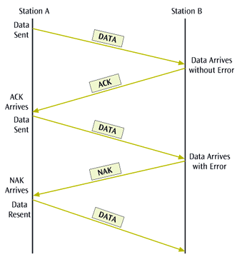
Stop-and-wait ARQ
A transmitter sends a frame then stops and waits for an acknowledgment
If a positive acknowledgment (ACK) is received, the next frame is sent
If a negative acknowledgment (NAK) is received, the same frame is transmitted again

Slide 18
Go back-N ARQ
Go-back-N ARQ and selective reject are more efficient protocols
  They assume that multiple frames are in transmission at one time (sliding window)
A sliding window protocol allows transmitter to send up to the window size frames before receiving any acknowledgments
When a receiver does acknowledge receipt, the returned pack contains the number of the frame expected next
Using the go-back-N ARQ protocol, if a frame arrives in error, the receiver can ask the transmitter to go back to the Nth frame and retransmit it
After the Nth frame is retransmitted, the sender resends all subsequent frames

Slide 19
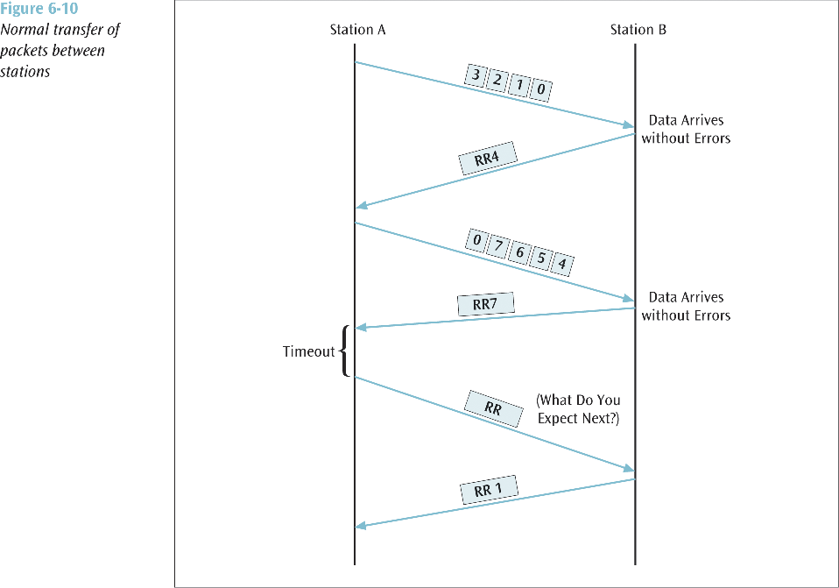
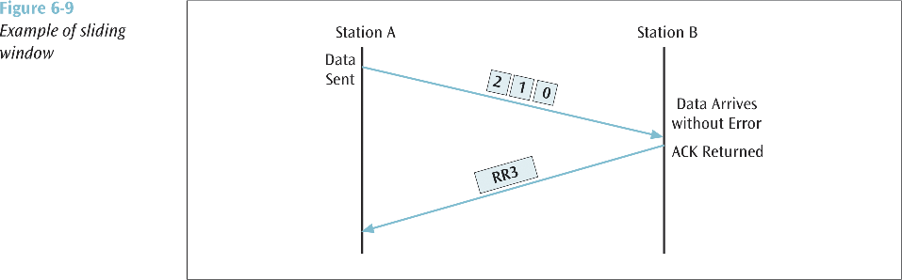

Slide 20
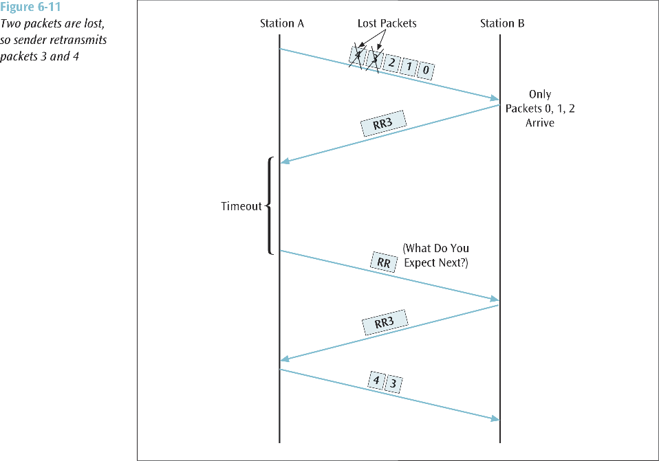
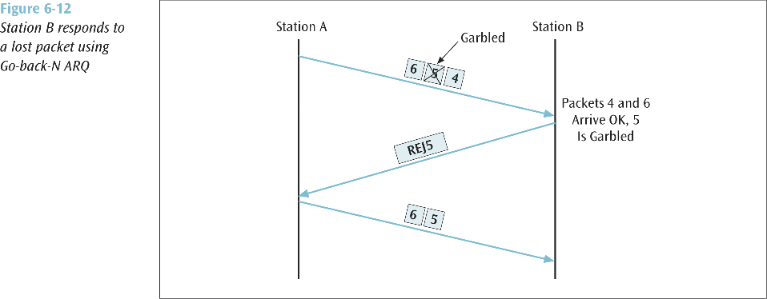

Slide 21
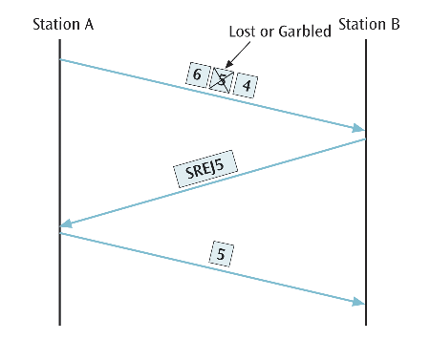
Selective-reject ARQ
Most efficient error control protocol
If a frame is received in error, the receiver asks transmitter to resend ONLY the frame that was in error
Subsequent frames following the Nth frame are not retransmitted

Slide 22
Correct the Error
For a receiver to correct the error with no further help from the transmitter requires a large amount of redundant information accompanying original data
This redundant information allows the receiver to determine the error and make corrections
This type of error control is often called forward error correction

