Slide 1
Chapter 7
Local Area Networks: The Basics

Slide 2
Learning Objectives
State the definition of a local area network
List the primary function, activities, and application areas of a local area network
Cite the advantages and disadvantages of local area networks
Identify the physical and logical topologies of local area networks
Cite the characteristics of wireless local area networks and their medium access control protocols
Specify the different medium access control techniques
Recognize the different IEEE 802 frame formats
Describe the common local area network systems

Slide 3
Primary Function of a LAN
File serving - large storage disk drive acts as a central storage repository
Print serving - Providing authorization to access a particular printer, accept and queue print jobs, and user access to print queue to perform administrative duties
Video transfers - High speed LANs are capable of supporting video image and live video transfers
Manufacturing support - LANs can support manufacturing and industrial environments
Academic support – In classrooms, labs, and wireless
E-mail support
Interconnection between multiple systems

Slide 4
Advantages of LAN
Ability to share hardware and software resources
Individual workstation might survive network failure
Component and system evolution are possible
Support for heterogeneous forms of hardware and software
Access to other LANs and WANs
Private ownership
Secure transfers at high speeds with low error rates

Slide 5
Disadvantages of LAN
Equipment and support can be costly
Level of maintenance continues to grow
Private ownership?
Some types of hardware may not interoperate
Just because a LAN can support two different kinds of packages does not mean their data can interchange easily
A LAN is only as strong as it weakest link, and there are many links

Slide 6
Basic LAN Topologies
Bus/tree
Star-wired bus
Star-wired ring
Wireless

Slide 7
Bus/Tree Topology
The original topology.
Workstation has a network interface card (NIC) that attaches to the bus (a coaxial cable) via a tap.
Data can be transferred using either baseband digital signals or broadband analog signals.
Baseband signals are bidirectional (broadcast) and more outward in both directions from the workstation transmitting.
Broadband signals are usually uni-directional and transmit in only one direction. Because of this, special wiring considerations are necessary.
Buses can be split and joined, creating trees.

Slide 8
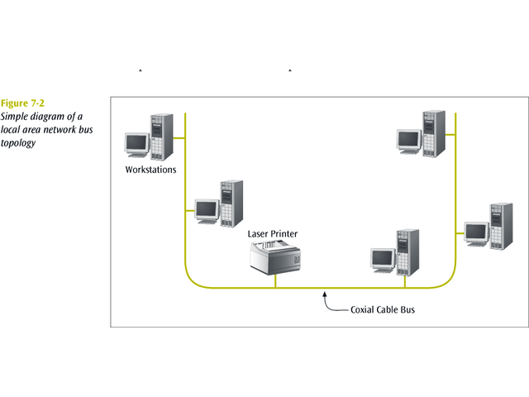

Slide 9
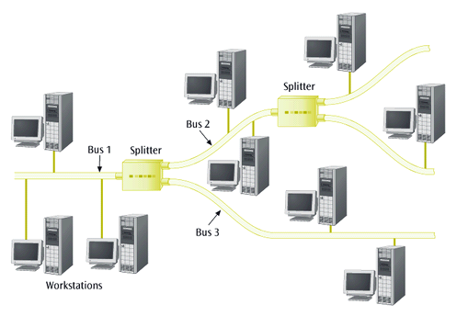

Slide 10
Star-wired Bus Topology
Logically operates as a bus, but physically looks like a star
Star design is based on hub. All workstations attach to hub
Unshielded twisted pair usually used to connect workstation to hub
Hub takes incoming signal and immediately broadcasts it out all connected links
Hubs can be interconnected to extend network size
Modular connectors and twisted pair make installation and maintenance of star-wired bus better than standard bus
Hubs can be interconnected with twisted pair, coaxial cable, or fiber optic cable
Biggest disadvantage: when one station talks, everyone hears it. This is called a shared network. All devices are sharing the network medium

Slide 11
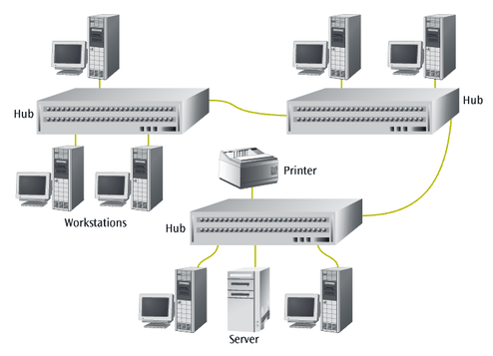

Slide 12
Star-wired Ring Topology
Logically operates as a ring but physically appears as a star
Based on MAU (multi-station access unit) which functions similarly to a hub
Where a hub immediately broadcasts all incoming signals onto all connected links, the MAU passes the signal around in a ring fashion
Like hubs, MAUs can be interconnected to increase network size

Slide 13
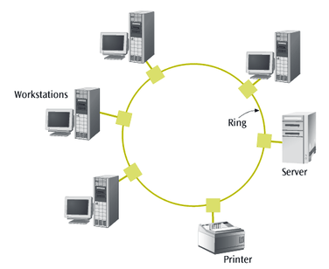

Slide 14
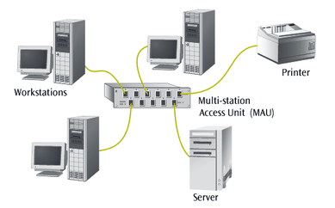
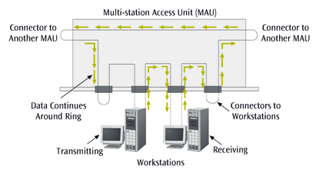

Slide 15
Wireless LANs (I)
Not really a specific topology
Workstation in wireless LAN can be anywhere as long as within transmitting distance to access point
Several versions of IEEE 802.11 standard defines various forms of wireless LAN connections
Two basic components necessary:
  Client Radio - usually PC card with integrated antenna installed in a laptop or workstation
  Access Point (AP) - Ethernet port plus transceiver
AP acts as bridge between wired and wireless networks
  Can perform basic routing functions
Single-cell - Workstations reside within a basic service set
Multiple-cell - Multiple basic service sets create an extended service set
Ad-hoc - Wireless LANs configured without access point

Slide 16
Wireless LANs (II)
IEEE 802.11 – The original wireless standard, transmitting data at 2 Mbps
IEEE 802.11b – The second wireless standard, transmitting data at 11 Mbps
  In actual tests, 11 Mbps 802.11b devices managed 5.5 Mbps
  With directional antennae designed for point-to-point transmission (rare), 802.11b can transmit for more than 10 miles
  With an omni-directional antenna on a typical AP, range may drop to as little as 100 feet
IEEE 802.11a – One of the more recent standards, transmitting data at 54 Mbps using 5 GHz frequency range
IEEE 802.11g – The other recent standard, also transmitting data at 54 Mbps but using the same frequencies as 802.11b (2.4 GHz)
  Backwards compatible with 802.11b
HiperLAN/2 (European standard, 54 Mbps in 5 GHz band)
To provide security, most systems use either Wired Equivalent Privacy (WEP)
  Provides either 40- or 128-bit key protection
Or a more advanced standard such as WPA

Slide 17
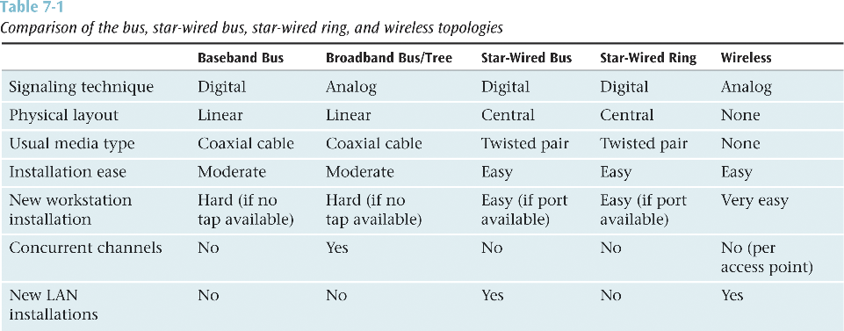

Slide 18
Medium Access Control Protocols
How does a workstation get its data onto the LAN medium?
Medium access control protocol - software that allows workstations to “take turns” at transmitting data
Two basic categories:
  Contention-based protocols
  Round robin protocols

Slide 19
Contention-Based Protocols
Essentially first come first served
Most common example:
  Carrier sense multiple access with collision detection (CSMA/CD)
If no one is transmitting, a workstation can transmit
If someone else is transmitting, workstation “backs off” and waits
If two workstations transmit at the same time
  Collision occurs
When the two workstations hear the collision
  Stop transmitting immediately
Each workstation backs off a random amount of time and tries again
Hopefully, both workstations do not try again at the exact same time
CSMA/CD: example of non-deterministic protocol

Slide 20
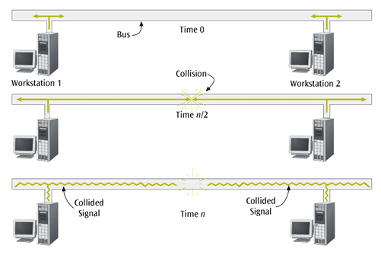

Slide 21
Round Robin Protocols
Each workstation takes turn transmitting  turn is passed around the network from workstation to workstation
Most common example is token ring LAN:
  Software token is passed from workstation to workstation
Token ring: example of deterministic protocol
Token ring more complex than CSMA/CD. What happens if token is lost? Duplicated? Hogged?
Token ring LANs are losing the battle with CSMA/CD LANs

Slide 22
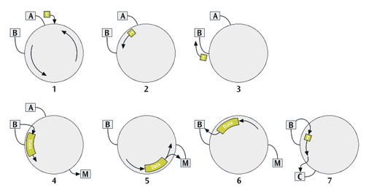

Slide 23
IEEE 802
To better support local area networks, data link layer of the OSI model was broken into two sublayers:
  Logical link control sublayer
  Medium access control sublayer
Medium access control sublayer defines the frame layout
  More closely tied to specific medium at physical layer
Thus, when people refer to LANs they often refer to its MAC sublayer name, such as 10BaseT

Slide 24
IEEE 802 Frame Formats
IEEE 802 suite of protocols defines frame formats for CSMA/CD (IEEE 802.3) and token ring (IEEE 802.5)
Each frame format describes how data package is formed
If a CSMA/CD network connects to a token ring network, frames have to be converted from one to another

Slide 25
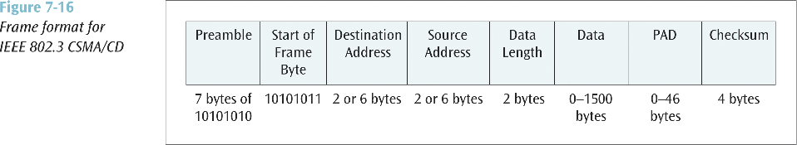
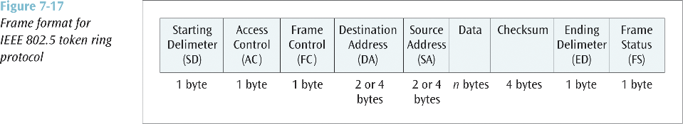

Slide 26
LAN Systems
Ethernet or CSMA/CD
IBM Token Ring
FDDI (Fiber Distributed Data Interface)

Slide 27
Ethernet
Originally, CSMA/CD was 10 Mbps.
Then 100 Mbps was introduced. Most NICs sold today are 10/100 Mbps.
Then 1000 Mbps (1 Gbps) was introduced.
  Transmission is full duplex (separate transmit and receive), thus no collisions.
  Prioritization is possible using 802.1p protocol.
  Topology can be star or mesh (for trunks).
  Cabling can be either UTP or optical.
  Where 10 Mbps Ethernet has less than 30% utilization due to collisions, 1000 Mbps is limited only by traffic queuing.
  Distance with 10 Mbps is limited by CSMA/CD propagation time, whereas 1000 Mbps is limited only by media.
10 Gbps is now beginning to appear.

Slide 28
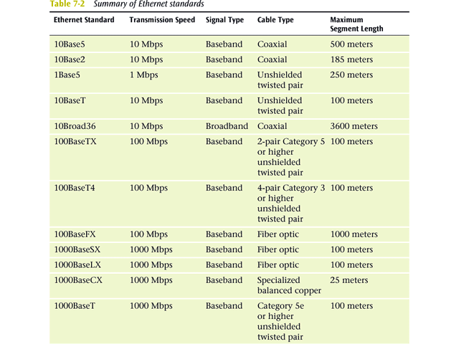

Slide 29
IBM Token Ring
Deterministic LAN offered at speeds of 4, 16 and 100 Mbps.
Very good throughput under heavy loads.
More expensive components than CSMA/CD.
Losing ground quickly to CSMA/CD. May be extinct soon.

Slide 30
FDDI
Based on the token ring design using 100 Mbps fiber connections.
Allows for two concentric rings - inner ring can support data travel in opposite direction or work as backup.
Token is attached to the outgoing packet, rather than waiting for the outgoing packet to circle the entire ring.

Slide 31
Steps in setting up a network
Design the network (decide on and buy the components)
Install the NICs (Ethernet 10/100Base-T)
Attach the cable (UTP Cat5, UTP Cat3, Fiber optic)
Attach required hubs, switches, routers
Configure network software

Slide 32
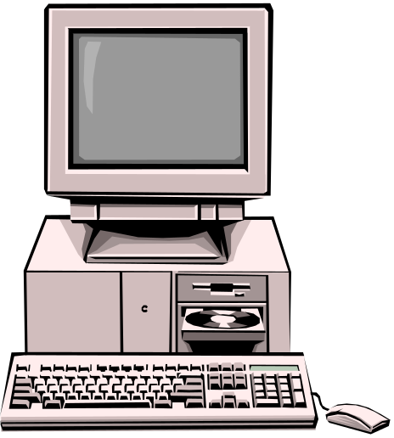
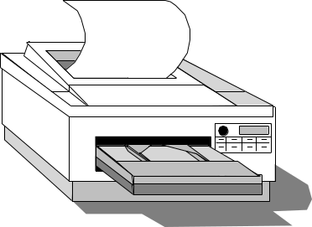
Types of configuration: 1 of 4
Repeaterless LAN
  PCs connected using a cross-over cable, each PC is a peer, no server (<3 PCs)
Cross-over cable

Slide 33
Types of configuration: 2 of 4
Peer-to-peer networks:
  All computers function as both a client and as a server
    Only useful for small (<10) device networks
Hub

Slide 34
Types of configuration: 3 of 4
Dedicated server LAN:
  One or more computers are permanently assigned to being the network server(s)
    File, Database, Print, Communications servers
Switch

Slide 35
Types of configuration: 4 of 4
Virtual private networks (VPNs):
  Devices assigned to a logical network
    using software and third-party network (telephone company or ISP)
Switch

