Slide 1
Chapter 8
Local Area Networks: Internetworking

Slide 2
Learning Objectives (I)
List the reasons for interconnecting multiple local area network segments and interconnecting local area networks and wide area networks
Identify the functions and purposes of the various interconnection devices that have been used over time
Define a hub and describe the situations in which a hub is used
Describe how a transparent bridge learns
Describe what a switch is and how it differs from other devices
Describe the types of situations in which using a switch is advantageous
Describe what a router is and how it differs from other devices
Describe the types of situations in which a router is used

Slide 3
Introduction
Necessary to connect a local area network to another local area network or to a wide area network.
  LAN-to-LAN connections are often performed with a bridge-like device.
  LAN-to-WAN connections are usually performed with a router.
  A switch can be used to interconnect segments of a local area network.

Slide 4
Why Segment or Interconnect?
To separate / connect one corporate division with another
To connect two LANs with different protocols
To connect a LAN to the Internet
To break a LAN into segments to relieve traffic congestion
To provide a security wall between two different types of users

Slide 5
Hubs
Interconnects two or more workstations into a local area network.
When a workstation transmits to a hub, the hub immediately resends the data frame out all connecting links.
A hub can be managed or unmanaged. A managed hub possesses enough processing power that it can be managed from a remote location.

Slide 6
Hub issues
Maximum distance between devices (100m in 10Base-T)
Must avoid loops between connected hubs
  message would circulate endlessly
Number of devices on network increases collision risks
  collisions during peak traffic periods can crash the network (200 devices)

Slide 7
Bridges
Connect two similar LANs, such as two CSMA/CD LANs.
Connect two closely similar LANs, such as a CSMA/CD LAN and a token ring LAN.
Examines the destination address in a frame and either forwards this frame onto the next LAN or does not.
Examines the source address in a frame and places this address in a routing table, to be used for future routing decisions.

Slide 8
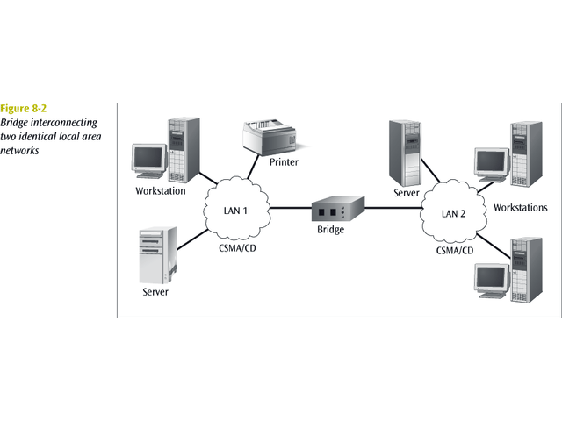
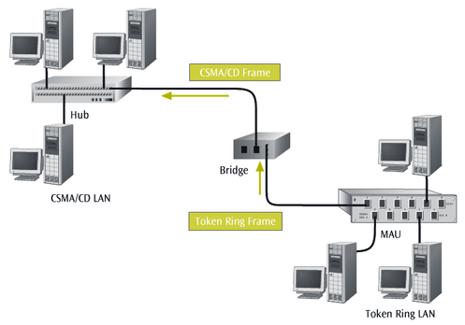

Slide 9
Transparent Bridge
Does not need programming but observes all traffic and builds routing tables from observation.
  The observation is called backward learning.
Each bridge has two connections (ports) and there is a routing table associated with each port.
Observes each frame that arrives at a port, extracts the source address from the frame, and places that address in the port’s routing table.
Found with CSMA/CD LANs.
Can also convert one frame format to another.
  Sometimes refereed to as a gateway or sometimes a router.
Removes the headers and trailers from one frame format and inserts (encapsulates) the headers and trailers for the second frame format.

Slide 10
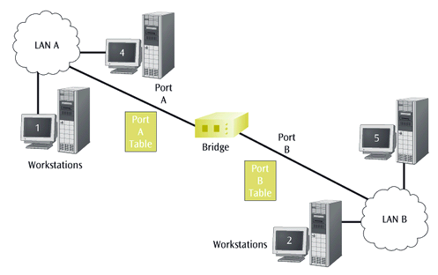
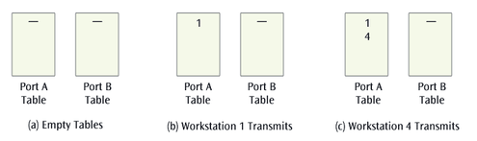

Slide 11
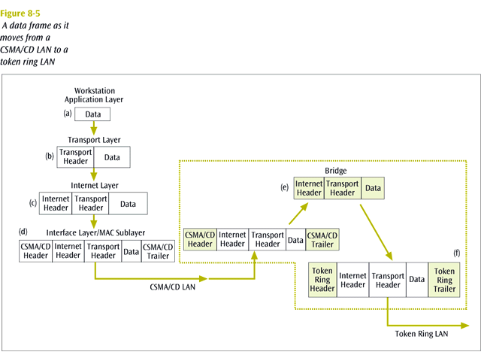

Slide 12
Source-routing Bridge
Used with token ring networks.
Do not learn from watching tables.
When a workstation wants to send a frame, it must know the exact path of network / bridge / network / bridge / network …
If a workstation does not know the exact path, it sends out a discovery frame.
The discovery frame makes its way to the final destination, then as it returns, it records the path.

Slide 13
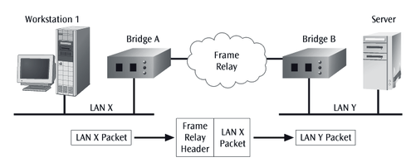
Remote Bridge
Passing a data frame from one LAN to another when the two LANs are separated by a long distance and there is a wide area network connecting the two LANs.
Takes the frame before it leaves the first LAN and encapsulates the WAN headers and trailers.
When the packet arrives at the destination remote bridge, that bridge removes the WAN headers and trailers leaving the original frame.

Slide 14
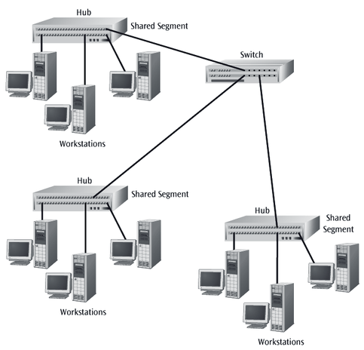
Switches (I)
Combination of a hub and a bridge.
Can interconnect two or more workstations, but like a bridge, it observes traffic flow and learns.
When a frame arrives at a switch, the switch examines the destination address and forwards the frame out the one necessary connection.
Workstations that connect to a hub are on a shared segment.
Workstations that connect to a switch are on a switched segment.

Slide 15
Switches (II)
The backplane of a switch is fast enough to support multiple data transfers at one time.
A switch that employs cut-through architecture is passing on the frame before the entire frame has arrived at the switch.
Multiple workstations connected to a switch use dedicated segments. This is a very efficient way to isolate heavy users from the network.
A switch can allow simultaneous access to multiple servers, or multiple simultaneous connections to a single server.
Virtual LANs – logical subgroup within a LAN, can be created within a network.

Slide 16
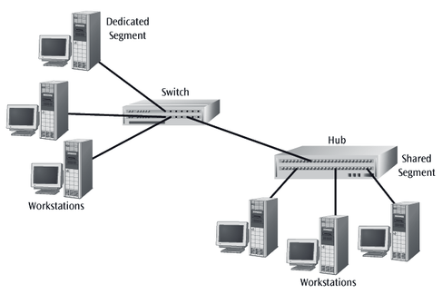
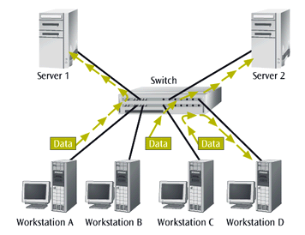

Slide 17
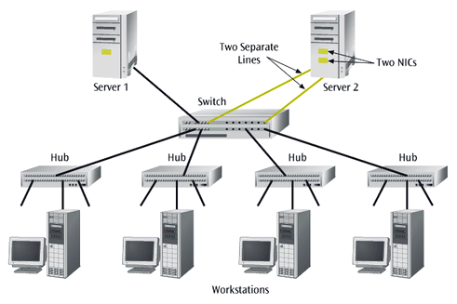

Slide 18
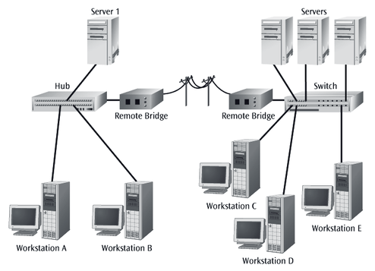

Slide 19
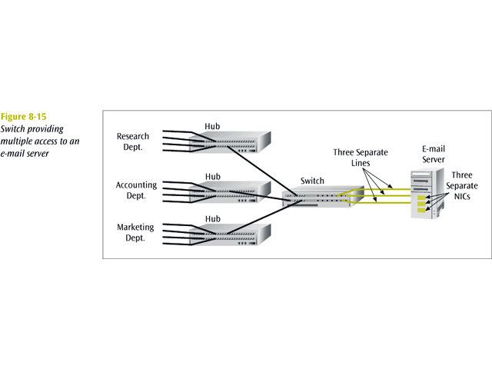

Slide 20
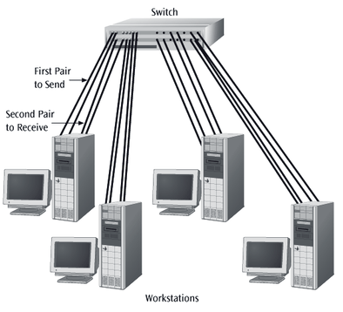
Full Duplex Switches
Allows for simultaneous transmission and reception of data to and from a workstation
This full duplex connection helps eliminate collisions
To support a full duplex connection to a switch, at least two pairs of wires are necessary
  One for the receive operation
  One for the transmit operation
Most people install four pairs today, so wiring is not problem

Slide 21
Network Servers
Network servers provide necessary storage for LAN software
Usually focal point for network operating system
Increasingly, network servers are functioning as bridges, switches, and routers
By adding appropriate card, a server can assume multiple functions

Slide 22
Routers
Router - device that connects a LAN to a WAN or a WAN to a WAN
Router:
  Accepts outgoing packet
  Removes any LAN headers and trailers
  Encapsulates necessary WAN headers and trailers
Because router has to make wide area network routing decisions  router has to dig down into the network layer of the packet to retrieve network destination address
Routers are often called “layer 3 devices”
  Operate at the third layer, or OSI network layer, of the packet
Often incorporate firewall functions

Slide 23
