Slide 1
Chapter 9
Local Area Networks: Software and Support Systems

Slide 2
Learning Objectives
Identify the main functions of operating systems and network operating systems, and distinguish between the two
Identify the basic features of Novell NetWare, Windows NT/2000/2003, Unix, and Linux network operating systems
Compare and contrast the Novell NetWare, Windows NT/2000/2003, Unix, and Linux network operating systems
Recognize the importance of the network server and the different types of network servers available
Identify common examples of network utility software and Internet software
Enumerate the various components of software licenses
Identify the different types of support devices commonly found on local area networks

Slide 3
Network Operating Systems
An operating system manages all applications and resources in a computer
A multitasking operating system supports the execution of multiple processes at one time
A network operating system is a large, complex program that manages the resources common on most local area networks
  Besides performing standard operating system functions, also called upon for additional functions (refer to next slide)

Slide 4
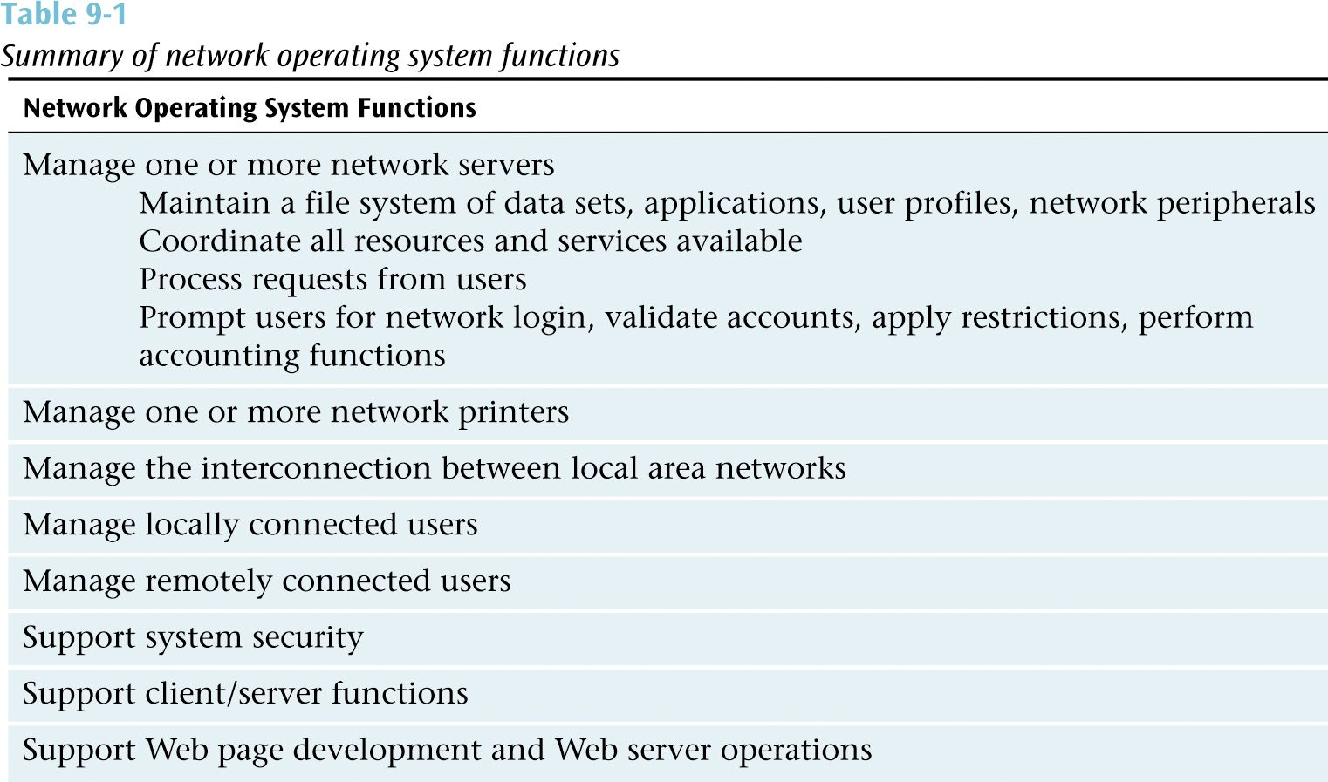

Slide 5
Popular NOS
Novell NetWare versions 3, 4, 5 and 6
Windows NT, 2000, and 2003
Unix
Linux

Slide 6
Novell NetWare
Version 3 - Popular but older version. Is no longer supported by Novell (end of 2000). User logs onto a particular server. Bindery maintains directory system.
Version 4 - Unlike version 3 this version allows single network login. Bindery replaced by powerful NDS database.
Version 5 - Allows administrator to use IP protocol instead of Novell’s proprietary IPX/SPX protocols.

Slide 7
Novell NetWare Version 6
A client anywhere on the Internet can print and use storage services from a NetWare 6 server without loading a single byte of Novell’s Client32 software
Powerful Internet printing services (iPrint) make printing nearly idiot-proof
  User clicks on graphical image of floor plan showing printers
  If user does not have printer driver, it is loaded automatically in background
iFolder:
  Very effective background application powered by Apache Web Server to “equalize” the documents in each system’s My Documents folder with an identical set on the server
  Volumes can hold 8 terabytes of data in up to 8 trillion files and can keep 1 million files open concurrently

Slide 8
Novell NDS (NetWare
Directory Services)
Novell NDS: Database that maintains information on, and access to, every resource on the network, including users, groups of users, printers, data sets and servers
Network administrator creates a hierarchical tree structure that represents the layout of the organization
Tree structure is composed of:
  Organizational units  composed of further objects
  Leaf objects  not composed of further objects

Slide 9
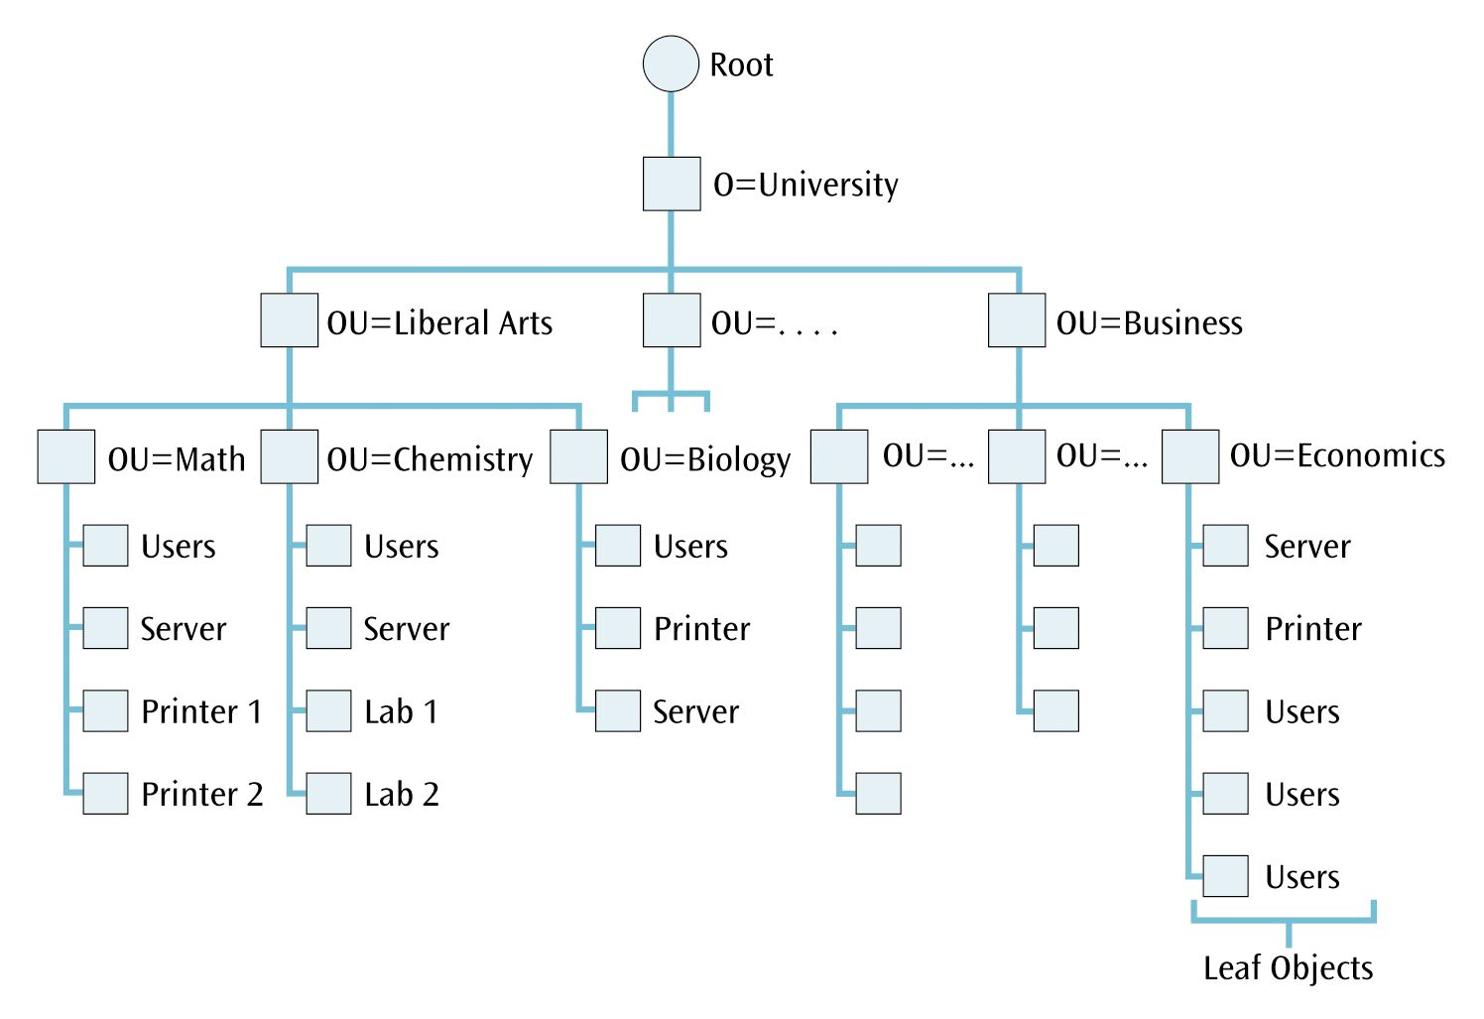

Slide 10
Windows NT Version 4 (I)
User interface based on popular Windows operating system, but is NOT the same as Windows 98 or Windows Me
Full service multi-tasking operating system capable of supporting multiple servers
NT systems work very well with other Microsoft products
Questionable if NT can support large systems
Blue screen of death (BSOD) plagues NT systems

Slide 11
Windows NT Version 4 (II)
Domain
  Group of users, servers, and other resources that share account and security information
  May have from 1 to several hundred domains depending on size of system
Every domain has one and only one primary domain controller (PDC) (a server)
Centrally manages account information and security
Each domain should have at least one backup domain controller (BDC) (a server)

Slide 12
Windows NT Version 4 (III)
Single domain model
  Simplest Windows NT domain model
  One domain that services every user and resource
Multiple domain model
Master domain model
  Uses single domain to exert control over user account information
  Separate resource domains manage resources such as networked printers
Multiple master domain model
  Uses two or more master domains that are joined in two-way trusts to manage many resource domains

Slide 13
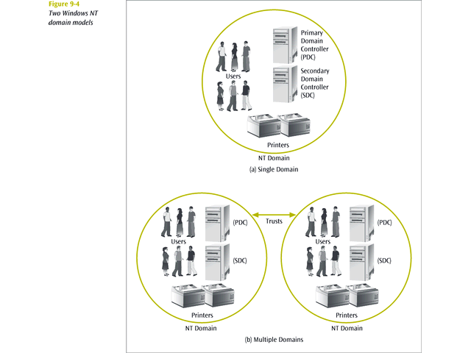

Slide 14
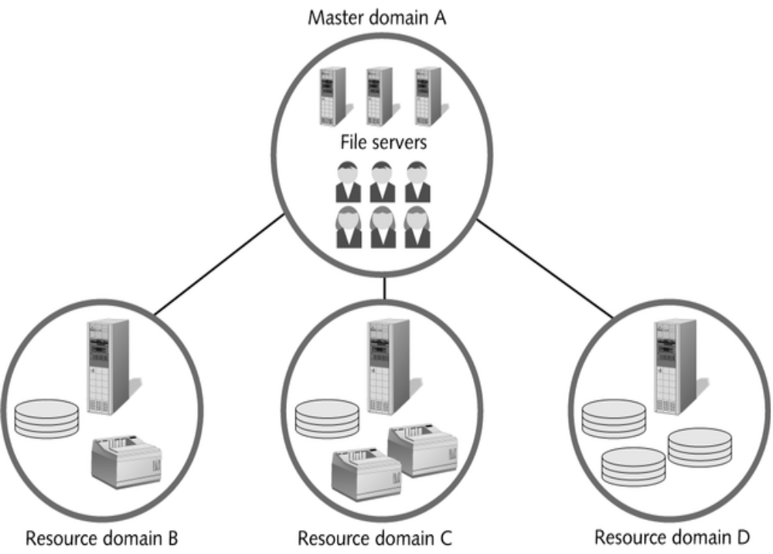

Slide 15
Windows 2000 (I)
Updated version of Windows NT network operating system
Specific versions of 2000 designed to support wide variety of system types:
  Windows 2000 Professional - replaces NT Workstation
  Windows 2000 Server - replaces Windows NT Server
  Windows 2000 Advanced Server – supports up to 8 procs / 8GB
  Windows 2000 Datacenter Server - supports up to 32 processors and 64GB RAM

Slide 16
Windows 2000 (II)
Biggest change from NT: Active Directory
AD is central repository for all objects that make up the enterprise:
  Domains, organizational units, users, groups, computers, printers, etc.
Roughly based on X.500 spec, creates a hierarchical tree
At top of hierarchical model  single forest of one or more trees
Must contain:
  At least one (root) domain, which must contain at least one organizational unit (OU)
  Several other containers (see next slide)
Recommended size limitation of 1 million objects per domain
  However, lab tests have hit 10 million objects without failure

Slide 17
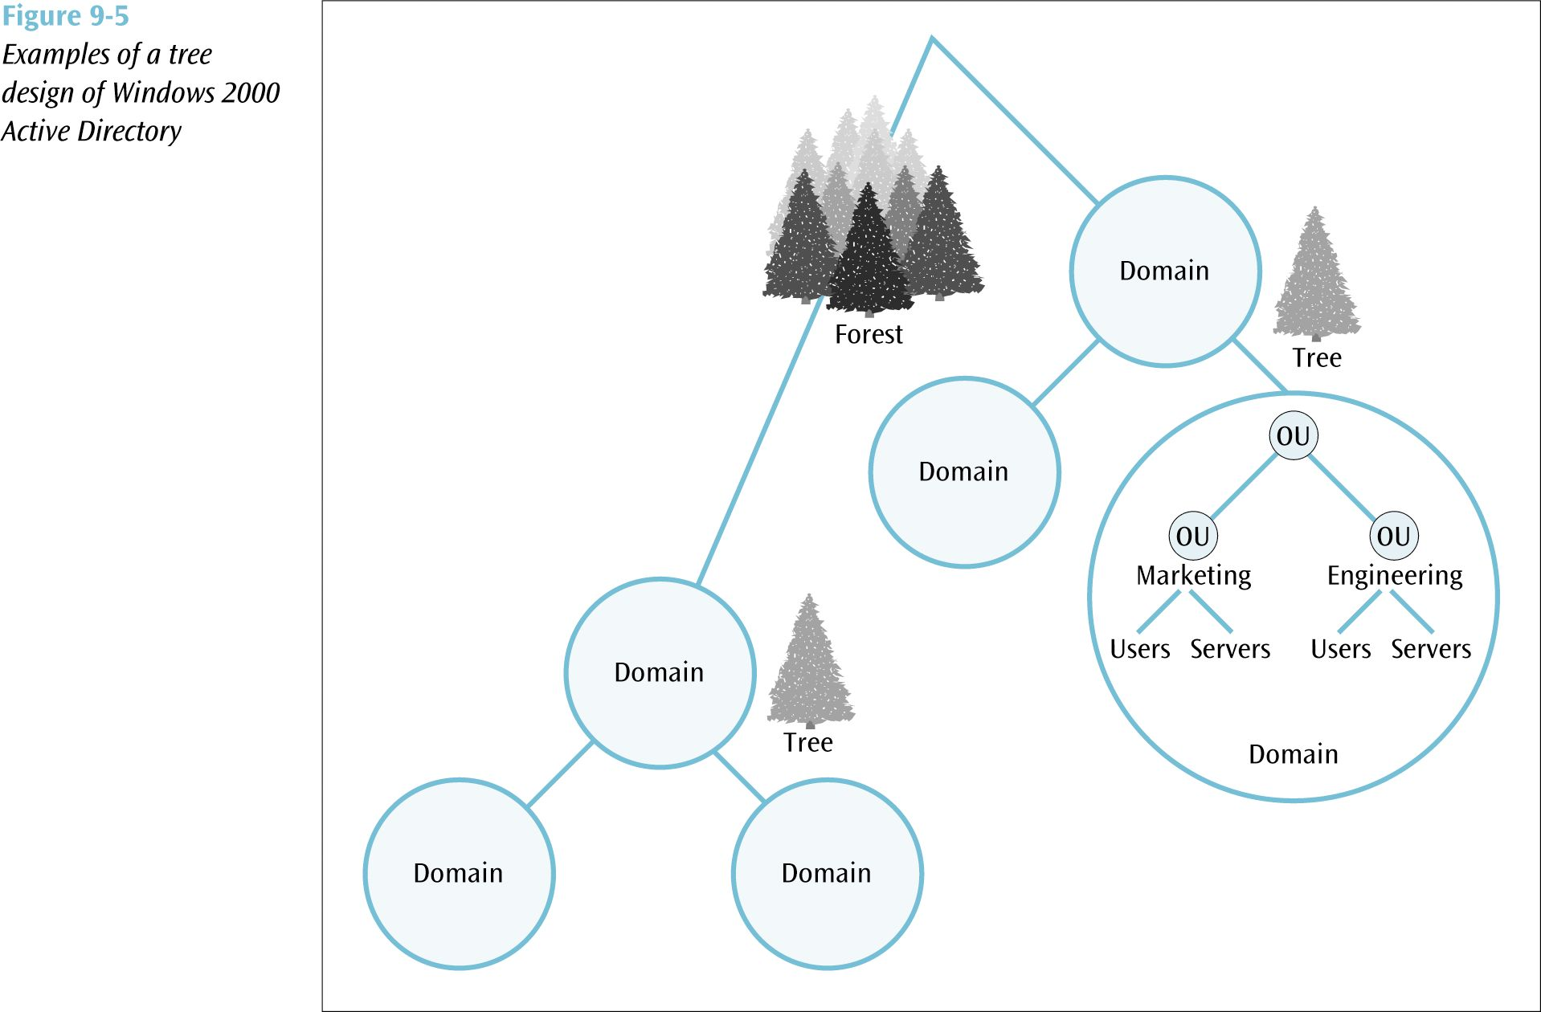

Slide 18
Windows 2000 (III)
The domain has basically remained the same, but now you can have parent and child domains
Parent and all child domains are defined as single domain tree, with multiple trees in the same AD and forest
Domains are named in accordance with the Internet’s DNS standard RFCs 1034 and 1035
Example, the root domain in a tree could be called bigcompany.com
  The marketing child domain could be mktg.bigcompany.com, and the production child domain could be prod.bigcompany.com
  As in NT, you can create Trusts between parent and child domains
    Only with 2000 the trust can be transitive
Many still agree that Windows 2000 has a way to go to catch up to NetWare with regards to simplicity of administration
Nonetheless, NetWare has dropped below 20% of the market while Windows continues to climb (>50%)

Slide 19
Windows 2003
The newest version of Windows network operating systems
Improvements to Active Directory, including new management tools
Capability to interconnect up to 8 Windows servers
New and improved file and print support services
Support for IPv6
Security improvements

Slide 20
Unix
Older but very popular multitasking operating system capable of supporting network operations
First operating system written in the language C
Very stable system capable of supporting very large operations
Numerous versions available from different vendors

Slide 21
Linux
Operating system based on the principles of Unix
Many versions available for free or very small price
Very stable multitasking operating system
When incorporated with other free software products, such as the Apache Web Server and Atipa’s BlueBird network management software, this system becomes extremely cost effective and powerful

Slide 22
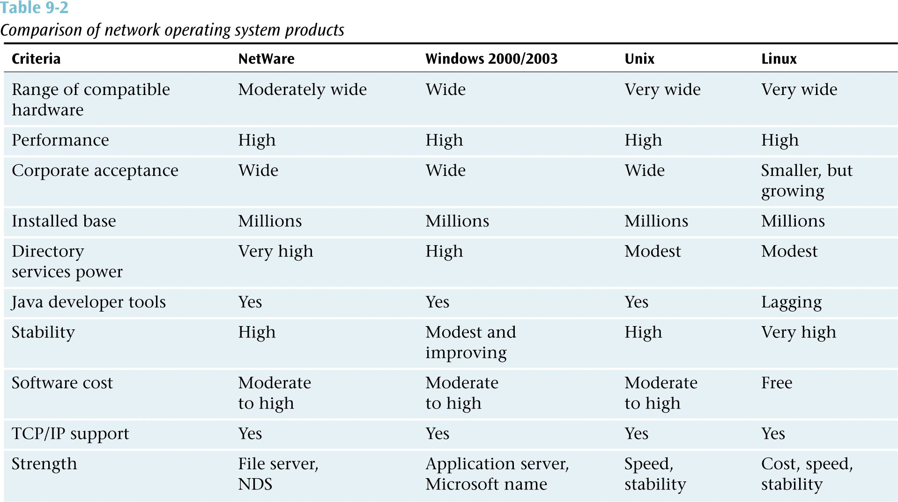

Slide 23
Client/Server vs.
Peer-to-Peer Networks
A clear majority of local area networks are client/server networks:
  Client/server network has one or more network servers supporting the operations of one or more clients, or user workstations
Peer-to-peer networks also exist:
  May have servers, but the network relies less on servers and more on communications between workstations

Slide 24
Network Software
Other types of software needed to support a network operating system:
  Utilities
  Internet software
  Programming tools
  Applications

Slide 25
Utilities
Eight of the more common groups of network utility software include:
  Antivirus software Antispam software
  Backup software Network-monitoring software
  Crash protection software Security assessment software
  Remote access software Uninstall software

Slide 26
Internet Software
Software necessary to support the server side of Internet connections
Retrieves web pages and other documents when asked to by a client workstation
Can interface with a database program allowing users to store and retrieve data via the Internet
Necessary with commercial Internet applications

Slide 27
Software Licensing Agreements
Most licensing agreements specify the following conditions:
  Software installation and use
  Network installation
  Back-up copies
  Decompilation
  Rental statement
  Upgrade availabilities
  Copyright restrictions
  Maintenance agreements
Most licensing agreements come in one of the following forms:
  Single user single station license
  Single user multiple station license
  Interactive user license
  Network server license
  Site license
  Corporate license

Slide 28
LAN Support Devices
Other devices necessary for the proper support of a LAN:
  Uninterruptable power supplies (UPS)
  Tape drives
  Printers
  Media converters
  Workstations (including thin client workstations)

