Slide 1
MIS 377
BUSINESS DATA COMMUNICATIONS
Network Design

Slide 2
Introduction
Issues in the design of a Local Area Network (LAN):
  Needs analysis – What do the users need from this network?
  Technological design – What devices are needed to properly support the demands that will be put on the network?
  Cost assessment – Can I afford it?!

Slide 3
The Traditional Approach
Following a structured systems analysis and design process:
  The network analyst met with users to determine the needs and applications
  The analyst estimated data traffic on each part of the network
  The analyst designed circuits needed to support this traffic and obtains cost estimates
  Finally, a year or two later, the network is implemented

Slide 4
Problems
The underlying technology (computers, networking devices, and circuits) is rapidly changing
  a couple of years is too slow
The growth in network traffic is immense
  everyone wants to be “hooked up” now
The balance of costs has changed dramatically over the last 10 years
  Token Ring overtaken by Cat5 Fast Ethernet

Slide 5
Building Blocks Approach
Begin by identifying applications and users, then define each as being either:
  Typical
    low volume or traffic from this node in the network
  High traffic
    heavily used application or user, suggesting high traffic node within the network
Then design a network to support this 2x2 matrix

Slide 6
2x2 Classification Table
APPLICATION
Typical
High
Traffic
Typical
100
100/1000
USER
High
Traffic
100/1000
???

Slide 7
Classifying Applications
Review the list of applications that currently use the network
  Identify the location of each one
  Identify the hardware and software requirements (baselining)
  In many cases, the applications will be relatively well defined

Slide 8
Classifying Users
Application systems used to account for the majority of network traffic. Today, use of the Internet (i.e. e-mail and WWW) produce most network traffic
Therefore, you must also assess the number and type of users that will generate and receive network traffic

Slide 9
And So …
Assess the relative amount of traffic generated in each segment, based on some rough assessment of the relative magnitude of network needs (i.e. typical vs. high volume)
  “Typical” users are allocated the “base level” client computers, as are servers supporting “typical” applications.
  “High volume” users and servers are assigned some “advanced” computers and possibly dedicated or higher capacity network segments.

Slide 10
What Normally Happens?
Failure (9%)
Success
(35%)
Partial
Success (56%)

Slide 11
What Goes Wrong?
Needs Analysis Problems
  64% had incomplete/inaccurate requirements
  30% encountered significant change in business requirements
Technology Problems
  99% bought the wrong equipment
  38% encountered vendor misrepresentation
68.7% of all statistics are
made up on the spot!!

Slide 12
Technology?
For each set of computers we connect to the network using a …
To connect a set of collision domains, we use a …
Our servers are typically connected to the network through a …
We typically connect to the backbone network using a …
HUB/SWITCH
SWITCH
SWITCH
ROUTER

Slide 13
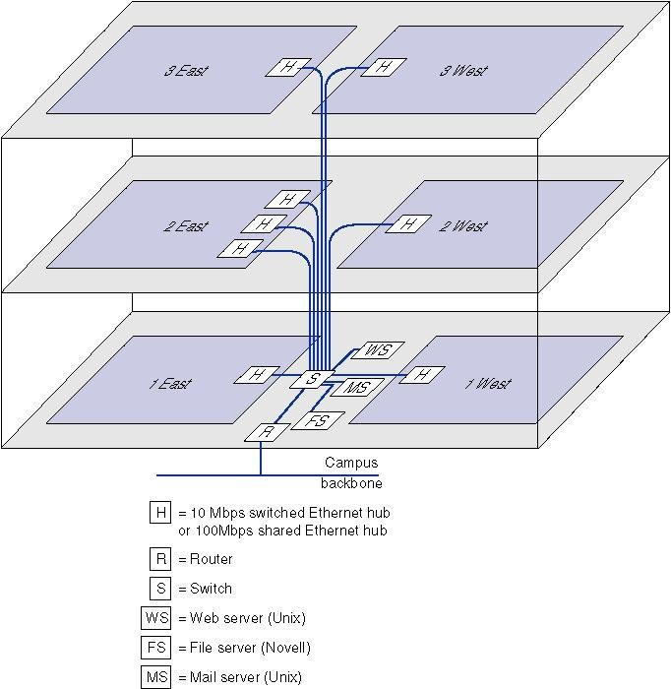

Slide 14
Looking For Hardware?
CDW:
  www.cdw.com
  Useful catalog of basic and professional grade networking equipment

Slide 15
White’s LAN Example
What type of system will interconnect twenty workstations in one room and 15 workstations in another room to a central server, which offers:
  Internal e-mail
  A database that contains all customer information
  High quality printer access

Slide 16
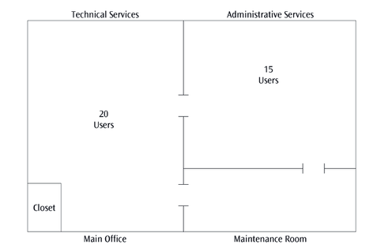

Slide 17
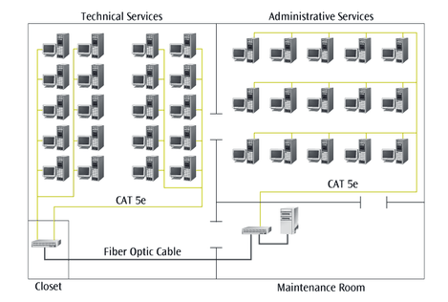

Slide 18
But why … ?
What are the justifications for the solution offered by White?
What hardware should we buy to implement this design?
What happens if we now define 5 of the technical services users as “high traffic”?
  How would that change the design?
  What new hardware might we need to buy?

Slide 19
Nomenclature
P1
Typical PC (1.5GHz)
M
Modem
P2
High Traffic PC (2.8GHz)
H
Hub
PR
Printer
SW
Switch
FS
File Server
R
Router
EF
Email/Fax Server

Slide 20
An easier way to draw (ALT I)
Technical
Services
Administrative
Services
24 port
24 port
P1
H
FO
H
P1
Cat5e
Cat5e
x20
FO
x15
Wiring
Closet
FS
Maintenance
Room

Slide 21
An easier way to draw (ALT II)
Technical
Services
Administrative
Services
24 port
24 port
P1
SW
Cat5e
SW
P1
Cat5e
Cat5e
x20
Cat5e
x15
Wiring
Closet
FS
Maintenance
Room

Slide 22
Network modeling
To identify each connection between sites:
d = distance of the connection (usually shown in either miles or kilometers)
s = security level (high, medium, low, or none)
du = duplexity (full duplex, half duplex, or simplex)
dr = data rate desired (in bps)
l = latency, or acceptable delay time across the network (usually in milliseconds, or ms)
QoS = Quality of Service (CBR - constant bit rate, VBR - variable bit rate, ABR - available bit rate, UBR - unreliable bit rate, or none)
de = delivery rate (sometimes called throughput percentage)

Slide 23
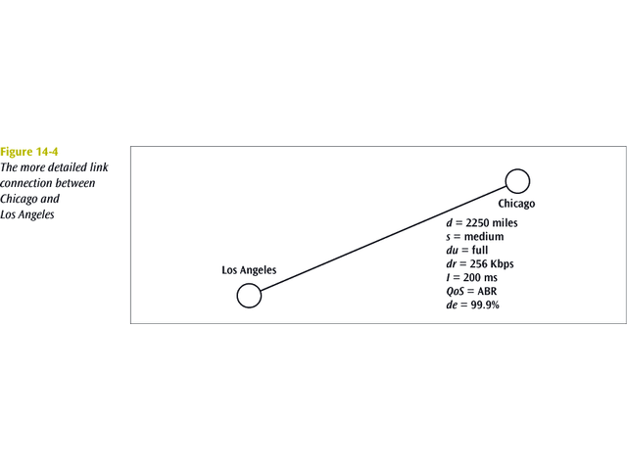
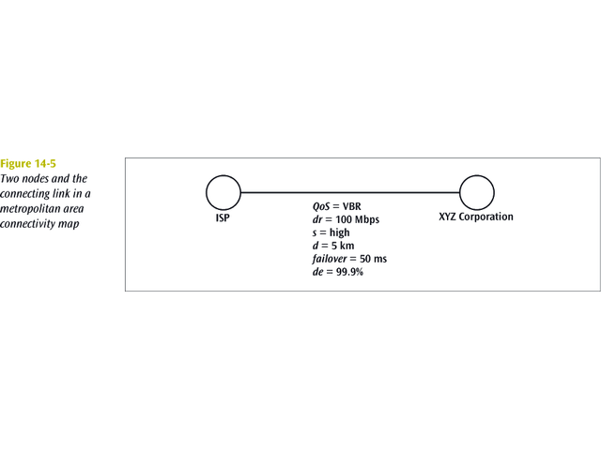
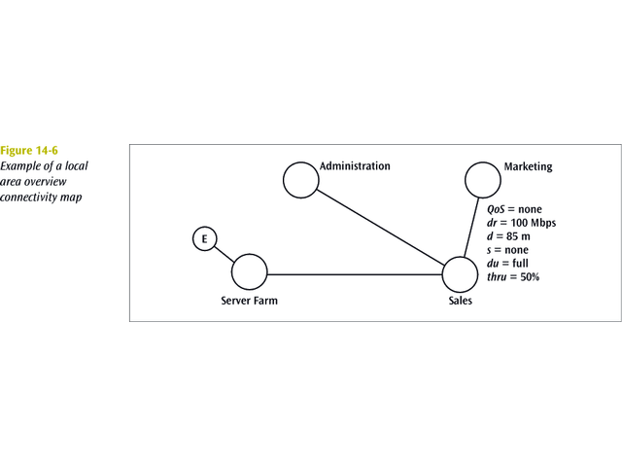

Slide 24
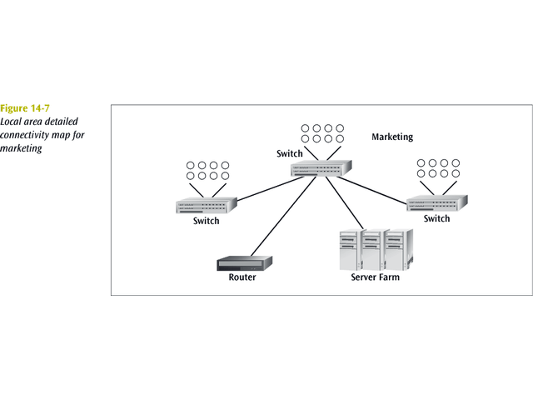

Slide 25
Summary
In order to construct a LAN, you must:
  Carry out a needs analysis, in order to develop a technological design, and cost assessment
  You need to know the needs of the company before you can design the LAN, but not every company can afford the LAN they need!
The designs should:
  Show the logical connection of users
  Show the support for traffic between nodes (connectivity maps)
  Allow a technically-competent technician to install the physical LAN layout

