Slide 1


Slide 2


SHIELD
Your piece has been granted a shield and may not be taken

Slide 3


FRACTURED
The current tile you're on has become fractured, you may now have another piece on the same tile

Slide 4

REWIND
Your last move has been undone

Slide 5
PROPAGANDA
WE NEED YOU!
One of the enemy pawns has fallen to your propaganda and has joined your forces

Slide 6

IMMOVABLE
Unfortunately, your piece has decided to take a lunch break and is immovable next turn

Slide 7


DEFECTED
Your piece has been unhappy with the work life balance and decided to join the other team

Slide 8

PAWNMORPHIS
One of your pawns has had a breakthrough in pawn science and evolved into a higher piece

Slide 9

WHERE AM I?
Two random pieces on the board have been swapped

Slide 10

CAMOFLOUGE
Your pieces were bored being frugal and have decided to change into something more flashy

Slide 11

FOG OF WAR
Vision of the board is obscured for the next turn

Slide 12

DECREE
By decree of your queen your king has been beheaded, you can only lose when you have no queens

Slide 13
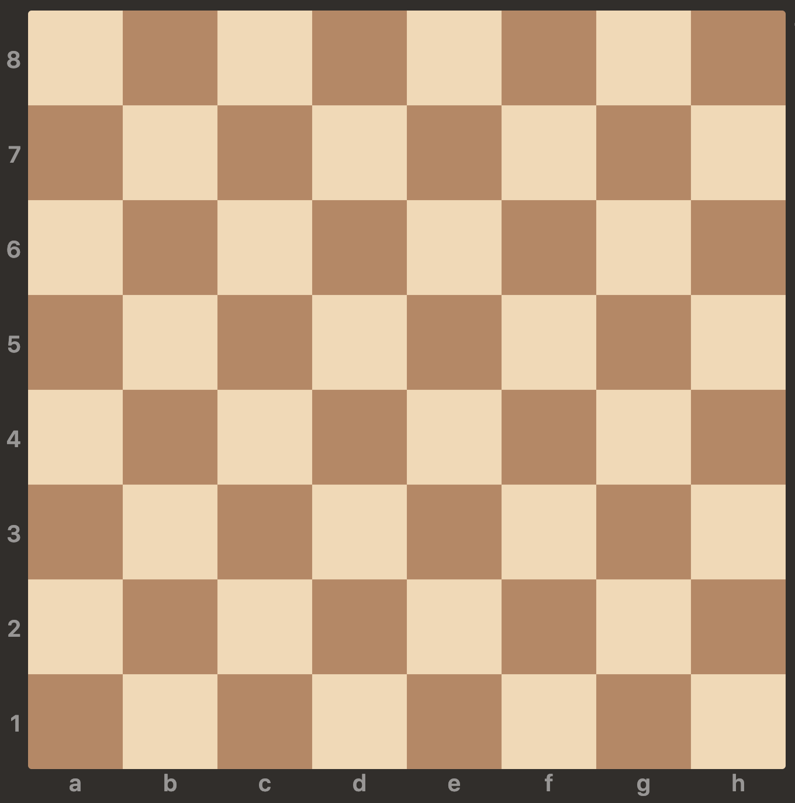

Roll a number between 2 and 12 to play

