Slide 1
Plant NER dataset

Slide 2
Statistic
Total sentences: 143,420
Filtered sentences (remove caption, reference, shorter than 5): 60,266
Split to train dataset, dev dataset, test dataset
Train | Dev | Test
44,111 | 8,123 | 8,032

Slide 3
 | total_cnt | sentence_cnt
B-Compound | 23589 | 15500
I-Compound | 9780 | 5694
B-Process | 14822 | 11764
I-Process | 2619 | 1542
B-Location | 19005 | 12454
I-Location | 5803 | 4027
B-Species | 13825 | 11426
I-Species | 5377 | 4274
B-CommonName | 32551 | 19057
I-CommonName | 5254 | 2083
O | 1209441 | 60265

Slide 4
NER experiment for different training epochs

Slide 5
Entity type
Compound
Process
Location
Species
CommonName

Slide 6
Training dataset
 | B- CommonName | B- Compound | B- Location | B- Process | B- Species | I- CommonName | I- Compound | I- Location | I- Process | I- Species | O | Average Sentence Length | Sentence Count
50 | 10 | 27 | 8 | 11 | 9 | 0 | 5 | 5 | 0 | 3 | 1016 | 21.8800 | 50
100 | 31 | 43 | 24 | 25 | 22 | 2 | 7 | 9 | 3 | 12 | 2066 | 22.4400 | 100
200 | 78 | 76 | 42 | 50 | 42 | 9 | 23 | 15 | 8 | 20 | 3934 | 21.4850 | 200
500 | 245 | 195 | 130 | 109 | 117 | 37 | 70 | 44 | 13 | 50 | 9659 | 21.3380 | 500
1000 | 510 | 371 | 264 | 235 | 237 | 87 | 145 | 90 | 38 | 94 | 19460 | 21.5310 | 1000
2000 | 1011 | 759 | 600 | 479 | 457 | 142 | 297 | 205 | 79 | 175 | 39369 | 21.7865 | 2000
5000 | 2677 | 1914 | 1599 | 1234 | 1149 | 410 | 784 | 495 | 212 | 421 | 99143 | 22.0076 | 5000
10000 | 5360 | 3978 | 3189 | 2536 | 2350 | 819 | 1646 | 989 | 439 | 851 | 199696 | 22.1853 | 10000
20000 | 10856 | 7916 | 6318 | 4959 | 4610 | 1697 | 3249 | 1910 | 919 | 1745 | 400211 | 22.2195 | 20000
30000 | 16199 | 11693 | 9404 | 7328 | 6836 | 2608 | 4833 | 2886 | 1342 | 2626 | 598699 | 22.1484 | 30000
40000 | 21424 | 15575 | 12464 | 9805 | 9240 | 3435 | 6449 | 3818 | 1709 | 3568 | 798663 | 22.1537 | 40000

Slide 7
Testing dataset
 | B- CommonName | B- Compound | B- Location | B- Process | B- Species | I- CommonName | I- Compound | I- Location | I- Process | I- Species | O | Average Sentence Length | Sentence Count
- | 4422 | 3220 | 2691 | 2028 | 1843 | 746 | 1258 | 850 | 392 | 744 | 163443 | 22.6141 | 8032

Slide 8
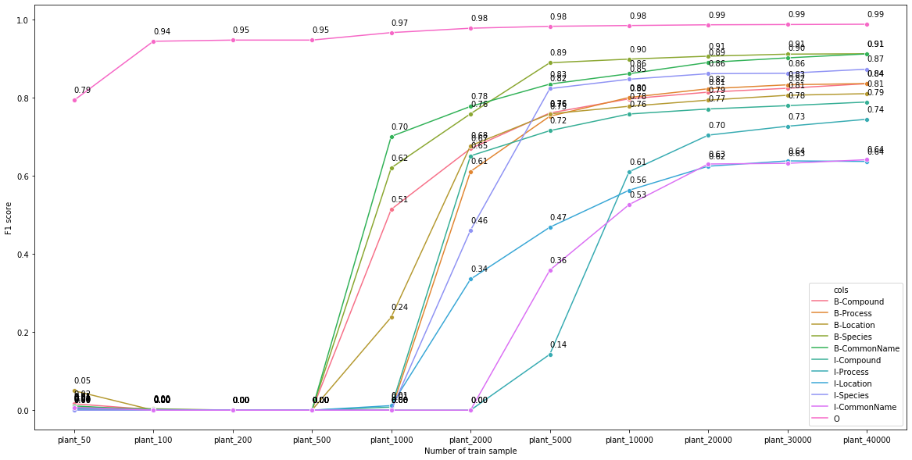
Epoch1 result (F1)

Slide 9
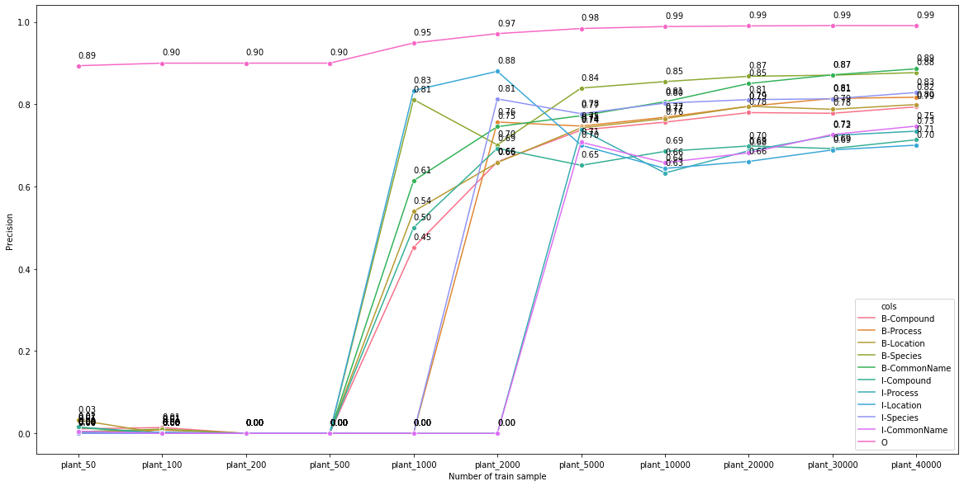
Epoch1 result (Precision)

Slide 10
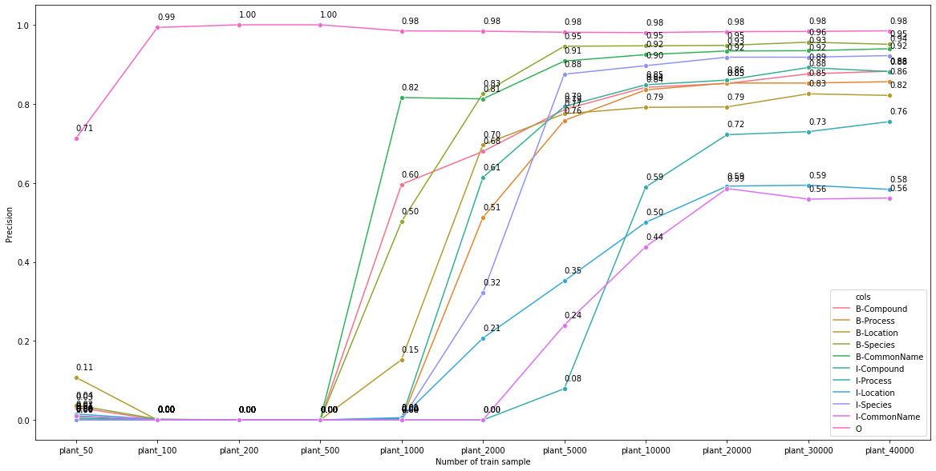
Epoch1 result (Recall)

Slide 11
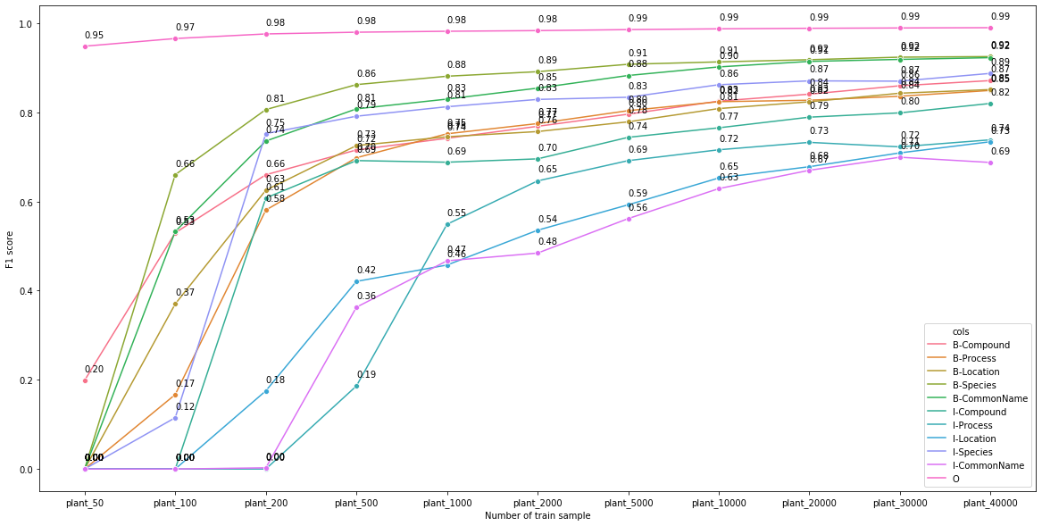
Epoch10 result (F1)

Slide 12
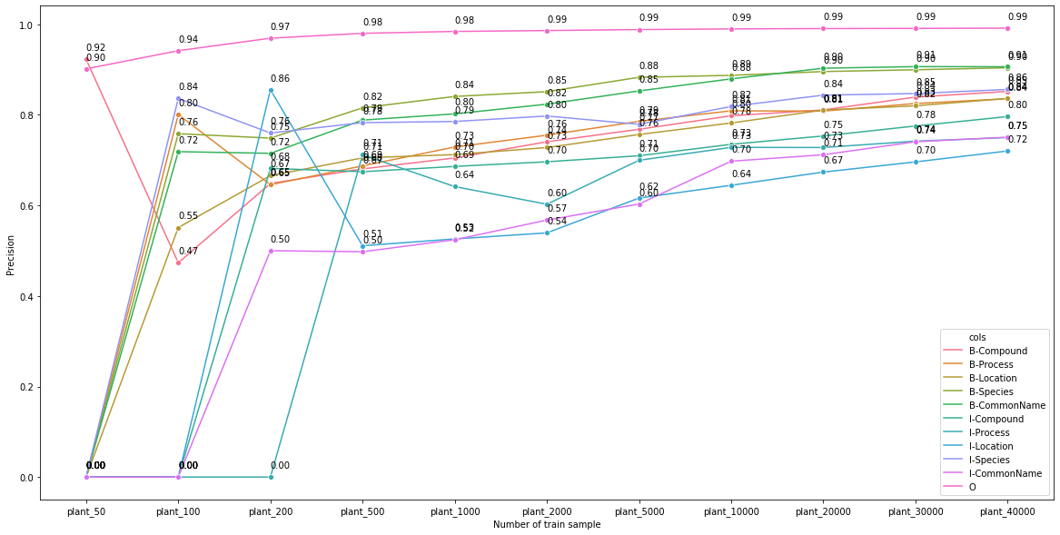
Epoch10 result (Precision)

Slide 13
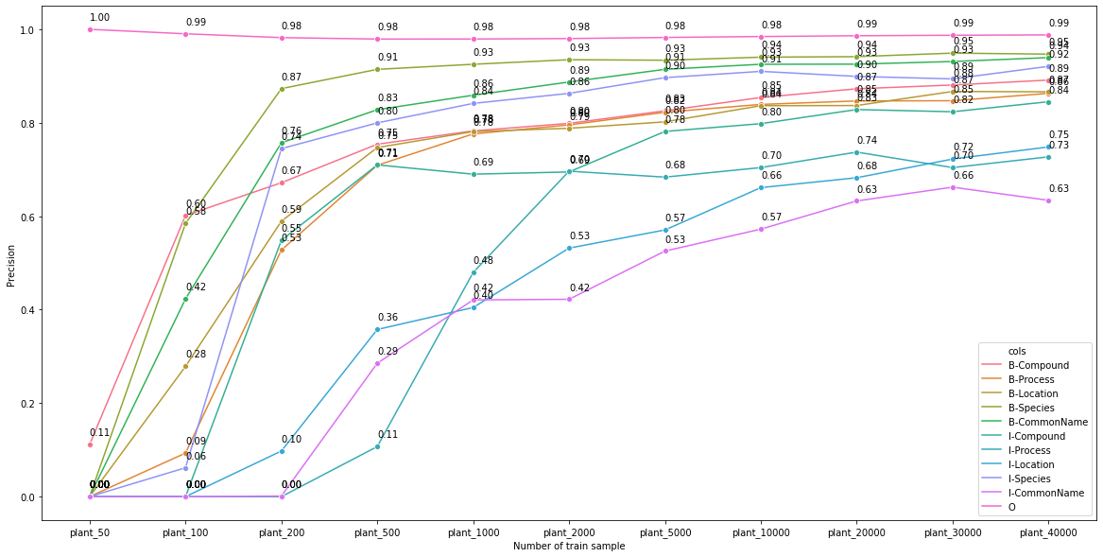
Epoch10 result (Recall)

Slide 14
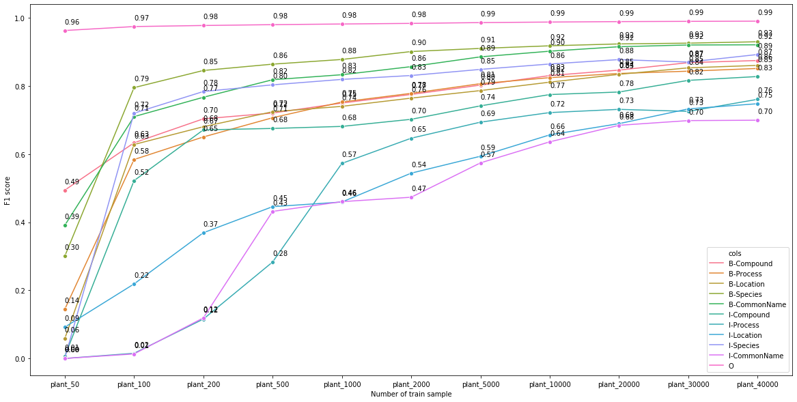
Epoch20 result (F1)

Slide 15
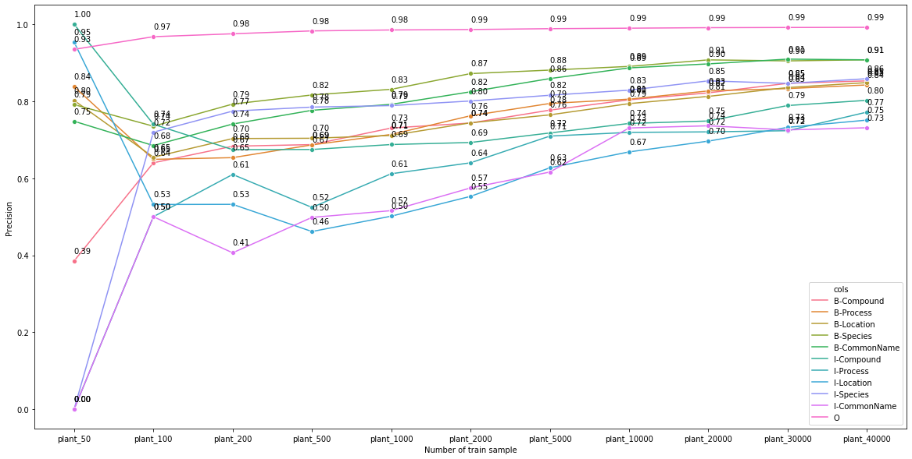
Epoch20 result (Precision)

Slide 16
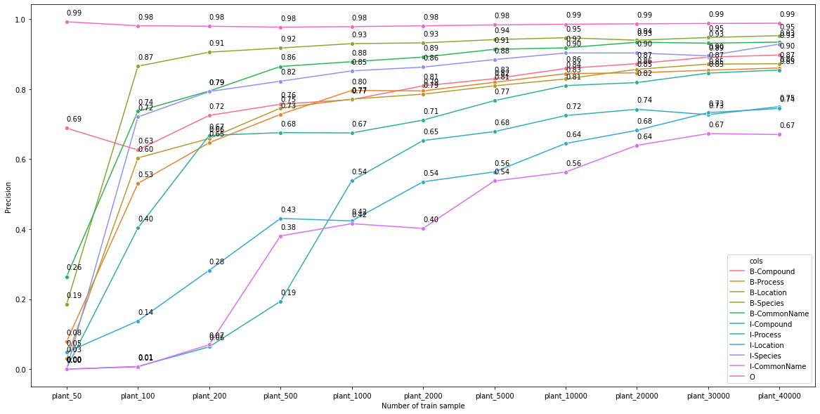
Epoch20 result (Recall)

Slide 17
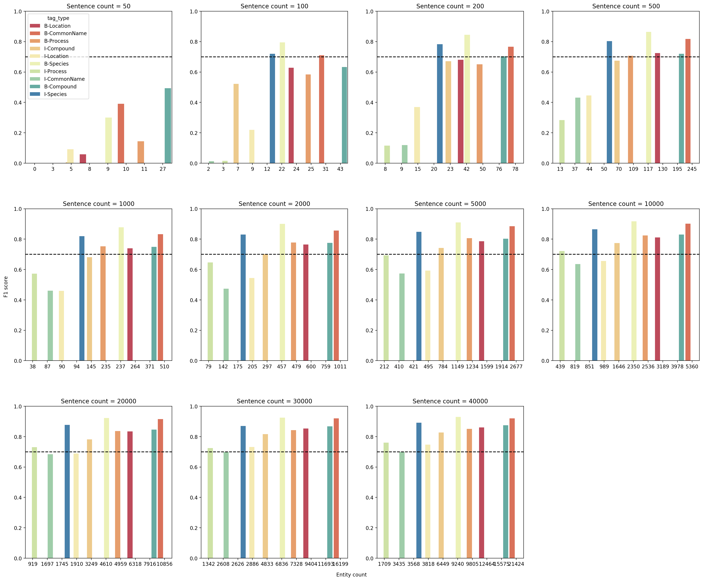

Slide 18
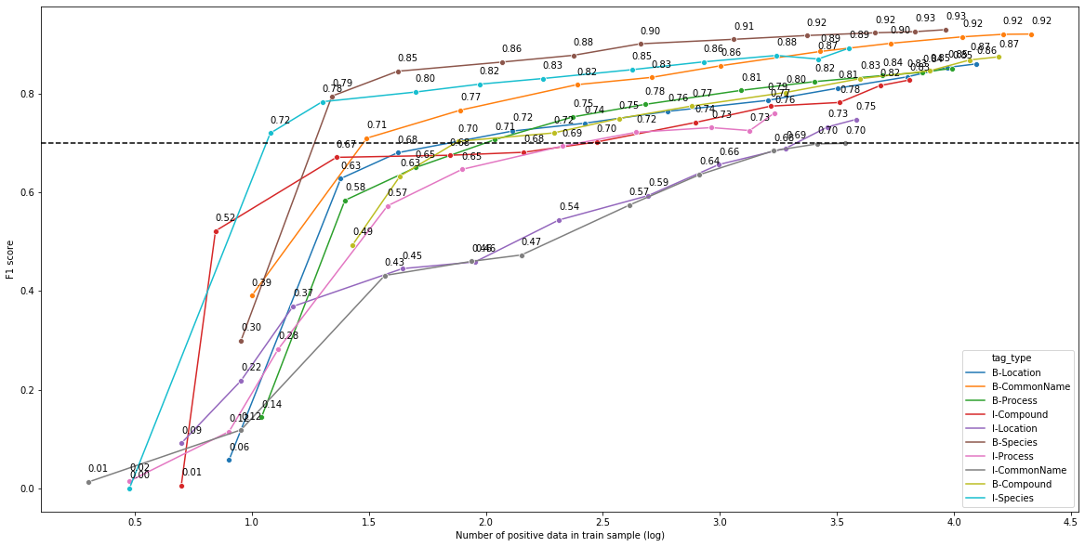

Slide 19
Plant NER result for new label

Slide 20
Plant NER
F1 |  | Compound | Process | Location | Species | CommonName
Old | B- | 0.88 | 0.85 | 0.86 | 0.93 | 0.92
 | I- | 0.83 | 0.75 | 0.75 | 0.88 | 0.70
Old ignore method | B- | 0.87 | 0.86 | 0.85 | 0.93 | 0.94
 | I- | 0.83 | 0.78 | 0.71 | 0.89 | 0.71

Slide 21
Plant NER
F1 |  | Compound | Process | Location | Species | CommonName
New | B- | 0.96 | 0.94 | 0.94 | 0.96 | 0.96
 | I- | 0.95 | 0.91 | 0.92 | 0.93 | 0.89
New ignore method | B- | 0.95 | 0.95 | 0.93 | 0.97 | 0.97
 | I- | 0.94 | 0.90 | 0.91 | 0.93 | 0.87

