Slide 1

Establishing a Just, Learning Culture
By: Jacob Achenbach

Slide 2
What is a Just Culture?
A just culture is a workplace approach that’s fair when mistakes might happen.
It focuses on learning and not blame.
It helps teams feel safe when speaking up, sharing errors, and improving together.
It sounds great but it's not always easy to put it into use.

Slide 3
Obstacles
Leaders can get stuck in the old way of a punishment first mindset.
People might be too scared to be honest about their mistakes.
Rules that are unclear or are applied uneven.
Not enough training, time, or money to support the change.
A company culture that doesn't want to shift.

Slide 4
Leadership Problems
Some leaders are more focused on who messed up rather than what went wrong.
Hard to let go of the command and control habits.
If leaders don’t model just culture then the employees wont buy into it.
Change starts at the top and that’s usually the hardest part.

Slide 5
Fear Factors
Employees might worry about punishment or bad reviews or event losing jobs.
Old experiences of blame make people skeptical of just culture.
Without trust people will try to hide their mistakes instead of reporting them.
Which would result in missed opportunities to fix problems before they get bigger.

Slide 6
Missing Pieces
No clear line between an acceptable mistake and reckless behavior.
Policies may become inconsistent across teams.
Training is usually underfunded or just skipped in general.
Everyone is busy so new culture practices might get pushed aside.

Slide 7
Old Habits Die Hard
Blame Culture can feel normal and hard to get rid of.
Some worry culture can be too soft.
People might resist open conversations about errors.
Real culture change takes patience and persistence.

Slide 8
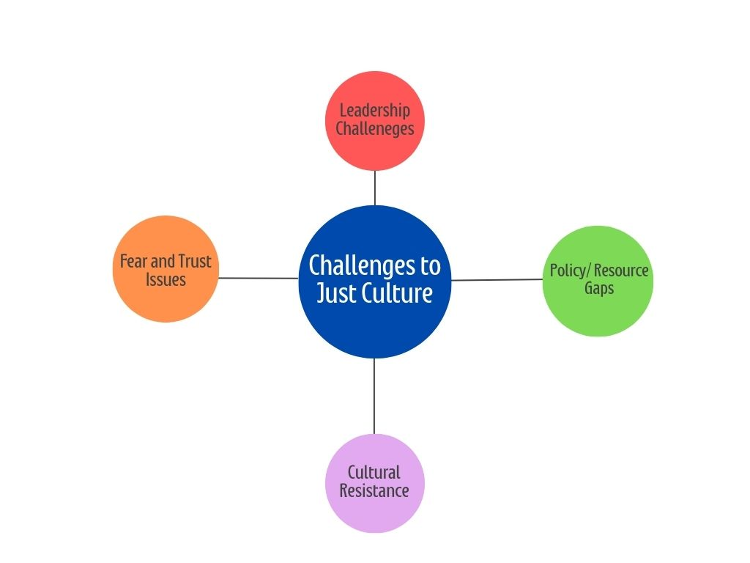
The Big Picture

Slide 9
What Actually Helps
Leaders need to walk the talk, meaning that they use fairness and learning and not blame.
Clear and consistent rules around accountability.
Invest in training, communication, and support.
Build trust so people feel safe speaking up.
Keep reinforcing because culture change isn’t a one time event.

Slide 10
Wrap up
Building a just culture is worth it but its not going to be easy.
The main blocks are leadership, fear, unclear policies, and old habits.
The key however is to keep patient stay persistent and make real commitment.

Slide 11
References
https://www.taylorfrancis.com/books/mono/10.4324/9781315251271/culture-sidney-dekker
https://pubmed.ncbi.nlm.nih.gov/31056126/
https://pmc.ncbi.nlm.nih.gov/articles/PMC3776518/

