Slide 1


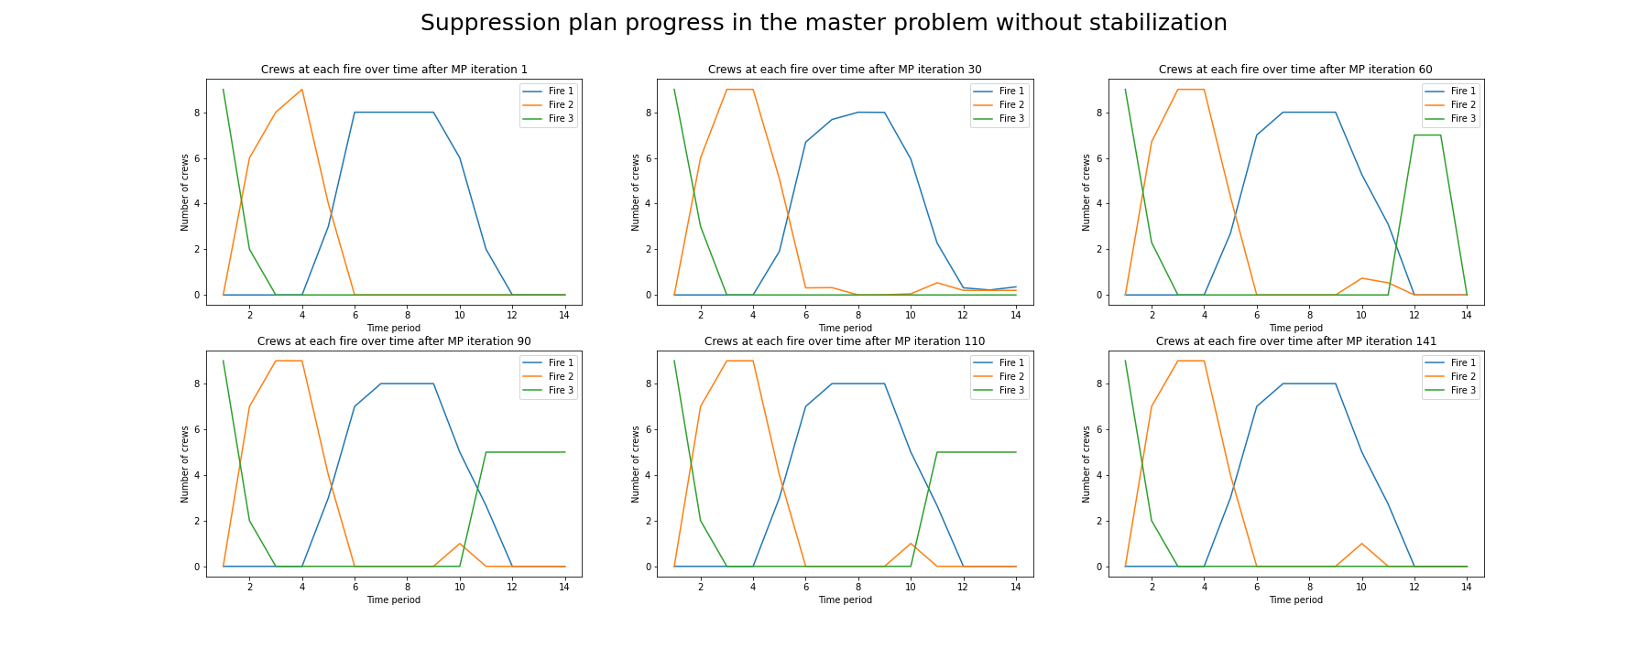
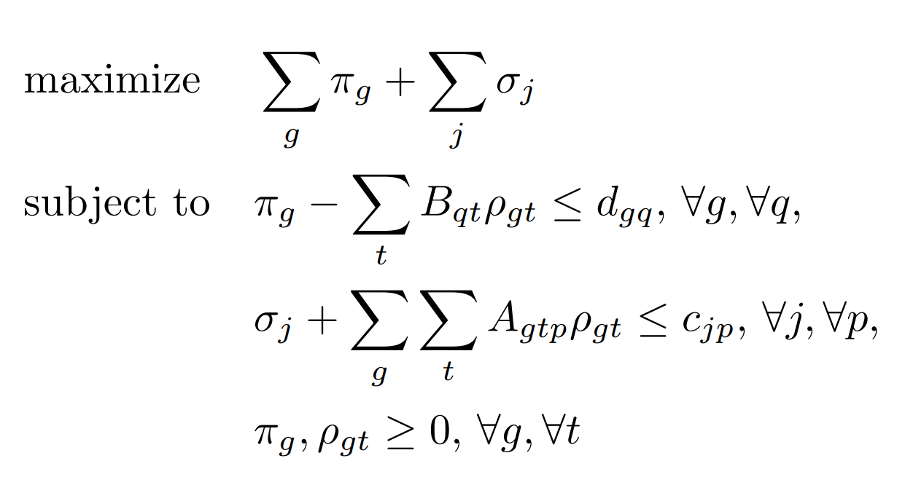
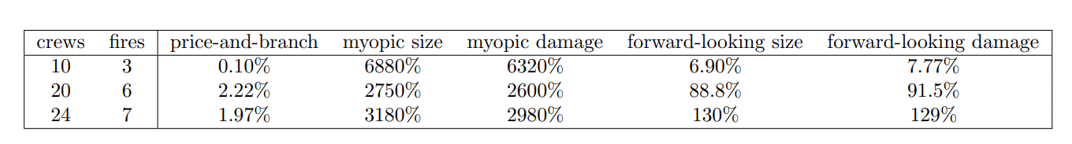
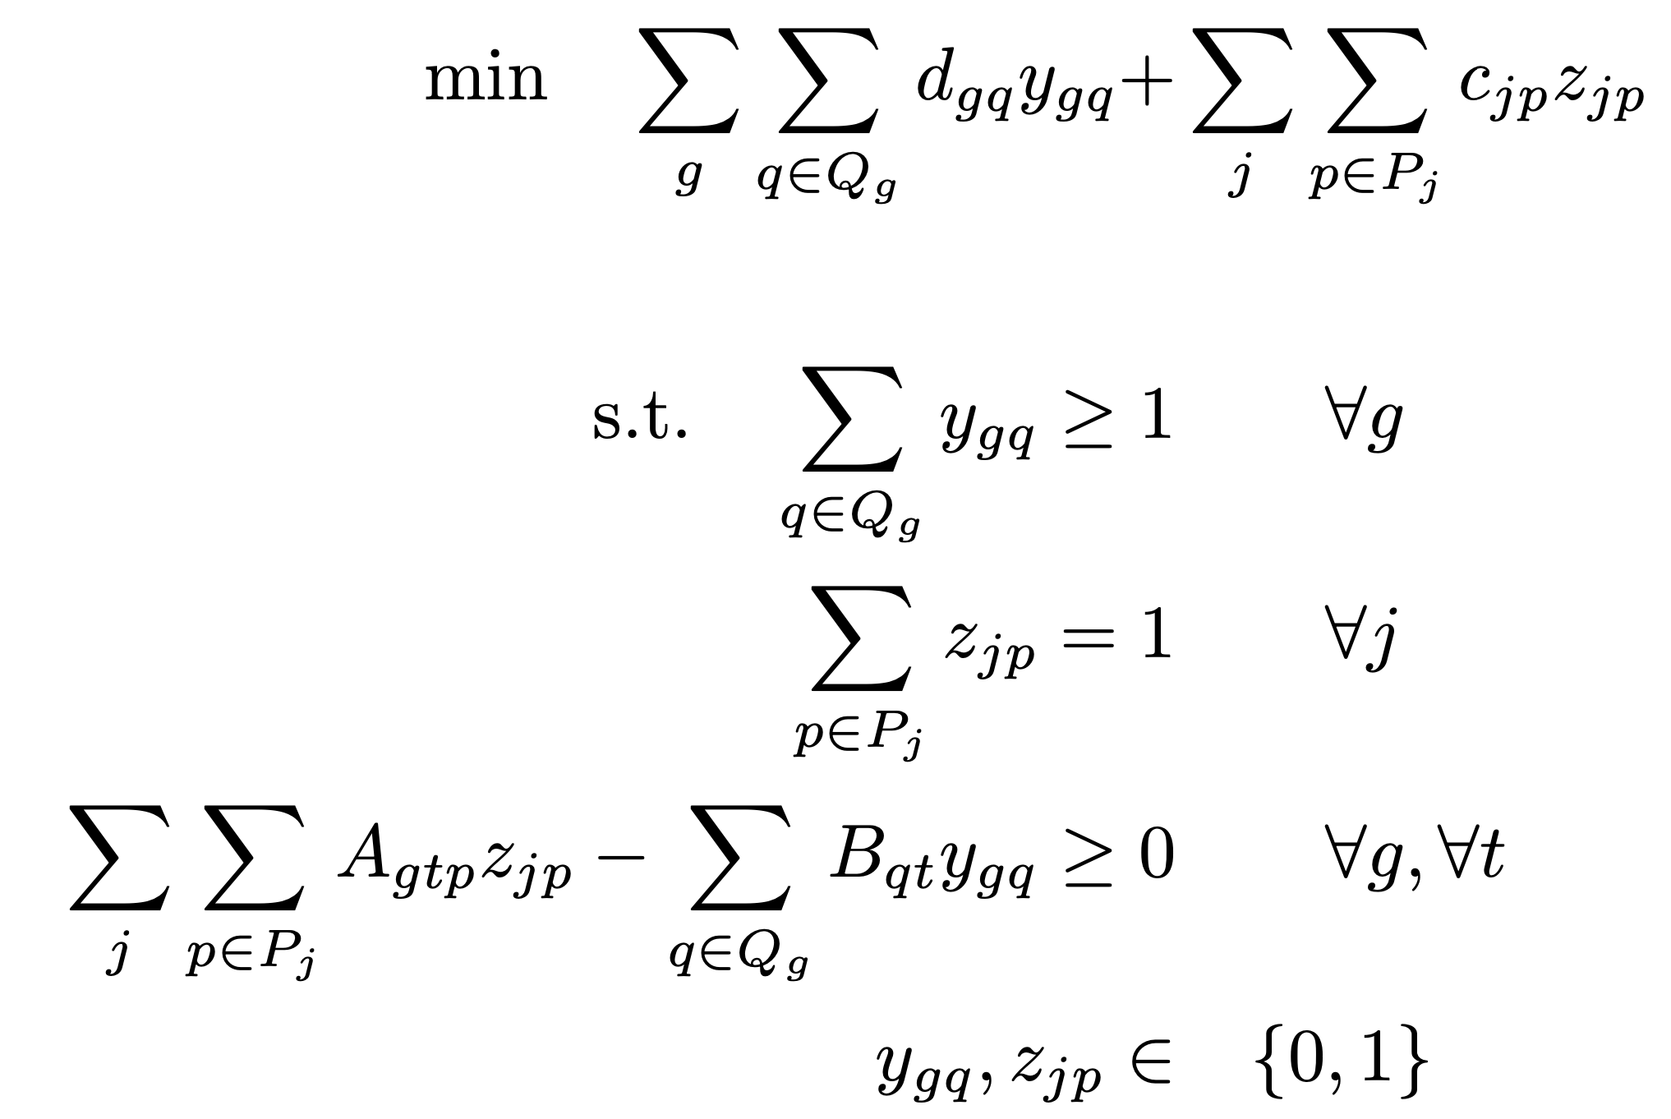
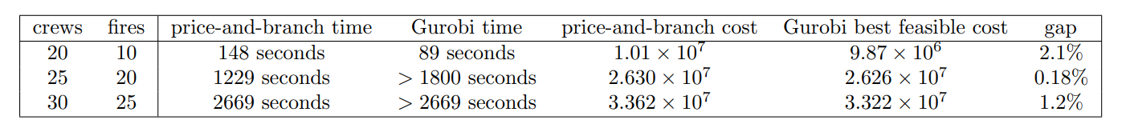
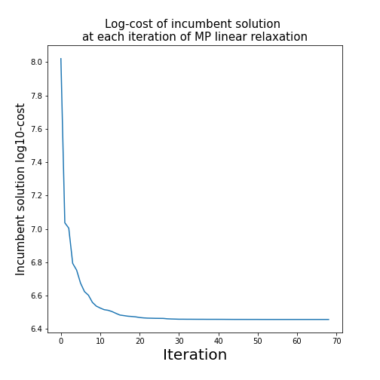
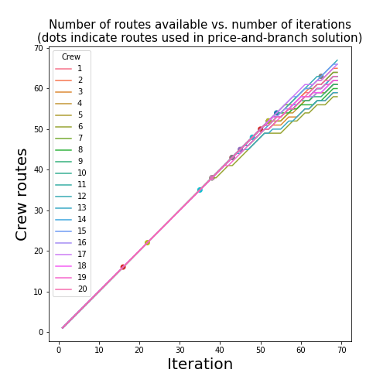
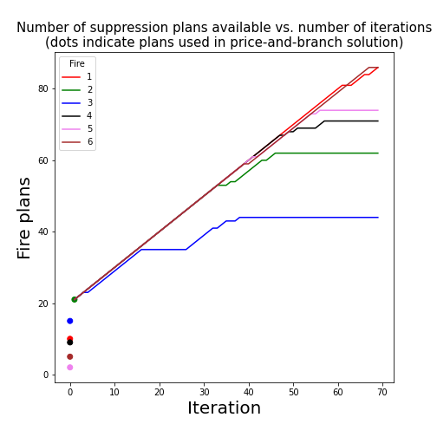


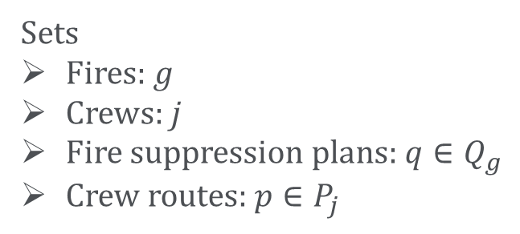
Improving dispatch and prioritization decisions
toward effective wildfire management
Claire Saillard, Jacob Wachspress
Motivation
Double Column Generation
Degeneracy and Stabilization
Increasing wildfire activity in the Western United States has created heavy economic and logistical burdens; climate change may bring even harsher fire seasons
The US Forest Service spent more money suppressing the 2021 Dixie fire than it spent for all fire suppression in 2010
Regional fire managers face difficult decisions for allocating limited firefighters to the right fires, trading off fire damage for travel cost and crew fatigue
Fire damage is insensitive to number of crews utilized after the fire is suppressed, leading to multiple optimal solutions in fire subproblem
“Useless” crew assignments can lead to bad convergence (shown below)
Natural decomposition into fire suppression plans and crew routes leads to a double column generation approach for linear relaxation
Master Problem
Crew route subproblem is a shortest path in a time-space network
HR rules such as mandatory rest requirements encoded by the absence of edges
Fire plan subproblem is a mixed-integer program that models damage as area burned
Assumes that at each time step, the fire grows at a given rate in the absence of suppression; each crew prevents a fixed amount of perimeter growth
Data
Fire plan
subproblems
Crew route subproblems
Solution: multi-objective cost function in fire subproblem
Add ε(total crews used) to cost function to break ties
In above example, reduces number of iterations from 141 to 28
Historical wildfire locations (US Forest Service incident reports)
Number of available firefighting crews in each region
Restrict to Type I (expert) crews, the most important suppression resource
Simulated (for now) crew home base locations
“HR rules” for crew routing (e.g., mandatory two-day rest every 14 days)
Dual variables
$π_{j}$ for each crew (choose one route)
$σ_{g}$ for each fire (choose one plan)
$ρ_{gt}$ for each fire, time period (crews meet fire demand); these bring local information to both subproblems
Results
Price-and-branch heuristic is tight, outperforms simple baselines
Fire subproblems seek violation
Formulation
Crew subproblems seek violation
Optimality gaps compared to Gurobi solution. Baselines assign available crews in proportion to the fires’ sizes or damage potential (if unsuppressed). Myopic plans look one time step ahead; forward-looking plans look to the end of the time horizon.
No violation = certificate of optimality
For larger instances, our algorithm terminates faster than Gurobi
However, the solver often returns a better feasible solution in equal time
Sets
Fires: $g$
Crews: $j$
Fire suppression plans: $q∈Q_{g}$
Crew routes: $p∈P_{j}$
Algorithmic Progress
Gurobi was allowed to run for the larger of 1800 seconds and the price-and-branch time. While the solver failed to terminate in the larger two cases, it still found a better feasible solution than the price-and-branch heuristic.
Data
$d_{gq}$: cost (damage) of plan $q$
$c_{jp}$: cost (travel, fatigue) of route $p$
$A_{gtp}$: indicator variable corresponding to route $p$ suppressing fire $g$ at time $t$
$B_{qt}$: number of crews used by suppression plan $q$ at time $t$
Charts show column generation progress with 6 fires, 20 crews
Future Work
Embed double column generation in branch-and-price tree to ensure optimality
Explore acceleration strategies
Specialized cuts based on problem structure
Incorporate global knowledge to improve suppression plans/crew routes generated by subproblems
Improve fire progression model
Dynamic programming formulation for increased flexibility
ML + causal inference to learn parameters from historical data
Constraint 1: each fire has at least one active suppression plan
Constraint 2: each crew has a single route assigned
Constraint 3 (linking): at each time period, the demand required by each active fire suppression plan is met by the supply of crews determined by the assigned routes
Quality feasible solutions found well before convergence
Useful fire plans generated in warm start, challenge is crew routing

