Slide 1

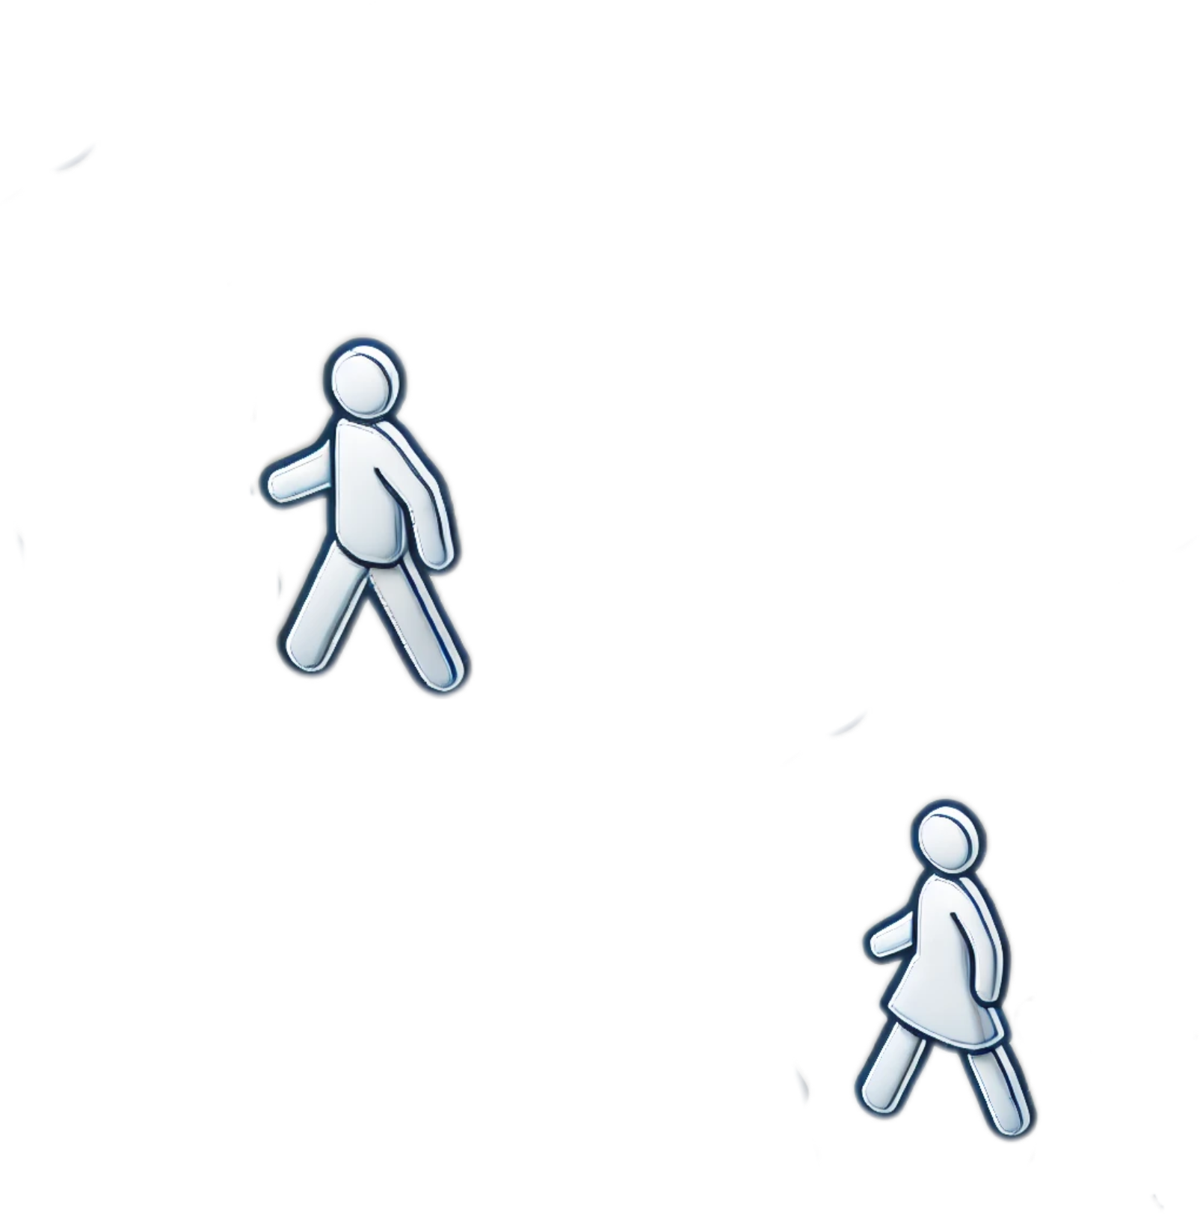
visible
occluded

Slide 2

visible
occluded

