Slide 1
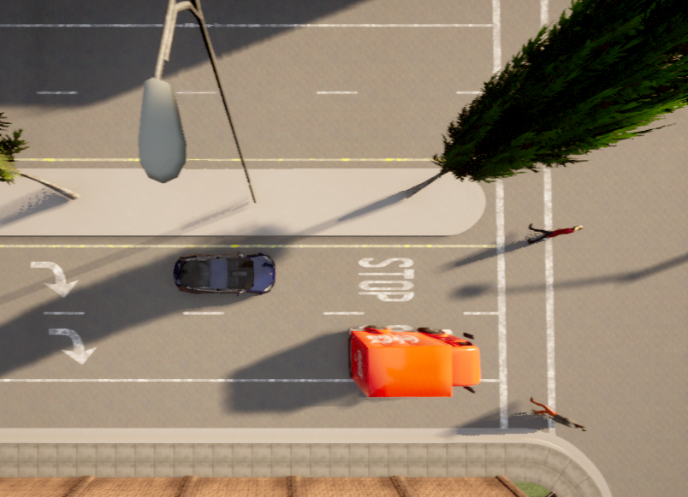







$$v_{ego_vehicle}$$
$$v_{pedestrian}$$
$$x=−7$$
(0,0)
$$x$$
$$o$$
$$y=5$$
Occluded Area
$$y$$

