Slide 1
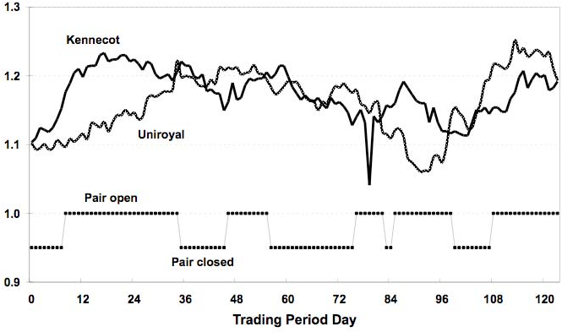
Topic & Brief Introduction
Topic:
Extending “Pairs Trading: Performance of a Relative-Value Arbitrage Rule” by Gatev, Goetzmann & Rouwenhorst, Review of Financial Studies (2006).
Brief introduction:
Tests a Wall Street rule: pair stocks whose normalized prices moved together, then bet on convergence when they diverge
U.S. daily data 1962–2002: top pairs earn up to ~11% a year in excess returns, above conservative cost estimates
Not explained by standard risk factors or simple reversal, but returns fall after the late 1980s
Our project: replicate the core experiment, then extend it to 2026 with explicit trading frictions, stress tests and new pair-selection methods
Team: Jared Cohen, Jacob Waxman, Eiko Reisz, Hao Wang
Figure 1 (GGR 2006): Kennecott vs. Uniroyal normalized prices, Aug 1963–Jan 1964. The pair opens and closes several times in one trading period.
IEOR 4576 · Extending Gatev, Goetzmann & Rouwenhorst (2006)
1

Slide 2
Summary of Paper
Do temporary divergences between historically similar stocks create relative-value arbitrage profits?
Idea: a broader Law of One Price; near-substitutes that drift apart should converge again
Method: form pairs over 12 months by minimum distance between normalized total-return prices; trade them over the next 6 months
Rule: buy the loser and short the winner at a 2σ divergence; close when the prices cross
Finding: profits survive conservative cost estimates and are not explained by known factors or simple reversal
Caveat: profitability declines in the later years of the sample
Source: GGR (2006) Table 1, fully invested, Jul 1963–Dec 2002. Waiting one day removes most of the bid-ask bounce; profits stay positive and significant.
IEOR 4576 · Extending Gatev, Goetzmann & Rouwenhorst (2006)
2

Slide 3
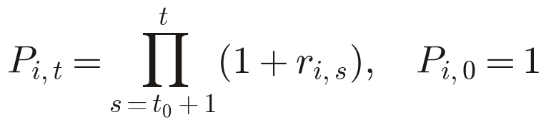
Data Sourcing
Daily CRSP data for all U.S. common stocks, including firms that later delist; factors and the T-bill rate from the Ken French Data Library.
Sources & sample
Variables
CRSP daily (WRDS): share codes 10–11 on NYSE, AMEX and NASDAQ, delisted firms included
Replication: Jul 1963–Dec 2002; extension through the latest CRSP release (Mar 2026)
Backups if CRSP access is limited: FMP, Alpha Vantage, Massive
Primary: RET (with dividends), DLRET, price, volume, shares outstanding, SIC, PERMNO
Constructed: total-return index; market cap → NYSE size deciles; SIC → sectors
Filtering & missing data
Limitations
Exclude stocks with any zero-volume or missing-return day in the formation window
Delisted positions close at DLRET; −30% if it is missing for performance delistings
Missing returns while listed are set to zero; nothing is interpolated
Daily closes ignore intraday execution; costs are inferred by waiting one day
Borrowing costs and short recalls are not observed
The ~23-year extension is shorter than the paper's 40 years and dominated by a few crises
Fallback vendors may under-cover delisted firms (survivorship bias)
IEOR 4576 · Extending Gatev, Goetzmann & Rouwenhorst (2006)
3

Slide 4
Pairs Construction Methodology
Start from the paper's mechanical rules, then make pair selection adaptive.
Paper's rules (baseline)
Our ideas (in progress)
Entry: open a long–short position when normalized prices diverge by more than 2 formation-period standard deviations
Convergence exit: close when the two price paths cross again
Time exit: if they never cross, close at the end of the 6-month trading period
Delisting exit: close at the delisting return or the last available price
Risk analysis: returns, worst losses, risk factors, transaction costs and short-selling risks; do not lean on historical VaR
Build pairs on each stock's total-return index, dividends included
ML-based pair selection (specified on slide 12)
Regime-based selection: choose dynamically which pairs to trade
Structural-break test with risk factors: drop pairs that stop moving together and close their positions
IEOR 4576 · Extending Gatev, Goetzmann & Rouwenhorst (2006)
Jared Cohen (draft) · 4

Slide 5
Research Questions → Experiments
The paper answers seven questions with one engine, the pairs-trading simulation. We replicate each experiment before extending any of them.
Research question | Paper experiment | Table | Target to replicate (top-20 pairs)
Q1 Is pairs trading profitable? | Simulation: trade on the signal day vs. wait one day | T1 | 1.44% vs. 0.90%/mo employed; 0.81% vs. 0.52% committed
Q2 What trades, and how often? | Trading statistics; size and sector mix | T2 | 1.96 round trips; open 3.76 mo; 71% utilities
Q3 Only one sector? | Pairs matched within 4 S&P sectors | T3 | Util 1.08%, Transp 0.58%, Fin 0.78%, Ind 0.61%
Q4 Explained by known factors? (gate) | FF3 + MOM + REV and Ibbotson regressions; VaR | T4–T5 | α 0.76%/mo (t 7.08), R² 0.09; 1% VaR −1.94%
Q5 Just short-term reversal? | Random-pair bootstrap; long vs. short legs | T6–T7 | Random pairs ≈ 0; alpha from the short leg
Q6 Why did returns fall? | Pre/post-1989 split; latent common factor | T8 | Raw 1.18% → 0.38%; α 0.67% → 0.42%; corr 0.51 → 0.18
Q7 Can arbitrageurs capture it? | Implied bid-ask cost; large caps; short recalls | §3.3, T9 | 81 bp spread; 0.91% large caps; 0.85% with recalls
Data-snooping check: rules frozen in 1999; the 1999–2002 hold-out earned 10.4% a year (t 4.82)
Q4 is our gate: an idea that known factors already explain is not a new result
IEOR 4576 · Extending Gatev, Goetzmann & Rouwenhorst (2006)
Hao Wang · 5
Notes:
The paper answers seven questions with one engine, the pairs-trading simulation. We replicate each experiment before extending any of them.
The hold-out's standard deviation was 3.8% a year. From Table 1 Panel B onward, every result in the paper uses the wait-one-day rule. Our replication reports both conventions.
Because of the gate, every extension gets the same factor regression as the replication before we spend more time on it.

Slide 6
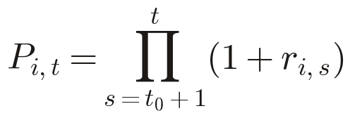
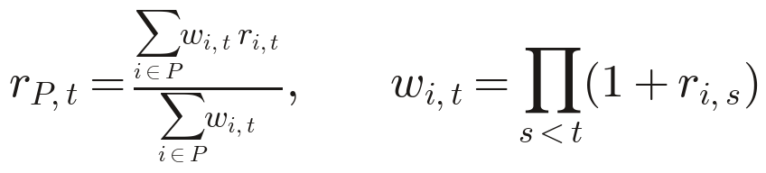

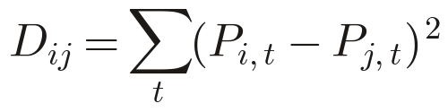
Core Experiment: The Trading Simulation
The rules are fixed by the paper: a 12-month formation window for estimation, then a 6-month trading window that is out of sample, rolled forward every month.
Formation · 12 months
Trading · next 6 months
Returns & aggregation
Universe: CRSP common stocks on NYSE, AMEX, NASDAQ, incl. later delistings
Drop any stock with a no-trade day in the window
Match each stock to its minimum-distance partner; rank pairs by distance
Estimated per pair: distance D and spread s.d. σ; nothing else is fitted
Open when normalized prices diverge by 2σ or more
$1 long the loser, $1 short the winner
Close at the next crossing, at the end of the period, or on delisting
Constraints: dollar-neutral, no leverage, top-n pairs only
Daily mark-to-market with buy-and-hold weights (paper eqs. 2–3)
Committed capital: payoff ÷ pairs selected; employed capital: ÷ pairs opened
A new cohort starts every month; the 6 overlapping cohorts are averaged
Signals are checked daily
Inputs · outputs · benchmarks
Inputs: CRSP daily RET, DLRET, VOL, PRC, SHROUT, SIC, PERMNO; French factors; T-bill
Outputs: monthly excess returns for the top-5, top-20, 101–120 and all-pairs portfolios
Benchmarks: S&P 500 and CRSP VW excess returns; FF reversal factor; random pairs
Samples: replicate Jul 1963–Dec 2002; extend Jan 2003–Mar 2026
IEOR 4576 · Extending Gatev, Goetzmann & Rouwenhorst (2006)
Hao Wang · 6
Notes:
The rules are fixed by the paper: a 12-month formation window for estimation, then a 6-month trading window that is out of sample, rolled forward every month.
Formation · 12 months: The normalized price P is the growth of $1 with dividends reinvested, built from CRSP RET. Sector variant (Table 3): match only within Utilities, Transportation, Financials and Industrials, assigned by SIC code.
Trading · next 6 months: A pair may reopen after it converges. Each top pair completes about two round trips per period. Delisting: use the CRSP delisting return, or −30% if it is missing for a performance-related delisting (Data section convention). The paper's own robustness check gives −100% to the long leg on delisting, and the top-20 portfolio still earns 1.32% a month.
Returns & aggregation: Idle cash earns zero, which understates returns slightly. Committed capital is the conservative measure, because it charges for pairs that never open. Averaging six cohorts that start a month apart follows Jegadeesh and Titman (1993) and removes the overlap in the monthly series.
Inputs · outputs · benchmarks: Pass criterion: Tables 1–2 must match within tolerance before any extension starts. Differences in data vintage (today's CRSP CIZ vs. the authors' 2006 database) are documented, not tuned away.

Slide 7
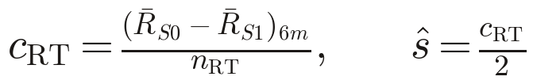
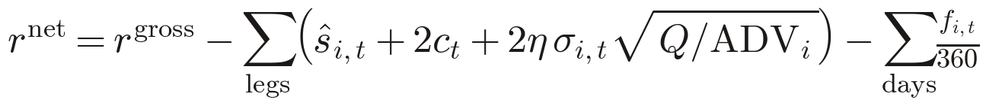
Microstructure Frictions
The paper only infers trading costs. We model them explicitly and add one friction at a time, so each cost can be measured on its own.
S0
Trade at the close on the signal day (T1 Panel A)
→ Gross upper bound
S1
Wait one day to open and close (T1 Panel B)
→ Bid-ask bounce
S2
S1 + spread, commission, price impact
→ Trading costs
S3
S2 + borrow fees, recalls, short-sale bans
→ Implementable net return
Replicate the paper
Extend: explicit net-return model
Bounce: the S0 − S1 gap implies the trading cost
324 bp per 6 months ÷ 2 round trips = 162 bp per round trip, or an 81 bp effective spread
T9a: trade only the top-3 NYSE size deciles, where few stocks are special
T9b: force-close on a short recall when volume exceeds its 18-month mean + 1 s.d.
Spread per stock and day: CRSP closing bid/ask, else the Corwin–Schultz or Roll estimator
Commissions by era (fixed until May 1975), plus square-root price impact
Short leg pays a borrow fee f: ~25 bp/yr general collateral, higher tiers for illiquid stocks
No new shorts in banned financials, Sep 19 – Oct 8, 2008
IEOR 4576 · Extending Gatev, Goetzmann & Rouwenhorst (2006)
Hao Wang · 7
Notes:
The paper only infers trading costs. We model them explicitly and add one friction at a time, so each cost can be measured on its own.
Replicate the paper: Part of an observed divergence is bid-ask bounce: the winner tends to print at the ask and the loser at the bid. Waiting one day removes most of that effect. The paper finds most risk-adjusted profit comes from the short leg (Table 7), so short-selling frictions matter more than long-side ones.
Extend: explicit net-return model: Output: the break-even effective spread s* = gross 6-month return ÷ (2 × round trips), by decade, comparable to the paper's 81 bp. Prior to test: Do and Faff (2012) find profits only modest after commissions, impact and short fees (about 30 bp a month for refined pairs) and largely gone after 2002. Rad, Low and Faff (2016) report 91 bp before and 38 bp after time-varying costs for distance pairs over 1962–2014. The paper cites 4–15 bp a year as the rebate cost for large traders (Geczy et al. 2002). We use 25 bp as the general-collateral base and run a fee-shock grid.

Slide 8
Explaining the Returns: Factors, Reversal, Decline
This is the gate: an extension is only worth our time if its alpha survives known factors and trading costs.
Replicate (Tables 4–8)
Extend the gate
Why did returns fall?
Five-factor regression with Newey–West (6-lag) errors; Ibbotson factor set where data allow
Random-pair bootstrap: 200 draws matched on prior-month return decile (T6)
Long and short legs regressed separately (T7)
Pre/post-1989 split; top-20 vs. 101–120 correlation as a latent factor (T8)
Add the FF5 profitability and investment factors (RMW, CMA)
Add one-month industry momentum (Chen et al. 2019: reversal + industry momentum explain pairs profits)
Run on 2003–2026 and in rolling 5-year blocks
Decision rule: pursue an extension only if α stays significant after factors and costs
Split at 1989, 2002 and 2009
Causes to test: cheaper trading, more arbitrage capital, a dormant common factor
Rad, Low and Faff (2016): fewer trading opportunities after 2009
Track the rolling latent-factor correlation through 2026
IEOR 4576 · Extending Gatev, Goetzmann & Rouwenhorst (2006)
Hao Wang · 8
Notes:
This is the gate: an extension is only worth our time if its alpha survives known factors and trading costs.
Replicate (Tables 4–8): Ibbotson set: S&P 500 excess return, small-stock premium, bond default premium and horizon premium, built from the Goyal–Welch and DFSCX inputs. The pre-1982 small-stock series is still missing (see report/IBBOTSON_DATA_SOURCES.md). The paper's rolling 24-month correlation chart (Fig. 4) is reproduced as a monitor.
Extend the gate: New data needed: FF5 factors and the 49 industry portfolios from the French library. Neither is in data/raw yet.
Why did returns fall?: The paper's view is that raw returns fell while risk-adjusted returns held up better (α 67 → 42 bp), consistent with a dormant common factor rather than pure competition.

Slide 9
Out-of-Sample Design: Training vs. Testing
Every reported result is out of sample in two senses: within each cohort, and across decades.
Paper's sample: replication, 1963–2002
New data: extension, 2003–2026
Train
1963–1995
Validate
1996–2002
Test (locked)
2003–Mar 2026
Fit any tuned extension (selection rules, ML)
Choose hyperparameters; includes the paper's 1999–2002 hold-out
Run once; contains the GFC, COVID and every stress window
Within each cohort
Across decades
Inference
Formation (12 months) is estimation; trading (6 months) is strictly out of sample
Filters and rankings use formation-window data only
Delisted firms are kept, so there is no survivorship bias
The paper's rules have no fitted parameters, so replication needs no training
Frozen-rule test: the exact 2006 rules run on 2003–2026 to test alpha decay
Tuned extensions follow the train / validate / locked-test split
Every configuration tried is logged
Newey–West t-statistics (6 lags) on monthly portfolio returns
Stationary block bootstrap CIs for Sharpe, max drawdown and ES
Deflated Sharpe Ratio corrects for the number of configurations tried
IEOR 4576 · Extending Gatev, Goetzmann & Rouwenhorst (2006)
Hao Wang · 9
Notes:
Every reported result is out of sample in two senses: within each cohort, and across decades.
Across decades: Running the original rules unchanged on 23 years of new data repeats the paper's own 1999–2002 hold-out logic, at a much larger scale.
Inference: Block bootstrap: Politis and Romano (1994). Deflated Sharpe Ratio: Bailey and López de Prado (2014).

Slide 10

Risk Metrics & Stress Testing
The paper warns against relying on historical VaR, so we pair it with stressed and simulated losses.
Risk metrics
Historical stress windows
Return: mean excess return (committed and employed capital), NW t, Sharpe, Sortino
Tail: VaR 1% and 5% (daily and monthly, as in T5), ES 97.5%, skew, kurtosis
Path: max drawdown, Calmar ratio, worst day and month, time to recover
Trading: round trips per pair, days open, turnover, cost drag
Episode | Window | What it stresses
1987 crash | Oct 1987 | Gap risk, spreads
LTCM | Aug–Oct 1998 | Arbitrage capital withdrawal
Quant quake | Aug 6–10, 2007 | Crowded stat-arb unwind
GFC + short ban | Sep 2008–Mar 2009 | Non-convergence, shorting
COVID crash | Feb 19–Mar 23, 2020 | Volatility, wide spreads
Meme squeeze | Jan 2021 | Short-leg squeeze
Rates / banks | 2022; Mar 2023 | Utility and bank pairs
Hypothetical shocks & Monte Carlo
Spreads ×2 and ×3; borrow fee 300–1,000 bp/yr; recall probability ×3
Forced liquidation of all open pairs on the worst day
Block bootstrap of daily P&L for the loss distribution
Simulated OU spreads with regime-switching κ for non-convergence losses
Hypothesis: Do and Faff (2010) find the strategy held up in prolonged turbulence, including the GFC
IEOR 4576 · Extending Gatev, Goetzmann & Rouwenhorst (2006)
Hao Wang · 10
Notes:
The paper warns against relying on historical VaR, so we pair it with stressed and simulated losses.
Historical stress windows: Also reported: the 2000–02 dot-com unwind and August 2011. For each window: return, max drawdown, share of pairs that fail to converge, spread widening and cost drag.
Hypothetical shocks & Monte Carlo: Regime z switches the mean-reversion speed. With κ near zero, spreads stop converging within six months, the failure mode behind the paper's end-of-period losses.

Slide 11
Proposed Extensions
Ranked by what replication will tell us. Each extension must pass the factor gate.
# | Extension | Question it answers | Basis
E1 | Extended period with frozen rules (2003–2026) | Has the alpha decayed? | Do & Faff 2010, 2012; Rad et al. 2016
E2 | Refined selection: same industry, zero crossings, cointegration, copula | Does better pair choice restore profits? | Do & Faff 2010; Rad et al. 2016
E3 | ML pair ranking (next slide) | Can we predict which pairs converge after costs? | Krauss, Do & Huck 2017; Krauss 2017
E4 | Intraday execution: TAQ quotes, 5-minute bars, 2020–2025 | What does trading really cost? | Measures the spread S0/S1 only infer
E5 | News filter: skip divergences on firm-specific news | Why do some pairs never converge? | Engelberg et al. 2009; Jacobs & Weber 2015
Two trading proposals: daily vs. intraday
Daily (core): CRSP 1963–2026, close-to-close; all replication plus E1–E3 and E5
Intraday (E4): TAQ NBBO for large caps; pairs formed daily, signals checked every 5 minutes
Intraday fills at the actual bid or ask, so the spread is measured, not inferred
Regime and structural-break exits from Pairs Construction plug into E2
IEOR 4576 · Extending Gatev, Goetzmann & Rouwenhorst (2006)
Hao Wang · 11
Notes:
Ranked by what replication will tell us. Each extension must pass the factor gate.
Two trading proposals: daily vs. intraday: E4 scope: top-3 NYSE size deciles, 2020–2025, the period where TAQ access has been verified. Quote cleaning and bar construction are their own work item (see report/DATA_REQUIREMENTS.md). E5 needs a news or earnings-date source that is not yet acquired, so it is optional.

Slide 12
Machine-Learning Specification (E3)
Learn which candidate pairs to trade. The paper's distance ranking is the baseline to beat.
Setup
Features (formation window only)
Unit: a candidate pair at the end of each formation window (top 200 by distance)
Target: the pair's next-6-month return net of S3 costs
Auxiliary target: whether the pair converges within the window
Re-rank monthly with each new cohort; retrain once a year
Distance, return correlation, Engle–Granger ADF statistic, half-life, zero crossings
Hurst exponent, spread volatility, same-industry flag, size-decile gap
Amihud illiquidity, factor-beta distance, market regime (trailing volatility, Goyal–Welch)
Models & tuning
Out-of-sample evaluation
Baseline distance rank → elastic net / logit → random forest → LightGBM → small MLP
Expanding-window CV inside 1963–1995, with an 18-month purge gap between folds
Grid or Bayesian search; select on net Sharpe of the top-20 portfolio, not MSE
Validate on 1996–2002; locked test on 2003–2026, run once
Rank IC; top-20 net return vs. the distance baseline (bootstrap test); turnover
Same factor gate as the replication; Deflated Sharpe Ratio over all models tried
IEOR 4576 · Extending Gatev, Goetzmann & Rouwenhorst (2006)
Hao Wang · 12
Notes:
Learn which candidate pairs to trade. The paper's distance ranking is the baseline to beat.
Models & tuning: The 18-month purge covers one formation plus one trading window, so no fold's features or labels overlap with the next fold.

Slide 13
Production Deployment & Data Architecture
A modular, reproducible research pipeline on Google Cloud Platform.
Ingest
CRSP daily, security metadata, French factors
Validate
Missing data, corporate actions, duplicates
Store
GCS Parquet: raw, cleaned, derived
Query
BigQuery: checks, analysis, reports
Backtest
Python strategy on Cloud Run Jobs
Research pipeline
Production extension
Raw, cleaned and derived datasets stay separate
Versioned configs and timestamped outputs: reproducible, no look-ahead
Python handles pair formation, signals, portfolio construction and backtesting
Cloud Run Jobs schedule ingestion and backtest runs
Refresh the eligible universe and re-rank pairs on a schedule
Monitor open positions and portfolio drawdowns
Alerts and predefined exits when spreads or risk exposures breach thresholds
Initial scope is historical research, not live execution
IEOR 4576 · Extending Gatev, Goetzmann & Rouwenhorst (2006)
13

Slide 14
Project Feasibility & Possible Hurdles
Feasible with data already in the repo: CRSP daily 1961–Mar 2026 and French factors are acquired and validated.
Hurdle | How we address it
Transaction costs and short-selling constraints | Model trading and financing costs explicitly (scenarios S1–S3)
Exposure to systematic risk factors | Report factor-adjusted alpha; the factor gate for every extension
Profitability varies over time | Compare subperiods; extend the sample to 2026
Look-ahead and survivorship bias | Point-in-time CRSP with delisted firms; formation-window data only
Regime changes; pairs that never re-converge | Regime-aware exits, stress tests, out-of-sample testing
Overfitting from repeated testing | Predefined parameters, locked test window, sensitivity analysis
Data vintage differs from the 2006 database | Document differences; report raw and risk-adjusted returns
IEOR 4576 · Extending Gatev, Goetzmann & Rouwenhorst (2006)
14

Slide 15
References
Gatev, E., W. N. Goetzmann and K. G. Rouwenhorst (2006). Pairs Trading: Performance of a Relative-Value Arbitrage Rule. Review of Financial Studies 19(3), 797–827.
Bailey, D. H. and M. López de Prado (2014). The Deflated Sharpe Ratio. Journal of Portfolio Management 40(5), 94–107.
Chen, H., S. Chen, Z. Chen and F. Li (2019). Empirical Investigation of an Equity Pairs Trading Strategy. Management Science 65(1), 370–389.
Corwin, S. A. and P. Schultz (2012). A Simple Way to Estimate Bid-Ask Spreads from Daily High and Low Prices. Journal of Finance 67(2), 719–760.
Do, B. and R. Faff (2010). Does Simple Pairs Trading Still Work? Financial Analysts Journal 66(4), 83–95.
Do, B. and R. Faff (2012). Are Pairs Trading Profits Robust to Trading Costs? Journal of Financial Research 35(2), 261–287.
Engelberg, J., P. Gao and R. Jagannathan (2009). An Anatomy of Pairs Trading: The Role of Idiosyncratic News, Common Information and Liquidity. SSRN 1330689.
Jacobs, H. and M. Weber (2015). On the Determinants of Pairs Trading Profitability. Journal of Financial Markets 23, 75–97.
Krauss, C. (2017). Statistical Arbitrage Pairs Trading Strategies: Review and Outlook. Journal of Economic Surveys 31(2), 513–545.
Krauss, C., X. A. Do and N. Huck (2017). Deep Neural Networks, Gradient-Boosted Trees, Random Forests: Statistical Arbitrage on the S&P 500. European Journal of Operational Research 259(2), 689–702.
Politis, D. N. and J. P. Romano (1994). The Stationary Bootstrap. Journal of the American Statistical Association 89(428), 1303–1313.
Rad, H., R. K. Y. Low and R. Faff (2016). The Profitability of Pairs Trading Strategies: Distance, Cointegration and Copula Methods. Quantitative Finance 16(10), 1541–1558.
Roll, R. (1984). A Simple Implicit Measure of the Effective Bid-Ask Spread in an Efficient Market. Journal of Finance 39(4), 1127–1139.
IEOR 4576 · Extending Gatev, Goetzmann & Rouwenhorst (2006)
15

