Slide 1
To-do List Application
By Jacob Winkworth

Slide 2

Introduction
Me, myself and I:
A consultant at QA Academy.
A solid background in coding.
How I tackled the specification:
Background research into new technologies I’d be facing.
Use of BOSCARD to summaries.
Prioritisation methods:
MoSCoW

Slide 3
Consultant Journey
Version Control System: Git ✔
Source Code Management: Github ✔
Kanban Board: Jira ✔
Database Management System: MySQL Server 5.7 ✔
Back-End: Java ✔
API Development Platform: Spring ✘
Front-end: HTML, CSS, JavaScript ✔
Build Tool: Maven ✔
Static Analysis: SonarQube ✘
Unit & Integration Testing: JUnit & Mockito ✔
User-Acceptance Testing: Selenium ✘

Slide 4
Concept
Noted initial stand-out user stories.
Generated epics from those user stories.
Adhered to a simple SDLC nomenclature for following epics:
Planning, Analysis, Design…
Assigned tasks to these epics.

Slide 5
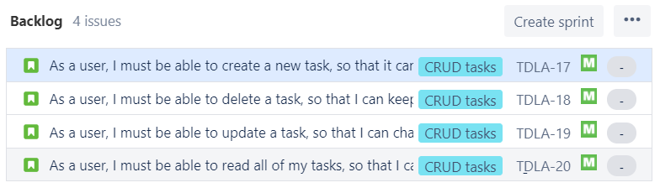
Example Epic

Slide 6
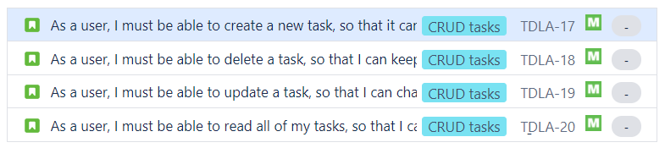
Sprint Plan

Slide 7

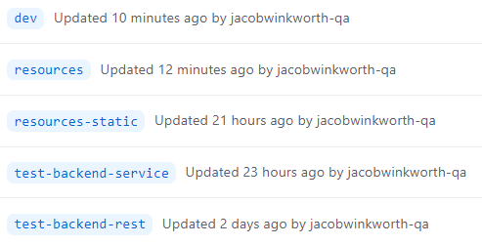
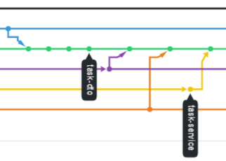
Continuous Integration
Simple branching structure:
Master -> Dev
Dev -> feature-<concept>
Feature-concept -> issue-fix
Stale branches were deleted after bug fixes.

Slide 8
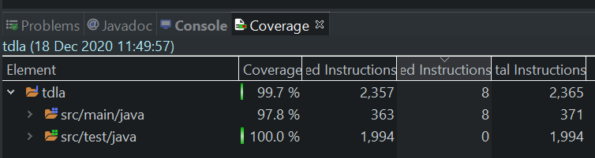
Testing (Backend)

Slide 9
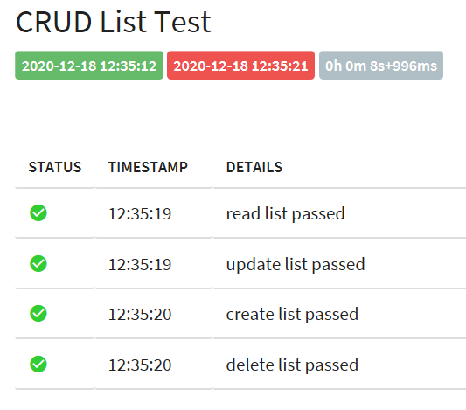
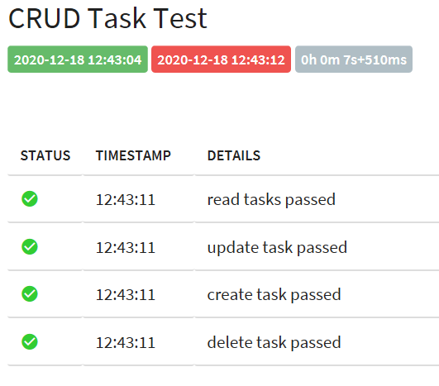
Testing (Frontend)

Slide 10
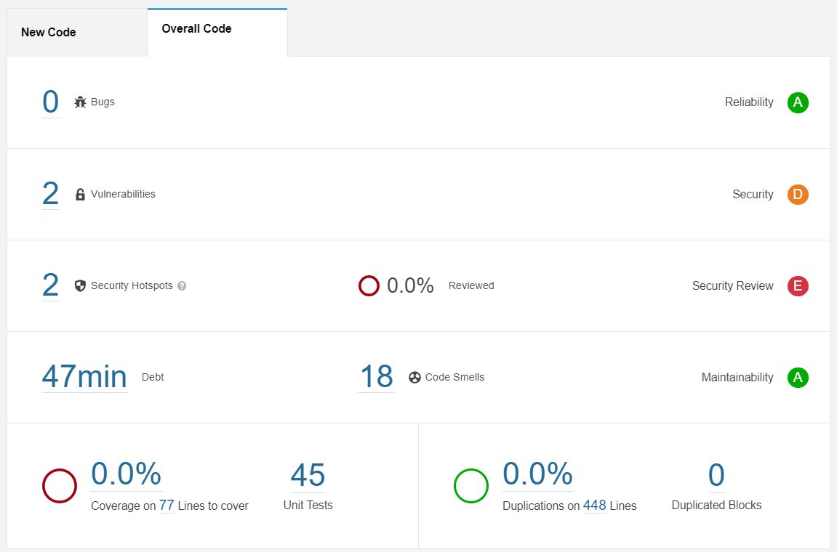
Static Analysis

Slide 11
Demonstation

Slide 12
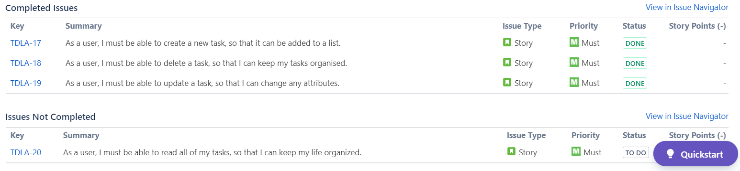
Sprint Review

Slide 13
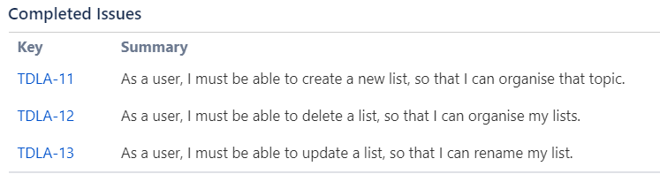
Sprint Retrospective
Sprint 1:
What went well:
Good prioritisation of tasks.
What went wrong:
Over-assigning of tasks.
Tasks were not completed.
Sprint 2:
Improvements:
Correct assignment of workload.

Slide 14
Conclusion
What went well:
MVP was met.
Strong improvement to skillset.
Good use of version control.
A great level of testing.
What could be improved:
Better usage of Jira board and project management software.

Slide 15
Thank you for listening
Any questions?

