Slide 1
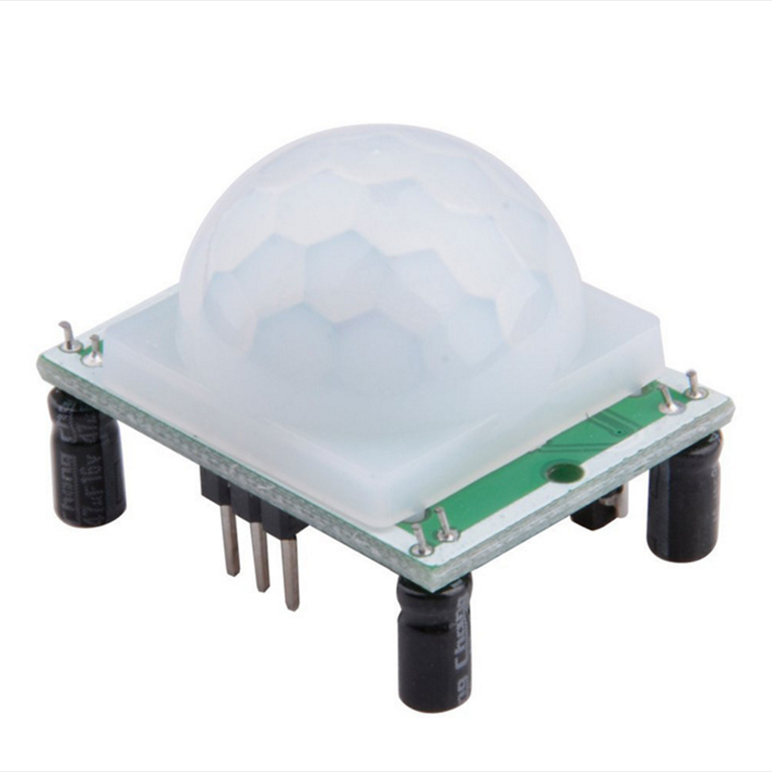
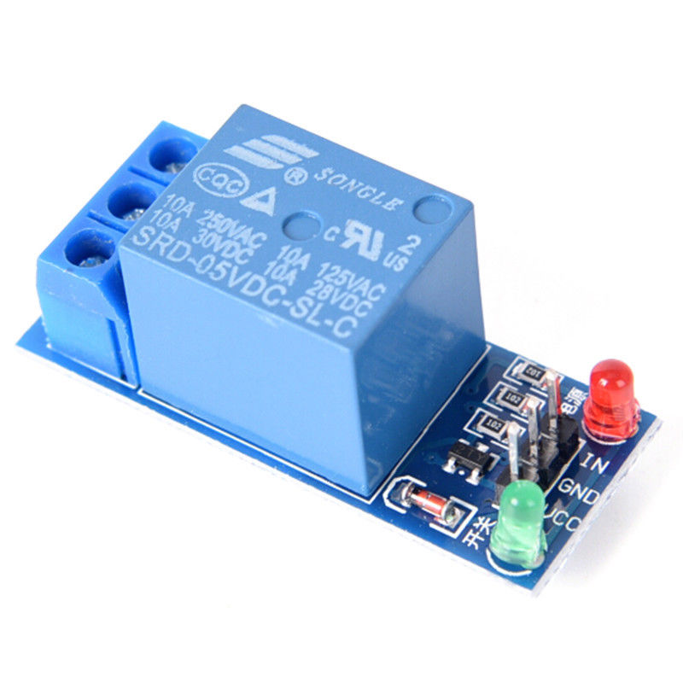
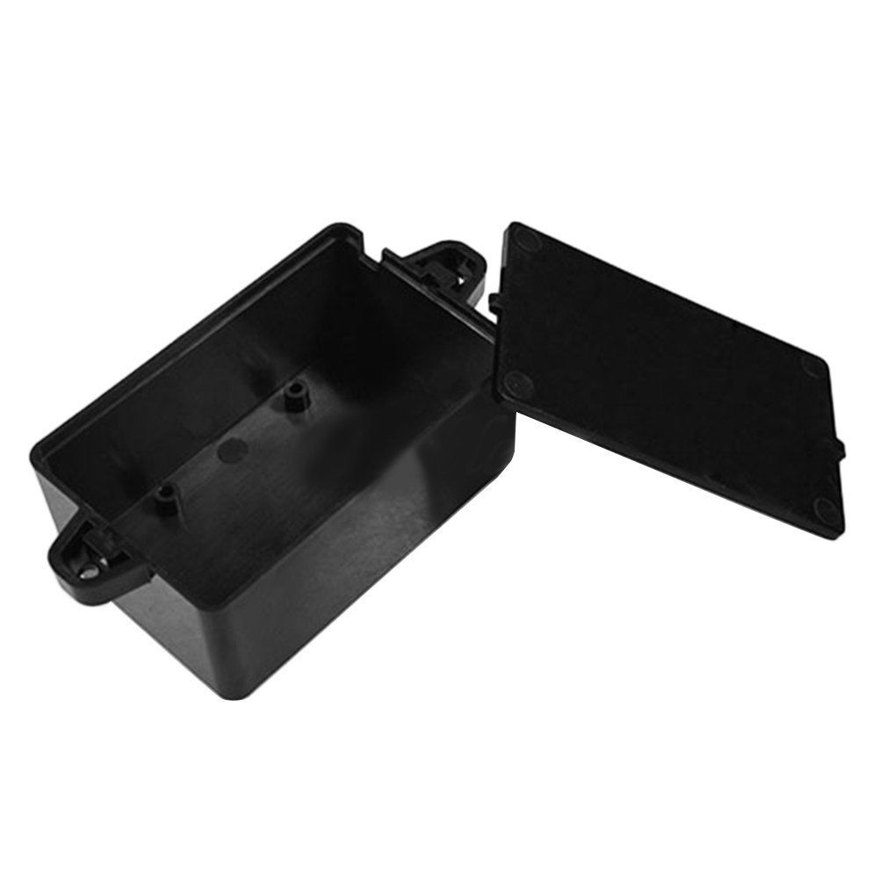
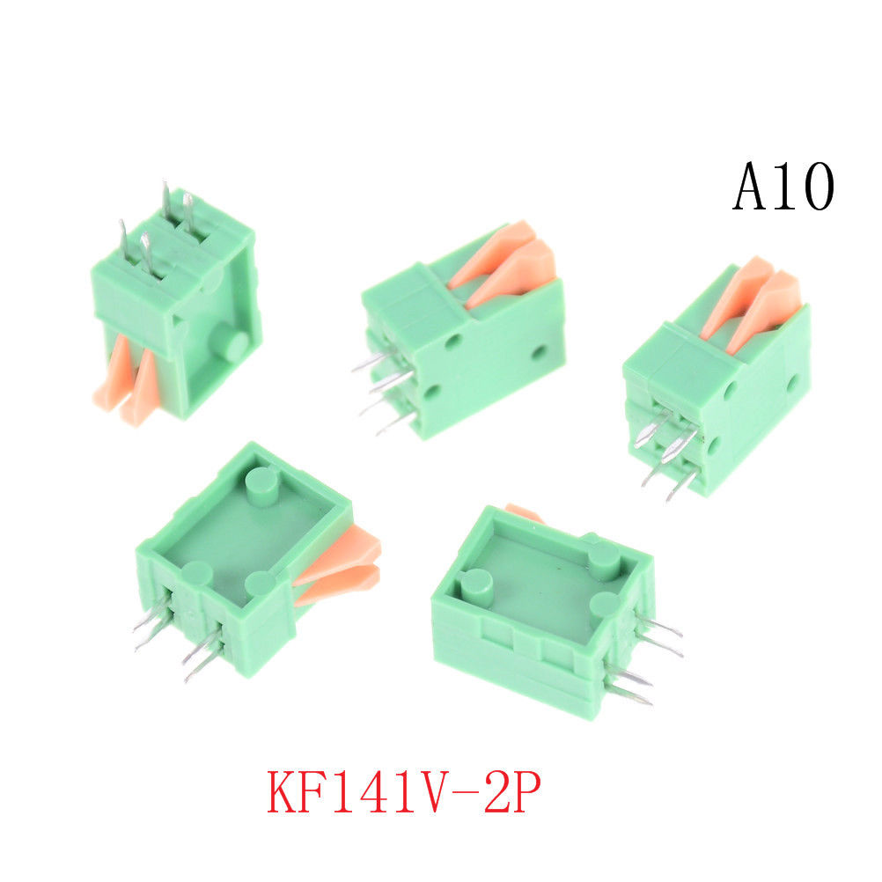
Materials list for Under Cabinet Lighting Project
1x ATTiny85
1x 100uF capacitor
1x Signal Diode (it is not important what type, it may not even be necessary in the circuit)
1x Motion detector with digital output (eBay)
1x Relay with 5Volt coil (eBay, you could also use a transistor)
2x 2 pin terminal blocks (eBay)
1x 3 pin terminal block (eBay)
1x plastic project enclosure, 82 x 52 x 35mm (eBay)
5V 1 Channel Relay Board Module Optocoupler LED For Arduino PIC ARM AVR -TOCA
HC-SR501 IR Pyroelectric Infrared IR PIR Motion Sensor Detector Module
Enclosure
KF141R KF141V 2.54mm Pitch PCB Connectors Spring Screwless Terminal Block BR

