Slide 1
Amandelbult Concentrator Defect Elimination Significant Incident Anniversaries
PLATINUM
September 2022
Confidential

Slide 2
Defect Elimination | Process
RELIABILITY INCIDENT Process Flow
Reliability Incident
Triggers
Production loss > 3 Hr
OR
Repair Cost > R250k
SE Section Engineer
EM Section Engineering Manager
AMS Asset Management Scheduler
RE Reliability Engineer
Snr AM Senior Asset Manager
Snr EM Snr Engineering Manager
GM General Manager
PMCo Planned Maintenance Co-ordinator
RCA Root Cause Analysis
1
Notification Report
Notify RE of all Reliability Incidents
If full RCA & Report can be submitted within 48 Hrs – no Notification report required
2
3
4
Schedule & Conduct RCA
only critical assets or critical failures
Submit Investigation Report
Closure
Recommendations & prevention solutions
SE & Team repair & fix, including preliminary findings (5-Why)
RE schedule RCA investigation
RE document findings, recommendations and prevention solutions
AMS create SAP work orders and Generates DR numbers
RE assign new RI number against Equipment ID
RE and SE invite all stakeholders
RE log into
Solution Tracker
SE compile 48 Hr report, present to SEM
SE & SEM review and approve
RE facilitate RCA & investigation
Schedule and Plan work
SEM review & circulate to RE & AS&R Team across Complex
Snr AM review and send to Snr EM
RE records findings, recommendations and prevention solutions
AMS Save report on Server
SE present confidence close-out side at Site Reliability Meeting
AMS save notification on Server
RE Follow up on Solutions
Within 48 Hours
Within 14 days of submitting 48 hour Report
30 - 45 Days
5
Value Reconciliation
&
Anniversary
RE confirms that all solutions are reported as complete
RE confirms that no repeat incident has been recorded in last year
Loss avoidance value added to value reconciliation and waterfall graph
RE Identify significant reliability incidents
RE extract all solutions.
RE & SE Verify compliance.
Present at Site Reliability Meeting
SEM Sign-off on the compliance and gap closure
1 Year after incident

Slide 3
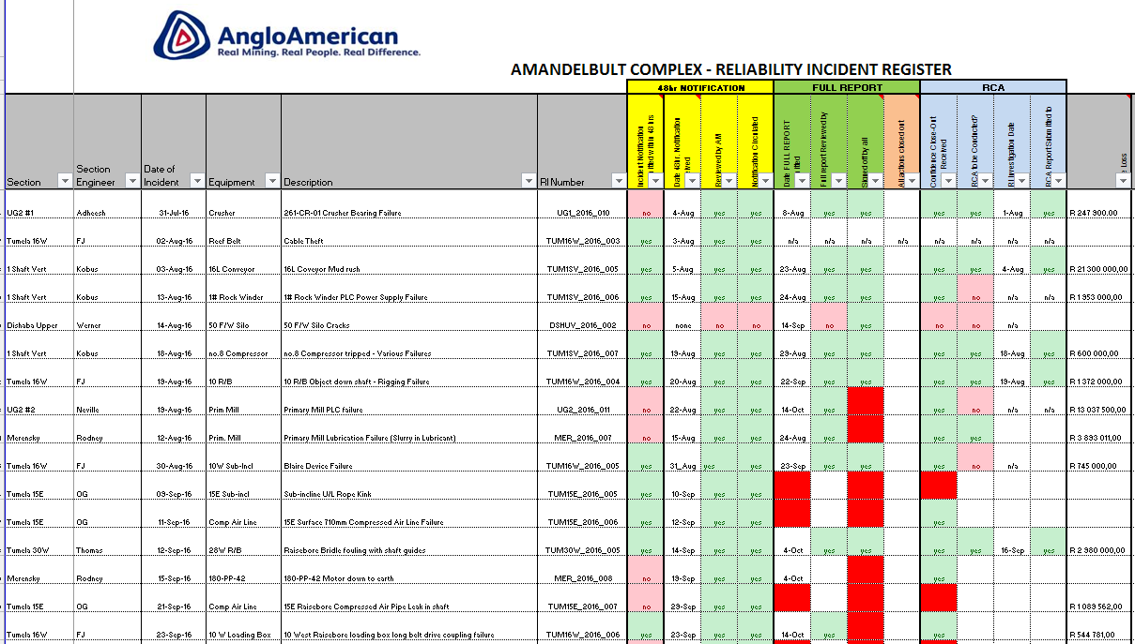
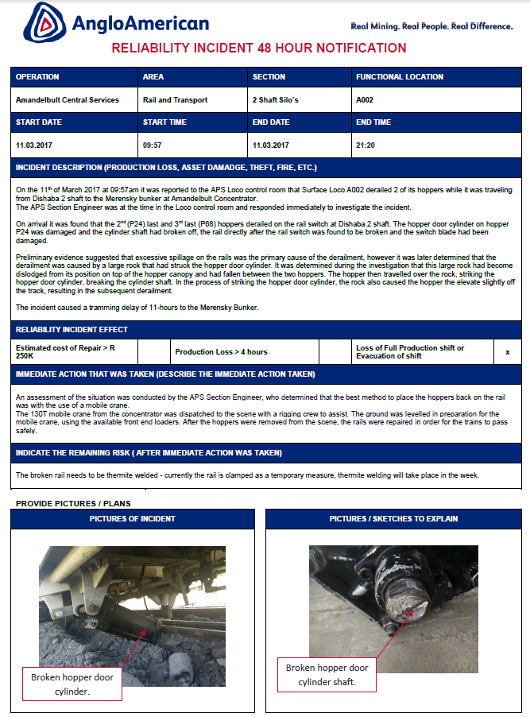
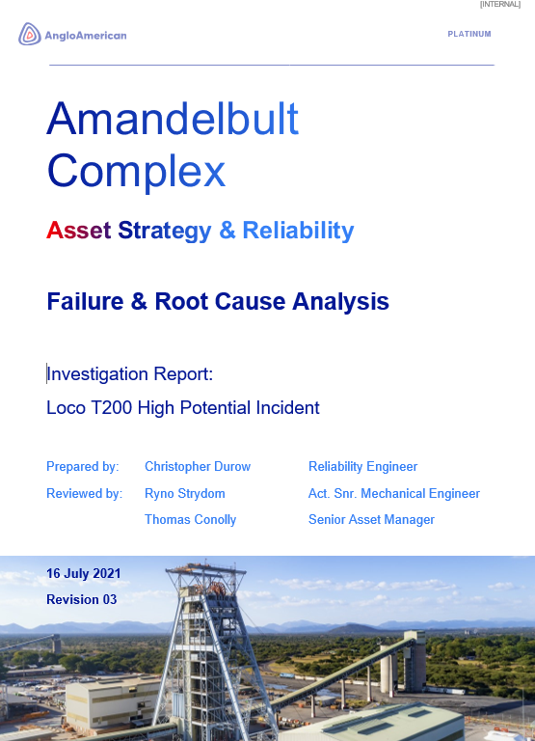
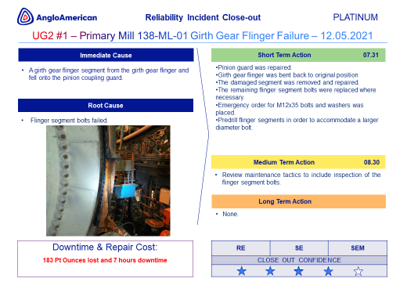
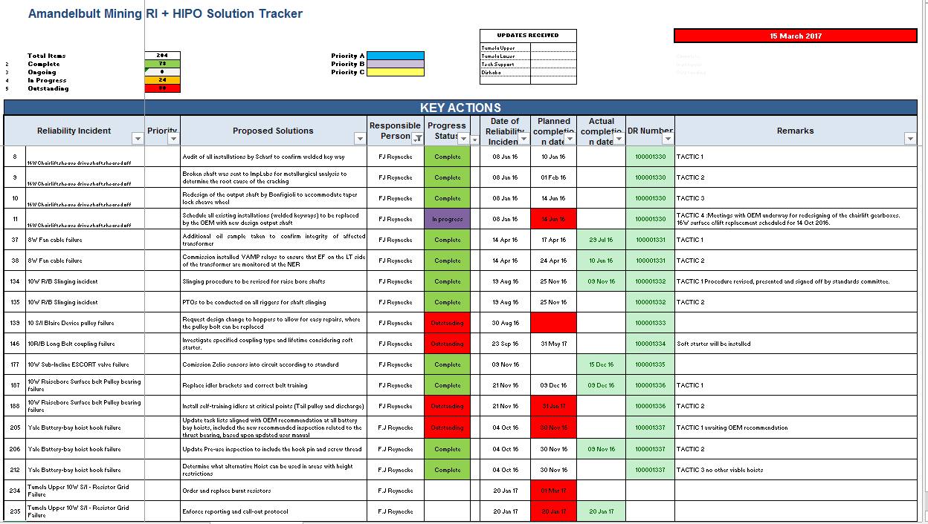
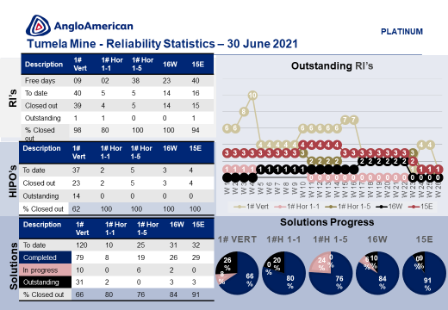
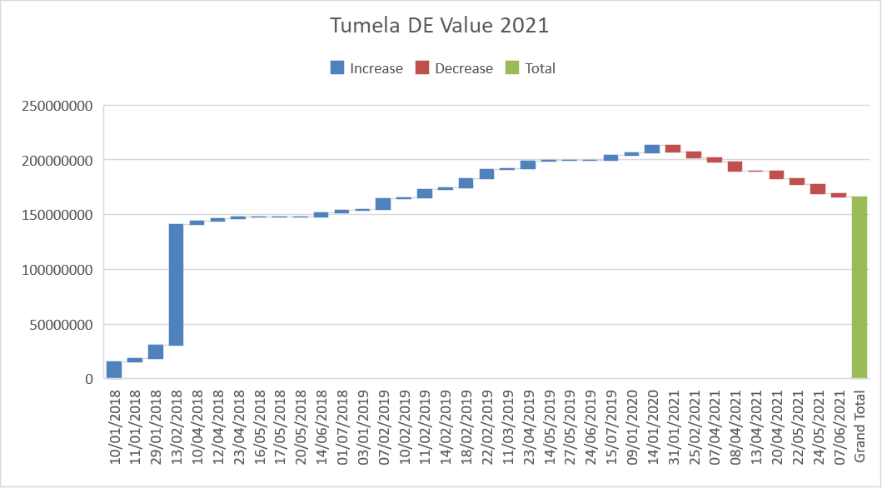
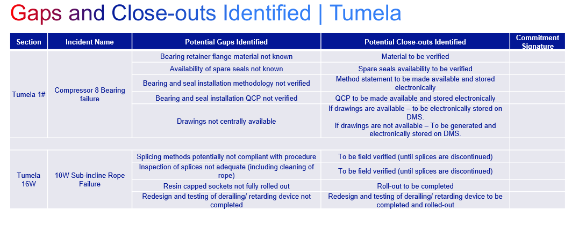
Defect Elimination | Process Overview
Register
Notification
RCA Report
Close-out Slide
Solution Tracker
System Compliance
Value Reconciliation
Anniversary

Slide 4
Incident Anniversaries | Process Overview
Purpose:
To verify that the close-out actions implemented to prevent significant reliability incidents are in place, effective and fully complied with.
In order to prevent repeat incidents.
Process Overview:
1. Identify significant reliability incidents.
2. Identify close-out actions for those incidents.
3. Verify compliance to the close-out actions.
4. Identify deficiencies in close-out actions and the compliance thereto.
5. Sign-off on the compliance and gaps, with the commitment to close gaps.

Slide 5
Significant Reliability Incidents Identified | Concentrator
Section | Date of Incident | Equipment | Incident Description | Solutions Tracked | Solutions Verified
UG2 #1 | 09-Sep-18 | Conveyor | Torn conveyor belt 135-CV-01 | yes | yes
UG2 #2 | 02-Sep-19 | Chrome Mill | Pinion bearing failure | yes | yes
Merensky | 08-Sep-19 | Conveyor | 132CV01 pulley bearing failure | yes | yes
Merensky | 15-Sep-19 | Conveyor | 110CV01 tail pulley failure | yes | yes
UG2 #1 | 08-Sep-20 | Primary mill | Primary Mill had tripped out on discharge pumps and on start up gearbox oil tank found LL and mill could not start. | yes | yes
UG2 #2 | 01-Sep-21 | Chrome Mill | Contamination in the trunnion lubrication oil detected | yes | yes
UG2 #2 | 02-Sep-21 | Thickener No1 | Thickener no 1 drive chain fell off | yes | yes
Merensky | 04-Sep-21 | Conveyor belt | Primary mills stopped due to empty silos due to 110CV02 bearing failure | yes | yes

Slide 6
Close-out Actions Identified | Concentrator
Section |  | Incident Name | Proposed Solutions | Progress Status | Solution Verified | Verification Comment
UG2 #1 |  | Torn conveyor belt 135-CV-01 | Replace torn belt and check belt magnets, adjust them if necessary | Complete | yes | In Place
UG2 #2 |  | Chrome mill pinion failure | Pinion failure was identified using condition monitoring earlier in the year, deterioration occurred faster than had been expected for the scheduled changeout date. Turn the girth gear as previously planned (December shutdown) | Complete | yes | In Place
Merensky |  | 132CV01 pulley bearing failure | Repair damaged structure which is causing uneven load distribution to the pulley, verify SIMMS audit actions | In Progress | yes | Pulley was replaced. Still to verify Simms actions
Merensky |  | 110CV01 tail pulley failure | Replace failed pulley with a new one and consult with design engineer on the suitability of current installation findings to form part of the bunker reliability roadmap and actioned with priority. | In Progress | yes | Pulley was replaced. Still to verify Simms actions
UG2 #1 |  | Primary Mill had tripped out on discharge pumps and on start up gearbox oil tank found LL and mill could not start. | Include instrumentation inspection on PMO3s | Complete | yes | In Place
 |  |  | Perform and log tank level inspection routinely monthly to trend tank level and oil usage. | Complete | yes | In Place
 |  |  | Replace dirty sight glass hindering oil level inspection | Complete | yes | In Place
UG2#2 |  | 408-ml-15 NDE trunnion bearing experiencing higher vibrations | Oil cooler to be replaced with a new unit. | Complete | yes | In Place
UG2#2 |  |  | Contaminated oil to be drained and reservoir to be cleaned | Complete | yes | In Place
UG2#2 |  |  | Additional protection equipment to be installed on the mill trunnion bearings. | In Progress | yes | In Progress
UG2#2 |  | Thickener no 2 rake tripped on overload | Thickener drained and mud was washed to free rake (velocity breaker to be removed) | Complete | yes | In Place

Slide 7
Close-out Actions Identified | Concentrator
Section |  | Incident Name | Proposed Solutions | Progress Status | Solution Verified | Verification Comment
Merensky |  | Primary mills stopped due to empty silo 110 CV 02 unavailable | Investigate new type of sealing arrangements on bearings that have a better seal against water exposure. | In Progress | yes | Still investigating new technology

Slide 8
Close-out Actions Identified | Concentrator
Road map on the Merensky structure repair continuing
Notes:

Slide 9
Gaps and Close-outs Identified | Concentrator
Section | Incident Name | Potential Gaps Identified | Potential Close-out identified | Commitment Signature
 |  | None identified

