Slide 1

Curriculum-Score:
Developing and Evaluating an Interpretable Learning to Rank Model for Resume Enhancement
Iommi Andrea

Slide 2
Outline
Generator of instances:
Sources
Generator of Job-Offer
Generator of Curricula
Matching score
Experiments:
Lambda-Mart (Black box)
FIGS (Glass Box)
EBM (Glass Box)

Slide 3
Sources
Cities
Bertinoro
Basiano
Tribogna
Rhemes-Notre-Dame
Riva di Solto
Castelsilano
Torrevecchia Pia
Stradella
Zoagli
Tortorici
Cenate Sopra
Bianze
Cossano Canavese
Corneliano d'Alba
Boffalora d'Adda
Cecima
Morsasco
Volla
Poggiardo
Scillato
Pietraroja
Calvatone
Castrovillari
Sedrina
Subset of all Italian cities
Citizen distance in (km)
Education level
Language & language level
“Jobs-library”
1197 Cities

Slide 4
Sources
City A | City B | Distance(Km)
Abano Terme | Abbadia San Salvatore | 275
Abano Terme | Acireale | 905
Abano Terme | Acqualagna | 205
Abano Terme | Acquapendente | 290
Abano Terme | Acquasanta Terme | 315
Abano Terme | Acquaviva Collecroce | 455
Abano Terme | Acquaviva d'Isernia | 451
Abano Terme | Acri | 753
Abano Terme | Aggius | 539
Abano Terme | Agna | 24
Abano Terme | Agosta | 388
Abano Terme | Agrigento | 906
Abano Terme | Agropoli | 614
Abano Terme | Aielli | 392
Abano Terme | Ailano | 482
Abano Terme | Ailoche | 281
Abano Terme | Alagna Valsesia | 305
Abano Terme | Alba Adriatica | 328
Abano Terme | Albagiara | 663
Abano Terme | Albanella | 606
Abano Terme | Albuzzano | 197
Abano Terme | Altavilla Monferrato | 271
Abano Terme | Alvignano | 501
Abano Terme | Amatrice | 326
Subset of all Italian cities
Citizen distance in (km)
Education level
Language & language level
“Jobs-library”
In order to save space and memory, I’ve saved the lower triangular (symmetric) matrix before sorting the rows and columns (alphabetically).
During the “inference” first I order the CityA & B, then I search into dataFrame (with double index). It seems to be quite fast.

Slide 5
Sources
Subset of all Italian cities
Citizen distance in (km)
Education level
Language & language level
“Jobs-library”
Rank | Education | Distrb.1 | Distrib.2 | Min-age
0 | Null | 0.119 | 0 | 16
1 | Degree | 0.299 | 0.349 | 18
2 | Bachelor D. | 0.372 | 0.397 | 21
3 | Master D. | 0.198 | 0.223 | 24
4 | PhD | 0.012 | 0.031 | 27
Distrb.2 is used to sample when the job requires at lest “Degree”.
The minimal age is used to be coherent when we chose the age for the candidates.
With “rank” I means “importance”.

Slide 6
Sources
Language | Probability | Value
English | 0.214286 | 15
Spanish | 0.114286 | 8
French | 0.114286 | 8
German | 0.085714 | 6
Russian | 0.014286 | 1
Italian | 0.214286 | 15
Polish | 0.014286 | 1
Dutch | 0.014286 | 1
Ukrainian | 0.042857 | 3
Swedish | 0.014286 | 1
Norwegian | 0.014286 | 1
Danish | 0.014286 | 1
Greek | 0.028571 | 2
Portuguese | 0.014286 | 1
Turkish | 0.014286 | 1
Hungarian | 0.014286 | 1
Romanian | 0.014286 | 1
Bulgarian | 0.014286 | 1
Serbo-Croatian | 0.014286 | 1
Finnish | 0.014286 | 1
Subset of all Italian cities
Citizen distance in (km)
Education level
Language & language level
“Jobs-library”
Level | Prob.
A1 | 0.15
A2 | 0.3
B1 | 0.3
B2 | 0.15
C1 | 0.09
C2 | 0.01
“Value” as normalized into probabilities.

Slide 7
Sources
"Developer":{ "age":[22, 40], "salary":[26000, 60000], "experience":[0, 15], "degree": false, "smart working": true, "skills":[ "Python", "Java", "SQL", "Git", "Algorithm", "Database", "Operating systems", "C++", "PHP", "C", "Kubernetes", "Doker" ], "soft skills":[ "Problem solving", "Collaboration", "Retail aptitude", "Flexibility", "Professional Ethic", "Innovation", "Creativity" ], "certificates": [ "CCNA", "CSM", "PMP","IELTS","CAE"]}
Subset of all Italian cities
Citizen distance in (km)
Education level
Language & language level
“Jobs-library”
"HR Consultant":{ "age":[25, 50], "salary":[20000, 50000], "experience":[2, 15], "degree":true, "smart_working":true, "skills":[ "HR Management", "Recruitment", "Organisational development", "Industrial relations", "Labour legislation", "Analysis of data", "Selection and evaluation techniques", "Training and development" ], "soft_skills":[ "Empathy", "Management of the conflict", "Negotiation", "Ability to listen", "Coaching", "Management of stress" ], "certificates": [ "PHR", "SPHR","SHRM-CP","IELTS" ]}

Slide 8
Curricula’s information
Information
(Ideal)Job | random | (used only to generate information below)
Education | Random from distribution (consistent with job)
City | simple random
Job-range | random | 30 | 160
Skills | random (consistent with job) | 1 | 5
Soft skills | random (consistent with job) | 1 | 5
Age | random | Min_age(from Edu.) | Max_age (from jb)
Languages | (number of language) rnd with distrib. (0.7, 0.2, 0.1) + (level) rnd with distribution | 1 | 3
Certificates | Rnd with distribution (consistent with job) | 0 | 3
Experience | Min(Possion(3), Age – min_age) | - | -
Salary | random | min_s += min_salary * 0.07 * exp | max salary (from jb)
Smart Work | random | 0 | 1
Experience abroad | random | 0 | 1

Slide 9
Job-Offer’s information
Information
Job | random
Education | Random from distribution (consistent with job)
City | simple random
Skills | random (consistent with job) | 1 | 5
Soft skills | random (consistent with job) | 1 | 5
Age (Min) | Max(min_age(from Edu.), min_age(from jb))
Age (Max) | random | Age(Min) | Max_age(from jb)
Languages | (number of language) rnd with distrib. (0.7, 0.2, 0.1) + (level) rnd with distribution | 1 | 3
Certificates | Rnd with distribution (consistent with job) | 0 | 3
Experience | Min(Possion(3), Age - min age) | - | -
Salary | random | min_s += min_salary * 0.07 * exp | max salary (from jb)
Smart Work | random | 0 | 1
Experience abroad | random | 0 | 1

Slide 10
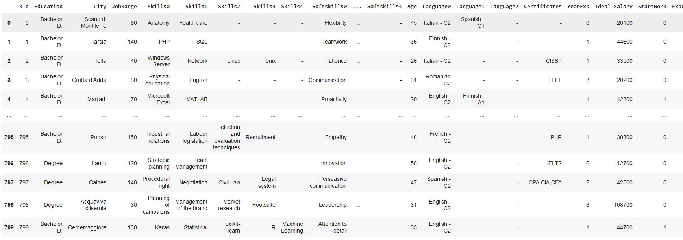
Example of curricula

Slide 11
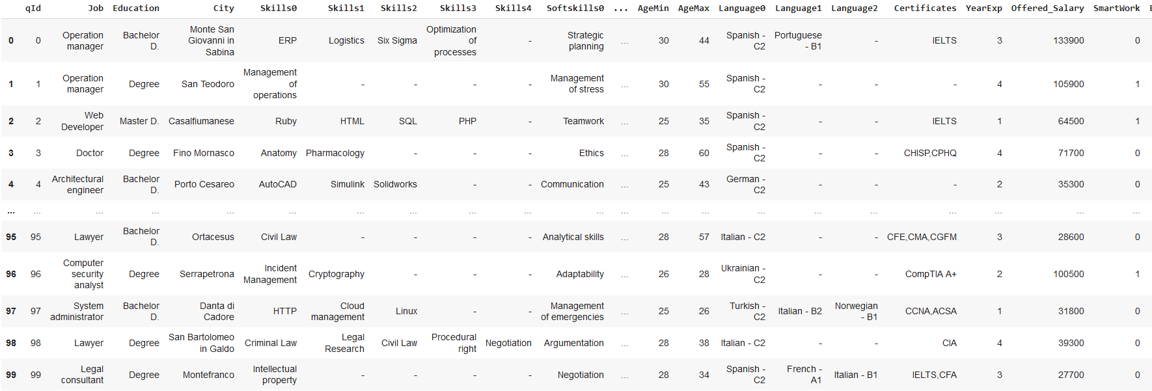
Example of jobs-offer

Slide 12
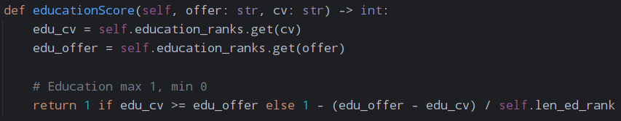
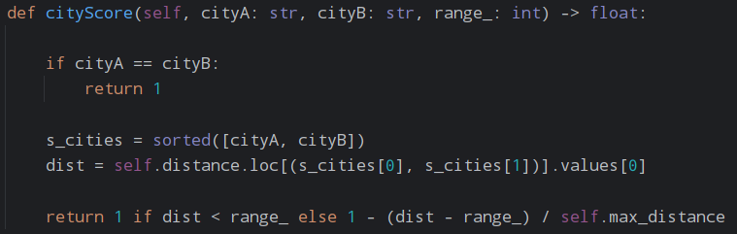
Matching score
Education score:
education_ranks (dict : name -> value)
len_ed_rank (number of education level)
Cities score:

Slide 13
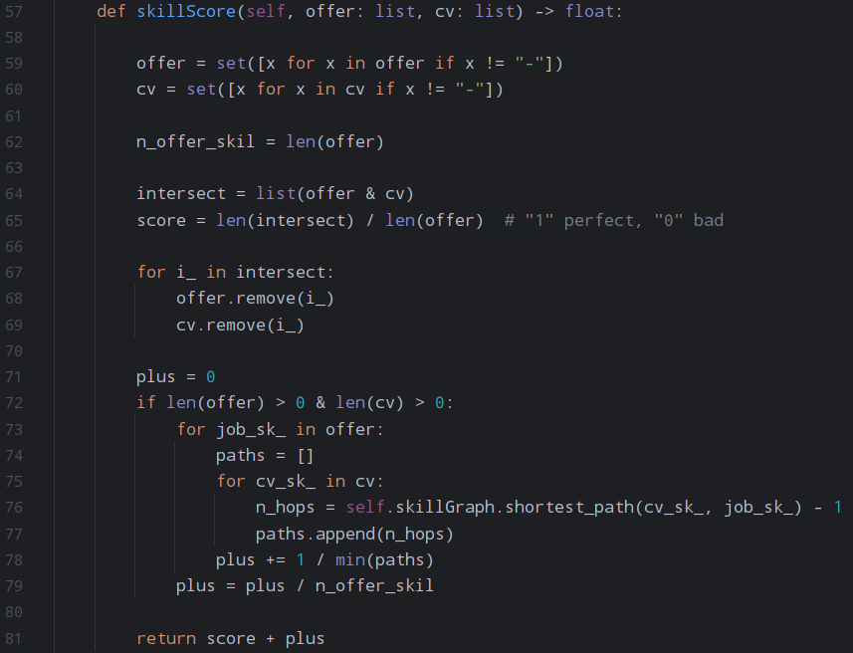
Matching score
Skill score (cv, offer):
(Initial score)
59-60 : Pre-processing (remove null values)
64-65 : Initial score based on intersection
67-69: Remove the “matched” skill
(Bonus score)
71-79: For each “unmatched” offer’s skill, I search which is the minimum number of hops to reach the cv’s skill in the knowledge graph.
The relation is inversely proportional : more hops → lower “bonus”

Slide 14
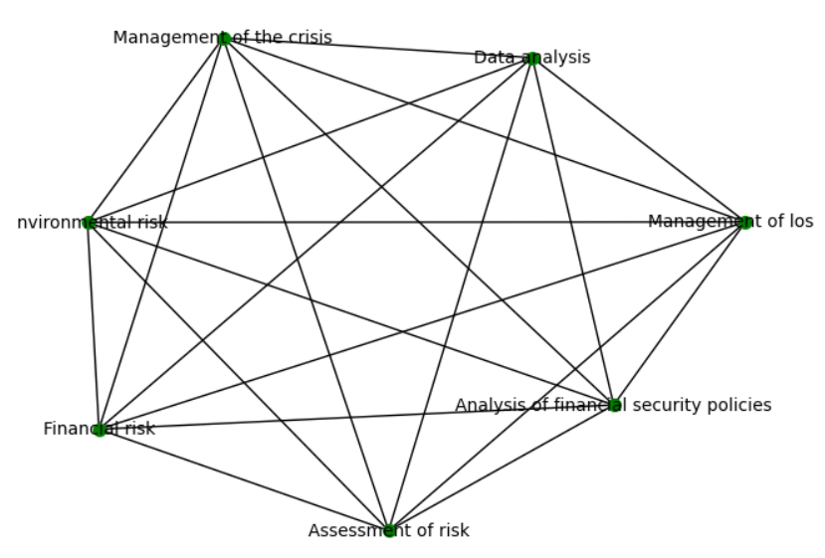
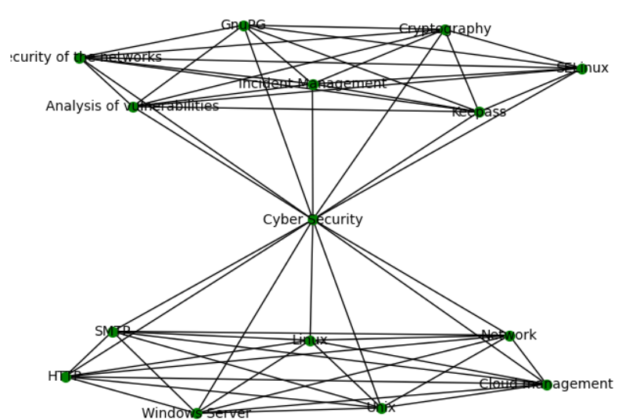
Matching score
Example of connected component of knowledge graph
I’ve built KG using the information in the “job-library”.
Two nodes are connected if they appear together in the same job.

Slide 15
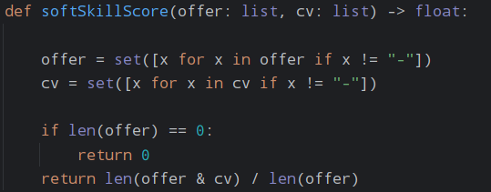
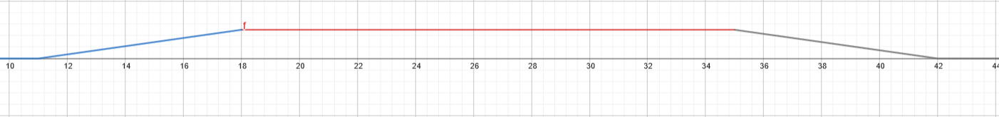
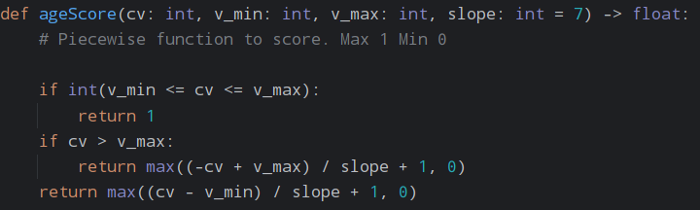
Matching score
Soft-skills score:
Simple intersection
Age function:
Age score:

Slide 16
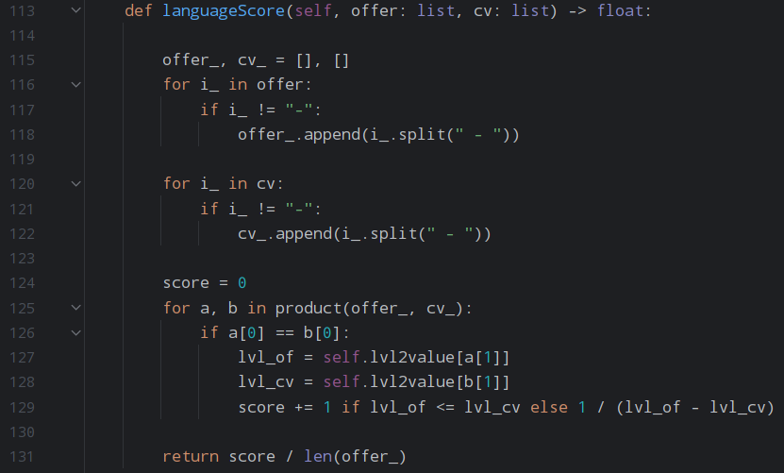
Matching score
Language score:
116-122 : Pre-processing (remove null values and split in (language, level) )
125: Cartesian product of offer & cv ‘s languages
126-129: For identical language, the score is based on the distance of level of language
lvl2value (dict e.g. “A1”:0, “A2”:1 …)

Slide 17
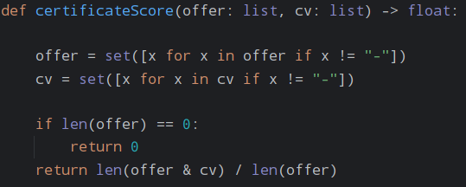
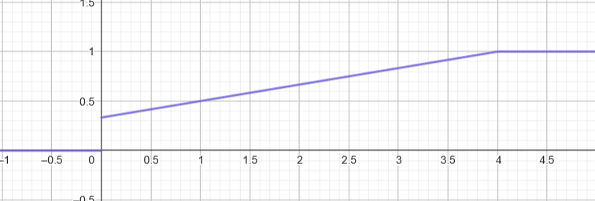


Matching score
Certificates score:
Simple intersection
Experience function:
Experience score:
Salary score:

Slide 18
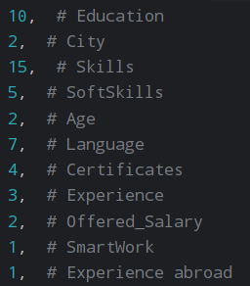
Weights (normalized with Min-Max)

Slide 19
Experiments
I’ve used the same handmade metric at nDGC@15
All model receive identical train, valid and test datasets
Model | Nature | Train | Validation | Test
LambdaMart (LightGBM) | LtR BlackBox | 0.8000 | 0.8065 | 0.8008
FIGS | Reg/Class Glassbox | 0.8008 | 0.8147 | 0.8088
ExpleniableBoostingMachine (Microsoft) | Reg/Class GlassBox
IlMart | LtR GlassBox

Slide 20
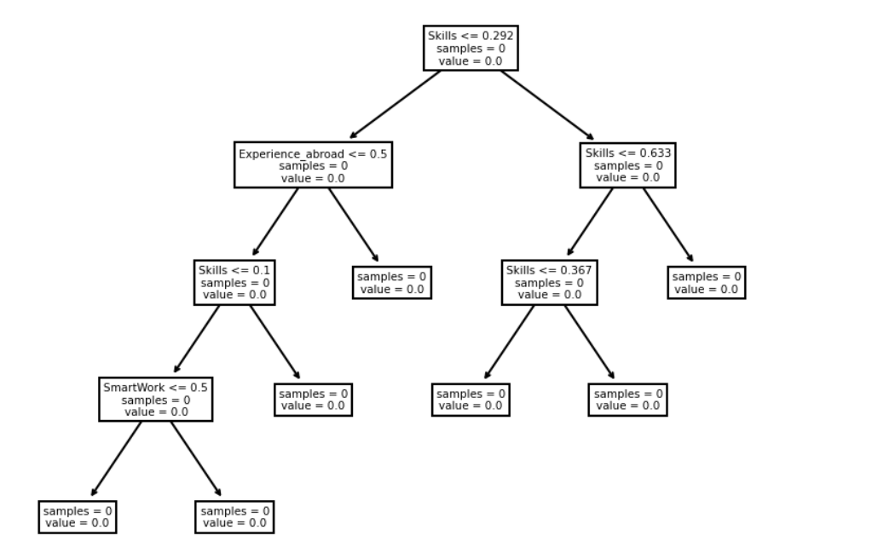
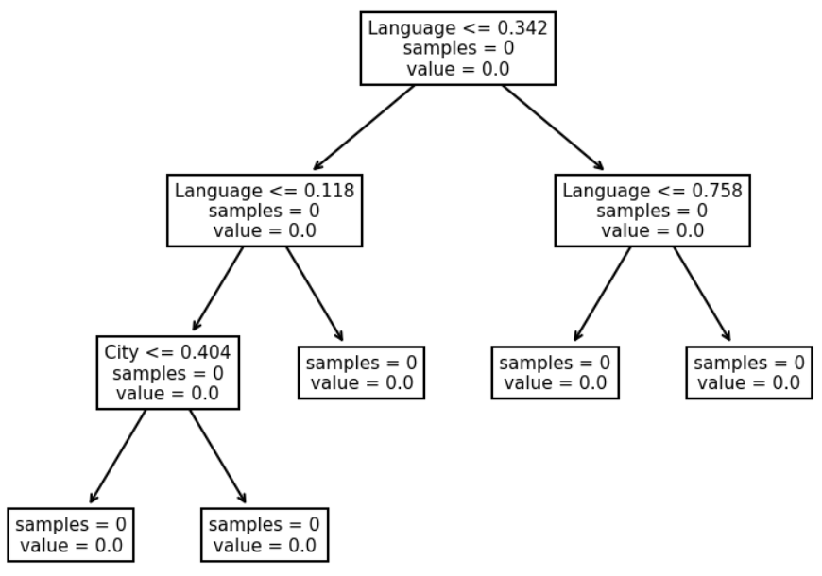
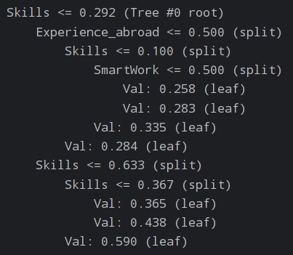
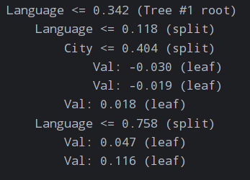
Example of trees
FIGS

