Slide 1


Literature Mining for Neurodegenerative disease
Computational Health Laboratory 2022/23
Andrea Iommi - a.iommi2@studenti.unipi.it
Geremia Pompei – g.pompei@studenti.unipi.it

Slide 2

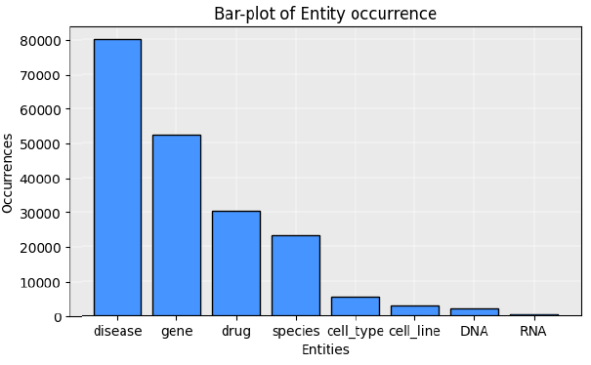
Retrieving documents
Retrieving and
pre-processing
Similarity metrics
Node-Rank
Dijkstra
Model Selection
Model Assessment

Slide 3
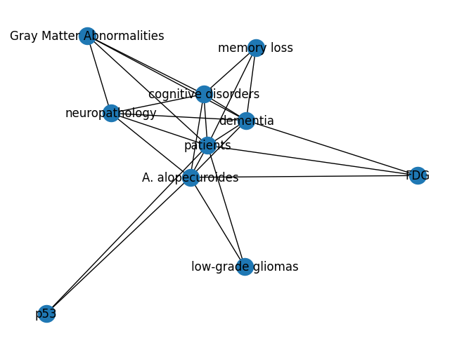


Similarity metrics: correlation matrix
Retrieving and
pre-processing
Similarity metrics
Node-Rank
Dijkstra
Model Selection
Model Assessment
We explored 2 kinds of similarity metric: Correlation matrix and Word2Vec:
In the correlation matrix, we assume a connection between two word if and only if the words appear together with a few characters of distance (k).
Pro:
Easy approach.
Cons:
K high, KG complex with a negligible nodes and edges.
K low, KG lacking of semantic

Slide 4
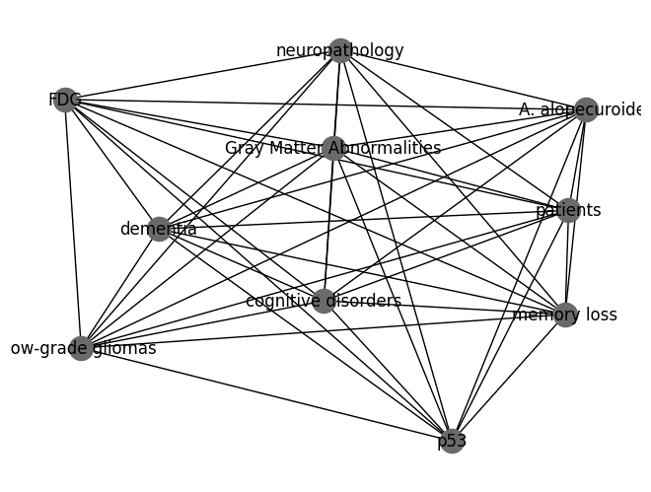
Similarity metrics: Word2Vec
Retrieving and
pre-processing
Similarity metrics
Node-Rank
Dijkstra
Model Selection
Model Assessment
The second metric used was Word2Vec.
Words with similar meanings or contexts tend to have similar vector representations, and their cosine similarity can be used to measure the correlation between words.
The cosine similarity is used as strength of connection.
Pro:
Semantic correlation.
Cons:
Several parameters.
Computational expensive to train.

Slide 5
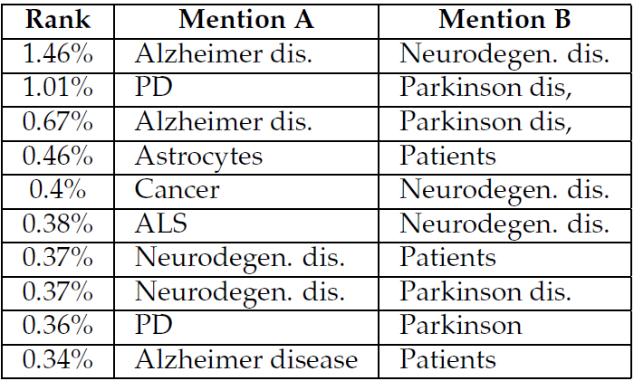
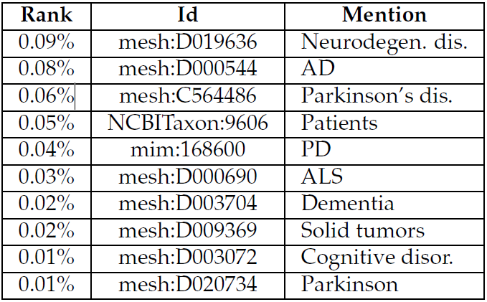
Node-Rank
Retrieving and
pre-processing
Similarity metric
Node-Rank
Dijkstra
Model Selection
Model Assessment
After built the KG, we discovered the most important node and edges. We developed a NodeRank from scratch.
The aim is to find the nodes that have a plenty of connections and the edges with highest strength.
Example of top 10 edges
Example of top 10 nodes.

Slide 6
Dijkstra’s algorithm
Retrieving and
pre-processing
Similarity metric
Node-Rank
Dijkstra
Model Selection
Model Assessment
We developed our implementation of Dijkstra algorithm from scratch.
Given a specific disease we algorithm discover the most important drugs connected with it.
We have as parameter z, which means the number of drug returned

Slide 7
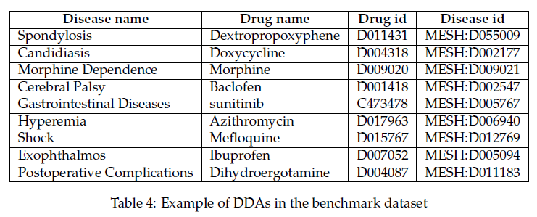
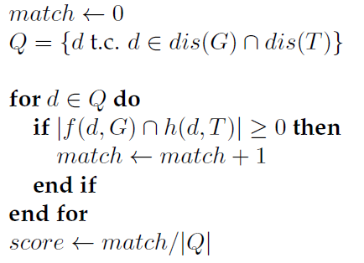
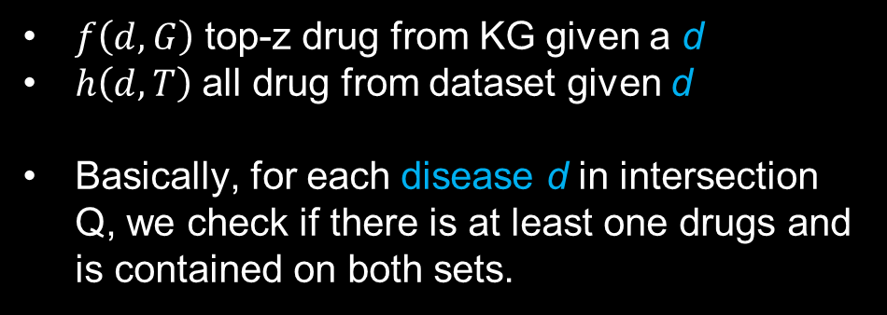
Model selection
Retrieving and
pre-processing
Similarity metric
Node-Rank
Dijkstra
Model Selection
Model Assessment
Among CM and Word2Vec, we had some parameters to explore.
We relied on a benchmark dataset.
We built a evaluation function and we selected the model with best score.
$f\left(d,G\right)$ top-z drug from KG given a d
$h\left(d,T\right)$ all drug from dataset given d
Basically, for each disease d in intersection Q, we check if there is at least one drugs and is contained on both sets.

Slide 8
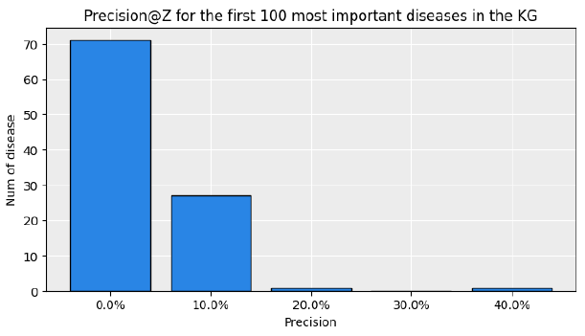
Precision@z and p-values
Retrieving and
pre-processing
Similarity metric
Node-Rank
Dijkstra
Model Selection
Model Assessment

Slide 9
Limitations

Slide 10
Conclusions

Slide 11
Thank you for the attention!

Slide 12

Introduction and motivations
Real-time electricity consumption data for improving energy management
TELPs (Typically Electricity Load Patterns) are useful to understand the characteristics of energy behaviors and detecting potential energy waste.
The identification of TELPs has been considered an important way to understand the characteristics of daily electricity load profiles (DELPs) of non-residential buildings.
ECMP (Energy Consumption Monitoring Platforms) collects data related to energy consumption (EC) of non-residential buildings.
AIM OF THE WORK
Propose a framework that integrate multiple DM technique for extracting TELPs and discover insightful hidden information in the patterns.
Confirm the effectiveness of the framework by exploiting it for anomaly detection of electricity consumption task.

Slide 13
Methodology
A general DM framework for extracting and discovering TELPs
This method integrated unsupervised and supervised learning techniques for providing a meaningful way to develop an interpretable framework for knowledge discovery from massive amounts of building electricity consumption data.
OUTLINE OF THE PROPOSED FRAMEWORK
Data Preparation
Features
Definition
2-step Clustering
Knowledge Discovery
DATASET FOR CASE STUDY APPLICATION
Dataset comes from Energy Consumption Monitoring Platform (ECMP) in China.
The collected data refers to 3 office building information, including 300 daily profile ranging from 2012 to 2013 and general information. Some weather information (temperature, humidity ECC.) are associated to a daily profile of the buildings.

Slide 14

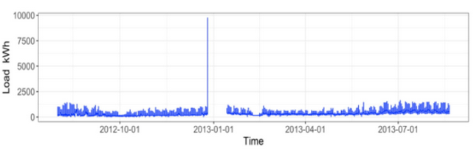


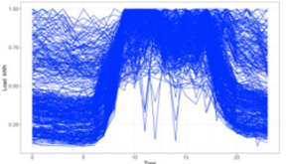

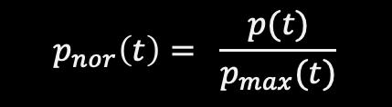
Data preparation
Data preprocessing, data segmentation and data normalization
Raw time-serie
Fixing missing values by using a simple moving average method with a windows size of 3.
Removing outliers based on the IQR thresholds.
Diurnal load data
Data segmentation: reshaping raw data into “DELPs”.
Normalization

Slide 15
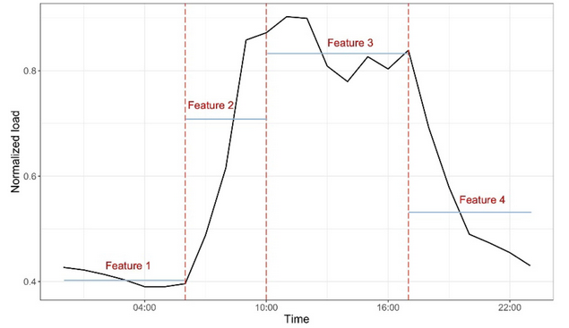
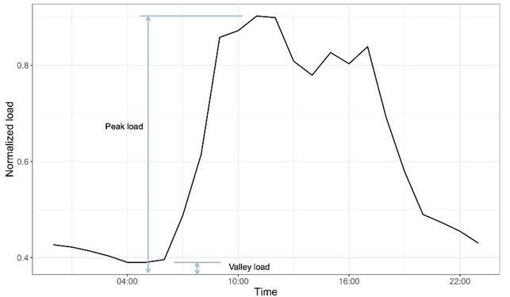
TELPs identification: Feature definition
Reduce dataset’s dimensions to improve cluster analysis (from 24 to 5)
Extraction of the first 4 statistical features
Extraction of the last statistical features
Daily profiles (DELPs) were segmented into 4 key periods: off time (00-06), rise time (7-10), daytime (11-17) and evening (18-23). The mean value of each period is used as feature.
The last feature is the ratio of the difference between the daily maximum and the minimum load to the daily maximum load.

Slide 16
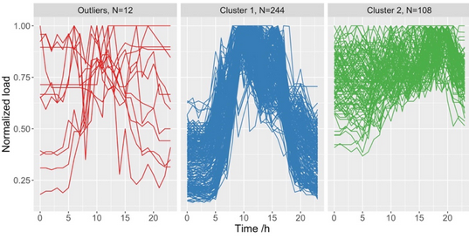
TELPs identification: 2-step clustering
Removal of outliers from daily electricity load profile with DBSCAN
DBSCAN results (building A033)
First clustering step is used to detect and remove outliers from DELPs.
No more that 5% of data was removed.
DSCAN result revealed two electricity load pattern, however it was not enough to represent all the potential TELPs.

Slide 17
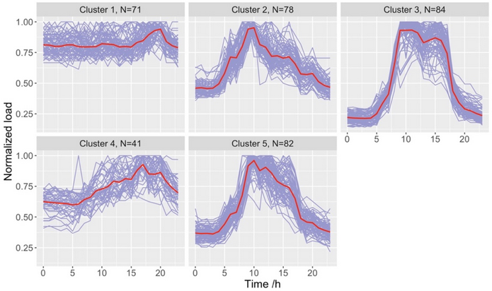
TELPs identification: 2-step clustering
TELP extraction with K-Means algorithm
K-means results (building A033)
The second clustering step, K-Means, is used to cluster similar electricity load profile (DELPs) and extract TELPs
The optimal number of cluster for each building is was found by Dunn index from the range (2 - 8).
The identified TELPs are reasonable since each cluster has a unique electricity load pattern with clear differences among them.

Slide 18
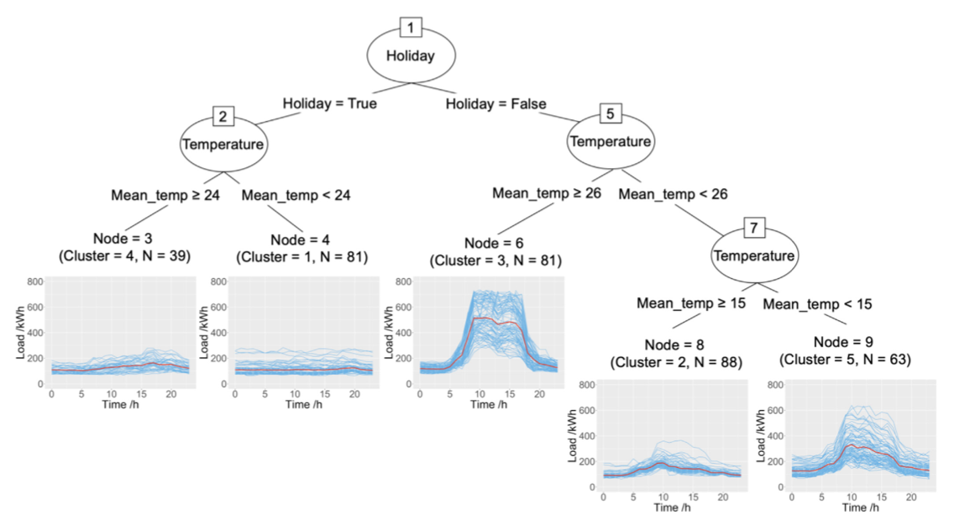


Knowledge discovery by CART
Explore underlying relationship between TELPs and influencing factors
Classification trees for typical electricity load patterns (Building A033).
A classification model was developed with CART algorithm to generate decision tree in order to better understand clustering results
Higher EC appears during working days when the outdoor air temperature is really high or really low.
Lower EC is related to non-working days and warm temperatures.

Slide 19
Knowledge discovery by CART
Case study application: extraction of decision rules
DECISION RULES RESULTING FROM THE CLASSIFICATION TREE (BUILDING A033)
Decision rule
Predicted Pattern
Occurrence probability of each pattern
If holiday = True and mean_temp >= 24
4
(13%, 3%, 3%, 77%, 5%)
If holiday = True and mean_temp < 24
1
(80%, 2%, 0%, 12%, 6%)
If holiday = False and mean_temp > 26
3
(0%, 0%, 93%, 1%, 6%)
If holiday = False and 15 < mean_temp < 26
2
(0%, 77%, 2%, 0%, 21%)
If holiday = False and mean_temp <= 15
5
(0%, 10%, 10%, 0%, 81%)
It is possible to predict an expected pattern under a given boundary condition with a high probability based on a classification tree (higher occurrence probability also indicates a better reliability of the predicted pattern) .

Slide 20
Potential application of the framework
Detect anomalous change in building electricity load profiles at early stage
2-STEP APPLICATION PROCEDURE
Use the decision rules to predict the expected pattern with an high occurrence probability under a certain boundary condition.
When the characteristic of the candidate load profile are not in accordance to the expected pattern, it could be consider a potential abnormal event.
Compare and quantify the difference between the expected and actual patterns via density heatmap.
The proposed framework can be used by building manager as an alert tool to detect anomalous trends in electricity profiles based on the whole-building level.

Slide 21
Overall conclusions
Fill the gap between users and unsupervised learning results.
MAIN ADVANTAGES
This framework reduces the dependency on expertise domain for building energy analysis; the time and labor costs can also be reduced.
It offers building managers an efficient way to understand the characteristics of building electricity consumption patterns and detect anomalies therein.
The 2-step clustering method outperforms the other single-step clustering methods in terms of detecting outliers and discovering significant typical electricity usage characteristics.

Slide 22


Limitations and future works
A study limited by its methods and the size of dataset
The features definition method based on working schedule of office buildings may not be suitable for highly different data.
Propose a data-adaptive method to define the features for several buildings to enhance framework’s flexibility.
This framework does not take into account the dynamical factors related to occupants’ behaviors.
Discover if insightful knowledge could be gained from the decision rules outcoming from these factors.
The framework is tested and validate on a small non-public dataset so it may not be generalizable or robust enough when it is applied to a larger dataset.
Study the applicability and generalizability of the proposed framework by using a larger dataset.
The framework consider only the whole-building electricity consumption (EC) and not EC data of electrical sub-systems which makes the fault detection difficult to discover the specific positions.
Explore the application of this framework in early anomaly detection for EC data of subsystems.

