Slide 1

Final project
Jacopo Sinigaglia

Slide 2
Problem
Context: A road-safety company wants to know which Italian municipalities to invest in, and wh
Where are road accidents highest, and why there?
How we measure risk: Three indicators used, accidents per 1,000 inhabitants (risk per person), accidents per km² (density) and total accidents (volume).
Data source: ISTAT API (SDMX, dataset 41_983) for accidents 2015–2024; SITUAS for municipality names, population and area (31/12/2020).

Slide 3
Data and tools
Fetch: ISTAT API by year chunks, with cache. SITUAS scraped with Selenium
Cleaning: Decode indicator codes, fill missing zeros (2024), drop merged municipalities (≤ 1% of accidents)
Join the data: Accidents + SITUAS population and area, by municipality code
Analysis: EDA, t-test, OLS regression, k-means clustering, forecast, risk score
Visualization: Power BI das
6. Tools : ython (pandas, requests, Selenium, scikit-learn) · Power BI (Power Query, DAX) · Git/GitHub
Key choices:
Analysis window 2022–2024: latest post-COVID years, 3-year average to reduce noise
Rankings only for municipalities with at least 10,000 inhabitants, to avoid small-town outliers

Slide 4
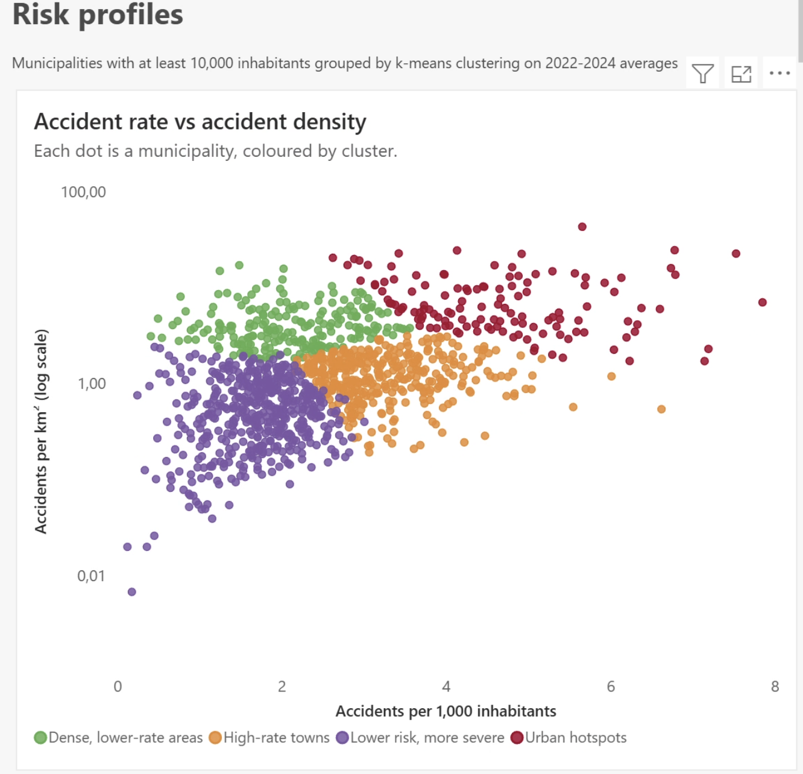
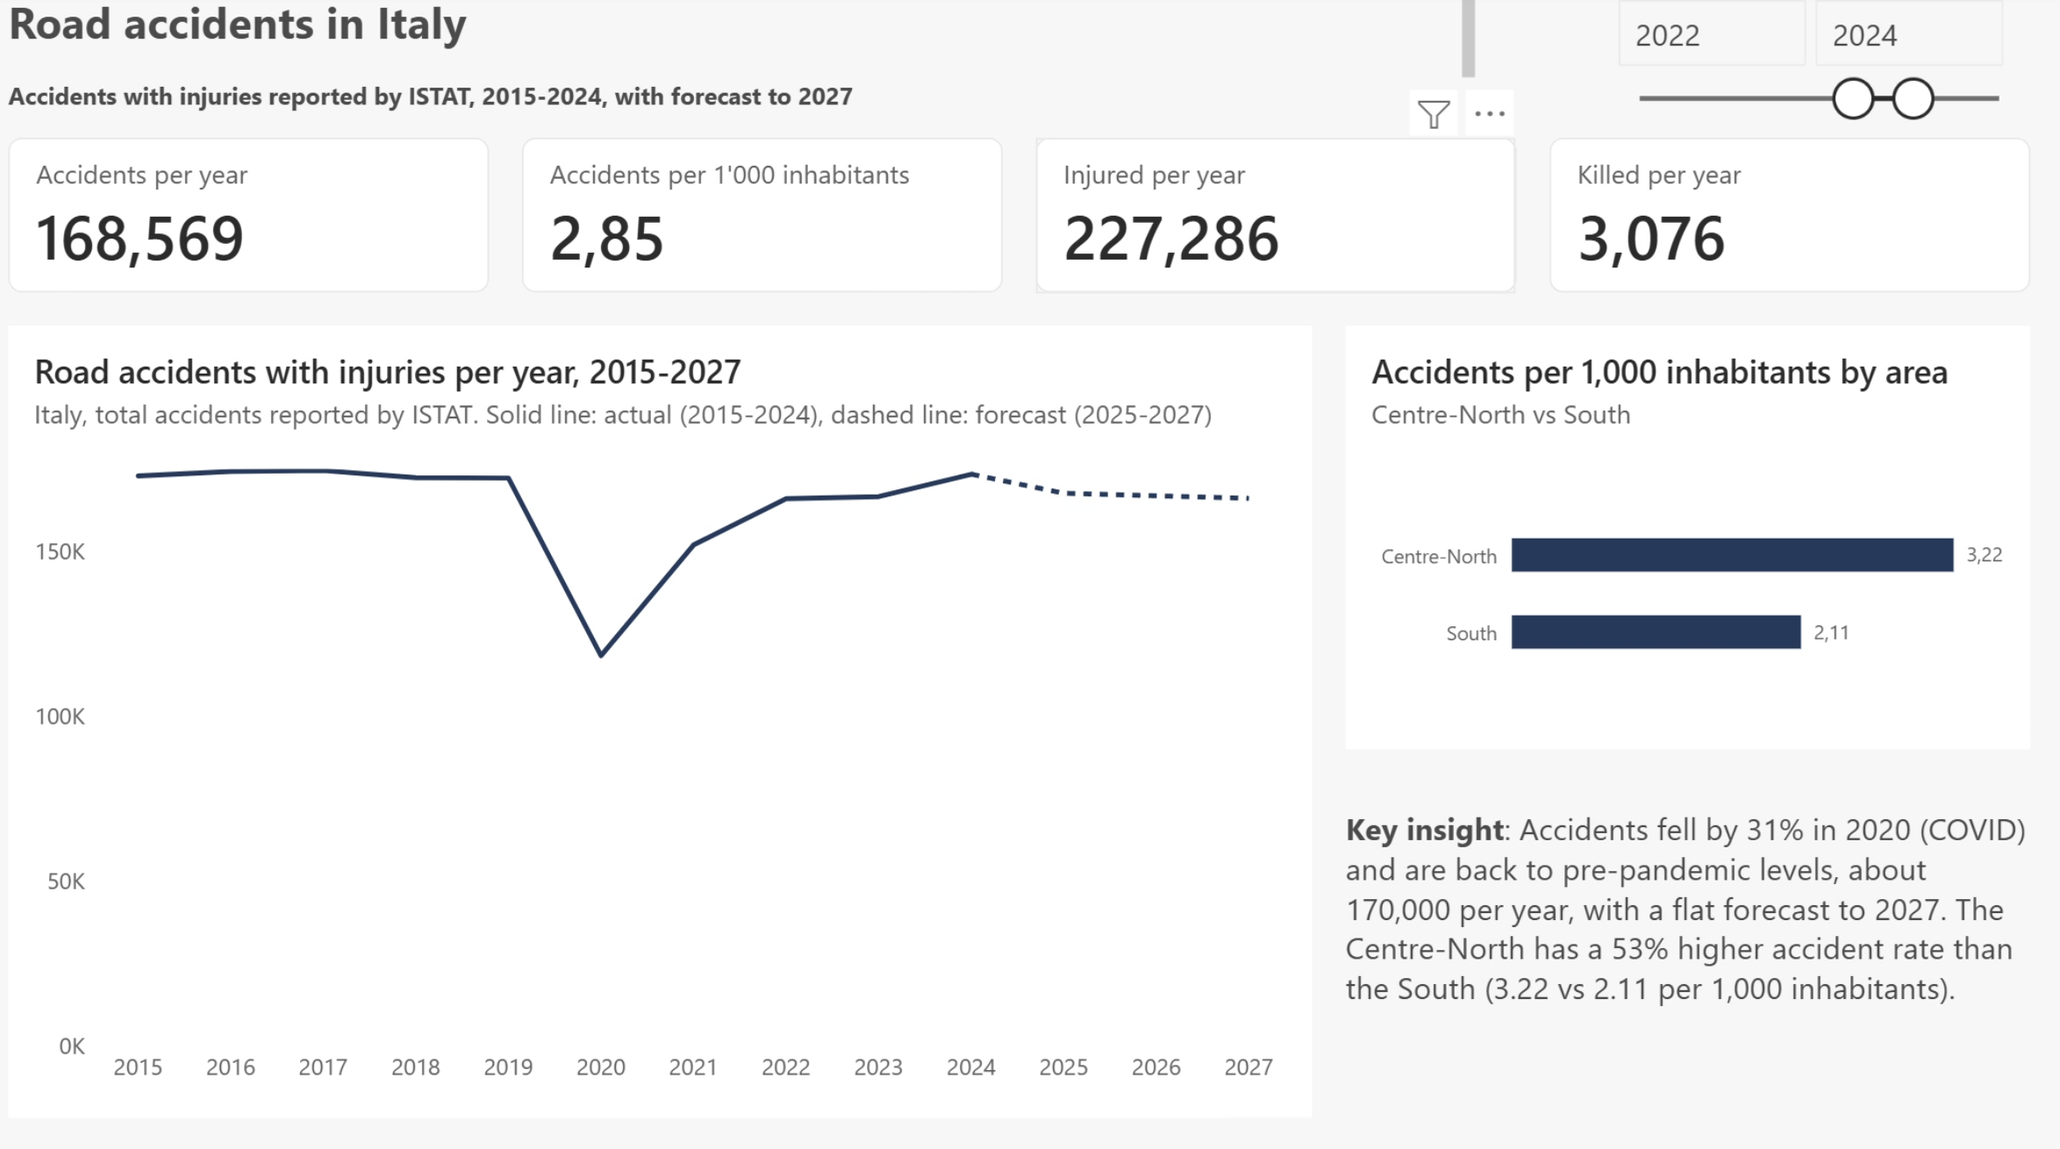
What the data shows
Stable Volume: About 170,000 accidents per year. -31% in 2020 (COVID), flat forecast to 2027.
North–South gap :Centre-North rate 53% higher than the South (3.22 vs 2.11 per 1,000 inhabitants). Statistically significant (t-test, p < 0.001), confirmed by OLS regression.
Concentrated risk: k-means clustering (k = 4): 128 urban hotspots account for 51% of all accidents.

Slide 5
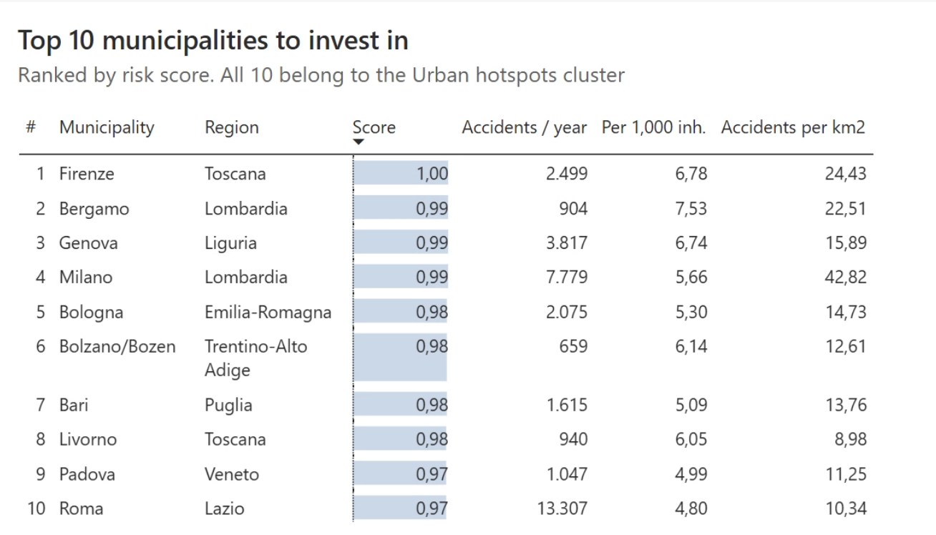
Where to invest
1. Start from the top 10
20.6% of Italian accidents with 10.8% of the population: almost twice their demographic weight.
2. Focus on the Centre-North
Highest rates in Liguria, Tuscany and Emilia-Romagna; 9 of the top 10 municipalities are there.
3. In the South, target severity
Fewer accidents, but about 3 deaths per 100 accidents vs 0.9 in urban hotspots.
Limitations:
Only accidents with injuries
2020 resident population (tourist towns overstated)
national forecast only

