Slide 1
SABD – Progetto 1
Danilo Dell’Orco
Jacopo Fabi
Michele Salvatori
ANalisi Del dataset dei taxi di nyc

Slide 2
Introduzione
L’obiettivo del progetto è quello di analizzare i dati forniti dal Taxi and Limousine Commission (TLC) riguardo le corse effettuate dai taxi, in particolare utilizzando il dataset “TLC Trip Record Data” fornito in formato parquet.
Si applica tramite NiFi una fase di pre-processamento e caricamento del dataset su HDFS, utilizzato come layer di storage.
L’analisi e l’esecuzione delle query avviene tramite Spark, sia sfruttando l'RDD API di più basso livello sia tramite l'astrazione offerta da SparkSQL.
I risultati delle query vengono inseriti su MongoDB e salvati anche in formato CSV su HDFS.
In aggiunta, i risultati ottenuti dall'esecuzione delle diverse query vengono resi visualizzabili tramite una dashboard offerta dal framework Grafana.

Slide 3
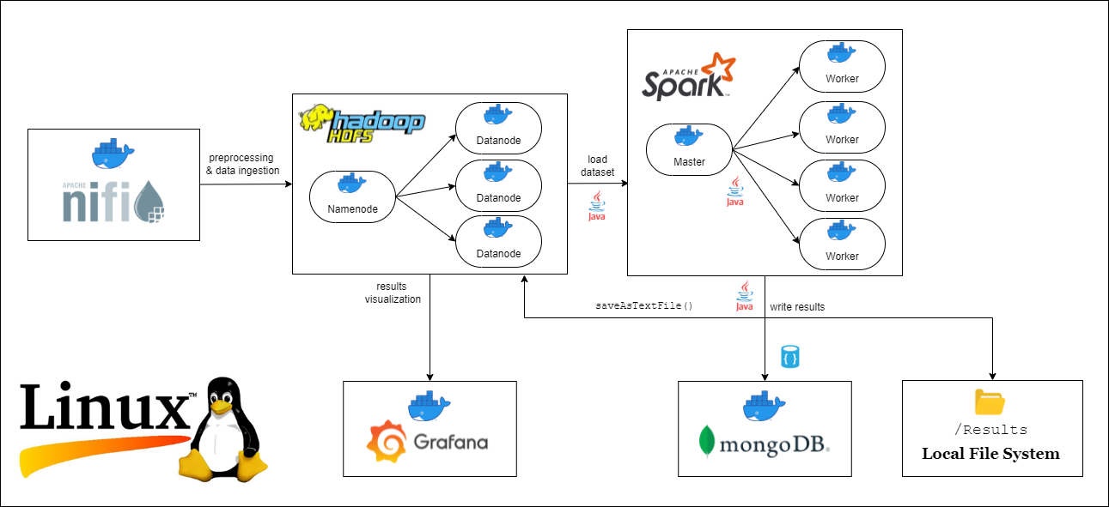

Architettura

Slide 4
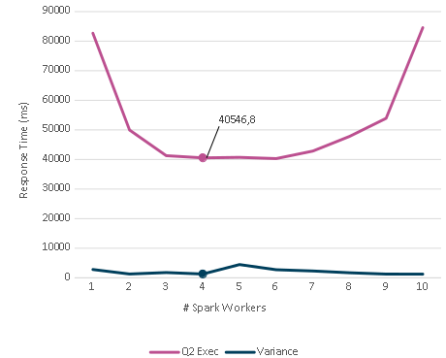
Architettura (2)
Il numero di nodi workers Spark è stato scelto testando il tempo di risposta al variare del loro numero in esecuzione.
La valutazione è basata sulla query 2 essendo la più complessa.
Sono state effettuate cinque iterazioni per ogni configurazione del numero di workers.
Consideriamo il valore della media e della varianza per identificare la configurazione ideale.

Slide 5
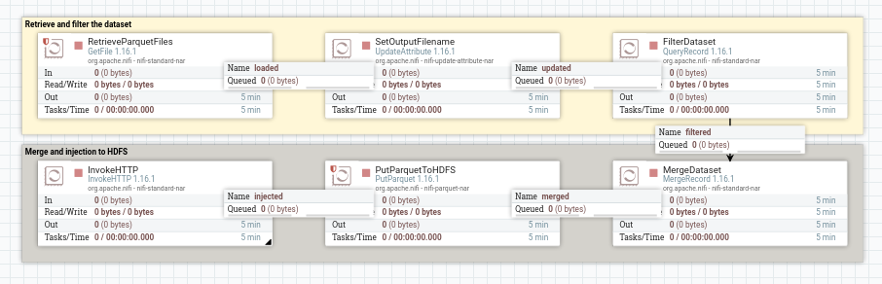
NiFi
Il flusso di NiFi è stato progettato per rimuovere dal dataset eventuali dati corrotti e colonne inutili non necessarie nella fase di processamento tramite Spark.

Slide 6
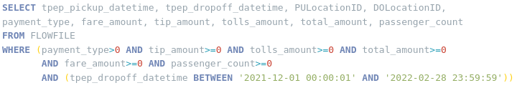
NiFi (2)
Il dataset viene filtrato nel processore QueryRecord:
Vengono eliminate le righe che presentano campi d'interesse con valori negativi.
Vengono eliminate le righe che presentano come timestamp di fine corsa un valore che non rientra nei tre mesi in analisi.
Vengono selezionate solamente le colonne necessarie per rispondere alle diverse query.

Slide 7
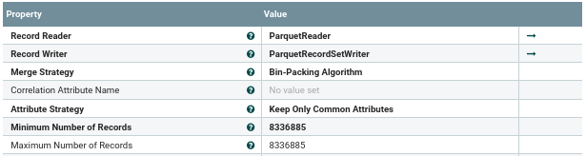
NiFi (3)
Il processore MergeRecord viene utilizzato per unire più flowfiles in un singolo flowfile:
L'obiettivo è scrivere su HDFS un singolo file parquet che rappresenta il dataset finale.
Reso bloccante finché non sono stati uniti tutti i records in un singolo flowfile di output.
Il numero massimo e minimo di records è impostato al numero totale di righe del dataset in output alla fase di filtraggio così da produrre una singola bin.

Slide 8
NiFi (4)
from http.server import BaseHTTPRequestHandler, HTTPServer
import subprocess
import urllib.request
import signal
import os
class handler(BaseHTTPRequestHandler):
def do_POST(self):
# stop nifi flow
subprocess.call(['sh', './stop-nifi-flow.sh'])
os.kill(os.getpid(), signal.SIGTERM) with HTTPServer(('172.17.0.1', 5555), handler) as server:
subprocess.call(['sh', './start-hdfs.sh'])
# start nifi flow when the web UI is up and running
message = 0
while (message != 200):
try:
message = urllib.request.urlopen("http://localhost:8090/nifi")
.getcode()
print("Nifi Web UI is up and running!")
print(message)
except:
print("Nifi not running...")
subprocess.call(['sh', './start-nifi-flow.sh'])
server.serve_forever()
Il processore InvokeHTTP effettua una POST all'indirizzo della macchina che ospita la rete dei vari containers:
Lo script seguente avvia HDFS e ne effettua il format, lancia il flusso di NiFi e si mette in ascolto sulla porta 5555.
Al termine del flusso il server riceverà la POST dal processore.
Si procedere ripristinando il flusso per una nuova esecuzione stoppandolo tramite le REST API offerte da Apache.

Slide 9
Query 1
«Per ogni mese solare, calcolare la percentuale media dell’importo della mancia rispetto al costo della corsa esclusi i pedaggi. Calcolare il costo della corsa come differenza tra l’importo totale (Total amount) e l’importo dei pedaggi (Tolls amount) ed includere soltanto i pagamenti effettuati con carta di credito.»

Slide 10
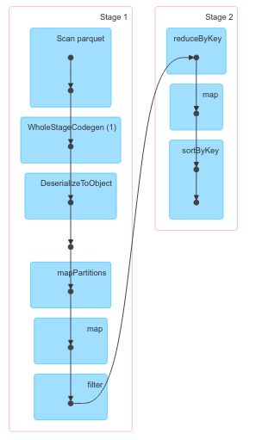
SparkRDD – Query1
public class ValQ1 implements Serializable {
Double tip_amount;
Double total_amount;
Double tolls_amount;
Long payment_type;
Integer trips_number;
...
JavaPairRDD<String, ValQ1> taxiRows = dataset.mapToPair(
r -> {
String month = Tools.getMonth(r.getTimestamp(1));
ValQ1 v1 = new ValQ1(r.getDouble(6), r.getDouble(8), r.getDouble(7), r.getLong(4), 1);
return new Tuple2<>(month, v1);
});
JavaPairRDD<String, ValQ1> filtered = taxiRows.filter(
(Function<Tuple2<String, ValQ1>, Boolean>) r -> r._2().getPayment_type() == 1);
reduced
resultsRDD
taxiRows
filtered

Slide 11
SparkRDD – Query1
// RDD:=[month,values_aggr]
JavaPairRDD<String, ValQ1> reduced = filtered.reduceByKey((Function2<ValQ1, ValQ1, ValQ1>)
(v1, v2) -> {
Double tips = v1.getTip_amount() + v2.getTip_amount();
Double total = v1.getTotal_amount() + v2.getTotal_amount();
Double tolls = v1.getTolls_amount() + v2.getTolls_amount();
Integer trips = v1.getTrips_number() + v2.getTrips_number();
ValQ1 v = new ValQ1();
v.setTip_amount(tips);
v.setTotal_amount(total);
v.setTolls_amount(tolls);
v.setTrips_number(trips);
return v;
});
// RDD:=[month,tip_percentage,trips_number]
JavaPairRDD<String, Tuple2<Double, Integer>> resultsRDD = reduced.mapToPair(
r -> {
Double tips = r._2().getTip_amount();
Double tolls = r._2().getTolls_amount();
Double total = r._2().getTotal_amount();
Double mean = tips / (total - tolls);
Integer trips = r._2().getTrips_number();
return new Tuple2<>(r._1(), new Tuple2<>(mean, trips));
})
.sortByKey();
reduced
resultsRDD
taxiRows
filtered

Slide 12
SparkRDD – Query1: Risultato Finale
|---------|---------------------|--------------|
| YYYY-MM | tip percentage | trips number |
|---------|---------------------|--------------|
| 2021-12 | 0.15973426958603487 | 2361627 |
|---------|---------------------|--------------|
| 2022-01 | 0.15624681545577337 | 1874779 |
|---------|---------------------|--------------|
| 2022-02 | 0.15672618046552844 | 2296156 |
|---------|---------------------|--------------|
reduced
resultsRDD
taxiRows
filtered

Slide 13
Query 2
«Per ogni ora, calcolare la distribuzione in percentuale del numero di corse rispetto alle zone di partenza, la mancia media e la sua deviazione standard, il metodo di pagamento più diffuso»

Slide 14
SparkRDD – Query 2: Tuple
Aggregazione su base oraria:
tpep_pickup_datetime
Distribuzione dei viaggi per ogni ora
PULocationID
Media e deviazione standard delle mance
tip_amount
Metodo di pagamento preferito
payment_type
public class ValQ2 implements Serializable {
Double tips;
Integer num_payments;
Integer num_trips;
Long payment_type;
Double tips_stddev;
}
public class KeyQ2PU implements Serializable {
String hour;
Long source;
}
public class KeyQ2Pay implements Serializable {
String hour;
Long payment;
}

Slide 15
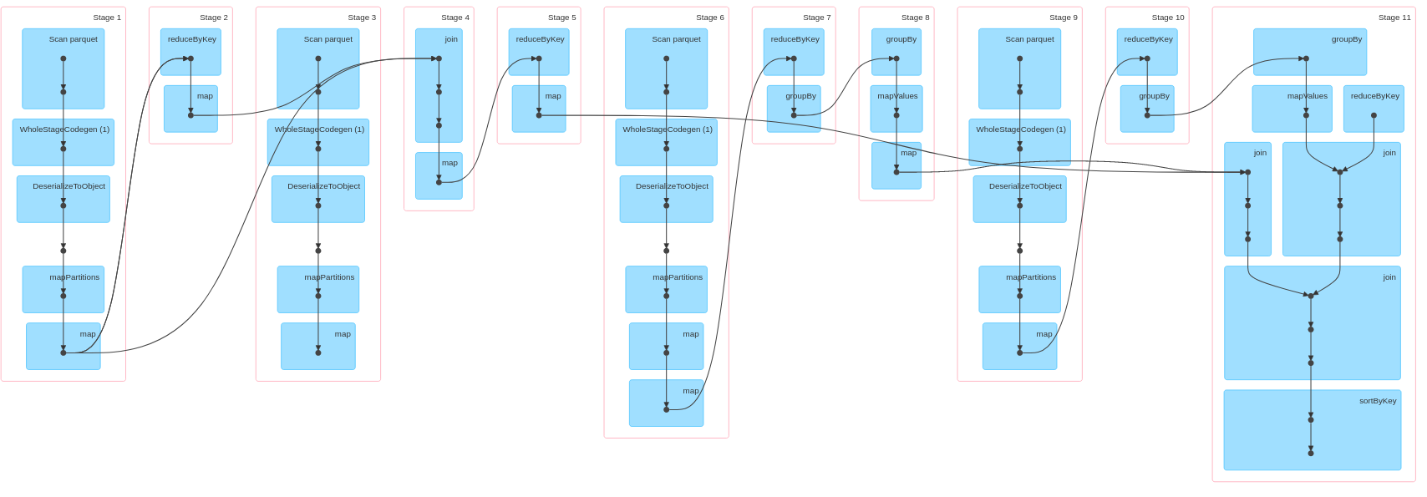
SparkRDD – Query2

Slide 16
SparkRDD – Query2
statistics
deviation
grouped_zones*
red_pay
top_payments
grouped_zones
joined
grouped
iterations
trips
zones
Distribuzione delle zone
aggr_pay
results_rdd
Media dei tips per ogni ora
Deviazione standard delle mance
Metodo di Pagamento Preferito
Risultato Finale

Slide 17
SparkRDD – Query2: Media Mance
// RDD:=[hour,statistics]
JavaPairRDD<String, ValQ2> trips = dataset.mapToPair(r ->
new Tuple2<>(Tools.getHour(r.getTimestamp(0)),
new ValQ2(r.getDouble(6), r.getLong(4), 1, 1))); //tips,payment_type
JavaPairRDD<String, ValQ2> aggregated = trips.reduceByKey((Function2<ValQ2, ValQ2, ValQ2>) (v1, v2) -> {
ValQ2 v = new ValQ2();
Integer aggr = v1.getNum_trips() + v2.getNum_trips();
Integer occ = v1.getNum_payments() + v2.getNum_payments();
Double tips = v1.getTips() + v2.getTips();
v.setNum_trips(aggr);
v.setNum_payments(occ);
v.setTips(tips);
return v;
});
JavaPairRDD<String, ValQ2> statistics = aggregated.mapToPair(
r -> {
Integer num_occurrences = r._2().getNum_payments();
Double tips_mean = r._2().getTips() / num_occurrences;
return new Tuple2<>(r._1(),
new ValQ2(tips_mean, num_occurrences));
});
aggregated
statistics
trips

Slide 18
SparkRDD – Query2: Deviazione Standard
// RDD:=[hour,statistics_deviation_it]
JavaPairRDD<String, ValQ2> iterations = joined.mapToPair( //joined = trips.join(statistics)
r -> {
Double tips_mean = r._2()._2().getTips();
Double tip_val = r._2()._1().getTips();
Double tips_dev = Math.pow((tip_val - tips_mean), 2);
r._2()._2().setTips_stddev(tips_dev);
return new Tuple2<>(r._1(), r._2()._2());
});
// RDD:=[hour,statistics_deviation_sum]
JavaPairRDD<String, ValQ2> stddev_aggr = iterations.reduceByKey((Function2<ValQ2, ValQ2, ValQ2>) (v1, v2) -> {
Double tips_total_stddev = v1.getTips_stddev() + v2.getTips_stddev();
ValQ2 v = new ValQ2(v1.getTips(), v1.getNum_payments(), v1.getPayment_type(), tips_total_stddev);
return v;
});
// RDD:=[hour,statistics_deviation]
JavaPairRDD<String, ValQ2> deviation = stddev_aggr.mapToPair(
r -> {
Double tips_mean = r._2().getTips();
Integer n = r._2().getNum_payments();
Double tips_dev = Math.sqrt(r._2().getTips_stddev() / n);
ValQ2 v = new ValQ2(tips_mean, n, tips_dev);
return new Tuple2<>(r._1(), v);
});
deviation
joined
iterations

Slide 19
SparkRDD – Query2: Metodo di Pagamento
// RDD:=[(hour,payment),1]
JavaPairRDD<KeyQ2Pay, Integer> aggr_pay = trips.mapToPair(r ->
new Tuple2<>(
new KeyQ2Pay(r._1(),r._2().getPayment_type())
,1));
// RDD:=[(hour,payment),occurrences]
JavaPairRDD<KeyQ2Pay, Integer> red_pay = aggr_pay.reduceByKey((Function2<Integer, Integer, Integer>) (v1, v2) -> {
Integer occ = v1 + v2;
return occ;
});
// RDD:=[hour,{((hour,payment),occurrences]
JavaPairRDD<String, Iterable<Tuple2<KeyQ2Pay, Integer>>> grouped = red_pay.groupBy((Function<Tuple2<KeyQ2Pay, Integer>, String>) r -> r._1().getHour());
// RDD:=[hour,(top_payment,occurrences)]
JavaPairRDD<String, Long> top_payments = grouped.mapToPair(r ->
new Tuple2<>(
r._1(),
getMostFrequentPayment(r._2())
));
red_pay
grouped
top_payments
aggr_pay

Slide 20
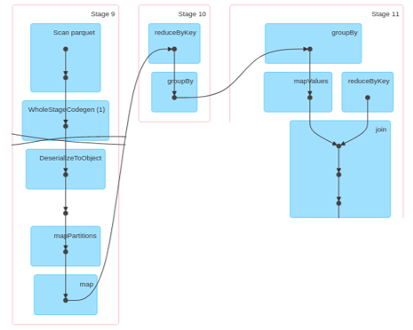
SparkRDD – Query2: Distribuzione Zone
// RDD:=[(hour,PU),1]
JavaPairRDD<KeyQ2PU, Integer> zones = dataset.mapToPair(r ->
new Tuple2<>(new KeyQ2PU(Tools.getHour(r.getTimestamp(0)), r.getLong(2)), 1));
// RDD:=[(hour,PU),occurrences]
JavaPairRDD<KeyQ2PU, Integer> red_zones = zones.reduceByKey((Function2<Integer, Integer, Integer>) (v1, v2) -> {
Integer occ = v1 + v2;
return occ;
});
// RDD:=[hour,((hour,PU),occurrences)]
JavaPairRDD<String, Tuple2<Iterable<Tuple2<KeyQ2PU, Integer>>, ValQ2>> grouped_zones = red_zones
.groupBy((Function<Tuple2<KeyQ2PU, Integer>, String>) r -> r._1().getHour())
.join(aggregated);
…
Iterable<Tuple2<KeyQ2PU, Integer>> occList = r._2()._2()._1();
List<Tuple2<Double, Long>> percentages = calcPercentagesList(occList, totalTrips);
grouped_zones*
grouped_zones
zones

Slide 21
SparkRDD – Query2: Risultato Finale
// RDD:=[hour,payment_stats,trips_stats]
JavaPairRDD<String, Tuple2<Tuple2<ValQ2, Long>, Tuple2<Iterable<Tuple2<KeyQ2PU, Integer>>, ValQ2>>> final_joined = deviation
.join(top_payments)
.join(grouped_zones)
.sortByKey(new DateComparator());
// RDD:= [hour, List<percentages>, avgTip, devTip, topPayment]
JavaPairRDD<String, Tuple4<List<Tuple2<Double, Long>>, Double, Double, Long>> results_rdd = final_joined
.mapToPair(
r -> {
String hour = r._1();
Long topPayment = r._2()._1()._2;
double avgTip = r._2()._1()._1().getTips();
double devTip = r._2()._1()._1().getTips_stddev();
Integer totalTrips = r._2()._2()._2().getNum_trips();
Iterable<Tuple2<KeyQ2PU, Integer>> occList = r._2()._2()._1();
List<Tuple2<Double, Long>> percentages = calcPercentagesList(occList, totalTrips);
return new Tuple2<>(hour, new Tuple4<>(percentages, avgTip, devTip, topPayment));
});
top_payments
grouped_zones
deviation
results_rdd

Slide 22
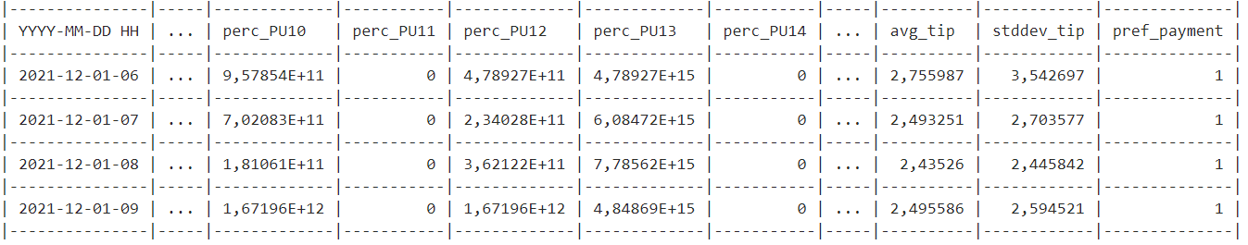
SparkRDD – Query2: Risultato Finale

Slide 23
Query 3
«Per ogni giorno, identificare le 5 zone di destinazione (DOLocationID) più popolari (in ordine decrescente), indicando per ciascuna di esse il numero medio di passeggeri, la media e la deviazione standard della tariffa pagata (Fare amount). Nell’output della query, indicare il nome della zona (TLC Taxi Destination Zone) anziché il codice numerico.»

Slide 24
SparkRDD – Query 3: Tuple
Identificazione delle cinque zone di destinazione più popolari
DOLocationID
Aggregazione su base giornaliera
tpep_dropoff_datetime
Media e deviazione standard della tariffa pagata
fare_amount
Media del numero di passeggeri
passenger_count
public class ValQ3 implements Serializable {
Double passengers;
Double fare;
Integer occurrences;
Double fare_stddev;
}
public class KeyQ3 implements Serializable {
String day;
Long dest;
}

Slide 25
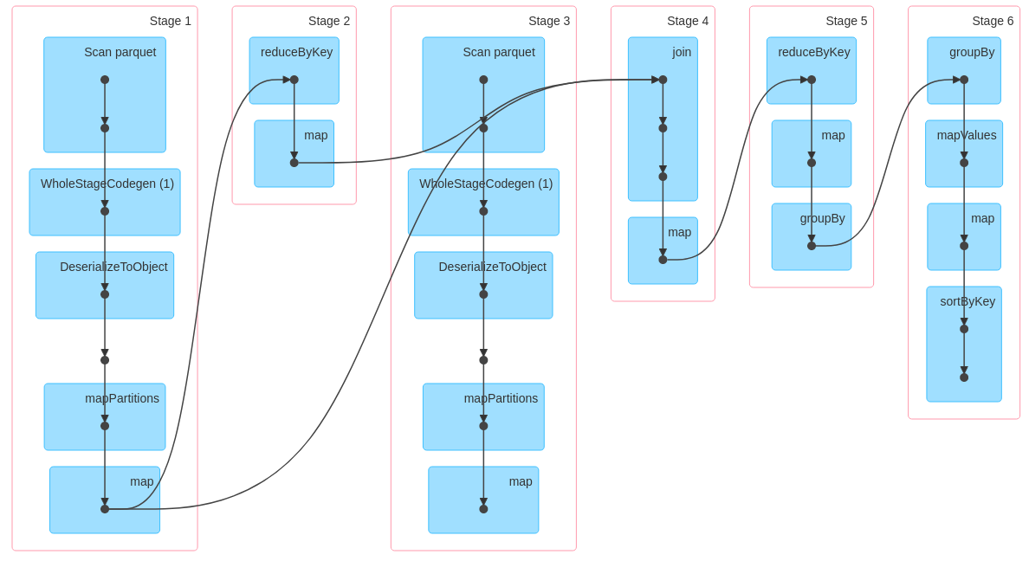
SparkRDD – Query3

Slide 26
SparkRDD – Query3
Medie per destinazione-fascia oraria
Deviazione Standard
Grouping

Slide 27
SparkRDD – Query3: Medie
// RDD:=[(day,DO),statistics]
JavaPairRDD<KeyQ3, ValQ3> days = dataset.mapToPair(
r -> new Tuple2<>(new KeyQ3(Tools.getDay(r.getTimestamp(1)), r.getLong(3)),
new ValQ3(r.getDouble(9), r.getDouble(5), 1)));
// RDD:=[(day,DO),statistics_aggregated]
JavaPairRDD<KeyQ3, ValQ3> reduced = days.reduceByKey((Function2<ValQ3, ValQ3, ValQ3>) (v1, v2) -> {
Double pass = v1.getPassengers() + v2.getPassengers();
Double fare = v1.getFare() + v2.getFare();
Integer occ = v1.getOccurrences() + v2.getOccurrences();
ValQ3 v = new ValQ3(pass, fare, occ);
return v;
});
// RDD:=[(day,DO),statistics_mean]
JavaPairRDD<KeyQ3, ValQ3> mean = reduced.mapToPair(
r -> {
Integer num_occurrences = r._2().getOccurrences();
Double pass_mean = r._2().getPassengers() / num_occurrences;
Double fare_mean = r._2().getFare() / num_occurrences;
return new Tuple2<>(r._1(),
new ValQ3(pass_mean, fare_mean, num_occurrences));
});

Slide 28
SparkRDD – Query3: Deviazione Standard
// RDD:=[(day,DO),(statistics,statistics_mean)]
JavaPairRDD<KeyQ3, Tuple2<ValQ3, ValQ3>> joined = days.join(mean);
// RDD:=[(day,DO),statistics_stddev_iteration]
JavaPairRDD<KeyQ3, ValQ3> iterations = joined.mapToPair(
r -> {
Double fare_mean = r._2()._2().getFare();
Double fare_val = r._2()._1().getFare();
Double fare_dev = Math.pow((fare_val - fare_mean), 2);
r._2()._2().setFare_stddev(fare_dev);
return new Tuple2<>(r._1(), r._2()._2());
});
// RDD:=[(day,DO)),statistics_stddev_aggregated]
JavaPairRDD<KeyQ3, ValQ3> stddev_aggr = iterations.reduceByKey((Function2<ValQ3, ValQ3, ValQ3>) (v1, v2) -> {
Double fare_total_stddev = v1.getFare_stddev() + v2.getFare_stddev();
ValQ3 v = new ValQ3(v1.getPassengers(), v1.getFare(), v1.getOccurrences(), fare_total_stddev);
return v; });
JavaPairRDD<KeyQ3, ValQ3> deviation = stddev_aggr.mapToPair(
r -> {
Double fare_mean = r._2().getFare();
Integer n = r._2().getOccurrences();
Double fare_dev = Math.sqrt(r._2().getFare_stddev() / n);
Double pass_mean = r._2().getPassengers();
ValQ3 v = new ValQ3(pass_mean, fare_mean, n, fare_dev);
return new Tuple2<>(r._1(), v); });

Slide 29
SparkRDD – Query3: Grouping Statistiche
// RDD:=[day,List<DO_with_statistics>]
JavaPairRDD<String, Iterable<Tuple2<KeyQ3,ValQ3>>> grouped =deviation.
groupBy((Function<Tuple2<KeyQ3,ValQ3>, String>) r -> r._1().getDay());
// RDD:=[day,List<top_5_DO_with_statistics>]
JavaPairRDD<String, List<Tuple2<Long,ValQ3>>> top_destinations = grouped.mapToPair(r ->
new Tuple2<>(
r._1(),
getTopFiveDestinations(r._2())
))
.sortByKey(new DateComparator());

Slide 30
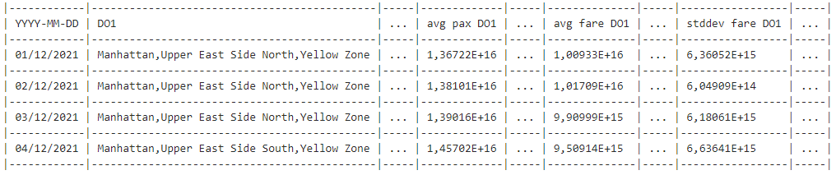
SparkRDD – Query3: Risultato Finale

Slide 31
SparkSQL – Dataset Creation
public Dataset<Row> createSchemaFromRDD(SparkSession spark, JavaRDD<Row> dataset) {
List<StructField> fields = new ArrayList<>();
fields.add(DataTypes.createStructField("tpep_dropoff_datatime", DataTypes.TimestampType, true));
fields.add(DataTypes.createStructField("tip_amount", DataTypes.DoubleType, true));
fields.add(DataTypes.createStructField("tolls_amount", DataTypes.DoubleType, true));
fields.add(DataTypes.createStructField("total_amount", DataTypes.DoubleType, true));
fields.add(DataTypes.createStructField("payment_type", DataTypes.LongType, true));
StructType schema = DataTypes.createStructType(fields);
Calendar cal = Calendar.getInstance();
cal.setTimeZone(TimeZone.getTimeZone("UTC"));
SimpleDateFormat sdf = new SimpleDateFormat("yyyy-MM-dd hh:mm:ss");
sdf.setTimeZone(TimeZone.getTimeZone("UTC"));
JavaRDD<Row> rowRDD = dataset.map((Function<Row, Row>)
v1 -> {
Timestamp ts = v1.getTimestamp(1);
cal.setTime(ts);
Timestamp ts_zone = Timestamp.valueOf(sdf.format(cal.getTime()));
return RowFactory.create(ts_zone, v1.getDouble(6), v1.getDouble(7), v1.getDouble(8), v1.getLong(4));
});
return spark.createDataFrame(rowRDD, schema);
}

Slide 32
SparkSQL – Query1
Dataset<Row> data = createSchemaFromRDD(spark, dataset);
data.createOrReplaceTempView("taxi_row");
Dataset<Row> values = spark.sql( "SELECT date_format(tpep_dropoff_datatime, 'y/MM') AS date," +
"sum(tip_amount) AS tips, sum(tolls_amount) AS tolls, sum(total_amount) AS total," +
"count(*) AS trips_number" +
"FROM taxi_row WHERE payment_type = 1 GROUP BY date_format(tpep_dropoff_datatime, 'y/MM’)"
);
values.createOrReplaceTempView("taxi_values");
results = spark.sql("SELECT date," +
"(tips/(total-tolls)) AS tips_percentage, trips_number FROM taxi_values ORDER BY date ASC");

Slide 33
SparkSQL – Query2: Distribuzioni viaggi
Dataset<Row> data = createSchemaFromRDD(spark, dataset);
data.createOrReplaceTempView("trip_infos");
// {timestamp, zone}, trips, total_trip_per_hour, zone_perc
Dataset<Row> scheduledTrips = spark.sql("SELECT timestamp, zone, trips, total_trip_hour, float(trips/total_trip_hour) as zone_perc FROM " +
"(SELECT date_format(tpep_pickup_datatime, 'y-MM-dd HH') as timestamp, pu_location_id as zone, COUNT(*) as trips" +
"FROM trip_infos " +
"GROUP BY timestamp, pu_location_id)" +
"JOIN " +
"(SELECT date_format(tpep_pickup_datatime, 'y-MM-dd HH') as timestamp_2, COUNT(*) AS total_trip_hour" +
" FROM trip_infos GROUP BY timestamp_2)" +
"ON timestamp = timestamp_2 ORDER BY timestamp ASC");
scheduledTrips.createOrReplaceTempView("scheduled_trips");
// {timestamp}, list(zone_id:zone_perc)
Dataset<Row> groupedTrips = spark.sql("SELECT timestamp, collect_list(concat_ws(':', zone, zone_perc)) as zone_percs" +
"FROM scheduled_trips GROUP BY timestamp");
groupedTrips.createOrReplaceTempView("grouped_trips");

Slide 34
SparkSQL – Query2: Statistiche
// {timestamp}, trips, avg(tip), stddev(tip)
Dataset<Row> hourly_values = spark.sql("SELECT date_format(tpep_pickup_datatime, 'y-MM-dd HH') as timestamp, COUNT(*) as trips," +
"avg(tip) AS avg_tip, stddev_pop(tip) AS stddev_tip " +
"FROM trip_infos " +
"GROUP BY timestamp " +
"ORDER BY timestamp ASC");
hourly_values.createOrReplaceTempView("hourly_values");
// {timestamp, payment_type}, occurrences
Dataset<Row> paymentOccurrences = spark.sql("SELECT date_format(tpep_pickup_datatime, 'y-MM-dd HH') AS timestamp," +
"payment_type, COUNT(*) AS counted " +
"FROM trip_infos GROUP BY timestamp, payment_type " +
"ORDER BY timestamp ASC");
paymentOccurrences.createOrReplaceTempView("payment_occurrences");
// {timestamp}, most_popular_payment, payment_occurrences
Dataset<Row> mostPopularPaymentType = spark.sql("SELECT timestamp, payment_type as most_popular_payment, counted AS payment_occurrences "FROM payment_occurrences table_1 WHERE counted =" +
"(SELECT MAX(counted) FROM payment_occurrences WHERE timestamp = table_1.timestamp)
"ORDER BY timestamp ASC");
mostPopularPaymentType.createOrReplaceTempView("most_popular_payment");

Slide 35
SparkSQL – Query2: Statistiche
// {timestamp}, avg_tip, stddev_tip, most_popular_payment, zone_percs
results = spark.sql(SELECT table_1.timestamp AS timestamp, avg_tip, stddev_tip, most_popular_payment, string(zone_percs) AS " trips_distribution, zone_percs AS percs_array FROM " +
"(SELECT most_popular_payment.timestamp AS timestamp, avg_tip, stddev_tip, most_popular_payment FROM " +
"hourly_values JOIN most_popular_payment ON hourly_values.timestamp = most_popular_payment.timestamp) table_1 " +
"JOIN grouped_trips ON table_1.timestamp = grouped_trips.timestamp " +
"ORDER BY timestamp ASC");

Slide 36
SparkSQL – Query3: Top-5
Dataset<Row> data = createSchemaFromRDD(spark, dataset);
data.createOrReplaceTempView("trip_infos");
Dataset<Row> values = spark.sql(" SELECT DATE(tpep_dropoff_datetime) AS day, do_location_id AS destination, AVG(passenger_count) AS
passenger_avg, AVG(fare_amount) as fare_avg, STDDEV_POP(fare_amount) AS fare_stddev, COUNT(*) AS dest_for_day
FROM trip_infos GROUP BY day, destination ORDER BY day, dest_for_day DESC");
values.createOrReplaceTempView("values");
Dataset<Row> top5_per_day = spark.sql(" SELECT day, destination, dest_for_day, passenger_avg, fare_avg, fare_stddev
FROM (SELECT *, ROW_NUMBER() OVER (PARTITION BY day ORDER BY dest_for_day DESC) AS top FROM values) WHERE top <= 5");
top5_per_day.createOrReplaceTempView("top5_per_day");

Slide 37
SparkSQL – Query3: Output
Dataset<Row> merged_days = spark.sql(" SELECT day, COLLECT_LIST(destination) AS dest, COLLECT_LIST(passenger_avg) AS pass,
COLLECT_LIST(fare_avg) AS fare, COLLECT_LIST(fare_stddev) AS stddev
FROM top5_per_day GROUP BY day");
merged_days.createOrReplaceTempView("merged_days");
spark.udf().register("setZones", (UDF1<String, String>) id -> Zone.zoneMap.get(Integer.parseInt(id)), DataTypes.StringType);
results = spark.sql(" SELECT day, setZones(CAST(ELEMENT_AT(dest, 1) AS String)) AS D01, setZones(CAST(ELEMENT_AT(dest, 2) AS String)) AS
D02,setZones(CAST(ELEMENT_AT(dest, 3) AS String)) AS D03, setZones(CAST(ELEMENT_AT(dest, 4) AS String)) AS D04,
setZones(CAST(ELEMENT_AT(dest, 5) AS String)) AS D05, ELEMENT_AT(pass, 1) AS avg_pax_D01, ELEMENT_AT(pass, 2) AS avg_pax_D02,
ELEMENT_AT(pass, 3) AS avg_pax_D03, ELEMENT_AT(pass, 4) AS avg_pax_D04, ELEMENT_AT(pass, 5) AS avg_pax_D05, ELEMENT_AT(fare, 1) AS
avg_fare_D01, ELEMENT_AT(fare, 2) AS avg_fare_D02, ELEMENT_AT(fare, 3) AS avg_fare_D03, ELEMENT_AT(fare, 4) AS avg_fare_D04,
ELEMENT_AT(fare, 5) AS avg_fare_D05, ELEMENT_AT(stddev, 1) AS avg_stddev_D01, ELEMENT_AT(stddev, 2) AS avg_stddev_D02,
ELEMENT_AT(stddev, 3) AS avg_stddev_D03, ELEMENT_AT(stddev, 4) AS avg_stddev_D04, ELEMENT_AT(stddev, 5) AS avg_stddev_D05
FROM merged_days");

Slide 38
Analisi performance
Per l’analisi delle prestazioni sono state eseguite diverse ripetizioni delle Query
Si valuta la media dei tempi di risposta di ogni ripetizione
Si carica il dataset ogni volta che si esegue una query
Specifiche macchina locale:
AMD Ryzen 5 5500U with Radeon Graphics, @6x2.10 GHz, RAM 8GB DDR4 @ 1593.9 MHz, Linux 5.15.23-76051523-generic amd64 (Pop!_OS by System76).

Slide 39
Analisi performance
Nel grafico vediamo la valutazione delle query effettuate tramite RDD API rispetto a quelle eseguite dal modulo SparkSQL.
Q1 | Q2 | Q3 | Q1SQL | Q2SQL | Q3SQL
11753 | 40248 | 25982 | 13612 | 33334 | 15308
11176 | 40915 | 26303 | 12299 | 33750 | 14053
11369 | 40195 | 26615 | 13157 | 32279 | 13524
11412 | 41048 | 25321 | 13470 | 34323 | 14088
11620 | 41589 | 25999 | 13442 | 31398 | 13362

Slide 40
Grafana Dashboard
La dashboard è stata creata andando ad effettuare query sui file csv, risultati della computazione di Spark.
Tramite un immagine docker di Grafana, viene offerta una visualizzazione dei dati tramite una semplice Dashboard.
Link Dashboard : http://localhost:3001/d/QVfEthCnz/sabd-1?orgId=1

Slide 41
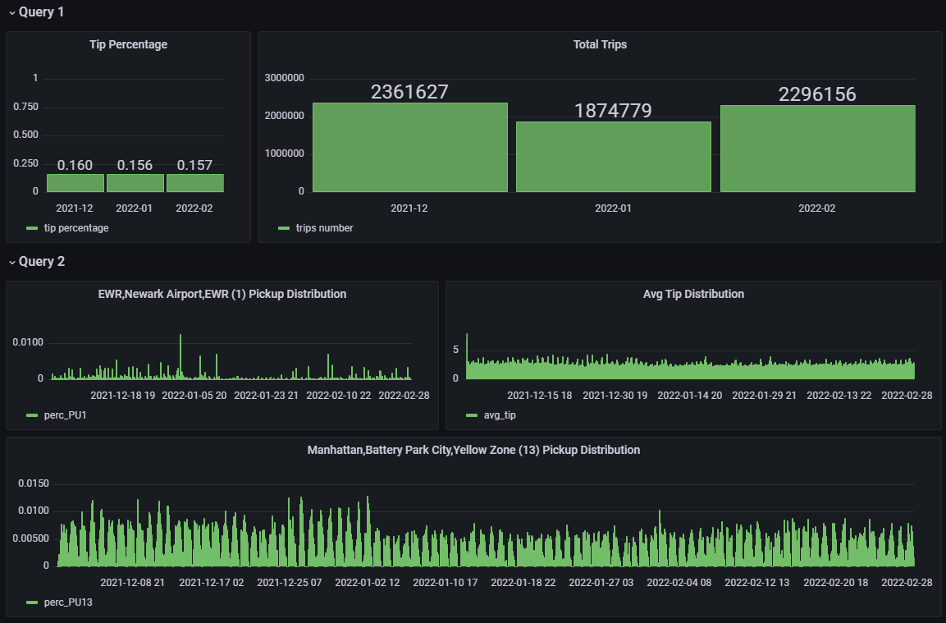
Grafana Dashboard – Query 1

Slide 42
Grafana Dashboard – Query 2

Slide 43
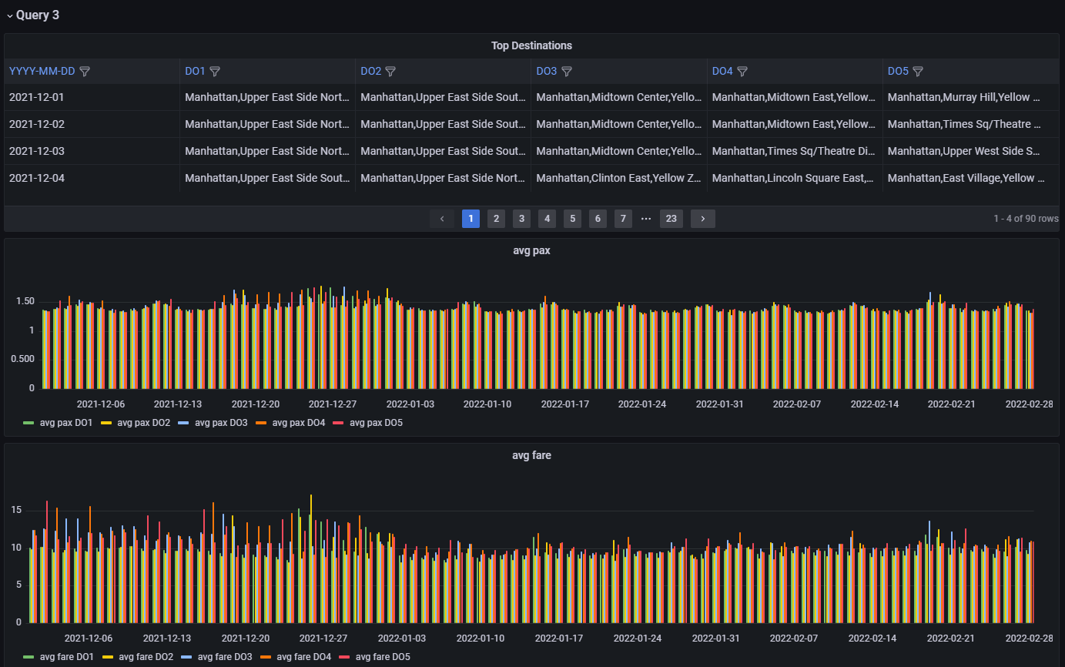
Grafana Dashboard – Query 3

Slide 44
Conclusioni
Punti di forza:
Ragionevole velocità di esecuzione
Pre-processamento tramite framework esterno
Limitazioni:
Supporto limitato di Grafana verso HDFS e MongoDB
Scalabilità limitata a causa delle ridotte risorse computazionali della singola macchina host

Slide 45
Grazie per l’attenzione
Danilo Dell’Orco
Jacopo Fabi
Michele Salvatori

