Slide 1


Politecnico di Milano
Software Engineering 2 Project
Authors: Francesco Larghi, Jacopo Fantin
Professors: Elisabetta Di Nitto, Luca Mottola

Slide 2
Goals
Provide a link between users and the car-sharing service
Offer an easy and effective tool to the customers in order to manage the car employment
Allow users to find the nearest car available and even reserve it for a limited time
Charge users for a given amount of money per minute and notify them of the current charges through a screen on the car
Allow users to leave the car where they want within a specified safe area
Apply discounts to incentivize the virtous behaviors of the users

Slide 3
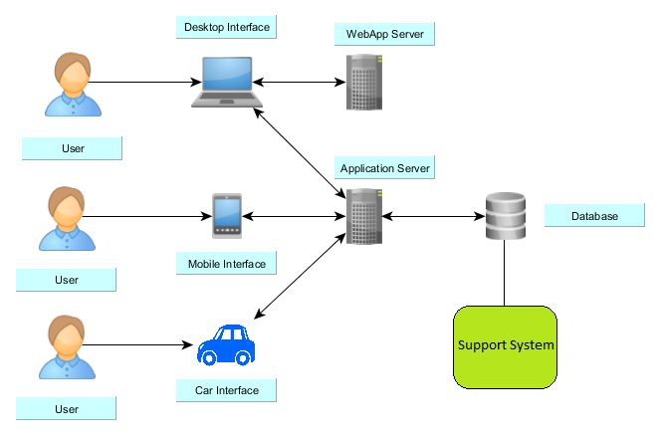
Proposed System

Slide 4
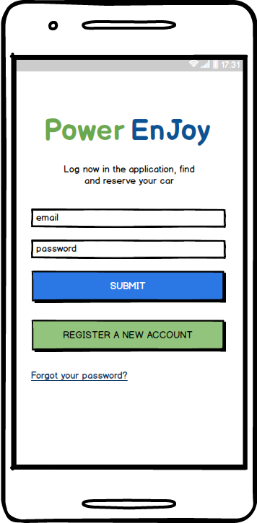
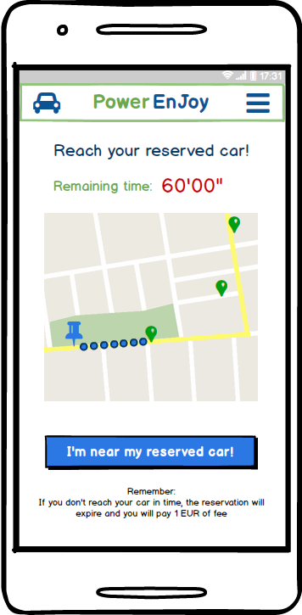
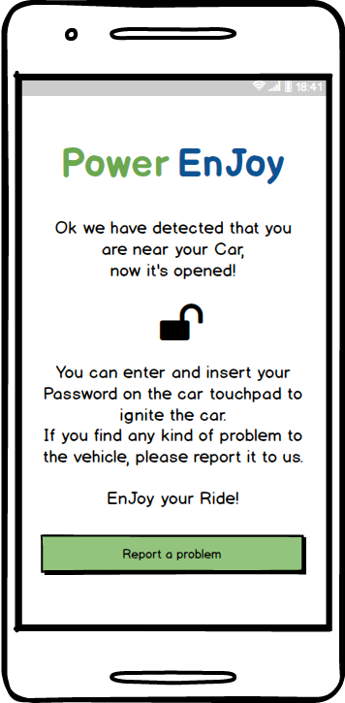
Some mobile app mockups

Slide 5
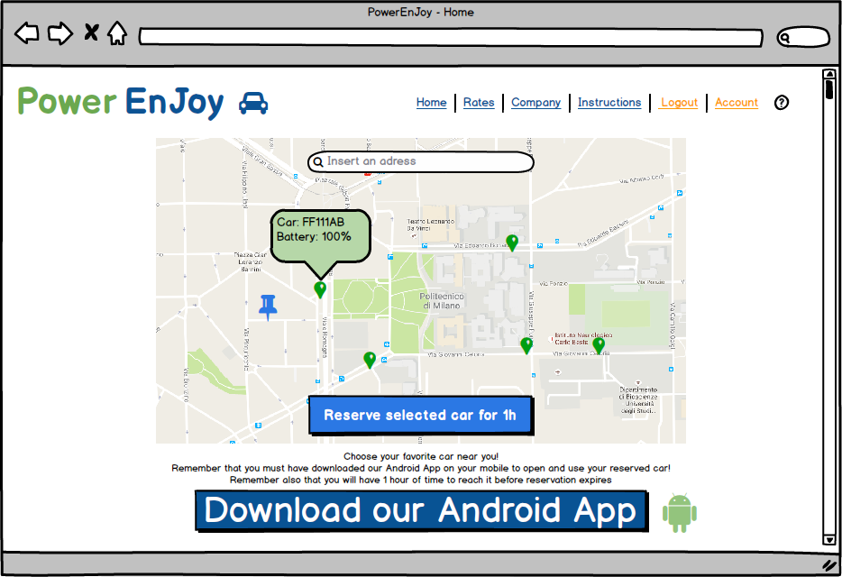
Webapp mockup

Slide 6
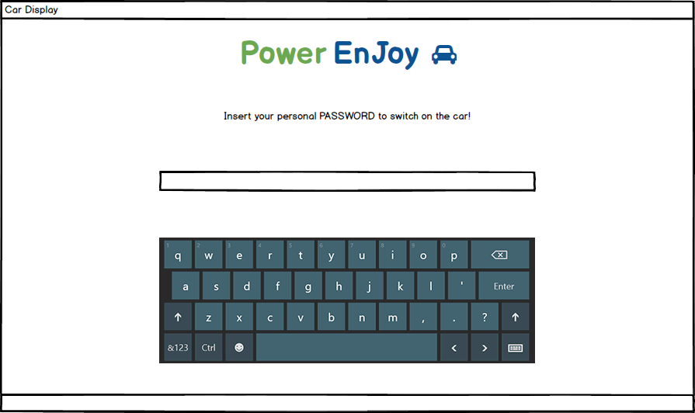
On-board interface

Slide 7
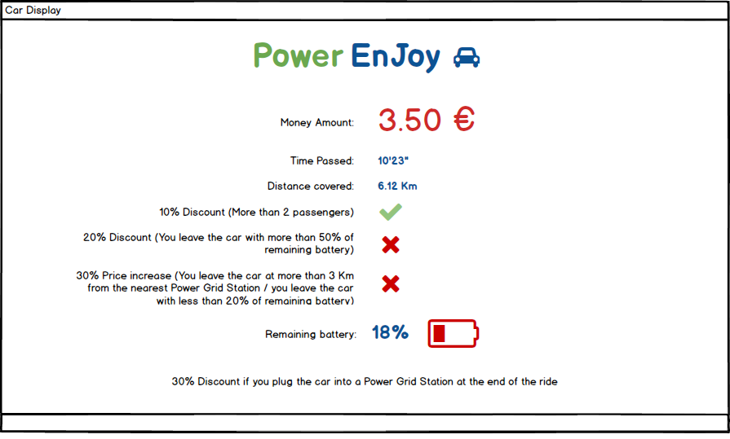
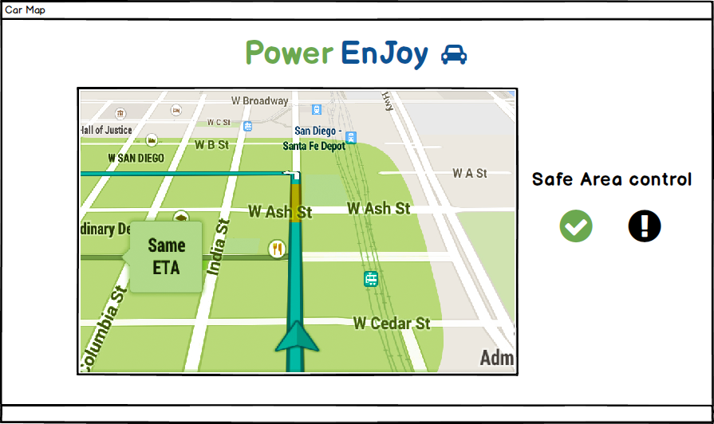

Slide 8
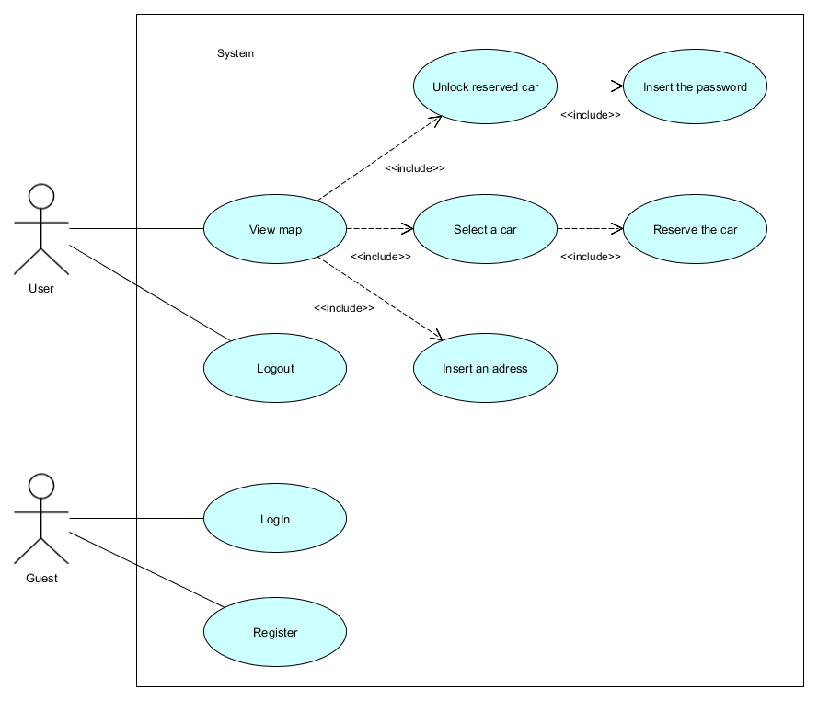
UML Diagrams

Slide 9
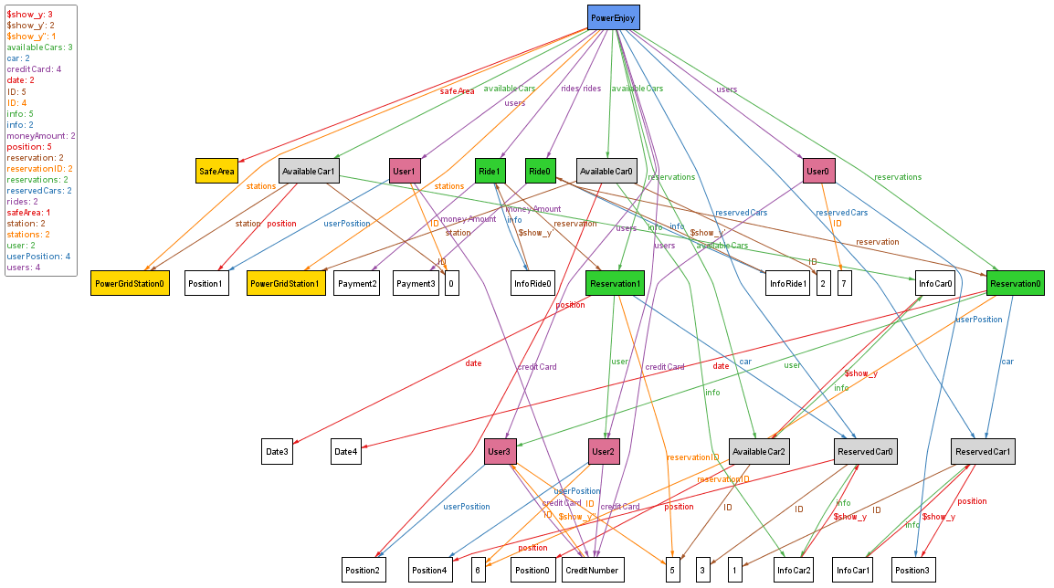
Alloy genereted world

Slide 10
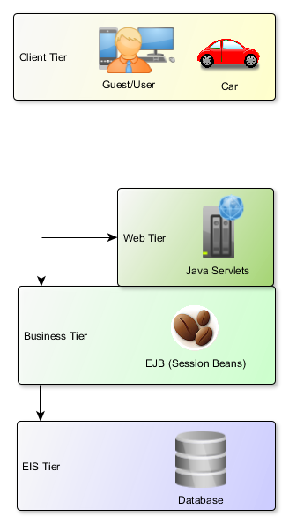
System Architecture
Client Tier, that runs on the client machine
Web Tier, which runs on the JEE Server
Business Tier, also runs on the server machine, contains the Enterprise JavaBeans (EJB)
Enterprise Information System Tier, that concerns external applications needed for the system of interest

Slide 11
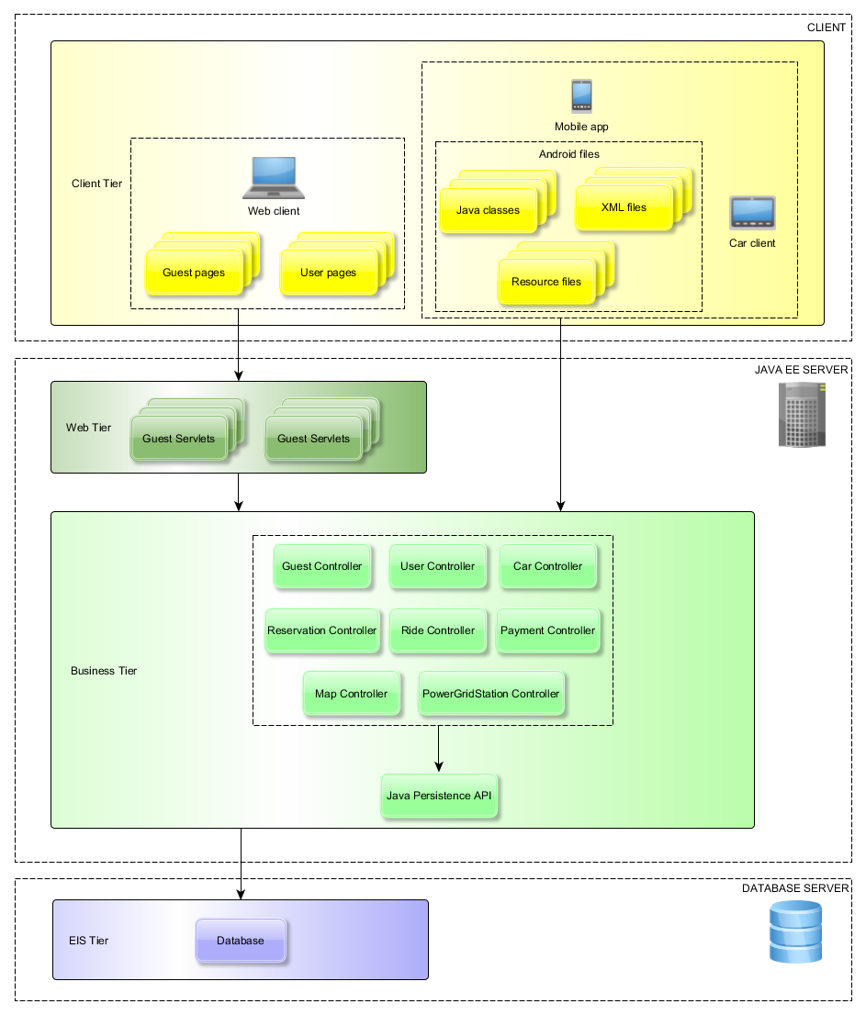
High Level Components
Client-side components:
high-level programmed (mobile application) and HTML (as for the web client) pages the user can navigate through
Server-side components:
Java Servlets and Entrerprise JavaBeans that receive user’s requests, compute the adequate response and perform the actual car sharing service

Slide 12
Database Structure

Slide 13
User experience diagram

Slide 14
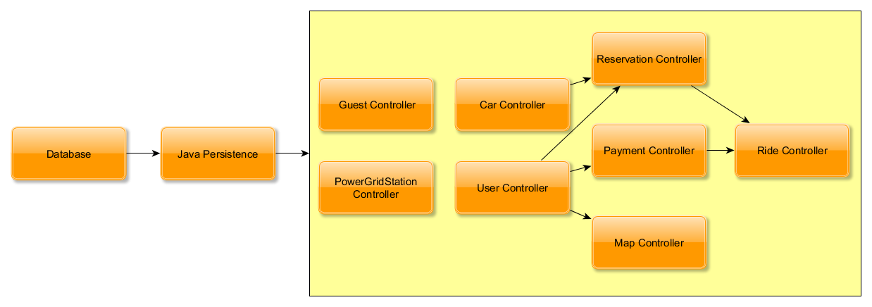
Integration test plan
Focus on Business Tier
Integration based on bottom-up strategy
Critical-Module-First in case of modules laying on the same layer

Slide 15
Integration test plan
A detailed description of the tests to be performed on integrated components with possible inputs and their effects to secure the correctness of the behavior with respect to invalid input
Tools:
Android Studio: simulation and virtualization of Android operating system through Android Virtual Device Manager (AVDM)
JUnit: test Java Classes and business logic tier components too
Arquillan: check the interaction between a component and its surrounding execution
Jmeter: load test behavior and measure performance.

Slide 16
Resource estimation
Size estimation: Function Points approach
Estimated size: 5150~7500 LOC (112 FPs)
Cost and effort estimation: COCOMO II
Estimated effort: 20~30 PM
Estimated schedule: 9.5~10.8 months

Slide 17

Questions

Slide 18
Thank You!

