Slide 1

Profiling Unidata packets per different time intervals (month/week/day)
Jacopo Maria Valtorta
Progetto “AMORE”
20/12/2018

Slide 2
Abstract
The gateways are the top six congested ones, selected among the whole Unidata network:
58A0CBEFFE014E4C
7276FF002E0503C8
1C497BEFFECAB36D
7276FF002E0616FD
7276FF002E0616C0
7276FF002E061491
The numbers represent the different users (dev_eui) using the network
On the x-axis are reported the six different SF values; while on the y-axis are represented the number of users sending using that specific SF, in a precise time interval using a specific GW.
The time intervals have been selected among the one most busy (different from GW to GW)

Slide 3
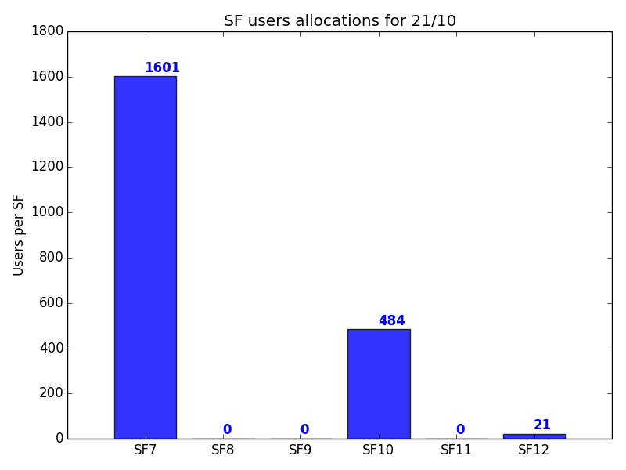
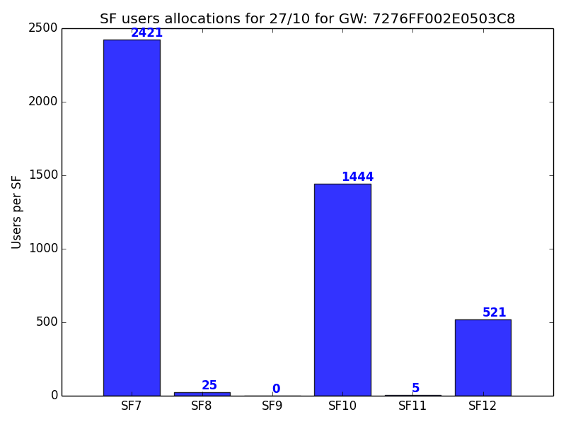
Daily: first and second GW

Slide 4
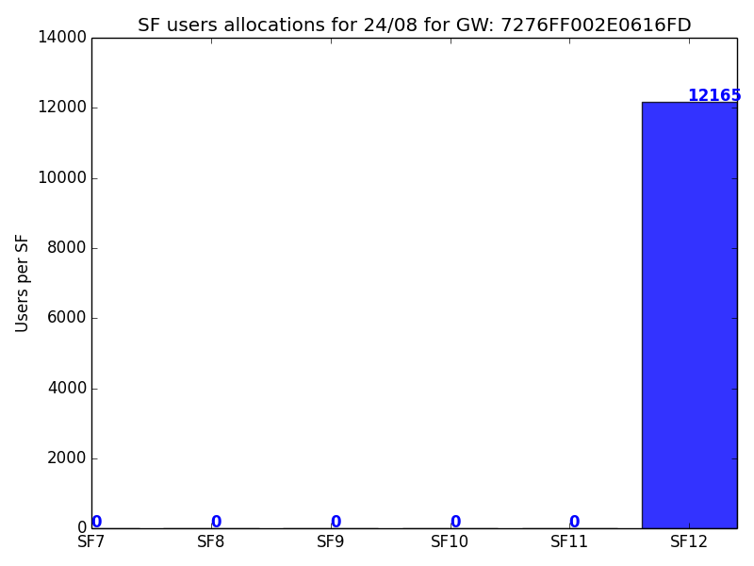
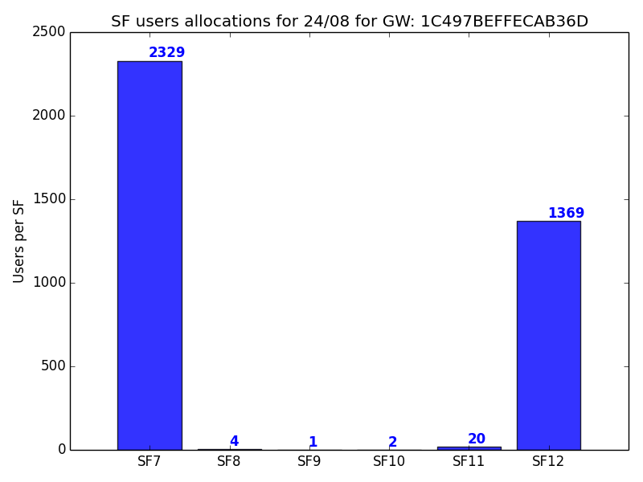
Daily: third and fourth GW

Slide 5
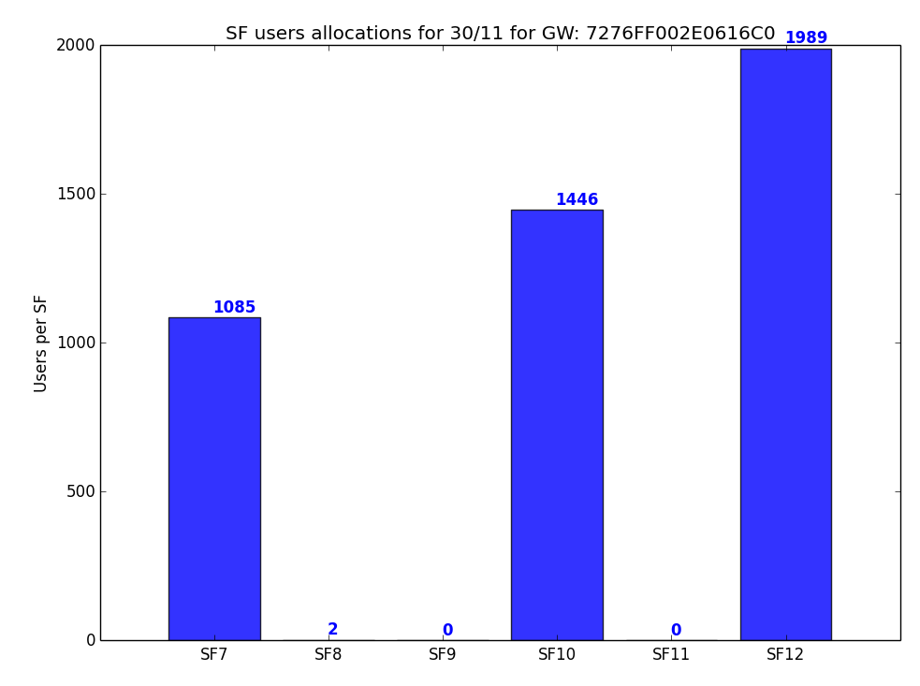
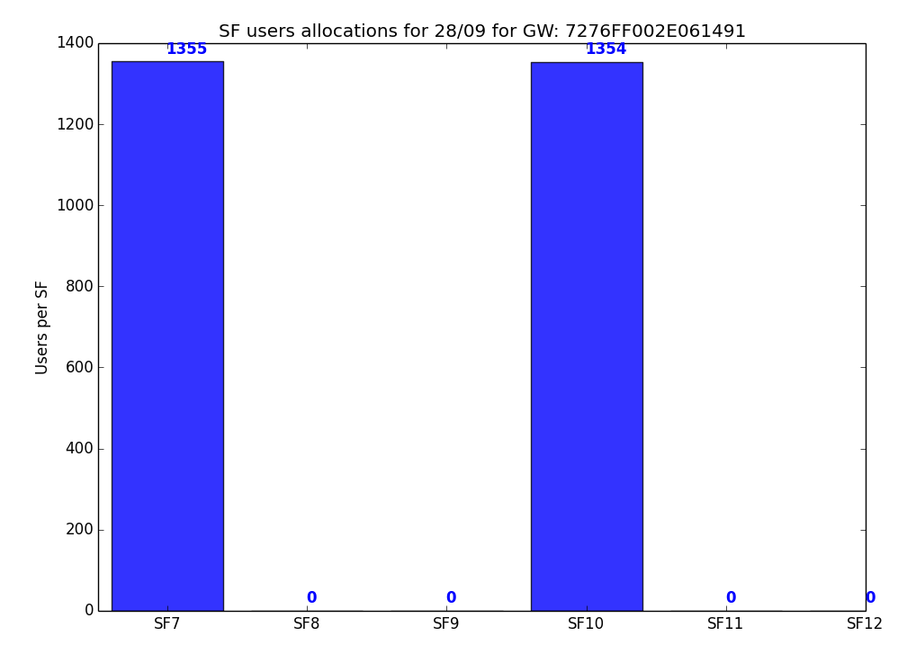
Daily: fifth and sixth GW

Slide 6
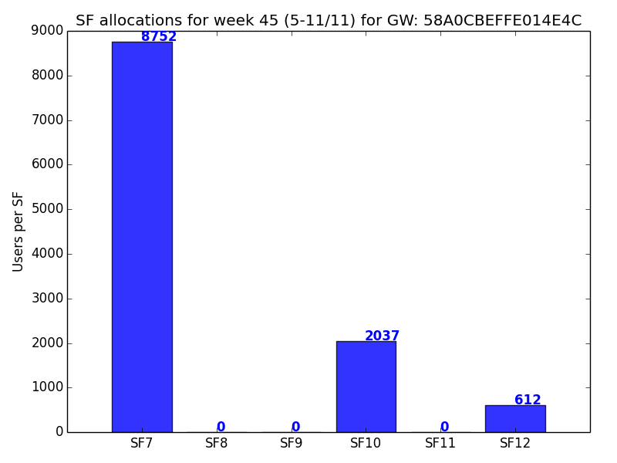
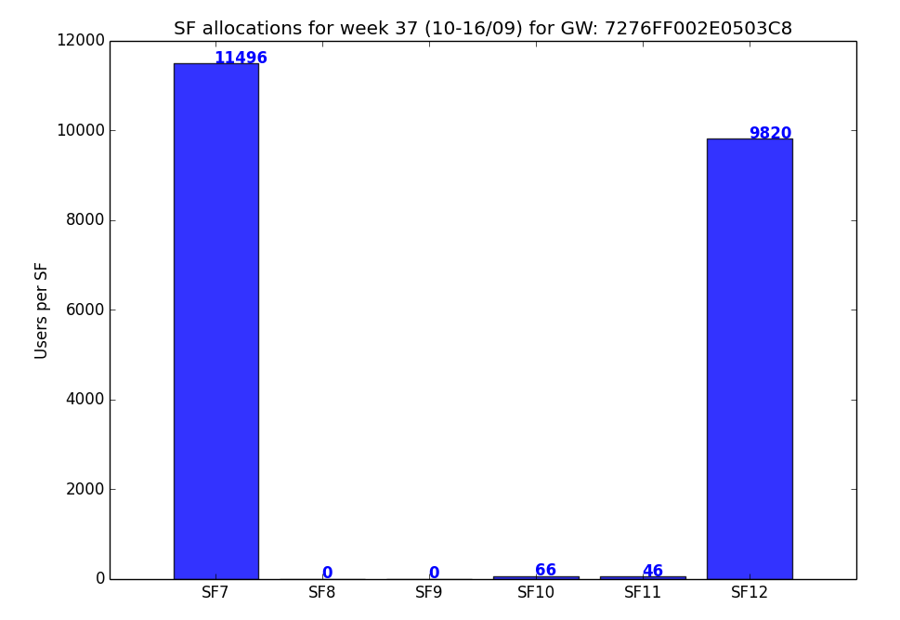
Weekly: first and second GW

Slide 7
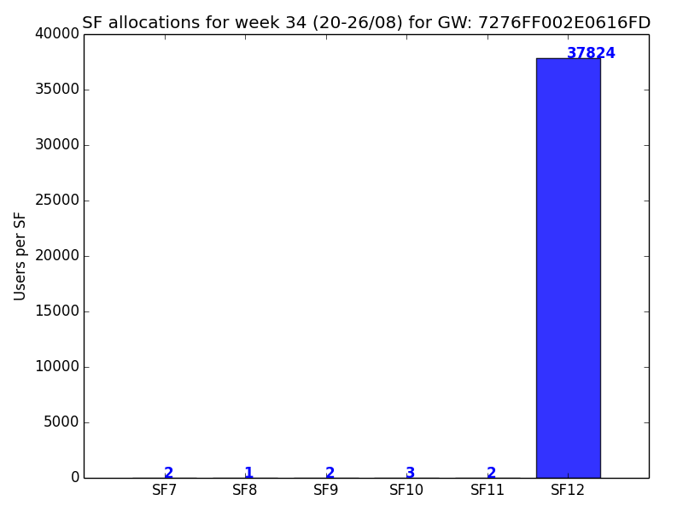
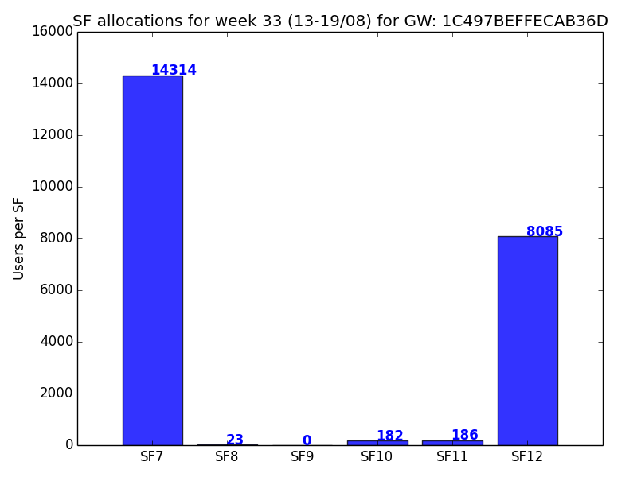
Weekly: third and fourth GW

Slide 8
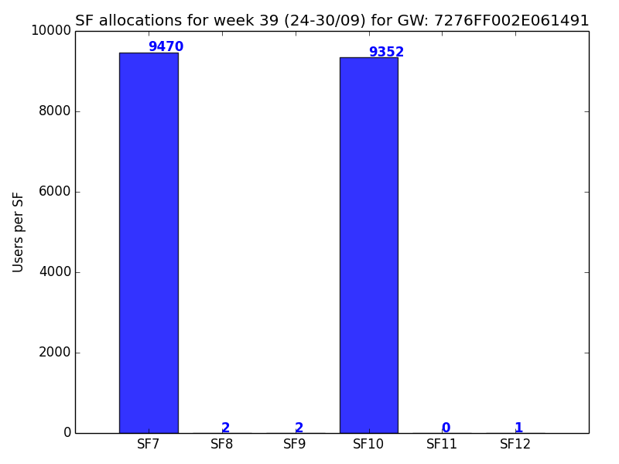
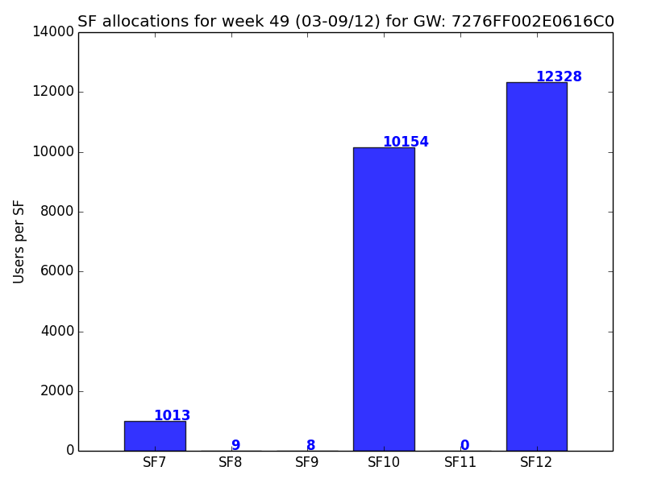
Weekly: fifth and sixth GW

Slide 9
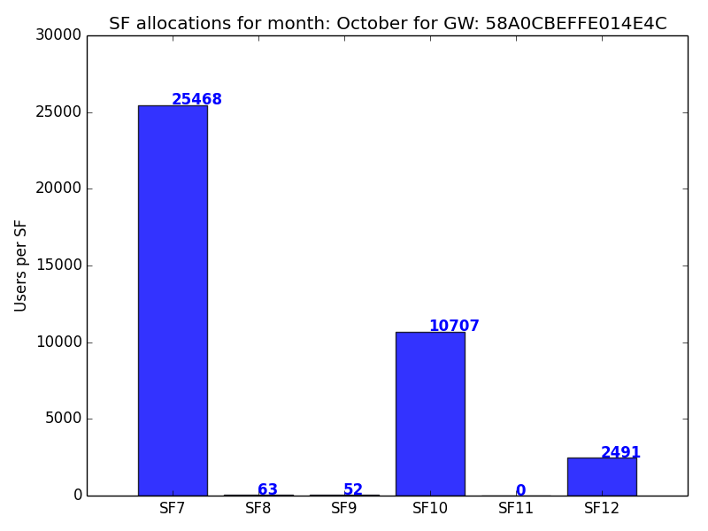
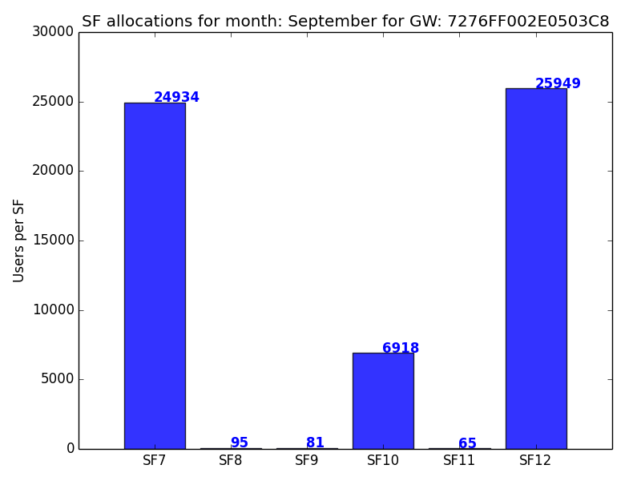
Monthly: first and second GW

Slide 10
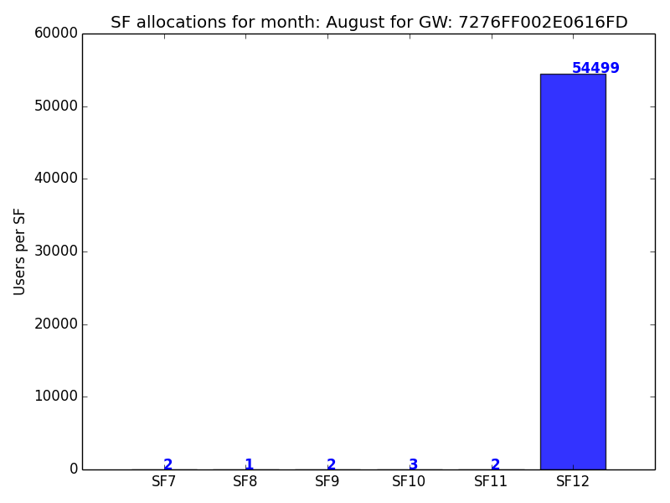
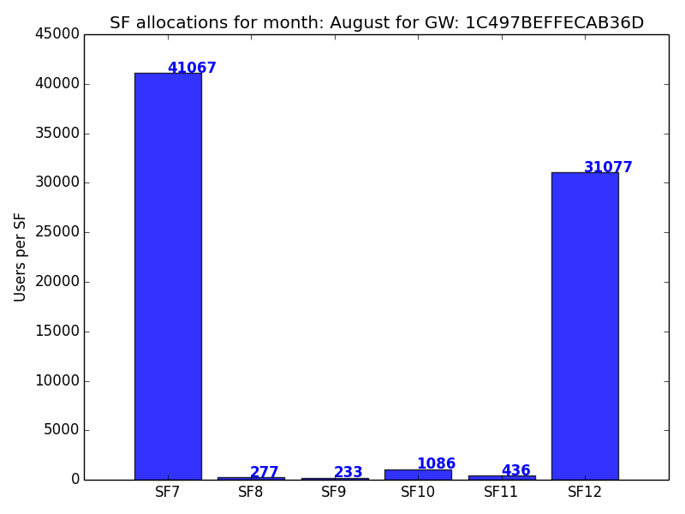
Monthly: third and fourth GW

Slide 11
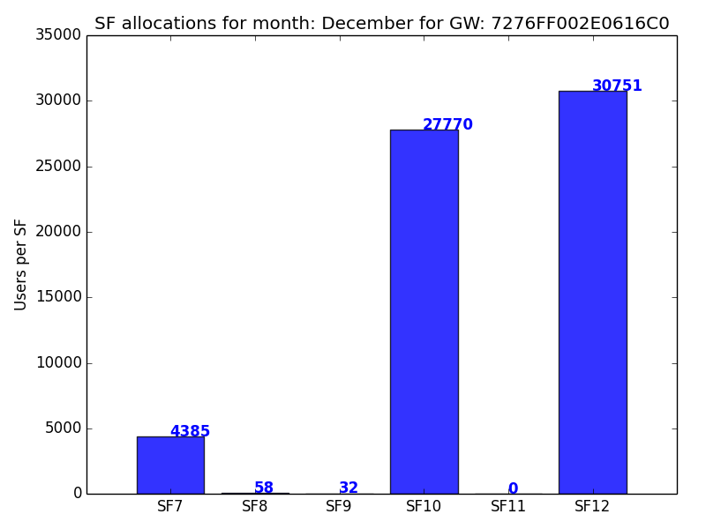
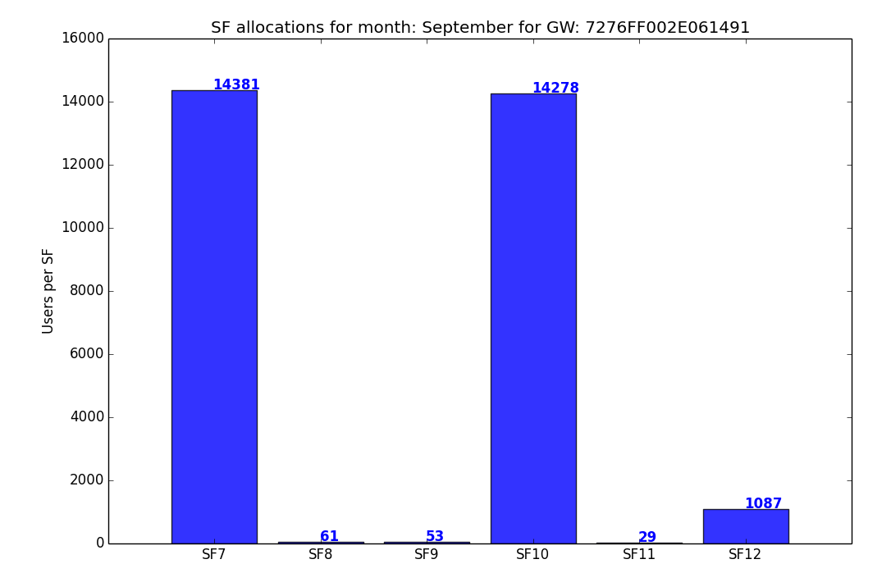
Monthly: fifth and sixth GW

