Slide 1

Profiling Unidata packets per different time intervals (month/week/day)
Jacopo Maria Valtorta
Project “AMORE”
08/01/2019
UNIDATA

Slide 2
Analysis specifications
Two indexes (device_packets):
lora-device_packet-pre_deduplication
lora-device_packet-deduplication
The 4 Gateways are the top congested ones, selected among the whole Unidata network:
Terni MAC: 70b3d54b13020000
First MAC: 58a0cbeffe014e4c
Second MAC: 7276ff002e0503c8
Third MAC: 1c497beffecab36d
Queries have been performed on ≃ 100.000 elements

Slide 3
Graphs legend
The numbers above the columns represent the different users (dev_eui) using the network
On the x-axis: the six different SF values and the average of the null dev_eui values for pre-deduplication;
On the y-axis: the number of users sending using that specific SF value, in a precise time interval using a specific GW.
The time intervals have been selected among the one most busy (different from GW to GW)
Notes:
Selezionati dopo aver svolto query su circa 100’000 elementi ed aver selezionato I mesi/settimane/giorni più trafficati per iascun GW

Slide 4
Pre-deduplication device packets
4 Gateways:
Terni MAC: 70b3d54b13020000
First MAC: 58a0cbeffe014e4c
Second MAC: 7276ff002e0503c8
Third MAC: 1c497beffecab36d

Slide 5
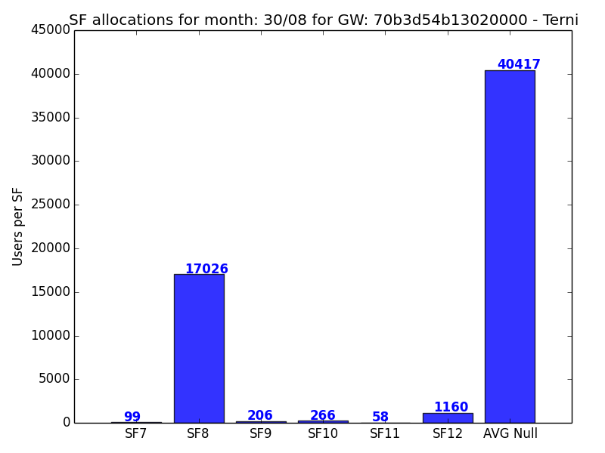
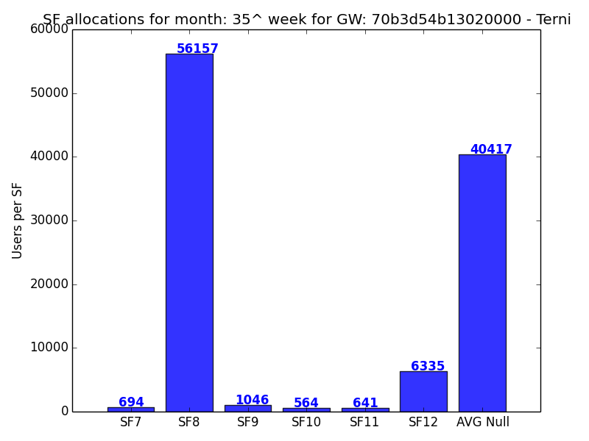
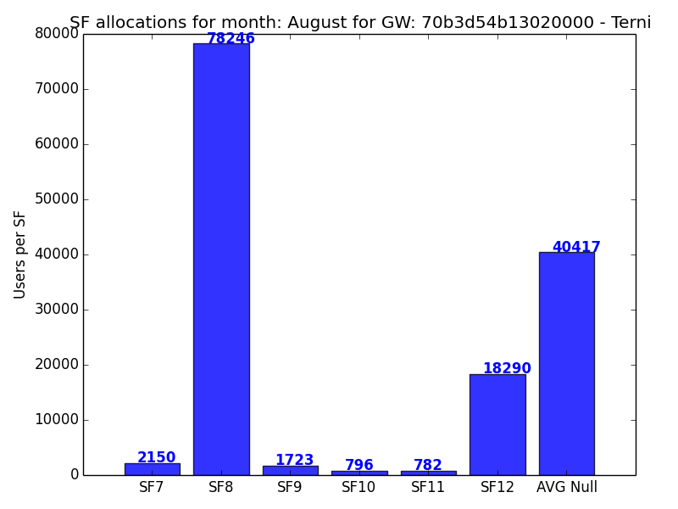
Terni - 70b3d54b13020000

Slide 6
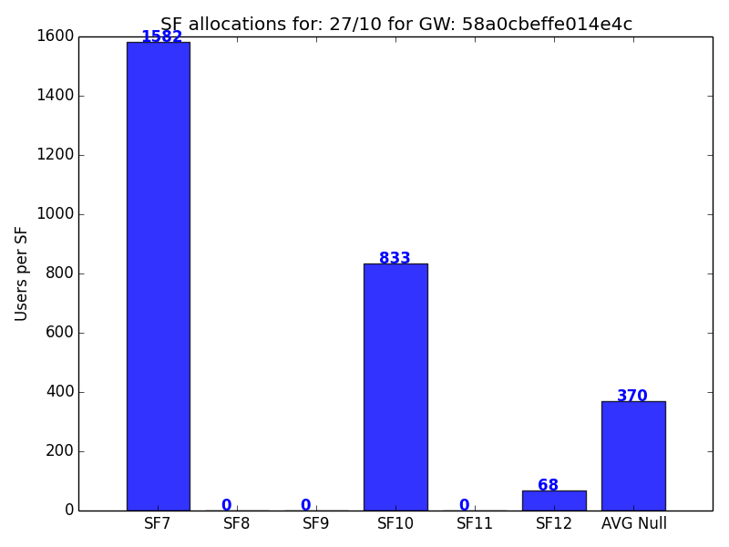
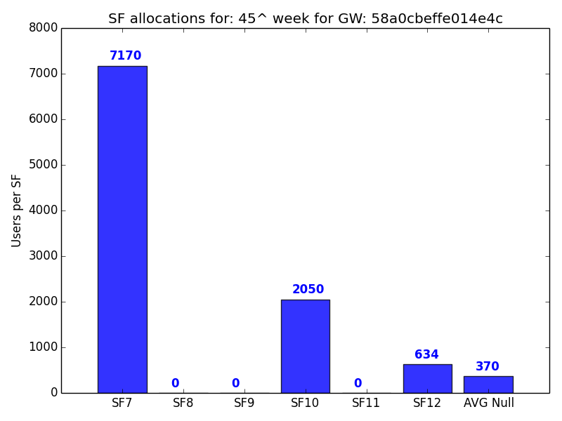
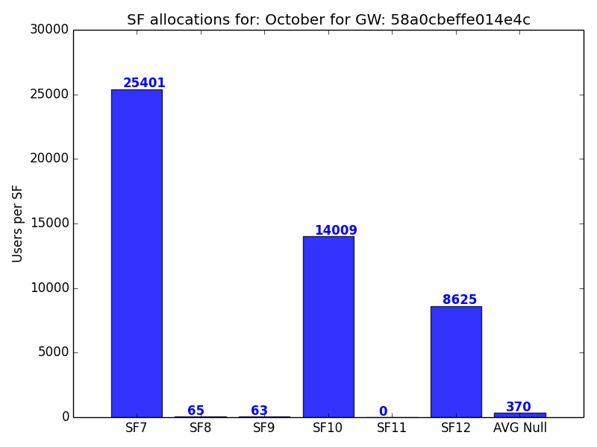
First - 58a0cbeffe014e4c

Slide 7
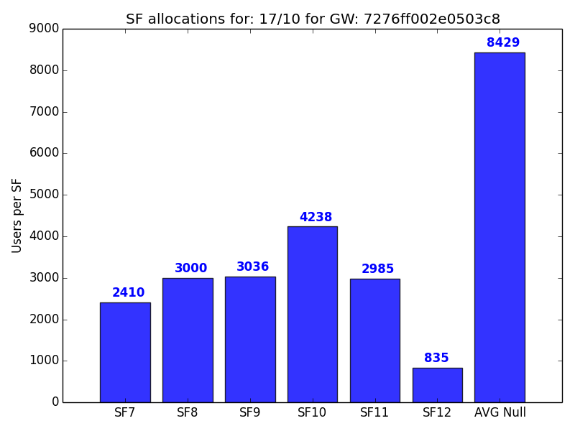
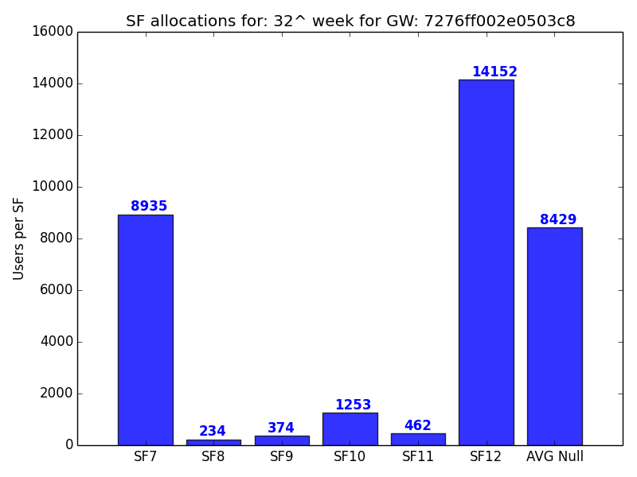
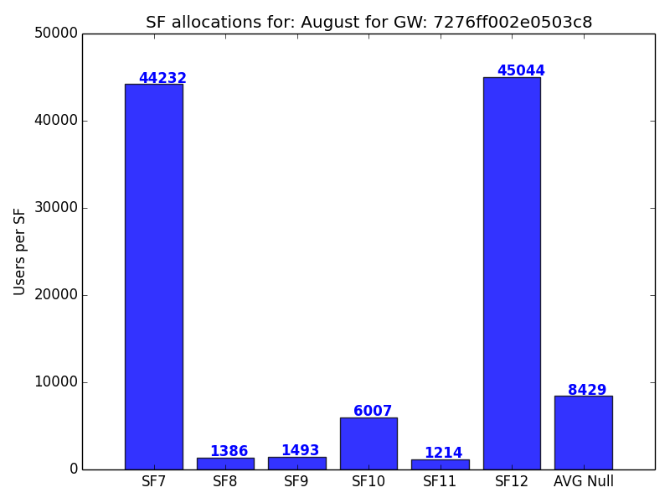
Second - 7276ff002e0503c8

Slide 8
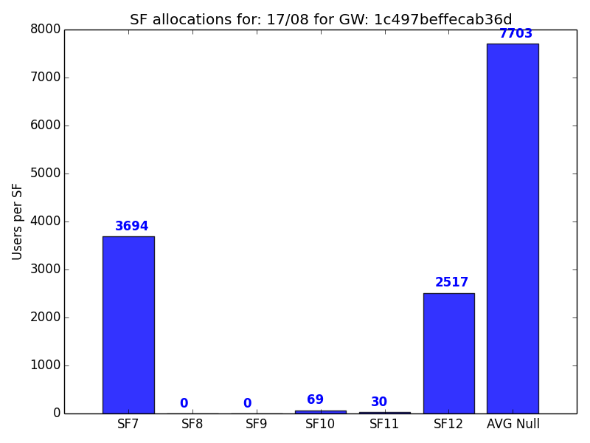
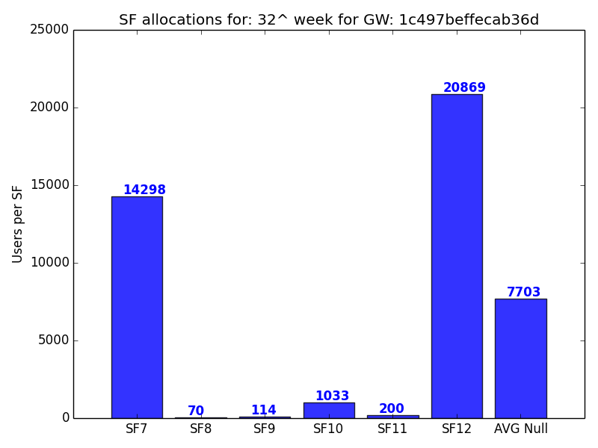
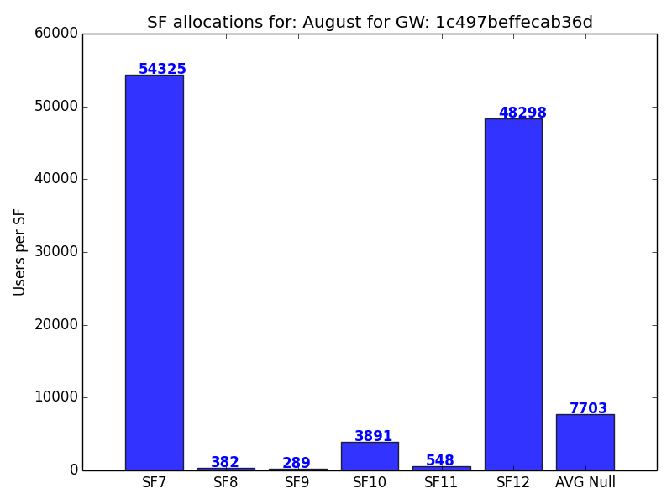
Third - 1c497beffecab36d

Slide 9
Deduplication device packets
3 Gateways:
First MAC: 58a0cbeffe014e4c
Second MAC: 7276ff002e0503c8
Third MAC: 1c497beffecab36d

Slide 10
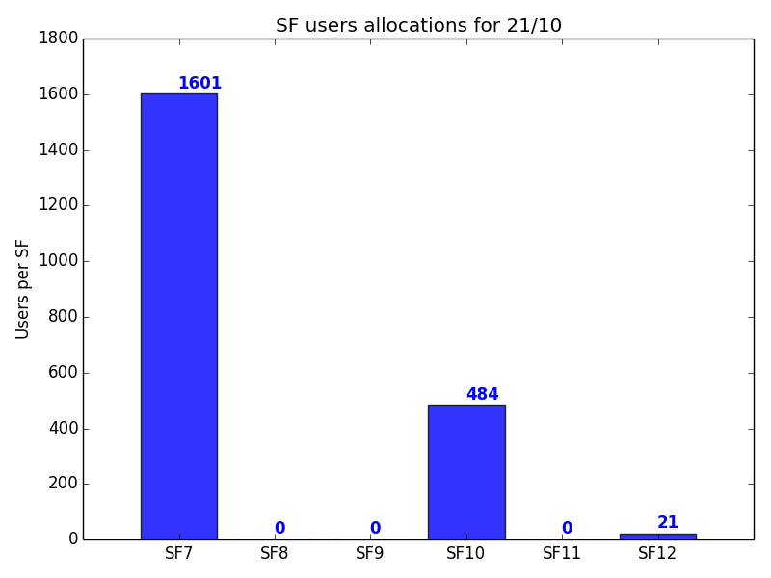
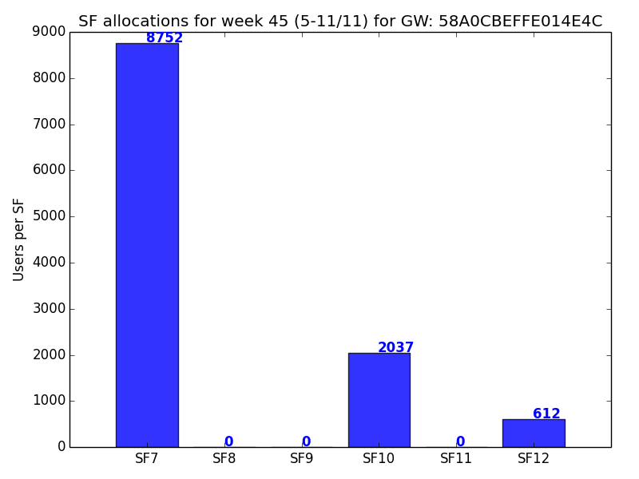
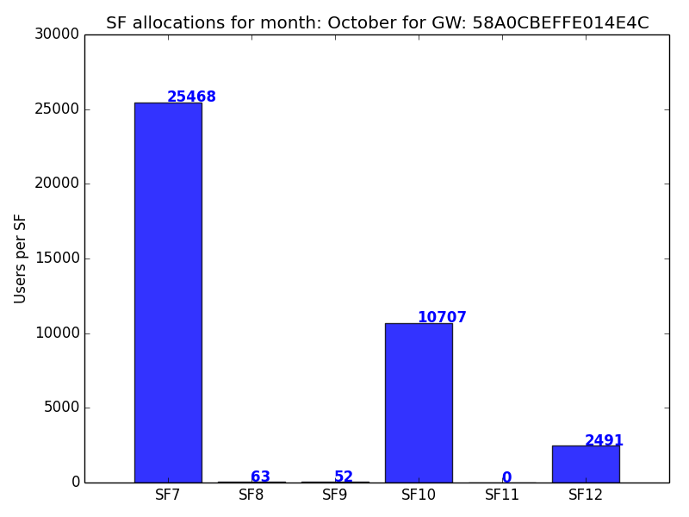
First - 58a0cbeffe014e4c

Slide 11
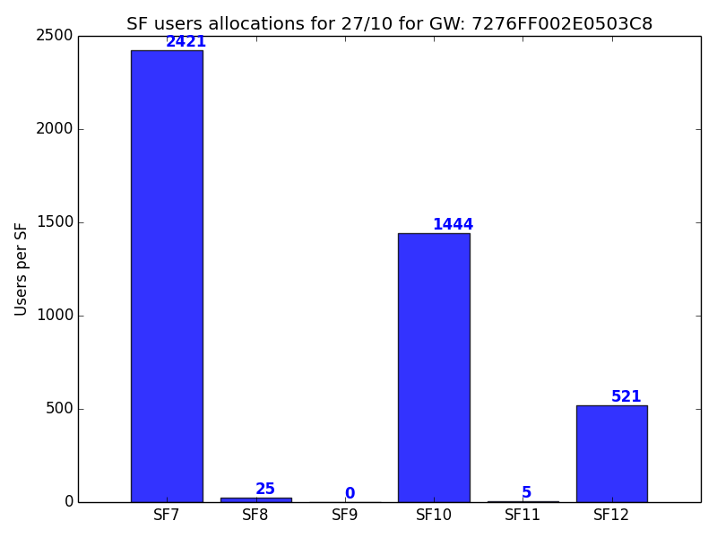
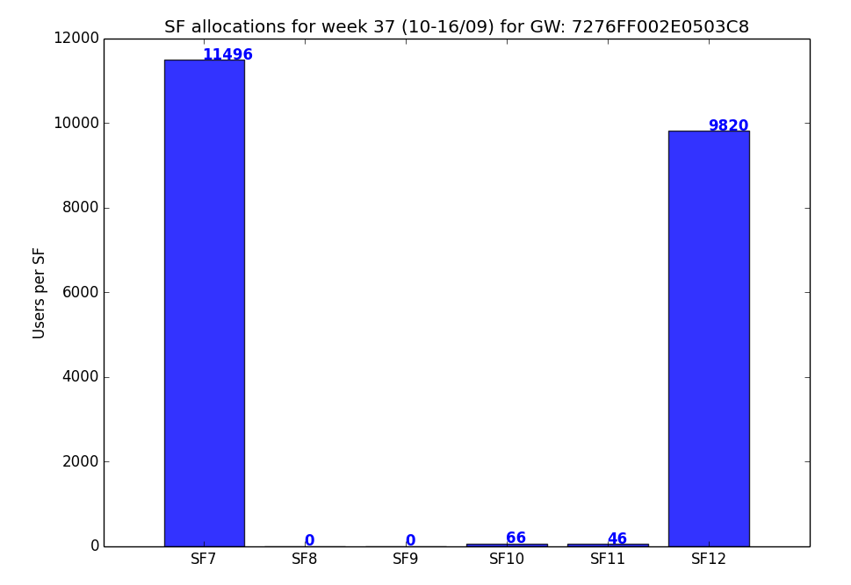
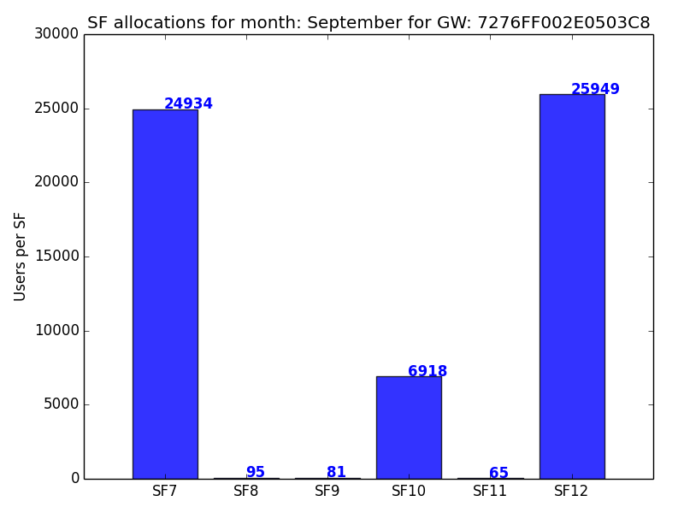
Second - 7276ff002e0503c8

Slide 12
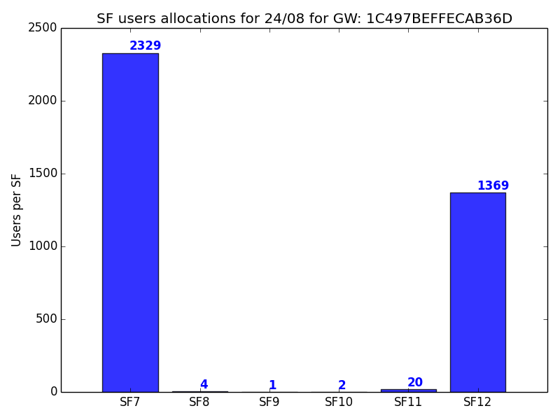
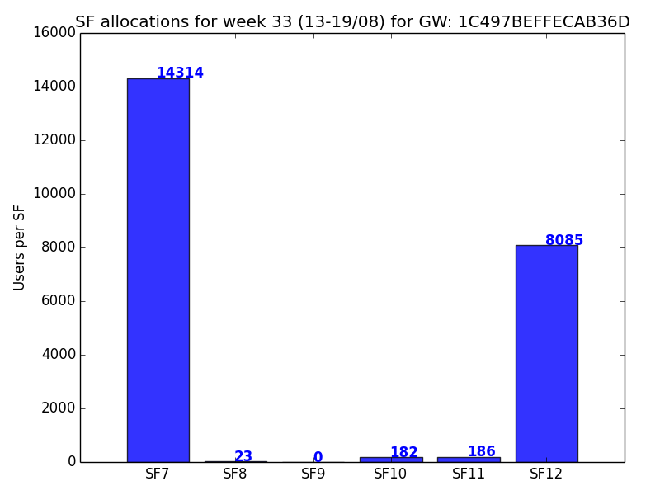
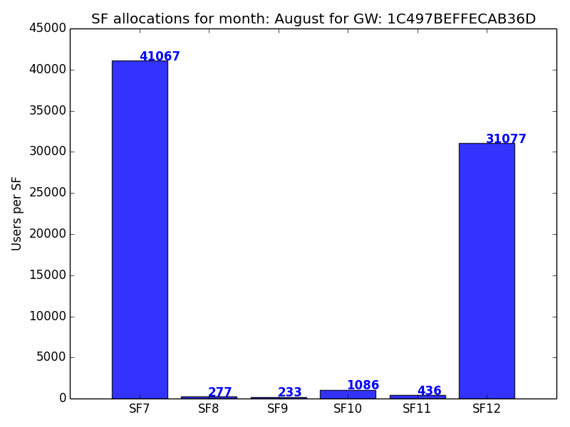
Third - 1c497beffecab36d

