Slide 1
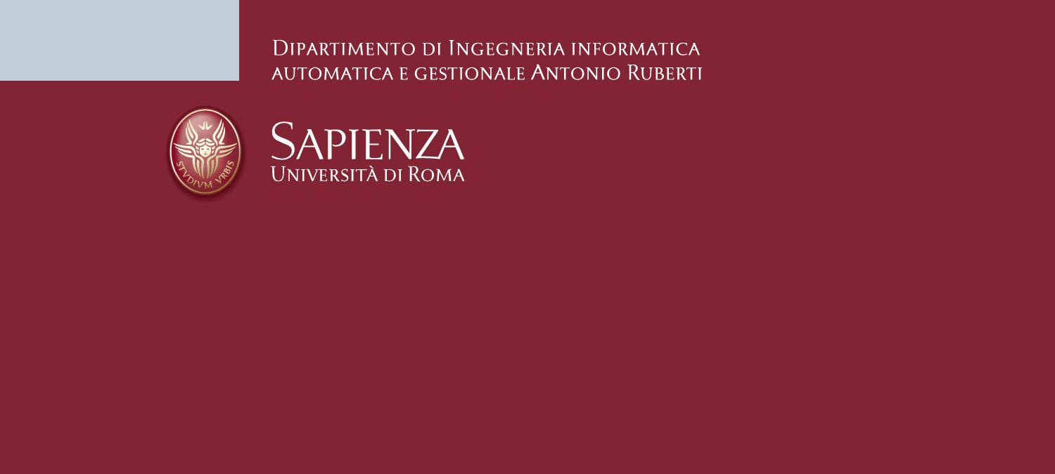
Master in Artificial Intelligence and Robotics
An Attitude Control Method of Aircraft Based on Neural Network
Course: Intelligent and Hybrid Control
Professor: Giuseppi Alessandro
Students: Tedeschi Jacopo 1882789
Titolo Presentazione
01/14/2024

Slide 2
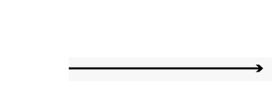

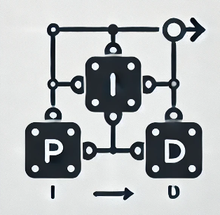
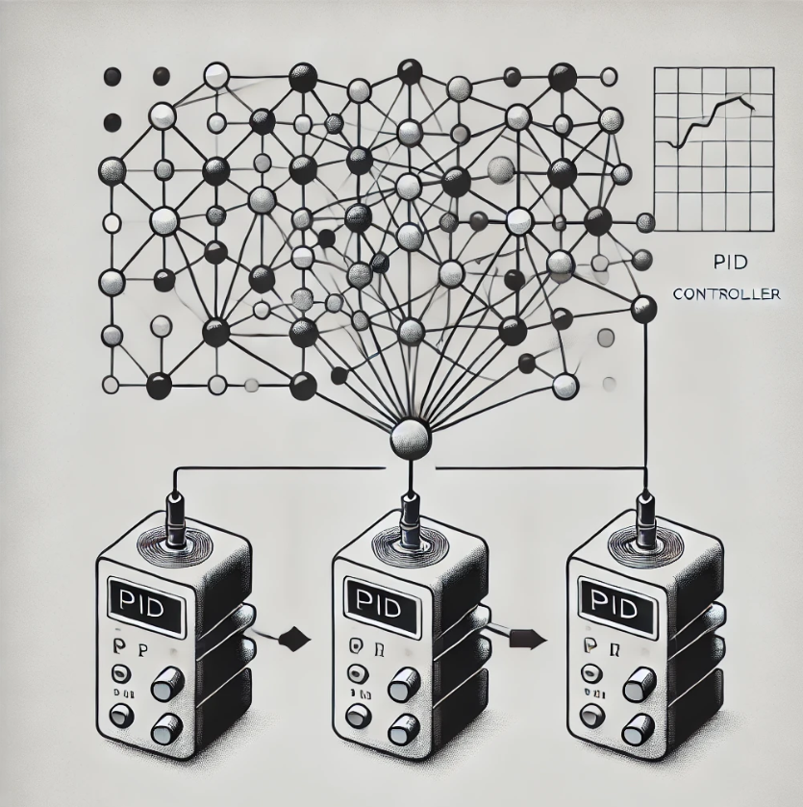
Problem: pitch angle’s control of a missile
Mantain a desired pose for pitch angle of a missile
Choose best parameters for a PID may requires lot of time
Use a Neural Network to estimate them
Pagina <number>

Slide 3

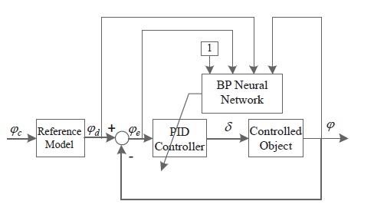

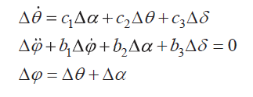
Problem: pitch angle’s control of a missile
Reference model: represent characteristic point of missile model
Neural Network’s output
Controlled object: pitch channel of the missile
Theta: trajectory inclination
Delta: pitch angle
Alpha: attack angle deviation
Phi: pitch angle deviation
Pagina <number>

Slide 4
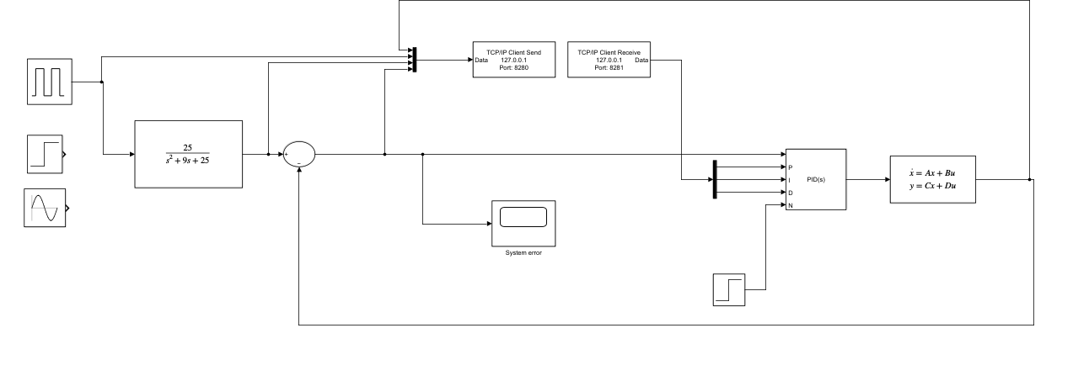
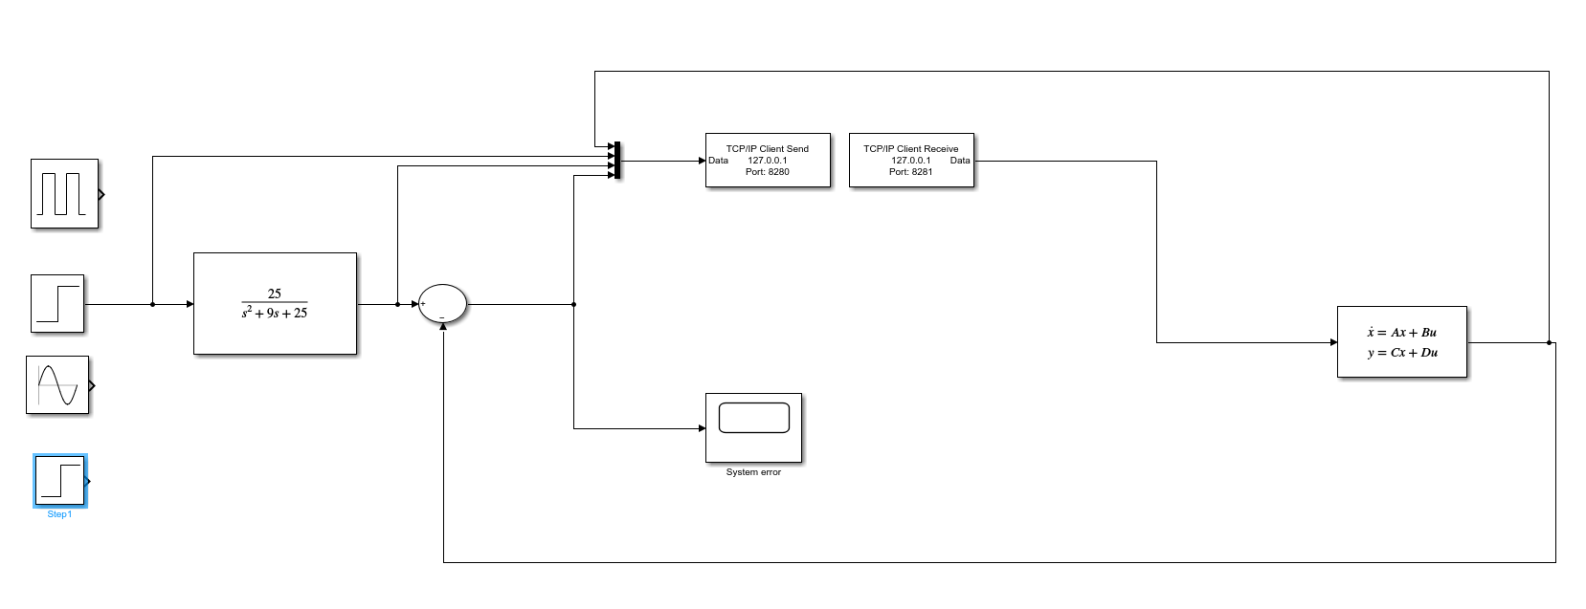
Proposed Solution
Pid parameter estimation
Use of a Feed Forward Network
Estimate PID parameters
Direct control of the object
Use of Actor-Critic Architecture with PID structure
PPO Algorithm to learn aircraft’s control
System information
State: error, reference model, position of the controlled object
Pagina <number>

Slide 5
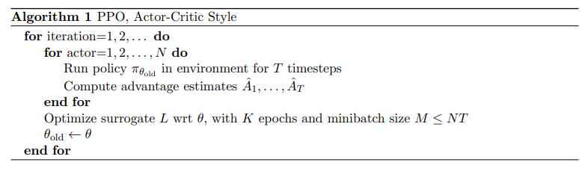
PPO Algorithm
actor_loss: maximization problem, it want to increase rewards as possible as it can
critic_loss: minimization problem, it want learn estimate correctly the value of the state
Pagina <number>

Slide 6
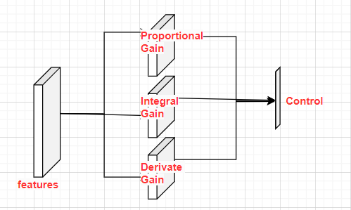
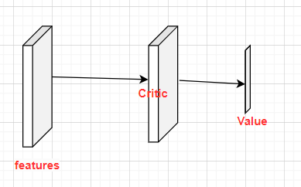
Network Architecture
To estimate the distribution of policy we used an actor-critic architecture
Actor: the network which select the action
Critic: estimate the value of a state, used for estimate the advantage
To estimate the distribution of policy we used an actor-critic architecture
Actor: the network which select the action
Critic: estimate the value of a state, used for estimate the advantage
Actor
1 linear layer with
2 output layer
Critic
1 input layer
1 output layer
Critic
1 input layer
1 output layer

Slide 7
Results,and future development
Feed Forward architecture: achieve completely the task. Sensible to output’s range space
Actor-Critic architecture: can’t achieve desired result because of high number of epoch requires and needed a powerful and different environment’s setup
Actor-critic: lighter computation and easy estimation of needed values.
Final loss: hard to code
Actual computation time: slower and smaller parallelization i.e. couldn’t see results
Complex and non-linear problem: substitute MLP layer with KAN layer to learn non linearity

Slide 8
References and materials
Paper: An Attitude Control Method of Aircraft Based on Neural Network Batch Training Strategy
PPO algorithm: Proximal Policy Optimization Algorithms
Slides: DIAG template for power point presentations
Images: Dall-e and An Attitude Control Method of Aircraft Based on Neural Network Batch Training Strategy

