Slide 1

TITA dynamic obstacle avoidance
Master’s Degree in Artificial Intelligence and Robotics

Slide 2

Pipeline
1 Sottotitolo
Whole Body Controller
Done
LQR with LIP model (regulation)
Todo
Disturbance rejection test
MPC (for trajectory tracking)
Final MPC (dynamic obstacle avoidance)
Obstacle recognition (Computer vision)
Obstacle avoidance Planning
Jump routine

Slide 3
Block scheme
1 Sottotitolo
Camera
Obstacle recognition
MPC
Jump routine
Whole Body Controller
robot
Online dynamic planning
State filter
sensors

Slide 4
Whole Body Controller
1 Sottotitolo
Equality constraints
Inequality constraints
  Contact wrench
  Max min forces
Compute inverse dynamics:

Slide 5
MPC (LQR-based)
1 Sottotitolo
So far MPC based on LQR
Linear dynamics (Lip model):
Assume the Value function is quadratic:
Riccati recursion

Slide 6
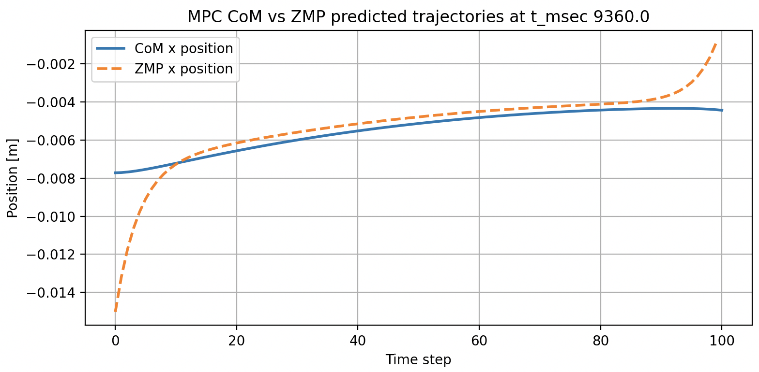
Experiments
1 Sottotitolo

Slide 7
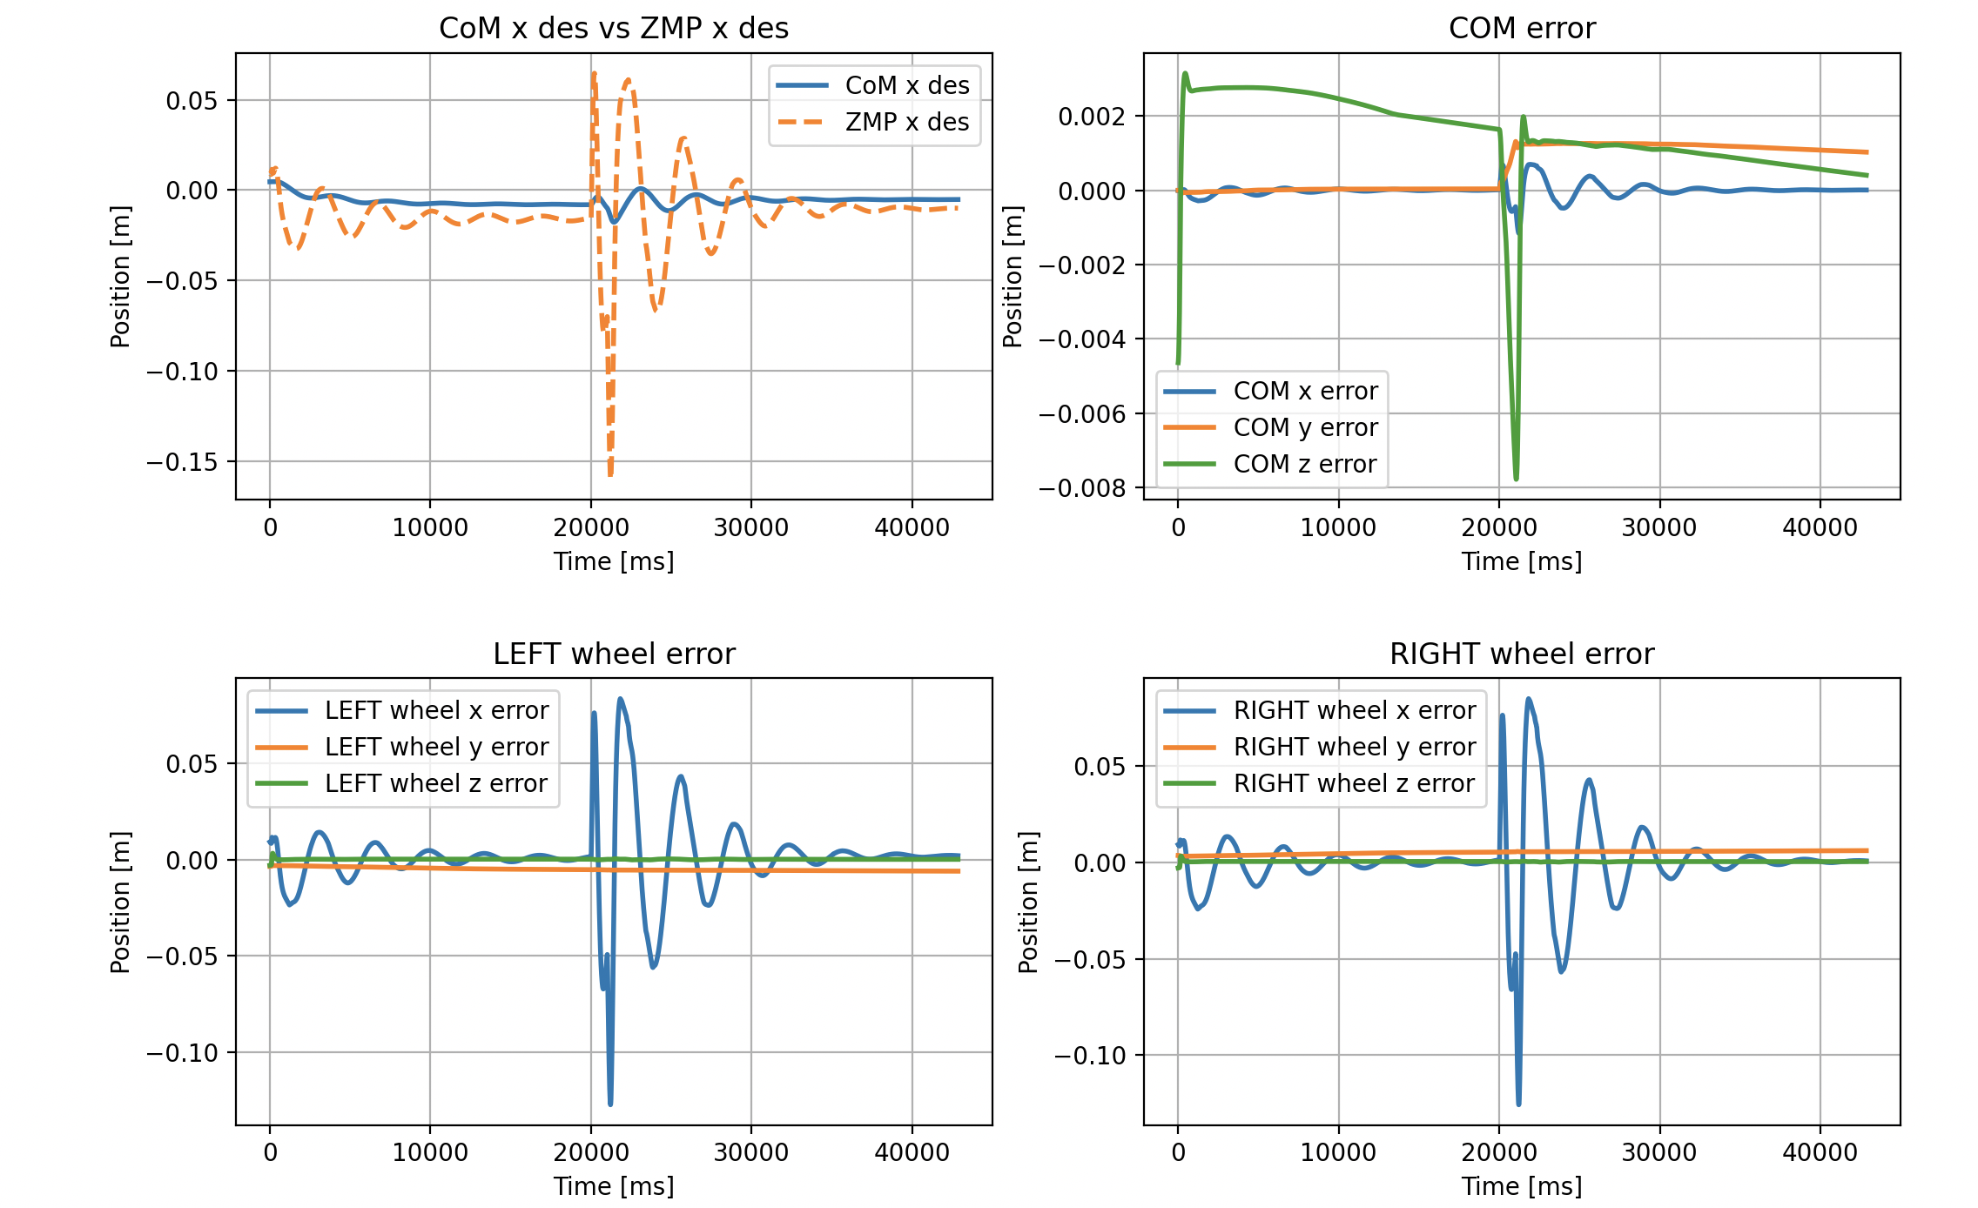
Experiments
1 Sottotitolo

Slide 8
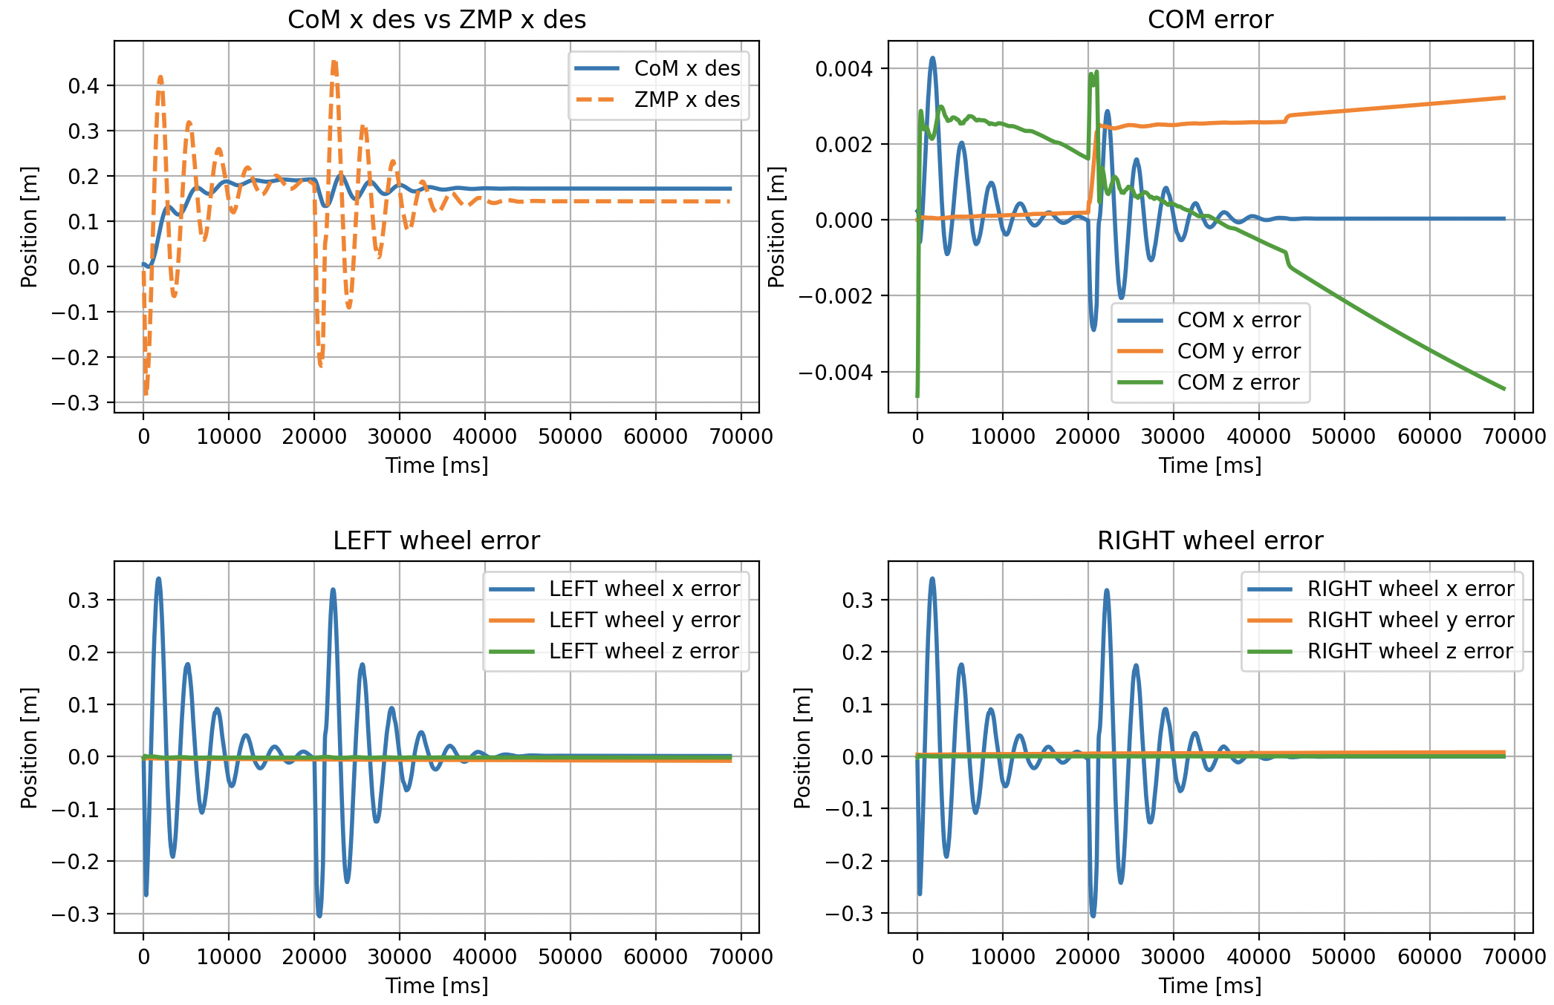
Experiments
1 Sottotitolo

Slide 9
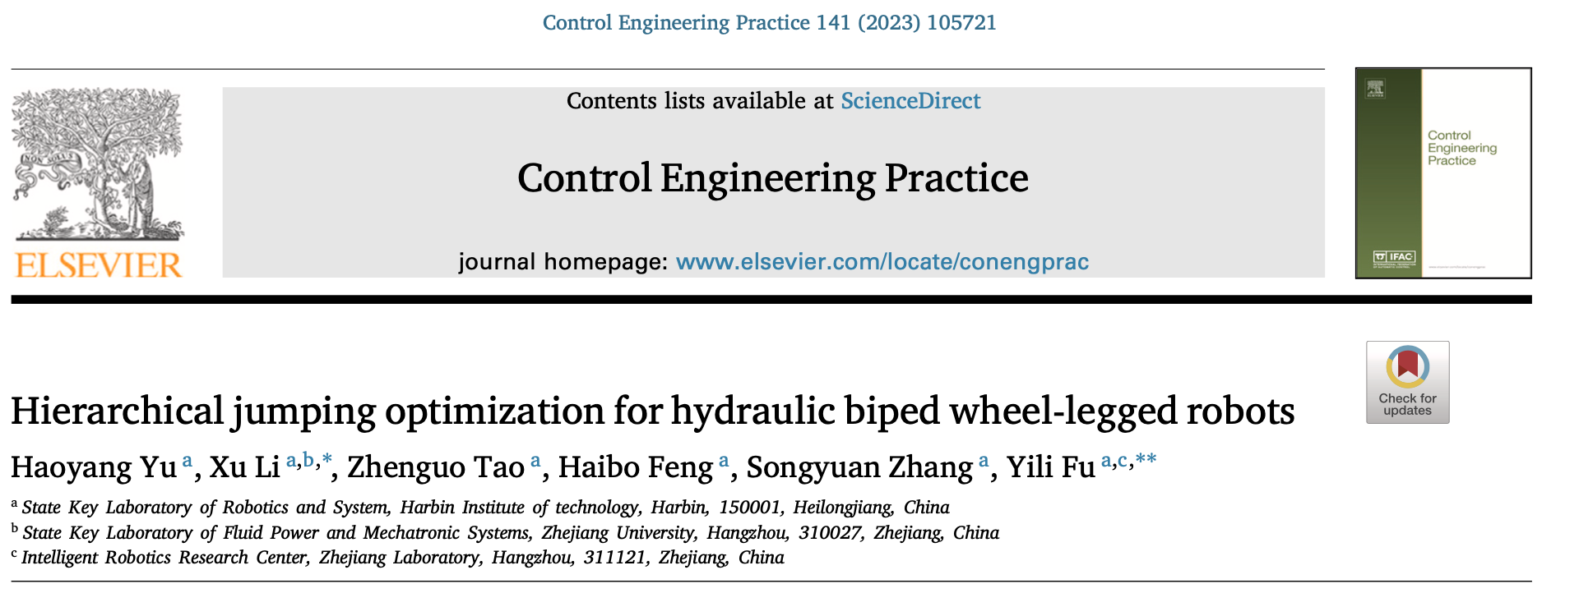
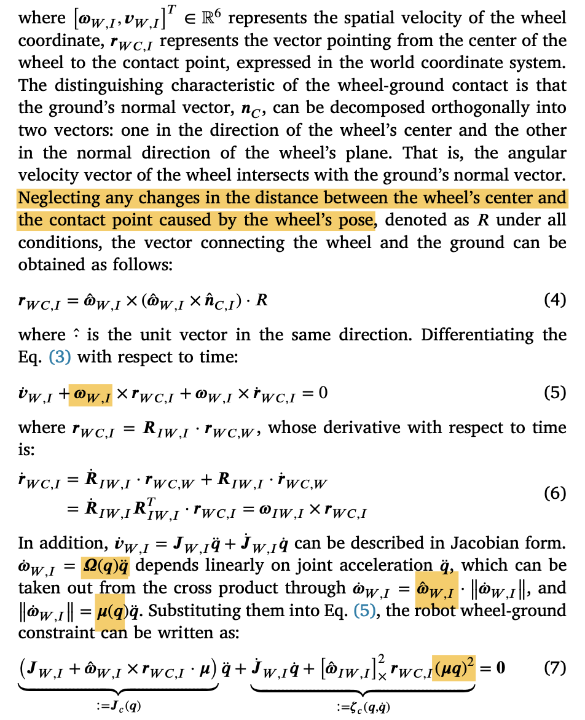
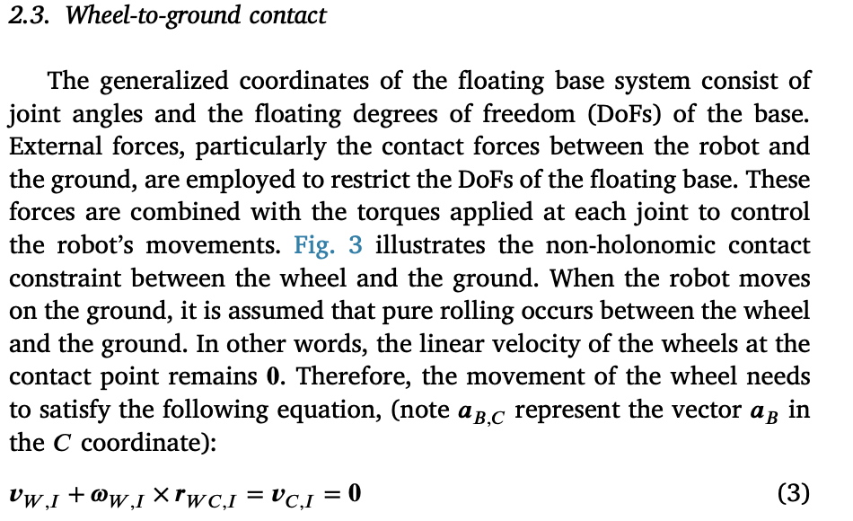
Wheel constraint
1 Sottotitolo

Slide 10
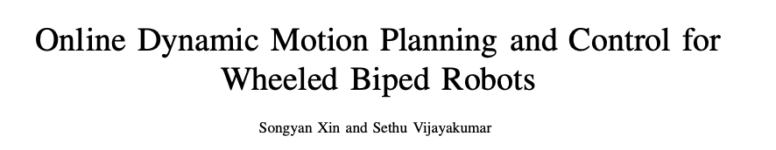
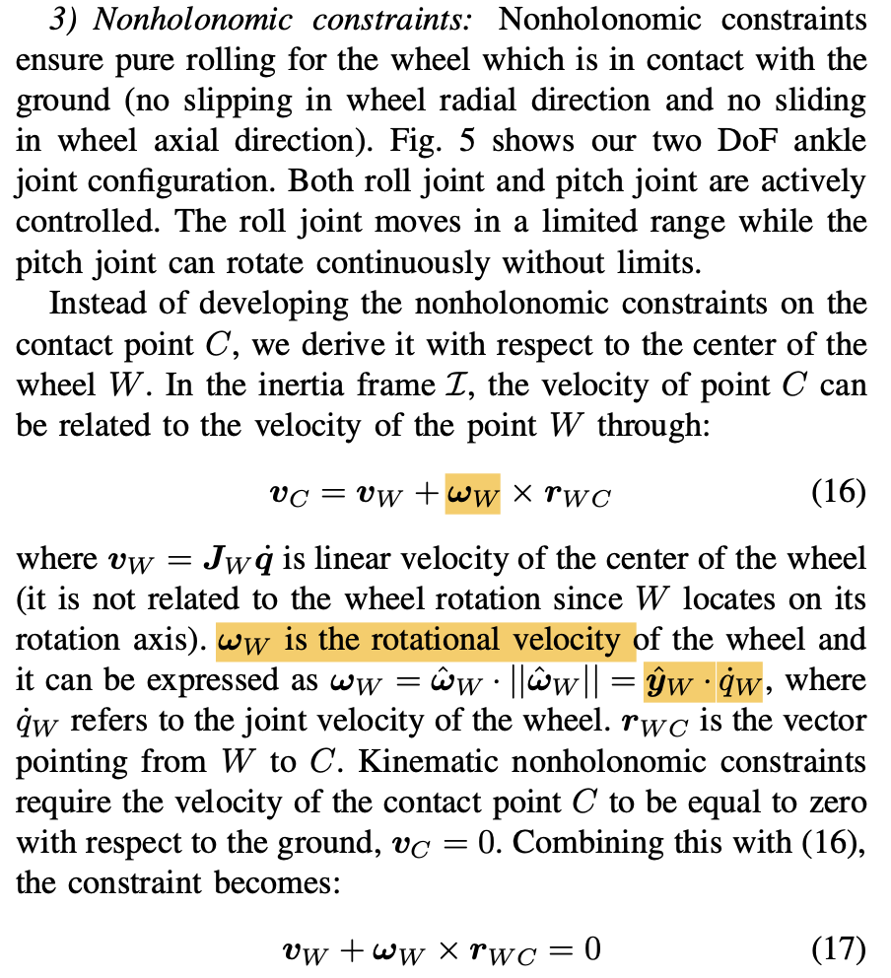
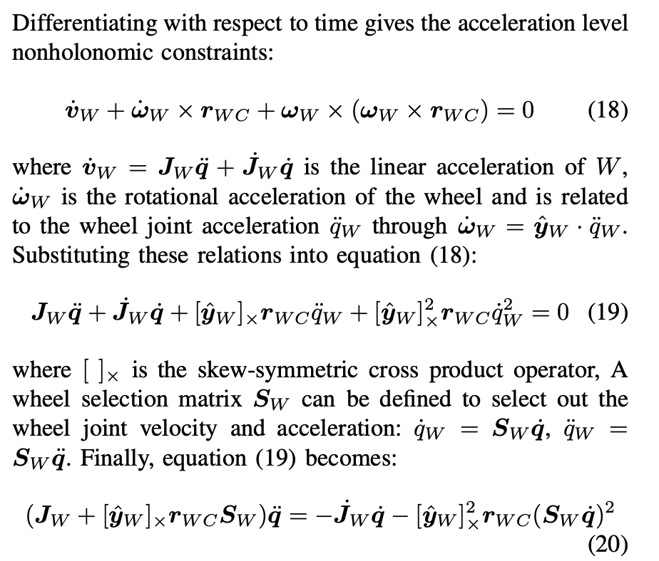
Wheel constraint
1 Sottotitolo

Slide 11
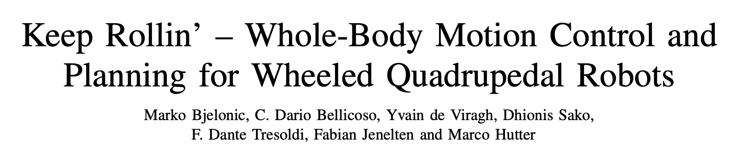
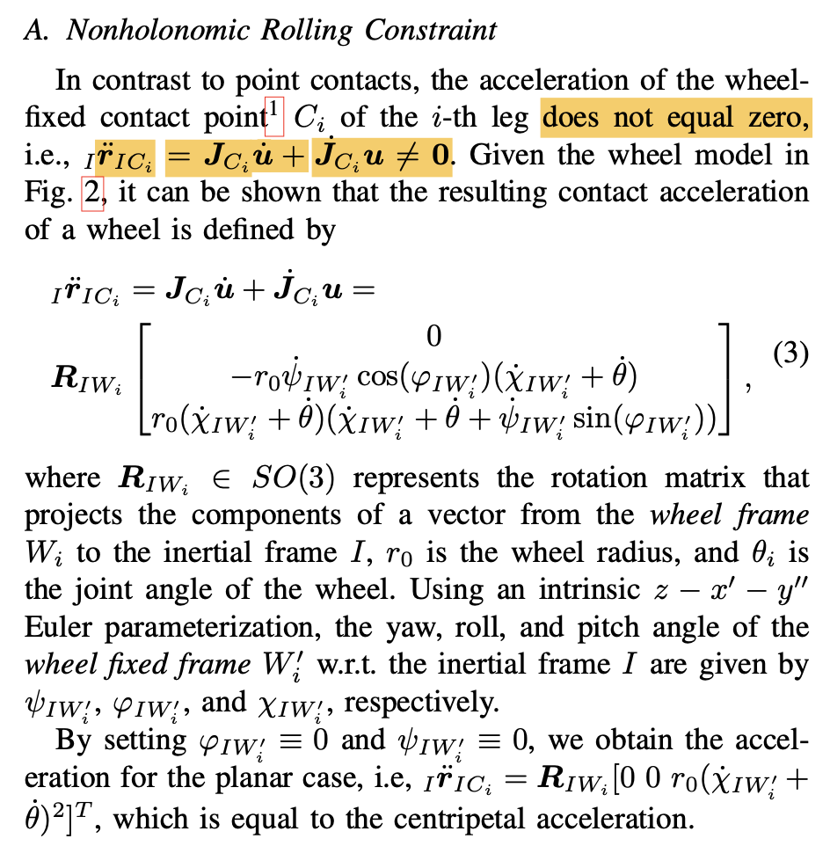
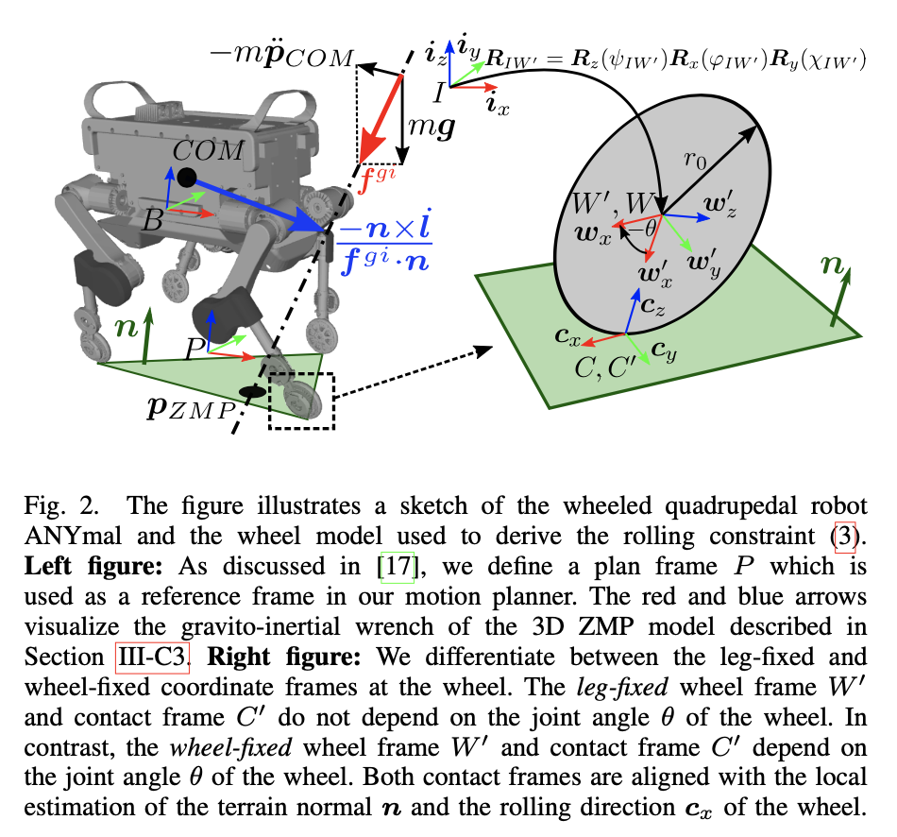
Wheel constraint
1 Sottotitolo

Slide 12
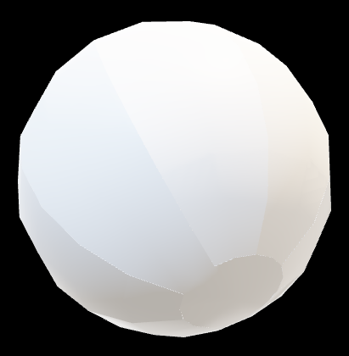
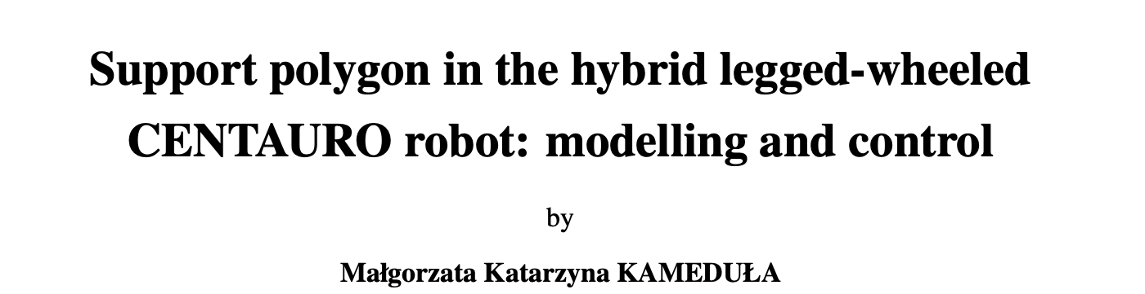
Wheel constraint
1 Sottotitolo
Pure rolling ball:
rigid body kinematics:
For P point in contact at time t:
The difference between the wheel center velocity at two time steps reads
The wheel acceleration is
where is a vector that describes a set of consecutive positions of the contact with the ground with respect to the wheel center
For P point in contact at time t: but
when the ball moves is always constant pointing downwards , but
In general :
W
C
P
C
( Page 16)

Slide 13
Wheel constraint
1 Sottotitolo
Rolling without slipping wheel:
The rolling constraint must take into account that
  in rolling direction:
but
  When a camber motion occurs, is not constant, it changes depending on the angular velocity
Rigid body kinematics
C
C

Slide 14
Wheel constraint
1 Sottotitolo
A virtual frame is introduced
angular velocity of the wheel rigid body
angular velocity of the virtual frame (same as rigid body without the rolling angular velocity component)
the rolling without slipping constraint, from is:
If the wheel does not have camber motion = 0 as in the ball case
C
C
=
=

