Slide 1
Methodology for integrate RL with MPC

Slide 2
List of papers
RL-augmented MPC Framework for Agile and Robust Bipedal Footstep Locomotion Planning and Control
Learning Agile Locomotion and Adaptive Behaviors via RL-augmented MPC
Reinforcement Learning for Blind Stair Climbing with Legged and Wheeled-Legged Robots
RL-augmented Adaptive Model Predictive Control for Bipedal Locomotion over Challenging Terrain
Reinforcement Learning Compensated Model Predictive Control for Off-road Driving on Unknown Deformable Terrain
Synthesis of Model Predictive Control and Reinforcement Learning: Survey and Classification

Slide 3
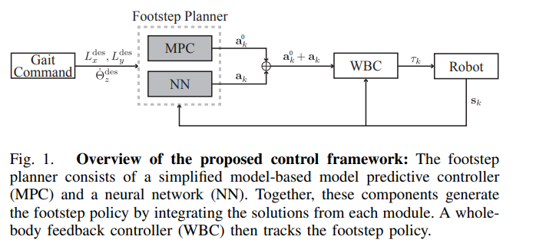

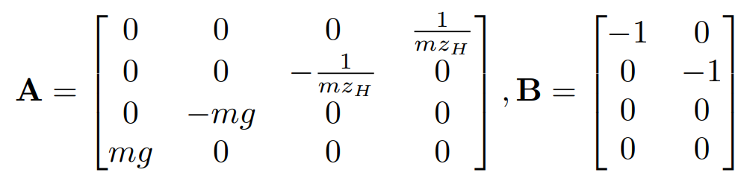
RL-augmented MPC Framework for Agile and Robust Bipedal Footstep Locomotion Planning and Control
Task and experiments: Velocity Tracking, Turning in place, Robustness against Disturbances, Walking in Sloppy Terrain
Robot: Humanoid robot DRACO 3
ALIP-based MPC Footstep Planner (II.A): The main objective of the ALIP-based MPC footstep planner is to compute the desired footholds to enable the angular momentum to converge to a desired state at the end of each step i.e. angular momentum tracking with
m robot mass, g gravitational constant, zₕ constant center of mass (CoM) height
x = [x_c, y_c, L_x, L_y]ᵀ: state vector
x_c, y_c: CoM position in x and y direction relative to stance contact point ( at each time, one with is the stance ones )
L_x, L_y: angular momentum about x and y axes of the contact point
u_fp = [u_x, u_y]ᵀ: input (control) vector, u_x, u_y are new foot placement positions on x-y direction from current stance contact point

Slide 4
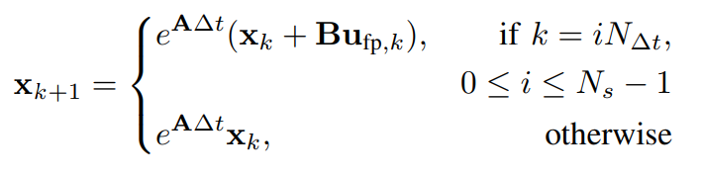
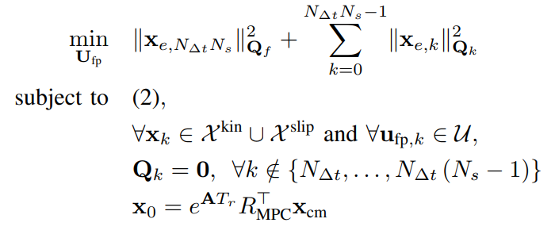





RL-augmented MPC Framework for Agile and Robust Bipedal Footstep Locomotion Planning and Control
MPC Formulation for Foot Placement: Assume conservation of angular momentum about the contact point before and after each footstep, each step having a fixed time duration of Ts where ∆t is the sampling time and N_∆t = Ts/∆t is the number of samples for each step. For the MPC we have kinematic constraints X_kin, friction cone constraints X_slip, and foot placement safety constraints U
sequence of foot placement control inputs over the prediction horizon.
to be tracked are computed as with L_offset being an additional lateral angular momentum
x0 is the predicted state just before impact during the current step using (1)
T_r denotes the remaining duration of the step
R_MPC is the rotation matrix considering the desired yaw orientation of the torso
x_cm represent the current state measurement
To keep into account rotational dynamics, they utilize the torso yaw rate command to compute the desired foot orientation command as a one-step ahead prediction, similarly to [7]

Slide 5
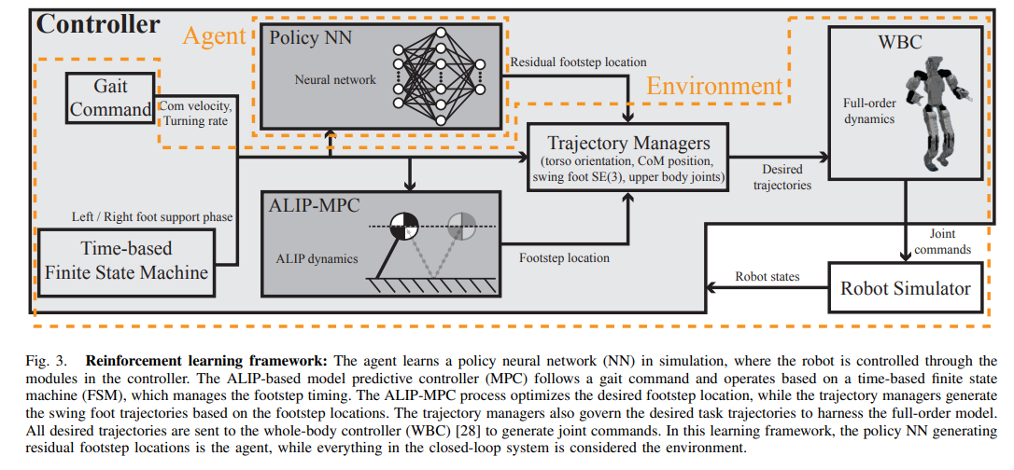







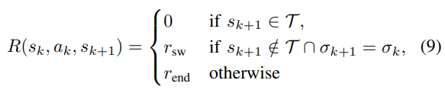
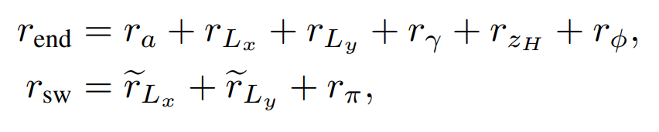



RL-augmented MPC Framework for Agile and Robust Bipedal Footstep Locomotion Planning and Control
RL goal: learn a policy to achieve a final policy
with the initial policy generated from the ALIP-based MPC process. (PPO algorithm)
Action Space: residual action is
where denotes the position deviation from the footstep position in the xy directions, and
represents the angle deviation from the footstep yaw
Observation Space:
sigma indicator for stance foot
Tr remaining foot swing time
state of the ALIP model
yaw_k: torso orientation, swing foot orientation, torso angular velocity
desired commands
policy action taken in the previous step
Reward function:
Specifically, r_sw and r_end are utilized during the intra-step and leg switching phases, respectively. Set of termination states are :

Slide 6
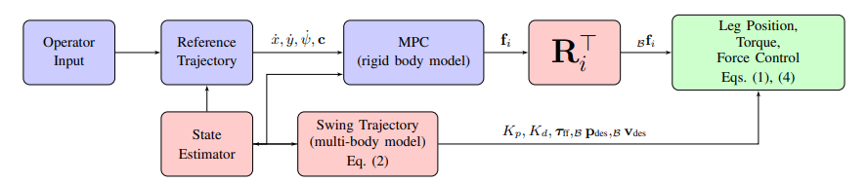
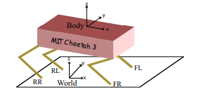

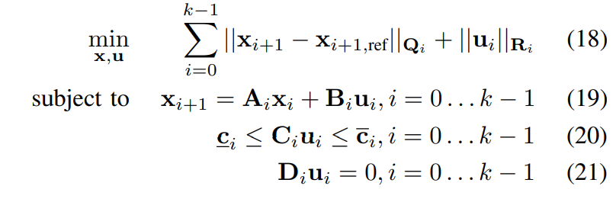
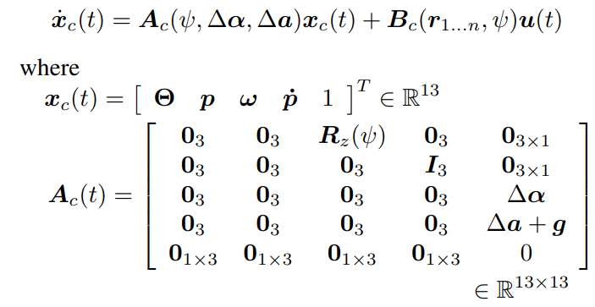
Learning Agile Locomotion and Adaptive Behaviors via RL-augmented MPC
Task and experiments: High Speed Turning, High-Speed Running and Steering, Walking with Significant Model Uncertainty, Blind Walking over Discrete Terrain
Robot: 4-legged robot Unitree A1
MPC: compute ground reaction forces
instead swing feet will follow a predefined trajectory
Force constraint (20)
foot selection (21), the one is swing must have no reaction force

Slide 7
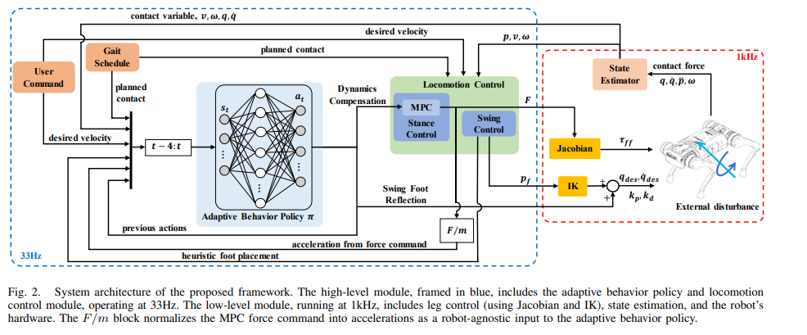


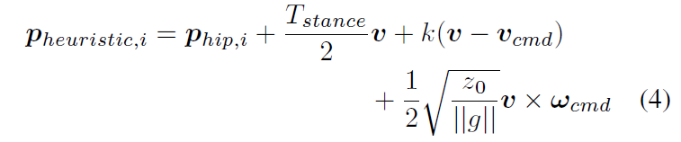
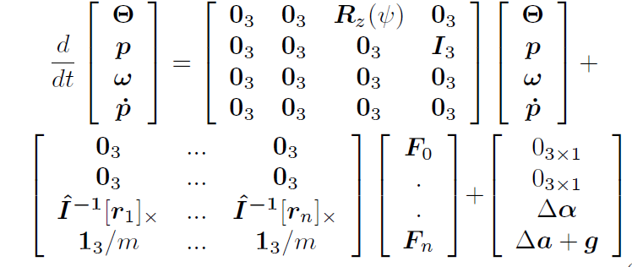
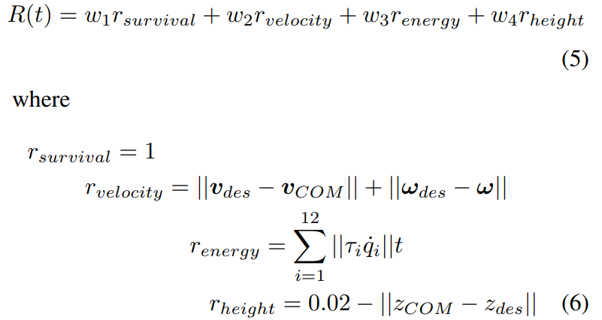
Learning Agile Locomotion and Adaptive Behaviors via RL-augmented MPC
RL goal: enhancement of foot placement and swing trajectory (PPO algorithm)
Action Space: learning module computes both dynamics compensation components and swing foot deviation from the nominal swing trajectory.
Reward function: designed to ensure velocity tracking of the robot while minimizing the energy cost.
Observation Space:
Joint angles and velocities
Linear and angular velocities of the COM
Planned contact state of each foot from gait schedule
Actual contact state from contact sensors
Desired COM state from user input v_des, w_des
Heuristic foot placement for each foot
Acceleration from force command of MPC optimization F/m. Similar to dynamics compensation, the ground reaction force command is expressed in terms of acceleration.

Slide 8
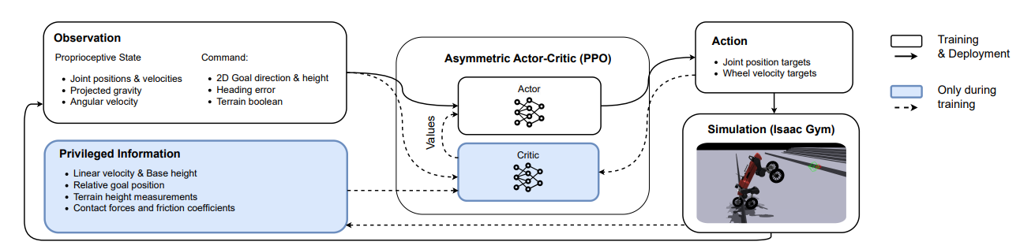
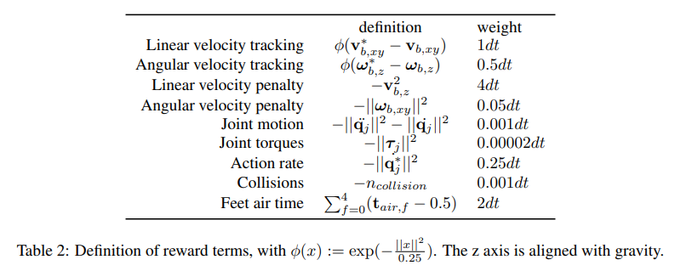
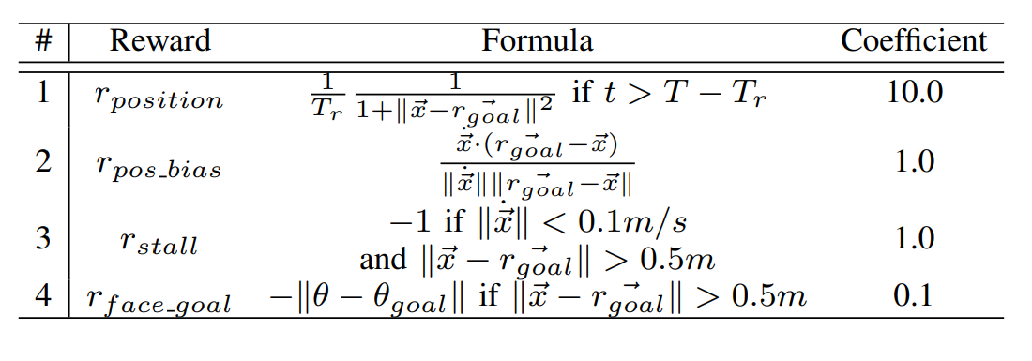
Reinforcement Learning for Blind Stair Climbing with Legged and Wheeled-Legged Robots
RL task: position-based navigation task, simulation only
Robot: Ascento Robot, Unitree Go1, Cassie and ANYmal on Wheels climbing steps
Actions: The actions are a vector of robot-dependent dimensions. For the articulated joints, the commands are directly interpreted as goal positions to be tracked by a low level PD controller. Analogously, actions are interpreted as target angular velocities for the wheeled joints.
State
observation: used in training and deployment contain joint position and velocity, projected gravity, angular velocity, 2D goal direction, heading error, terrain boolean ( for stair-climbing mode )
privileged information: ground truth, contact forces and friction coefficients
Rewards: sum of standard robot-specific shaping rewards and Reward #1 ( Only in last 2 s; encourages reaching the goal ), Reward #2 ( Temporary; rewards progress toward goal until halfway to best Reward #1), Reward #3 ( Penalizes stalling unless near goal ) Reward #4 ( Encourages facing the goal )

Slide 9


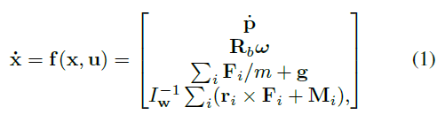
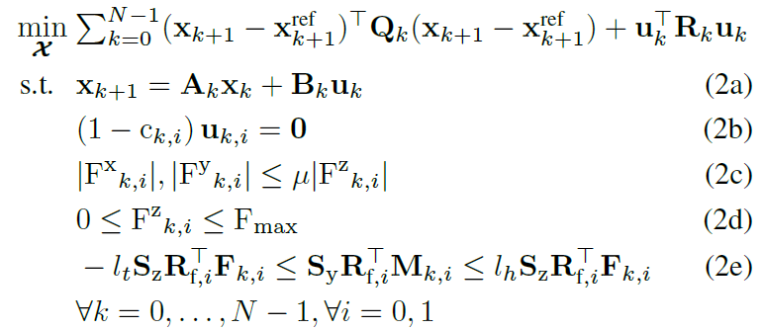
RL-augmented Adaptive Model Predictive Control for Bipedal Locomotion over Challenging Terrain
Task and experiments: walking in Pyramid stairs, random stairs, stepping stones, slippery surface
Robot: Hector robot
Modelling: Single Rigid Body Dynamics
State
Control input
Objective: trajectory error minimization
Chi: composed by state x_k and control u_k at all timesteps k = 0, .., N
dynamic constraint (2a), contact constraints (2b), friction pyramid (2c), force saturation (2d), line contact constraint (2e)
F_k and M_k represent ground reaction force and moment
Output: contact wrench [F, M] to track reference trajectory

Slide 10
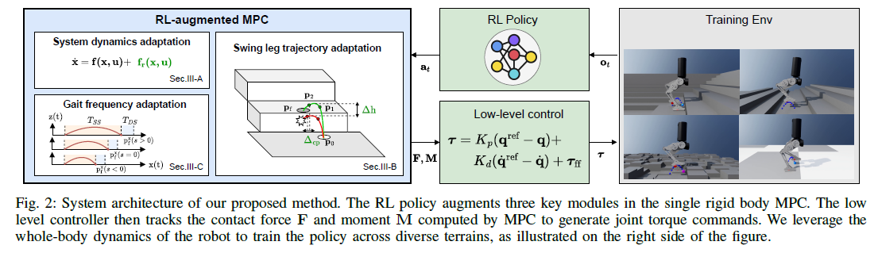

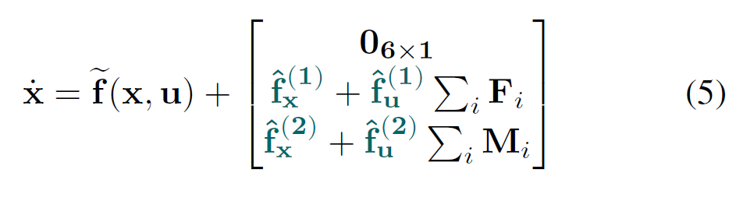


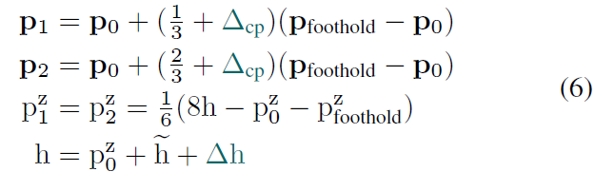
RL-augmented Adaptive Model Predictive Control for Bipedal Locomotion over Challenging Terrain
RL goal: Soft Actor Critic for augment system dynamics, shape swing leg trajectory and phases duration
dynamics is shaped with a term fr(x,u) residual dynamics
It is assumed that moments do no affect linear acceleration and forces passive from 6x12 matrix to two matrix 3x3
Further simplification is done imposing those matrix are diagonal passing from 9 to 3 variable for each matrix, consequently 12 parameters are learned with fx being residual acceleration and fu residual actuation matricies
Gait adaptation: controller use a pre-generated periodic gait for the contact sequence. Variable walking gait is achieved by parametrizing Ts = H*dt_mpc where H is MPC’s horzing and dt_mpc represent sampling time. Therefore step duration is manipulated as where we modify the nominal sampling time learning parameters s
Action space has 12+2+1 dimension while observation space is composed by proprioceptive information including base linear and angular velocities, joint position and velocity, command velocity and projected gravity vector, foot state ( foot position, reference foot position, planned footholds, swings phase) and action at previous timestep
Bézier curve for trajectory
is adapted by computing control point were p0 is the stance foot, p_foothold planned foothold, h apex height. RL learn residual apex height and control point coefficient

Slide 11
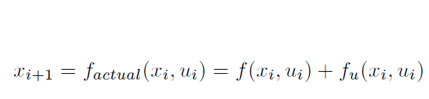
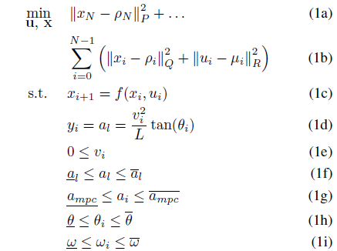
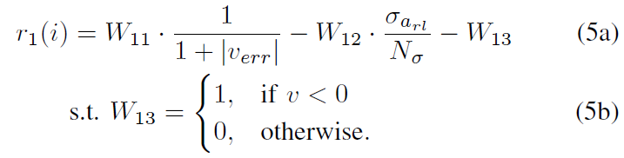
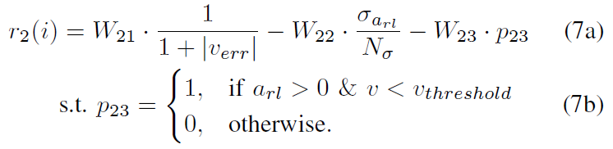

Reinforcement Learning Compensated Model Predictive Control for Off-road Driving on Unknown Deformable Terrain
Task and experiments: tracking on different unknow deformable terrain
Robot: car
RL goal: manipulate control input to the MPC and account for unmodelled dynamics (AC2 + MPC )
Objective: error minimization
x_i: vehicle state = bicycle state + slip angle
u_i: linear and angular velocity
Output: optimized controls
observation space: current vehicle speed, target speed, action history taken and speed tracking error history
action space: throttle command
r1: base reward function
r2: penalize control actions when apply unnecessary controls
Finally control input to the system

Slide 12
End of the papers

