Slide 1

Residual Learning for Agile Locomotion: Application to a Two-Wheeled Legged Robot

Slide 2

Table of Contents
1 What is Residual Learning
What is Residual Learning
Recap on papers
MPC formulations
Tita results
Lite3 results
Conclusions and contributions
1/48

Slide 3
Thesis recap
1 What is Residual Learning
MPC provides an interpretable, physically grounded baseline, but model mismatch, contact uncertainty and real-time computation can limit performance. RL learns adaptable behavior through experience, including interactions that are difficult to model. End-to-end policies require careful reward design and substantial training, and offer less interpretability. This thesis combines MPC with a neural network that learns residual corrections for improved locomotion.
Residual Learning Idea
MPC provides a structured, interpretable, constraint-aware baseline.
RL adapts to model errors, contacts and terrain variations.
The policy does not learn locomotion from scratch.
It learns a correction to the MPC action.
This combines model-based reliability with learned robustness.
2/48

Slide 4
Thesis recap
1 What is Residual Learning
Residual Learning has been widely used to augment model-based locomotion controllers.
In previous works, residual policies are used to:
compensate for model mismatch.
handle effects not explicitly modeled in MPC.
enhance specific modules of the control pipeline.
improve robustness on complex terrains.
. . .
Most applications focus on humanoids and quadruped robots. In contrast, residual learning for bipedal wheeled-legged robots remains less explored.
This work applies residual learning to a bipedal wheeled-legged robot, aiming to combine MPC structure with RL adaptability.
3/48

Slide 5
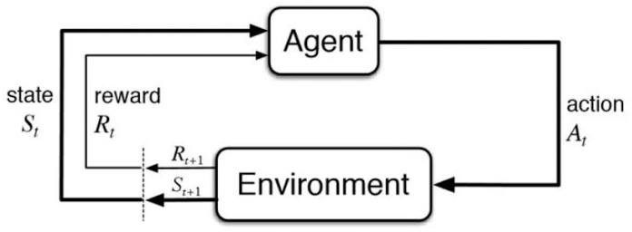
Definitions
1 What is Residual Learning
Agent: policy π_{ϕ}, implemented by a neural network.
Observation space: possible policy inputs, ot ^{∈ O.}
Action space: possible outputs, at ^{∈ A.}
^{Reward: scalar signal r}t ^{evaluating behavior.}
^{Transition: s}t+1 ^{∼ P(· | s}t^{, a}t ^{), with reward r}t ^{and observation o}t+1.
Replay buffer: stored transitions. PPO always empty this buffer and the end of the episode.
Simulation frame: one simulation step.
Actor: policy π_{ϕ}.
Critic: estimates V_{θ} (s) or Q_{θ} (s, a).
4/48

Slide 6
Table of Contents
2 Recap on papers
What is Residual Learning
Recap on papers
MPC formulations
Tita results
Lite3 results
Conclusions and contributions
5/48

Slide 7
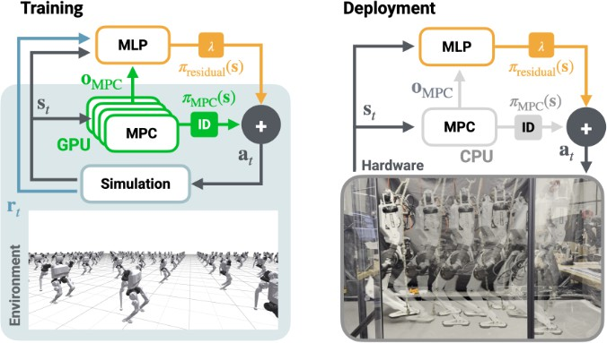
Residual MPC: Blending RL with GPU-Parallelized MPC
2 Recap on papers
MLP: three hidden layers, 256 ELU units each; Gaussian policy N (µ, σ²).
Scaling λ limits deviations from the nominal controller.
o = [p⊤, θ⊤, q⊤, ω⊤, v⊤, q˙⊤, ϕ⊤, V_{MPC}]⊤ ∈ R⁵⁴.
j j
Joint action – joint blending
τ = K_{p}(q_{MPC} + λa − q) + K_{d}(q˙_{MPC} − q˙) + τ_{MPC}.
Joint action – torque blending
τ = τ_{MPC} + λτ_{res},
τ_{res} = K_{p}(^{ˆ}q + λa − q) − K_{d}q˙.
Torque action – torque blending
τ = τ_{MPC} + λa.
p: base position; θ: orientation; q_{j}: joint positions; ω, v: angular/linear velocities; ϕ: contact phase; V_{MPC}: MPC value estimate.
Author suggestion: Joint–torque blending achieves
similar performance to joint–joint blending while avoiding corrections relative to potentially infeasible q_{MPC} setpoints when MPC diverges.
7/48

Slide 8
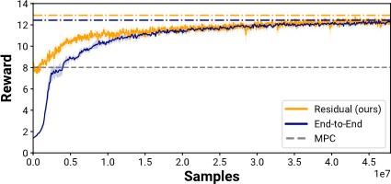
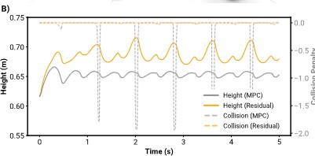
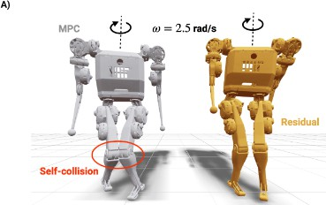
Residual MPC: training and self-collision avoidance
2 Recap on papers
Reward obtained during training with the 3 control techniques: MPC-only, Residual Learning, E2E approach
Given and angular command to the humanoid robot, with MPC approach, there is a knee-collision which is solved with Residual Learning approach
8/48

Slide 9
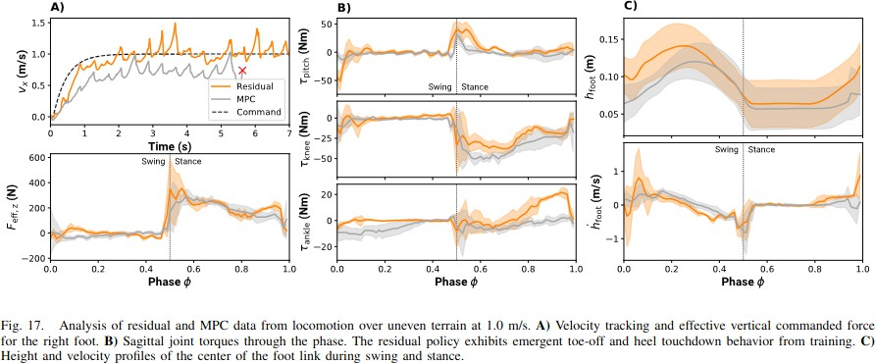
Residual MPC: terrain adaptation
2 Recap on papers
9/48

Slide 10
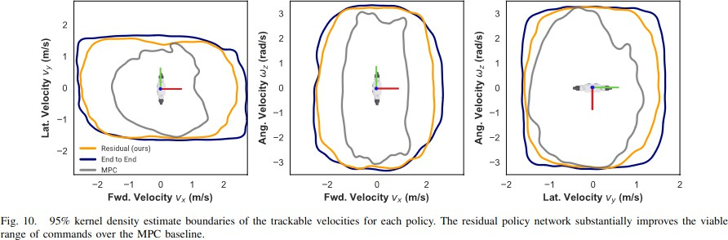
Residual MPC: robustness and achievable velocities
2 Recap on papers
The residual policy avoids unmodeled self-collisions.
It handles unseen uneven, rough and sloped terrain without fine-tuning or domain randomization.
Achievable velocities improve by 78% in vx, 12% in vy and 9% in ωz.
10/48
Achievable linear velocity: tracking error below 0.25 m/s.

Slide 11
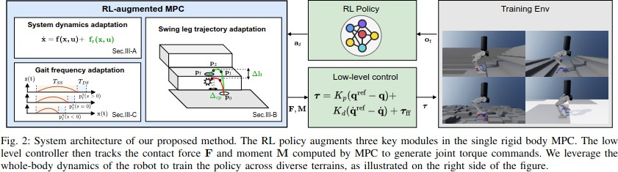
RL-augmented Adaptive MPC for Bipedal Locomotion
2 Recap on papers
g_{p}: projected gravity; v_{b}, ω_{b}: base velocities; v_{cmd}: velocity command; q_{j}, q˙_{j}: joint state; a_{t−1}: previous action; ϕ: swing phase; p_{fh}: planned foothold; p_{f} : foot position; p_{f,ref} : reference foot position.
MLP: (512, 256, 128) hidden units with ELU activations.
Observation:
⊤ ⊤ ⊤ ⊤ ⊤ ⊤ ⊤ ⊤ ⊤ ⊤ ⊤ ⊤ 59
o = [g , v , ω , v
, q , q˙ , a , ϕ , p , p , p ] ∈ R .
p b b cmd j j t−1 fh f f ,ref
Outputs: residual dynamics f ∈ R12; swing-foot height ∆h; swing-shape correction ∆cp^{; sampling coefficient}
s controlling gait duration.
11/48

Slide 12
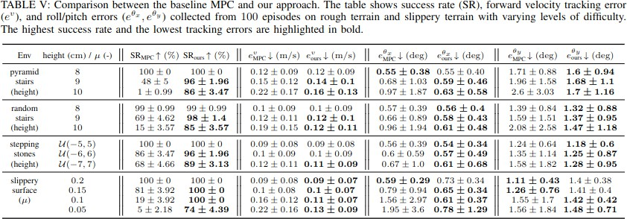
Adaptive MPC: success rate and tracking
2 Recap on papers
Success rate (SR) measures the fraction of successful, non-terminated trials.
12/48

Slide 13
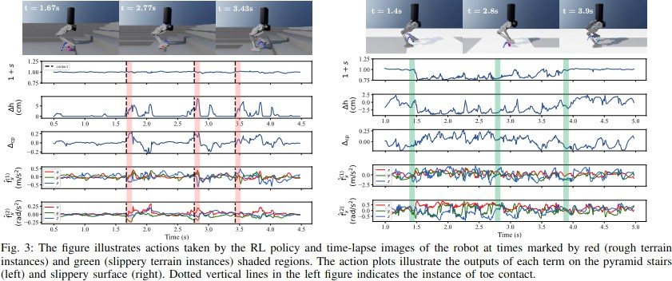
Adaptive MPC: challenging terrain
2 Recap on papers
13/48

Slide 14
Table of Contents
3 MPC formulations
What is Residual Learning
Recap on papers
MPC formulations
Tita results
Lite3 results
Conclusions and contributions
14/48

Slide 15

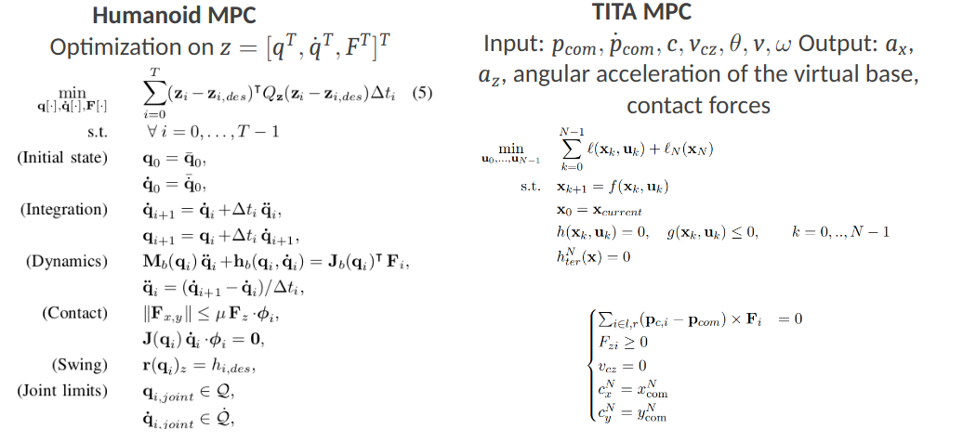
MPC
1 Sottotitolo
Input: current configuration q, dq current velocity, contact phases ϕ, command c=[h,vx,vy, w_z]
Output: joint torques tau_mpc, desired positions q_mpc:, desired velocities q_mpc, predicted trajectory z
Input: com position and velocity, position and velocity of the projected com c and its vertical velocity, orientation, linear and angular velocities
Output: linear, angular and vertical acceleration, ground reaction forces

Slide 16
Tita WBC and trajectory generation
3 MPC formulations
The Whole-Body Controller is formulated as a quadratic program. Given generalized velocity
v = [v⊤, ω⊤, q˙⊤]⊤, it includes:
b b ^{j}
regularization of velocity, contact forces and torque rate;
Cartesian-space and joint-space tracking;
angular-momentum regularization;
full-body dynamics constraints;
wheel–ground contact constraints;
contact-wrench constraints: unilateral contact, friction limits and no-tilting surface conditions.
Trajectory generator: the trajectory is generated online at each call of the MPC using virtual unicycle model. Given a desired velocity, it integrate a default acceleration to converge toward desired command and position.

Slide 17
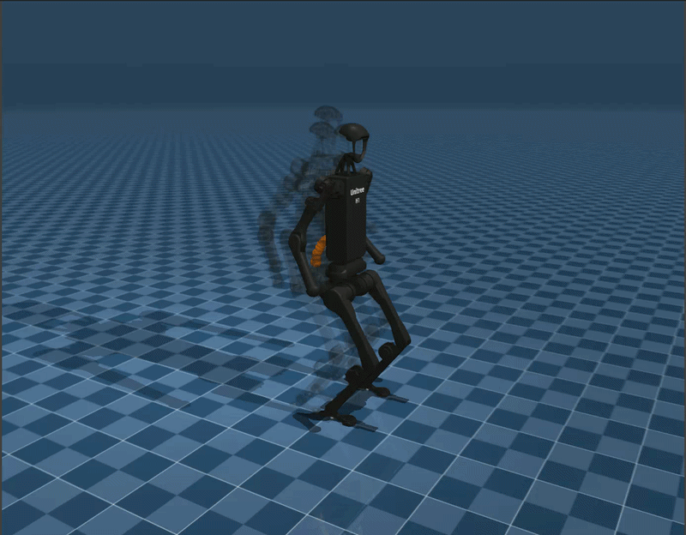
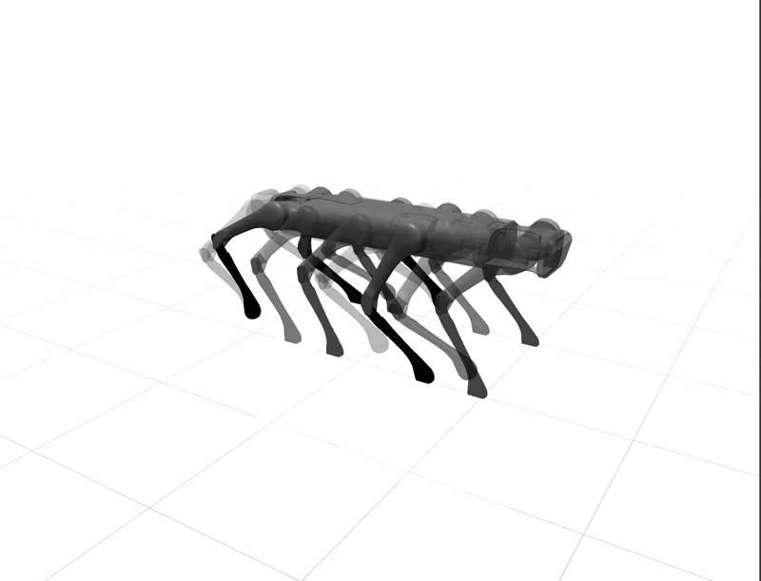
MPX implementation by IIT
3 MPC formulations
MPX is a library written in JAX for GPU array computation. It provides GPU parallelism, a fully differentiable solver, and integration into RL environments.
A multiple-shooting SQP formulation solves the KKT system in parallel, maintaining exactness and fast convergence. MPX provides primal-dual and FDDP solvers.
JAX is a Python library for accelerator-oriented array computation, designed for large-scale machine learning.
Brax is a framework implementing RL algorithms in JAX to train agents.
MPX also provides MPC-SRBD and MPC-WB controllers with the MuJoCo simulator.

Slide 18
Training information
3 MPC formulations
TITA: MPC at 100 Hz, horizon N = 50, ∆t_{MPC} = 0.01 s; FDDP solver. The inverse-dynamics/WBC layer runs at 100 Hz.
Lite3: MPC at 50 Hz, horizon N = 25, ∆t_{MPC} = 0.02 s; primal–dual solver. WBC runs at
500 Hz.
Both robots train exclusively on flat terrain and are evaluated on flat, rough terrain with obstacles and Perlin-noise terrains.
TITA noisy evaluations add zero-mean white noise to joint positions (0.01 rad) and velocities (0.1 rad/s), together with randomized initial conditions.
The noise affects the measurements provided to both the neural network and MPC, together with randomized initial conditions.

Slide 19
Table of Contents
4 Tita results
What is Residual Learning
Recap on papers
MPC formulations
Tita results
Lite3 results
Conclusions and contributions

Slide 20
Tita: residual training setup and evaluation
Neural network architecture: it has (512, 256, 128) shape with ELU activation functions and tanh(x) at the output layer
Neural network output: compute a joint setpoint from the default configuration and desired joint velocities for wheels. The output is in [-1,1].
observation vector: linear and angular velocities, projected gravity, joint position from the default configuration, joint velocities, CoM_z error, unicycle command, previous neural network action, MPC output, normalized feedforward torques
Given command during training:
  noise-free training:
    with 70% probability, sampling in vx = [0, 2.5], wz =[0, 0.6]
    with 30% sampling in vx = [2.5, 3.0], wz =[0.6, 0.8]
  noisy training:
    with 80% probability, sampling in vx = [0, 2.0], wz =[0, 0.6]
    with 20% sampling in vx = [2.0, 2.5], wz =[0.6, 0.8]
^{τ}RL,leg ^{= Kp(q}default ^{+s}legªleg ^{− q}leg^{), τ}RL,wheel ^{= K}d^{(s}wheelªwheel ^{+ q˙}wheel^{).}
s_{leg} = 0.5 rad; s_{wheel} = 25 rad/s. For r_{w} = 0.0925 m, this corresponds to 2.31 m/s maximum wheel speed correction.
Low-level control: 500 Hz; MPC, WBC and policy: 100 Hz.

Slide 21
Tita: PPO training parameters
4 Tita results
Training steps: 30 million residual; 80 million end-to-end
Parallel environments: 1024
Episode length: 1000 control steps
Simulation timestep: 0.002 s
Control timestep: 0.01 s
Policy and value MLPs: (512, 256, 128)
Policy distribution: Tanh-normal
Learning rate: 3 × 10⁻⁴
Discount factor: 0.99
Rollout length: 20 steps per environment between updates
Batch size: 256

Slide 22






Tita: residual reward setup
4 Tita results
Lin vel.. tracking (10)
Ang vel. tracking (5)
orientation (-1)
height (-1)
1st order action rate (-0.001)
2st order action rate (-0.0001)
dof pos limits (-1): sum of the distances by which the leg joints exceed their soft lower or upper position limits; the cost is zero when all joints remain within the allowed range.
termination: (-100): fall or base touch the ground

Slide 23
Tita: end-to-end reward setup
4 Tita results
Lin. vel. tracking (1): exp(−(vx_cmd − vx)² / 0.0625)
Ang. vel. tracking (0.5): exp(−(wz_cmd − wz)² / 0.0625)
Orientation (−1): sum(gravity_xy²)
Base height (−1): 1 − exp(−((h_com − h_cmd) / 0.05)²)
Posture (−1): exp(−sum(command²) / 0.25) × sum(weights × (q_leg − q_default)²)
Joint torques (−0.0001): sum(tau²)
1st-order action rate (−0.01): sum((a_t − a_t−1)²)
Dof position limits (−1): sum(max(q_lower − q_leg, 0) + max(q_leg − q_upper, 0))
Termination (−100): 1 if the robot overturns or a termination body touches the ground; 0 otherwise

Slide 24
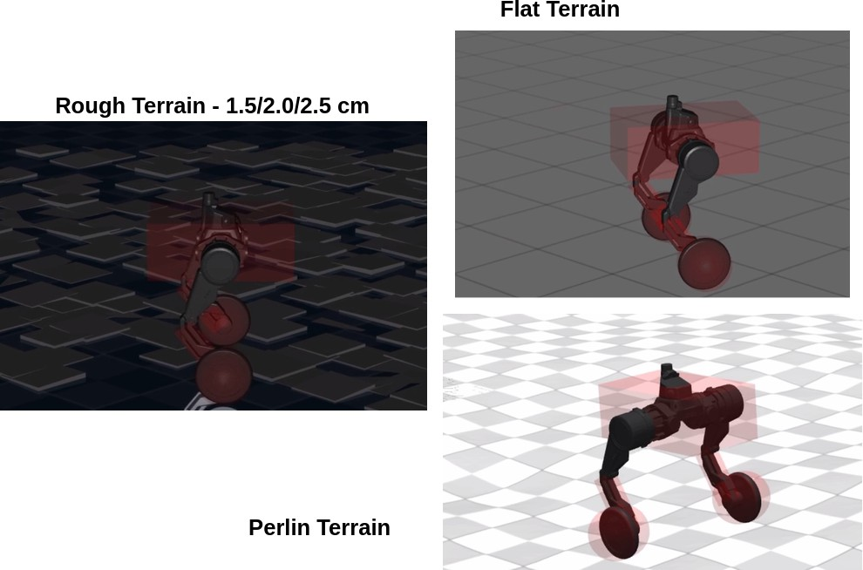
Tita results – terrains
4 Tita results

Slide 25
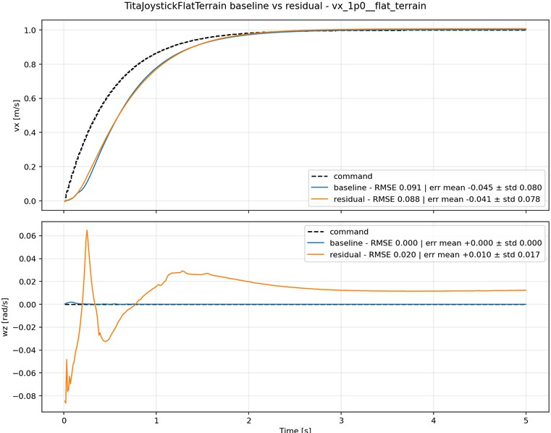
Tita results – flat terrain
4 Tita results
v_{x} = 1.0 m/s, ω_{z} = 0

Slide 26
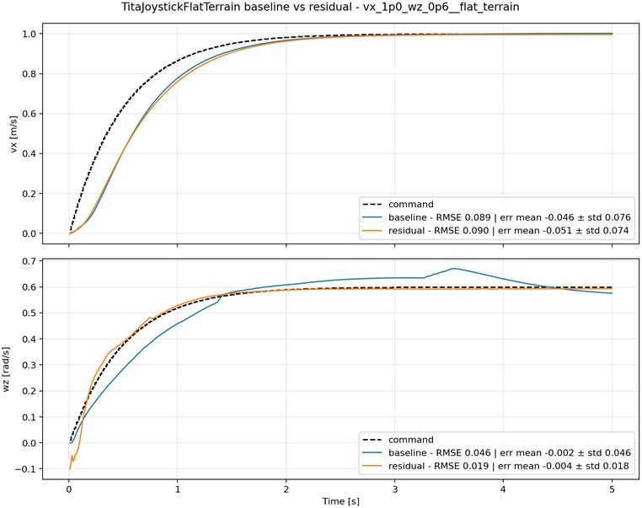
Tita results – flat terrain
4 Tita results
v_{x} = 1.0 m/s, ω_{z} = 0.6 rad/s

Slide 27
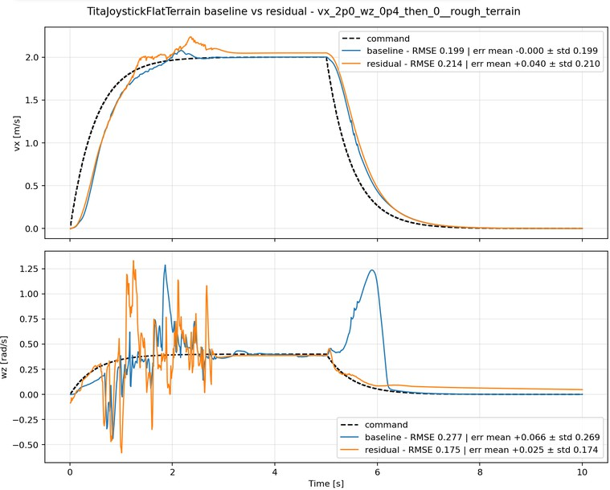
Tita results – rough terrain
4 Tita results
(v_{x}, ω_{z}) = (2.0, 0.5) −→ (0, 0)

Slide 28
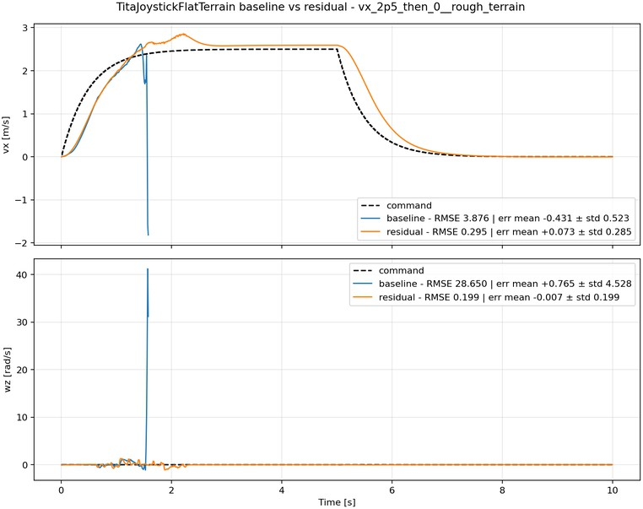
Tita results – rough terrain
4 Tita results
v_{x} = 2.5 m/s, ω_{z} = 0

Slide 29
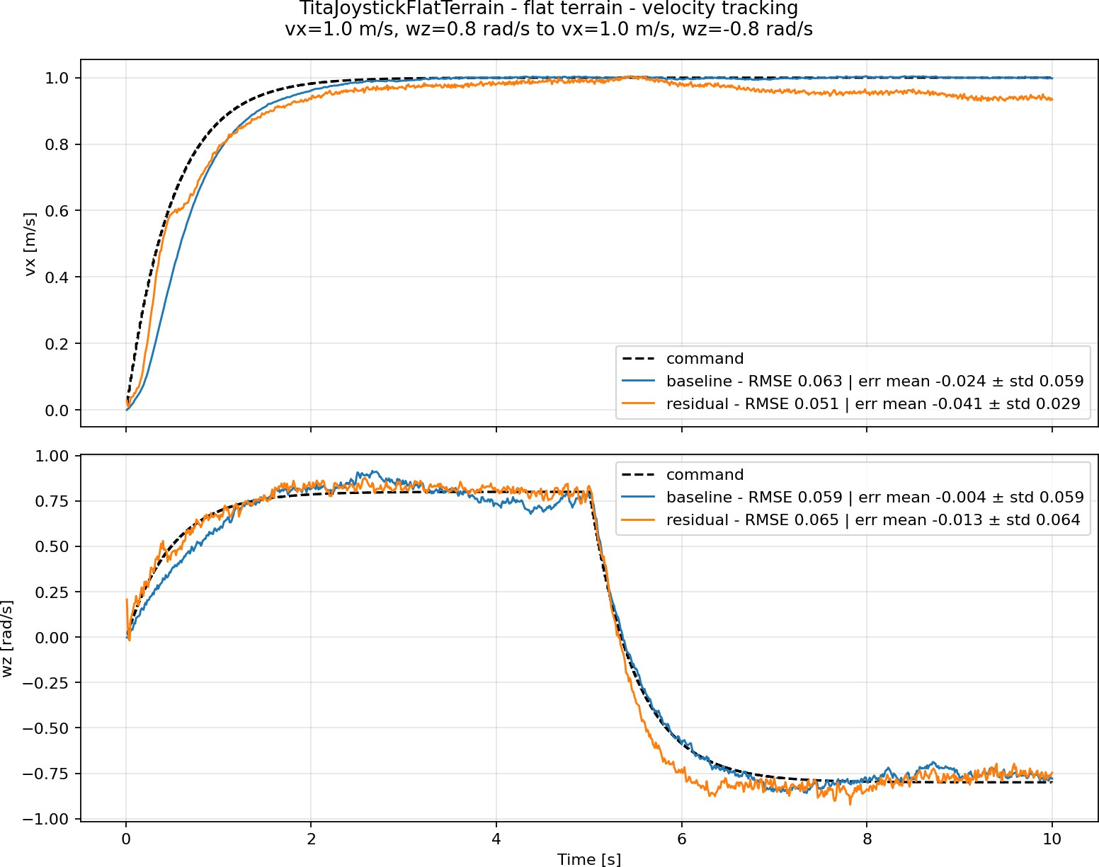
Tita results – flat terrain
4 Tita results
Noisy measurements

Slide 30
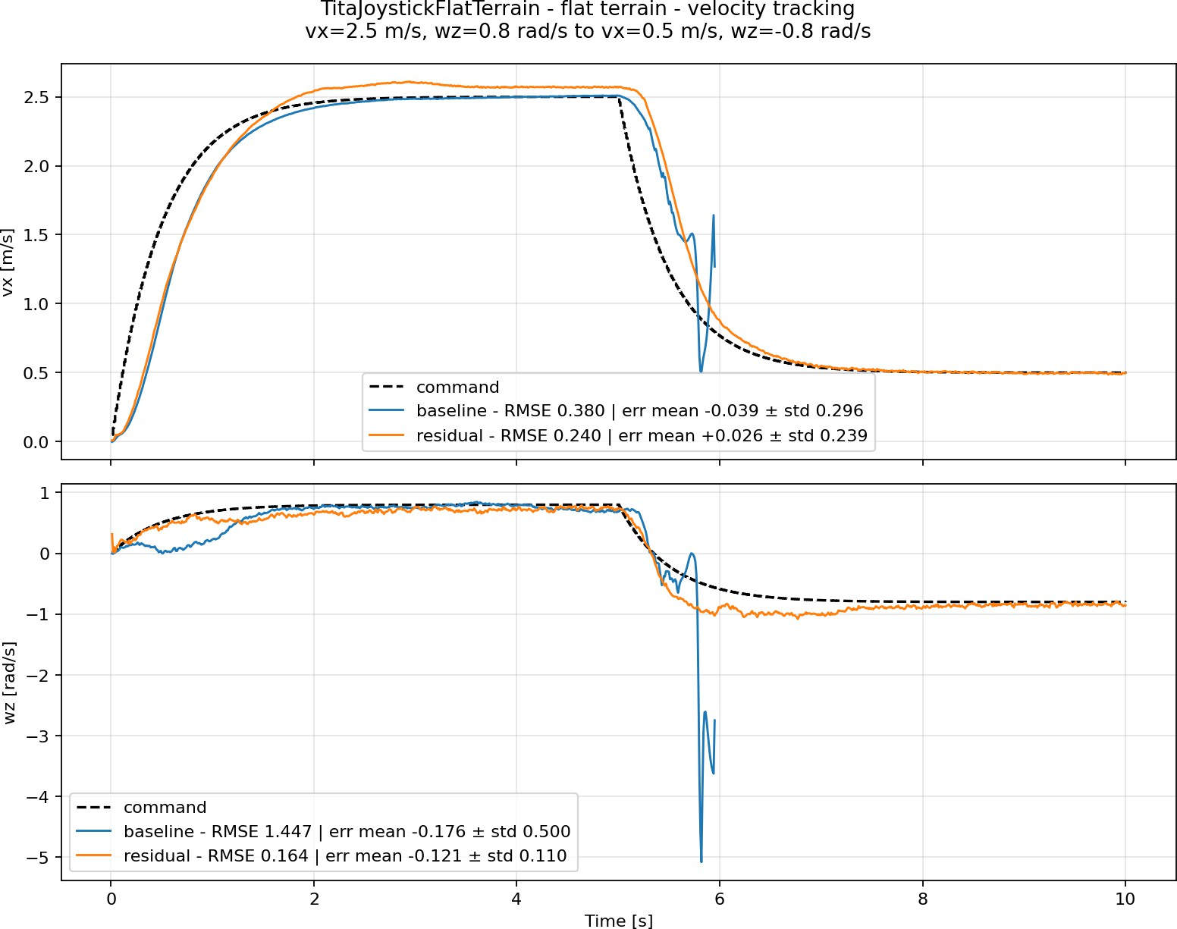
Tita results – flat terrain
4 Tita results
Noisy measurements

Slide 31
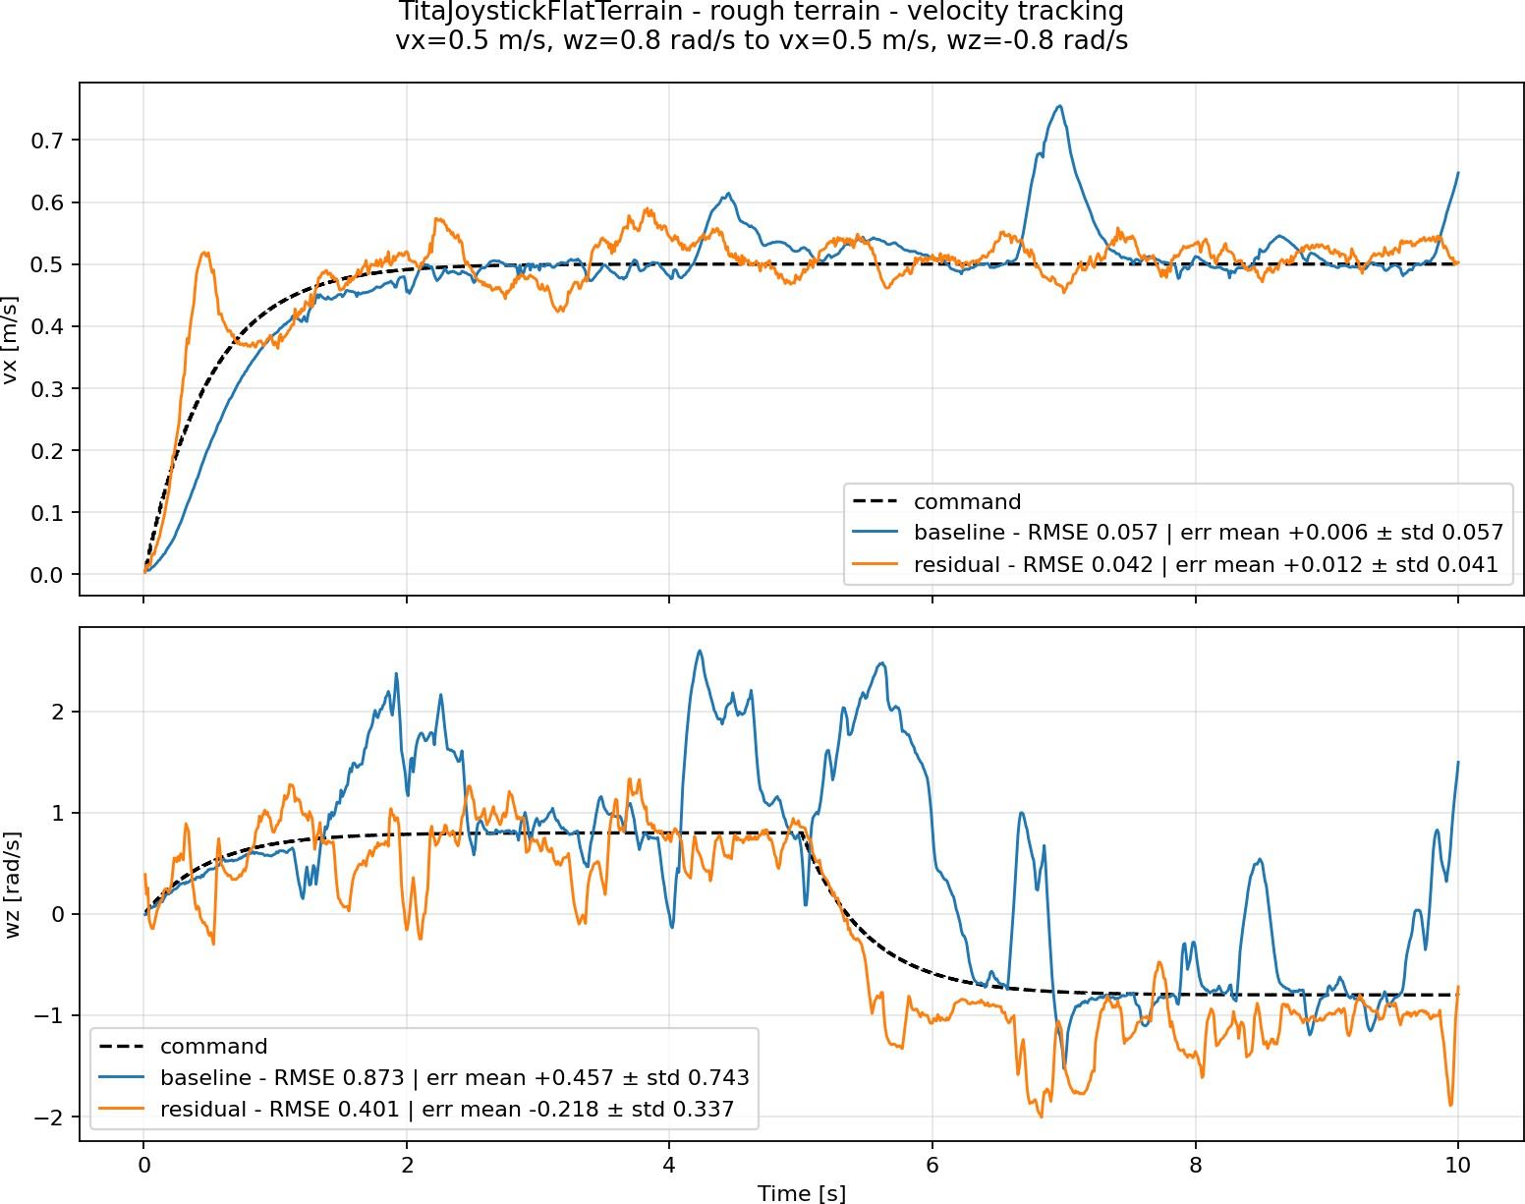
Tita results – rough terrain
4 Tita results
Noisy measurements

Slide 32
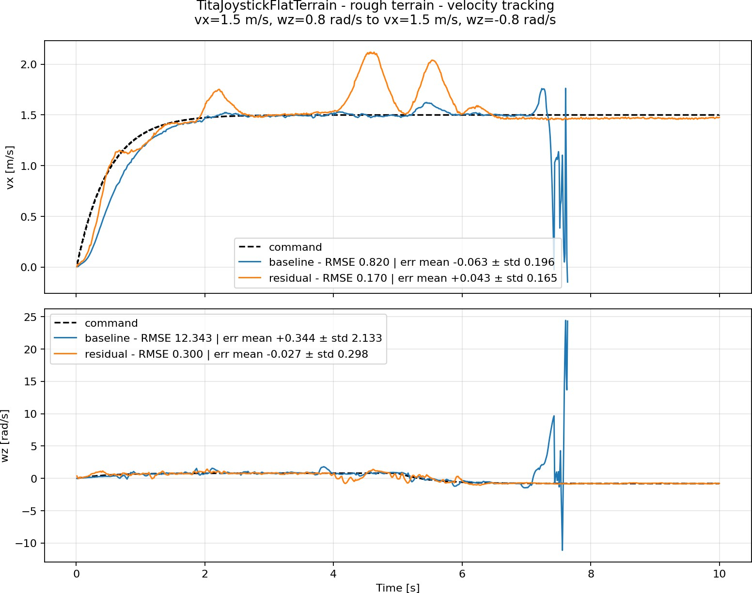
Tita results – perlin terrain
4 Tita results
Noisy measurements

Slide 33
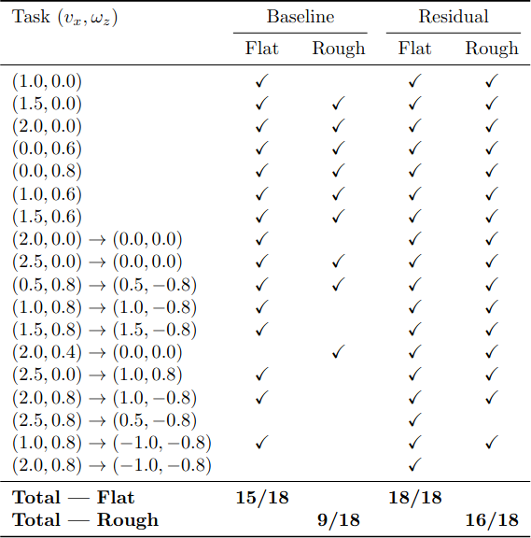
Tita results – conclusions
4 Tita results
Noise-free evaluation: completed tasks

Slide 34
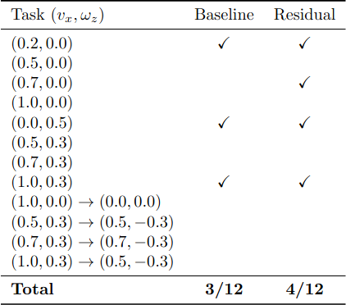
Tita results – conclusions
4 Tita results
Additional evaluation: completed tasks

Slide 35
Tita results – conclusions
4 Tita results
In both noise-free and noisy conditions, the neural network increases the maximum achievable velocity and improves locomotion robustness across different terrains.
However, the neural network can introduces sometimes disturbances into the nominal locomotion, resulting in less natural motion, for example, a wider leg stance and orientation oscillations.
Those problem can be fixed with some action-filter or with better reward shaping

Slide 36
Table of Contents
5 Lite3 results
What is Residual Learning
Recap on papers
MPC formulations
Tita results
Lite3 results
Conclusions and contributions

Slide 37
Lite3: residual training setup and evaluation
5 Lite3 results
MLP (256, 256, 256) with ELU activations and bounded actions a ∈ [−1, 1]¹².
Outputs: joint setpoints relative to the default configuration.
Observations: linear/angular velocity, projected gravity, joint-position offsets, joint velocity, unicycle command and previous action.
^{Training commands: v}x ^{∈ [0, 1.5], v}y ^{∈ [0, 0.6] m/s and ω}z ^{∈ [0, 1.2] rad/s.}
τ = τ_{MPC} + K_{p}(q_{default} + sa − q) − K_{d}q˙, s = 0.5.
SRBD MPC inputs: base pose and velocity, velocity/height commands, foot positions and measured contacts.
Outputs: predicted base trajectory and optimal ground-reaction forces.
Tasks: height tracking, roll/pitch stabilization, velocity tracking, contact-force optimization and friction-cone enforcement.
WBC map ground-reaction-force into joints.

Slide 38
Lite3: residual reward setup
5 Lite3 results
2
Lin. vel. tracking (1): exp(−sum((v_cmd_xy − v_xy)²) / 0.25)
Ang. vel. tracking (0.5): exp(−(wz_cmd − wz)² / 0.25)
Orientation (−5): sum(torso_z_axis_xy²)
Vertical linear velocity (−0.5): vz²
Roll/pitch angular velocity (−0.05): wx² + wy²
Default pose tracking (0.5): exp(−sum(weights × (q − q_default)²))
DOF position limits (−1): sum(max(q_lower − q, 0) + max(q − q_upper, 0))
Termination (−10): 1 if the robot falls or the state contains NaN values; 0 otherwise
Residual torque (−0.02): mean(tau_residual²)
Joint saturation (−0.5): mean(saturated_joints)
1st-order action rate (−0.01): sum((a_t − a_t−1)²)
2nd-order action rate (−0.001): sum((a_t − 2a_t−1 + a_t−2)²)
Joint torques (−0.0002): sqrt(sum(tau²)) + sum(|tau|)
Energy consumption (−0.001): sum(|dq| × |tau|)

Slide 39
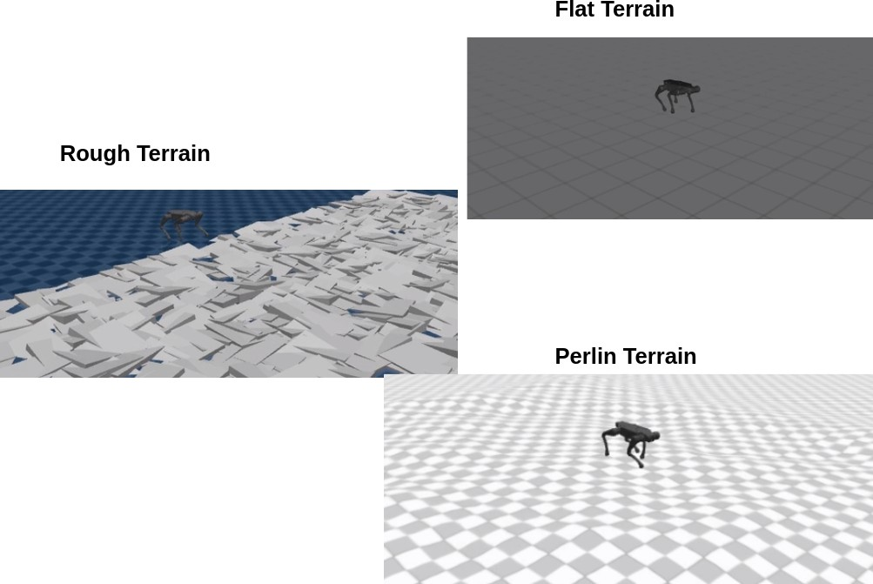
Lite3 results – terrains
5 Lite3 results

Slide 40
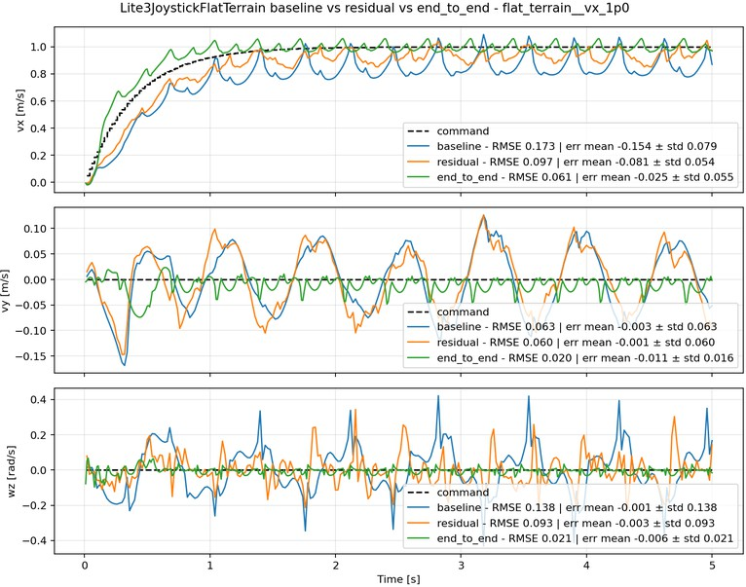
Lite3 results – flat terrain
5 Lite3 results
v_{x} = 1.0 m/s, v_{y} = 0.0 m/s, ω_{z} = 0.0 rad/s

Slide 41
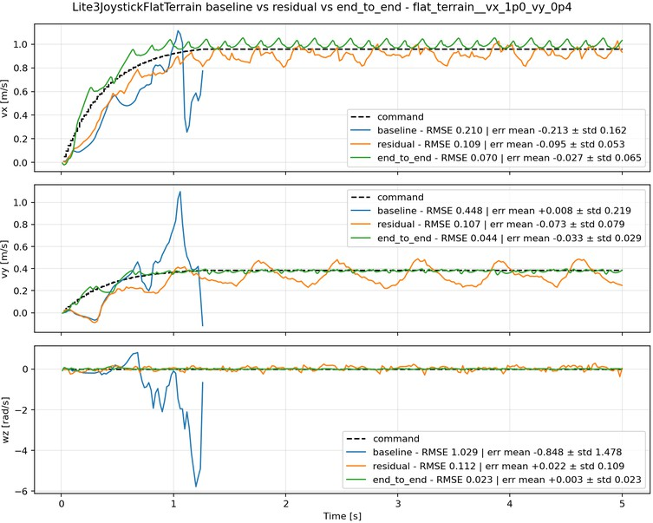
Lite3 results – flat terrain
5 Lite3 results
v_{x} = 1.0 m/s, v_{y} = 0.0 m/s, ω_{z} = 0.6 rad/s

Slide 42
Lite3 results – flat terrain
5 Lite3 results
v_{x} = 1.0 m/s, v_{y} = 0.4 m/s, ω_{z} = 0.0 rad/s

Slide 43
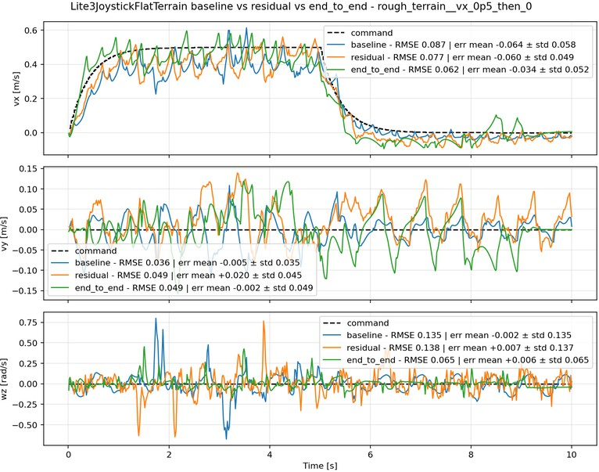
Lite3 results – rough terrain
v_{x} : 0.5 → 0.0 m/s, v_{y} = 0.0 m/s, ω_{z} = 0.0 rad/s
5 Lite3 results

Slide 44
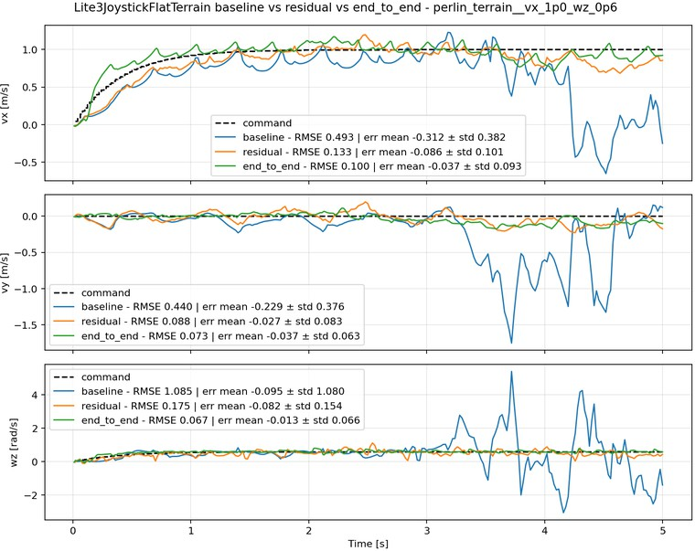
Lite3 results – perlin terrain
5 Lite3 results
v_{x} = 1.0 m/s, v_{y} = 0.0 m/s, ω_{z} = 0.6 rad/s

Slide 45
Table of Contents
6 Conclusions and contributions
What is Residual Learning
Recap on papers
MPC formulations
Tita results
Lite3 results
Conclusions and contributions

Slide 46
Conclusions and contributions
6 Conclusions and contributions
This work extends the MPX library with a simulation environment for wheeled-legged robots, focusing on the bipedal TITA platform.
A constraint-aware Whole-Body Controller is formulated as a Quadratic Program, replacing algebraic inverse dynamics.
The QP explicitly accounts for full-body dynamics, wheel–ground contact constraints, friction limits, contact-wrench feasibility, and actuator limits.
Residual learning is integrated with an MPC–WBC pipeline, allowing the neural network to correct the joint commands generated by the nominal controller.
This work investigates a less explored residual-learning architecture combining MPC with a separate QP-based WBC layer. Existing approaches generally include dynamics directly in MPC or rely on algebraic inverse dynamics.
The approach is evaluated on two robotic platforms, a quadruped and a bipedal wheeled-legged robot, across unseen terrains, with additional noisy tests for TITA.
The residual policy can reduce tracking errors, increase the maximum sustainable velocity, and improve robustness on rough and Perlin-noise-generated terrains.
Future work: improved reward design, action filtering, and real-robot validation.

