Slide 1
A Distributed Strategy for Generalized Biconnectivity Maintenance in Open Multi-robot Systems
Master’s Degree in Artificial Intelligence and Robotics Analysis and Control of Multi-Robot Systems
Professor Andrea Cristofaro Student Jacopo Tedeschi (1882789)

Slide 2

Table of Contents
1 Introduction
Introduction
Preliminaries
Generalized connectivity
Generalized biconnectivity for OMRS
Multi mode multi-dimensional switched system
Numerical example
Conclusion and future works
References
1/25

Slide 3
Introduction and related work
1 Introduction
Context: robust communication in open multi-robot systems (OMRS) with a dynamic number of robots
Problem: simple connectivity does not ensure robustness
Proposed solution: distributed gradient-based control to enforce connectivity
Advantages: support dynamic addition/removal of agents from a graph
Connectivity preservation by keeping all initial links ([1]–[3]): ensures the original connections never break, but this limits flexibility and adaptability
Fault-tolerant and robust control methods ([7]–[9]): focus on resilience of
multi-agent systems in case of failures, but are not specifically designed for OMRS
Local connectivity maintenance for OMRS (only addition of agents) ([10]): preserves connectivity under dynamic conditions but considers only joining agents, not removals
Biconnectivity maintenance algorithms ([11]–[14]): ensure the graph stays connected even after removal of a node
2/25

Slide 4
Table of Contents
2 Preliminaries
Introduction
Preliminaries
Generalized connectivity
Generalized biconnectivity for OMRS
Multi mode multi-dimensional switched system
Numerical example
Conclusion and future works
References
3/25

Slide 5
Robot model
2 Preliminaries
World frame W = {O_{w}, X_{W}, Y_{W}, Z_{W} } with Z_{W} aligned with vertical (gravity) direction.
Robot State
x_{i} ∈ R^{d} position w.r.t world frame with d ∈ {2, 3}.
ψ_{i} ∈ S¹ yaw angles around Z_{W} with S¹ representing unitary circumference.
v_{i} ∈ R^{d} body-frame linear velocity.
— w_{i} ∈ R body-frame angular velocity / yaw rate.
R 0
Kinematic model: η˙_{i} = J(η_{i})v_{i}, J(η ) :=
i
i
0 1
(
λ e −1
p˙ = F + F − B M p
i
i
i
= M p
i i
PHS model:
i
i = 1, . . . , N(t)
v =
∂K
−1
i
i
i
∂pi i
p_{i} = M_{i}v_{i} ∈^{d+1} generalized momentum, M_{i} ∈^{(d+1)×(d+1)} inertia matrix,
K_{i}(p_{i}) := ¹ p^{T}M⁻¹p_{i} kinetic energy, B_{i} ∈^{(d+1)×(d+1)} damping term, F^{λ} ∈^{(d+1)}
2 i i i
generalized biconnectivity force
4/25

Slide 6
Sensing and communication model
2 Preliminaries
Sensors: omnidirectional distance sensor to detect nearby robots and a camera-like sensor with limited FOV. If robot j is visible to robot i, the relative position is
x_{ij} = R^{T} (x_{i} − x_{j}), where R_{i}, x_{i}, and x_{j} are expressed in the world frame. These
i
measurements enable robots to identify neighbors in the interaction graph.
Interaction graph: time-varying graph G(V(t), E(t)) has nodes V(t) = {1, . . . , N(t)} and edges E(t) ⊆ V(t)² representing sensing/communication links. Set of neighbors of agent i is N_{i}(t) = {j ∈ V(t) : (i, j) ∈ E(t)}, and the adjacency matrix A has
a_{ij} > 0 if j ∈ N_{i}(t), otherwise a_{ij} = 0.
Laplacian matrix: Laplacian L = diag(A1) − A is symmetric and positive
semi-definite. Its second smallest eigenvalue λ₂, called algebraic connectivity, satisfies λ₂ > 0 if the graph is connected and λ₂ = 0 otherwise. The Laplacian and its eigenvalues thus capture the connectivity induced by the sensing/communication interactions among robots.
5/25

Slide 7
Table of Contents
3 Generalized connectivity
Introduction
Preliminaries
Generalized connectivity
Generalized biconnectivity for OMRS
Multi mode multi-dimensional switched system
Numerical example
Conclusion and future works
References
6/25

Slide 8
Generalized connectiviy
3 Generalized connectivity
The adjacency matrix A encodes the presence of an interaction link between agents (i, j)
and can also represent additional inter-agent behaviors and constraints.
aij = γijfijαijβij
γ_{ij} ≥ 0: maximum communication range / link quality
f_{ij} ∈ [0, 1]: FOV constraint (0 if outside FOV)
α_{ij} ≥ 0: hard requirements (e.g., collision avoidance)
β_{ij} ≥ 0: soft requirements (e.g., desired inter-agent distance)
By making a_{ij} smooth functions of agent states, the second smallest eigenvalue λ₂
becomes a smooth measure of graph connectivity.
7/25

Slide 9
Perturbed graph and perturbed algebraic connectivity
3 Generalized connectivity
Let G_{−i} be the graph remaining after the removal of node i, then G is said to be biconnected if for any i ∈ V, the remaining graph G_{−i} is connected. if G_{−i} is disconnected, the node i is called articulation point.
Sufficient condition for biconnection: If all nodes are locally biconnected then the entire graph is biconnected.
Associate to each agent a parameter ρ_{i} ∈ [0, 1 − δ] ,with δ > 0 small constant, given by
ρ˙_{i} = −k₁ρ_{i} + ^{k2} (1 + sign(σ − λ^{l} ))
2
λ 2,i
where k₁, k₂ are chosen such that ^{k2} = 1 − δ, σ_{λ} is a threshold parameters
k1
Perturbed Adjiacency matrix A˜ with a˜_{ij} = min{ϵ_{i}, ϵ_{j}}a_{ij} where ϵ_{i} = 1 − ρ_{i}
˜ ˜
Perturbed Laplacian matrix L˜ = diag(A˜1) − A˜ with λ^{ˆ}₂ = lim + ^{λ2} →− λ^{ˆ}₂ ≈ ^{λ2}
δ→0
δ δ
8/25

Slide 10
Weights
3 Generalized connectivity
Lets define the four sub-weights for a_{ij} = γ_{ij}f_{ij}α_{ij}β_{ij}: considering d_{ij} :=
xij
, we have

1 0 ≤ d_{ij} ≤ d_{γ}
 d_{γ} < d_{ij} ≤ D_{γ}
0 D_{γ} < d_{ij}

γ_{ij}(d_{ij}) =
1

2

B (d ) = exp(−
(d −d )
2
), σ > 0
ij ij
ij β
Q
σ
∗
α_{ij}(d_{ij}) = (^{Q} α (d ))(
α∗ (d_{jk})) ,
ik

k∈Si ij k∈S_{k}/{i} jk
0 0 ≤ d_{ij} ≤ d_{α}


α∗(d_{ij}) =
1 _{α}
d < d ≤ D
, α_{k}/f_{k} = 1 − cos( ^{π(d/cij−d/cα)} )
ij

2
k
α ij α
Dα/cM −dα/cm

1 D_{α} < d_{ij}

1 0 ≤ c ≤ c

ij m
1 _{fk}
f_{ij}(c_{ij}) = f ∗(c_{ij}) + f ∗(c_{ji}) − f ∗(c_{ij})f ∗(c_{ji}) ,
ij ji ij ji
f ∗(c_{ij}) =
c_{m} < c_{ij} ≤ c_{M}
0 c_{M} < c_{ij},
ij

2

9/25

Slide 11
Control design
3 Generalized connectivity
Let’s define
D := {λ^{ˆ}₂ ∈ R_{≥0} | λ^{ˆ}₂ > λ¯} feasible second smallest eigenvalues
V_{λ} : D → R_{≥0} which is differentiable and had the property that V_{λ}(λ^{ˆ}₂) → ∞ as
λ^{ˆ}₂ → ∂D so as it converge to the border of D
Generalized biconnectivity force F^{λ} in the PHS is a simple integrator defined as
i
" #
ˆ
ˆ
∂V (λ^{ˆ}₂)
∂V (λ )
∂λ
2
F^{λ} = −k
λ
= −k
λ 2
∂ψi
i
∂η_{i}
∂λ^{ˆ}₂
∂λ^{ˆ}2
∂ψi
ˆ ˆ ˜
_{e}2(λ^{ˆ}₂−λ˜∗)₊₁ ₋ ₁
∗
2
0 with
Choosing V_{γ} (λ₂) = coth λ₂ − λ − 1
⁼ _{e}2(λ^{ˆ}₂−λ˜∗)₋₁ ⁼ _{e}2(λ^{ˆ}₂−λ˜∗)₋₁ >
λ∗ = λ¯ being the biconnectivity lower bound we have
_{2e}(λ2−λ∗)
_{e}2(λ2−λ∗) ₋ ₁
∂V
^{λ} = csch²(λ^{ˆ}₂ − λ∗) = (
)² > 0
∂λ^{ˆ}₂
10/25

Slide 12
Closed-loop stability
3 Generalized connectivity
ˆ
λ
∂V (λ )
Control law: F = −k
λ 2
i ∂ηi
Key definitions: E∗ = {e₁, . . . , e
} (all possible edges), E ∈ R^{3N×3|E∗|}
N(N−1)/2
(rotational incidence matrix), ˜x_{k} = x_{i} − x_{j}, ψ˜_{k} = ψ_{i} − ψ_{j}, η˜_{k} = [˜x^{T} ψ˜_{k}]^{T} , ˜v_{k} = v_{i} − v_{j},
]T
k
∂˜x_{k} T
T T
= R , η˜ = [η˜ , . . . , η˜
]^{T} , ˜v = [˜v^{T} , . . . , ˜v^{T}
∂xi i 1 N(N−1)/2
1
N(N−1)/2
Σ
λ
λ
3N(N−1)/2 ∂V (λ )
Control in terms of relative poses: F = −
2
Σ
i
k=1 ∂η˜_{k}
System energy: H(p, η˜) =
N
i=1
(K_{i}(p_{i}) + V^{λ}(λ₂(η˜)) ≥ 0
" #
p˙
B −E
∂H
F
e
PH formulation: =
∂p
+
, ˜v = ^{∂H}
T
∂H
∂p
η˜˙
E 0
0
∂η˜
Energy derivative: H˙ (p, η˜) = − ^{∂H T}B^{∂H} + ^{∂H T}F^{e} ≤ ˜v^{T} F^{e}
∂p ∂p ∂p
Proposition: If G(t₀) is biconnected, the system is passive w.r.t. (F^{e}, ˜v) and the set D
is forward invariant ⇒ biconnectivity is maintained ∀t ≥ t₀.
11/25

Slide 13
Table of Contents
4 Generalized biconnectivity for OMRS
Introduction
Preliminaries
Generalized connectivity
Generalized biconnectivity for OMRS
Multi mode multi-dimensional switched system
Numerical example
Conclusion and future works
References
12/25

Slide 14
Biconnectivity for OMRS
4 Generalized biconnectivity for OMRS
Problem: After agent join/leave, λ^{ˆ}₂ ≤ λ¯, V_{λ} and F^{λ} become undefined.
i
Solution: Time-varying lower bound λ∗ : R_{≥0} → [0, λ¯ + ϵ]
— λ∗ = 0 when biconnectivity is lost, smoothly increases to guarantee reconnection.
— Each agent keeps a local copy λ∗ with dynamics:
i
Σ
˙
∗ ∗
∗
∗
′ ∗
λ = f (λ ) − k (λ − λ ) − k c (t)λ
i
i c
i
j
i
λ i
j∈Ni
where f (λ∗) = −k_{λ}(λ∗ − (λ¯ + ϵ)) and c_{i}(t) ∈ {0, 1} is a pinning variable.
i i
Properties:
— Synchronized agents: λ∗ → λ¯ + ϵ if c_{i}(t) = 0 ∀i
i
— Pinned agents: λ∗ → 0
i
— Passivity preserved:
∂V ∗
˙
˙
T e
λ
˜
V (λ^{ˆ} ) = coth(λ^{ˆ} − λ˜∗) − 1, H ≤ ˜
v F −
λ
λ 2 2
∂λ^{ˆ}
2
13/25

Slide 15
Biconnectivity for OMRS
4 Generalized biconnectivity for OMRS
Tank-Based Force Approximation:
— Tank state x_{ti} ∈ R, energy T_{i} = ¹ x² ≥ 0, dissipated energy D_{i} = p^{T}M⁻¹B_{i}M⁻¹p_{i}
(
2 ti i i i
e
−1
p˙ = F − w x − B M p
i
i ti i i
— Augmented dynamics:
i i
x˙_{ti} = ¹ D_{i} + u_{ti} + w^{T}v_{i}, v_{i} = M⁻¹p_{i}
xti
i i
ˆ
˙
1
λ
c_{i} ∂V_{λ} ∗
— Set w = − F , u =
λ
i
xti ^{i}
ti
Σ
i
xti ∂λ^{ˆ}₂
Total Energy: H(p
λ
, η˜, x ) = K (p ) + T (x ) + V (λ (η˜)) ≥ 0
t
i
i i i ti 2
PH Formulation:
  
_{W} 
₀
p˙ 0 E B 0
˙
  
T
 

e
T
η˜ = ( −E 0 0 −
0 0 0 )∇H + GF + G u ,
˜v = G ∇H
t t
T
x˙_{t} −W 0 0 −PB 0 0
Derivative: H˙ ≤ ˜v^{T} F^{e} + ϵ_{λ} ⇒ passivity preserved
Key Point: tanks compensate syncrhonization for errors due to the use of local λ^{l}
2
Passivity ensured via PH, tank, and M³D formulation, System remains passive at each
_{14/25} switching instant

Slide 16
Table of Contents
5 Multi mode multi-dimensional switched system
Introduction
Preliminaries
Generalized connectivity
Generalized biconnectivity for OMRS
Multi mode multi-dimensional switched system
Numerical example
Conclusion and future works
References

Slide 17
System dynamics
5 Multi mode multi-dimensional switched system
M3D system dynamics:
Nonlinear: x˙_{σ(t)}(t) = f_{σ(t)}(x_{σ(t)}(t))
Linear: x˙_{σ(t)}(t) = (A_{σ(t)} + B_{σ(t)}K_{σ(t)})x_{σ(t)}(t)
x_{σ(t)}(t) ∈ R^{nσ(t)} , dimension varies with commutation signal σ(t)
State may be discontinuous at switching instant t_{k}:
—
x + (t⁺) = Ξ + − x − (t ) + Φ
σ(t_{k} ) k σ(t_{k} ),σ(t_{k} ) σ(t_{k} ) k
k
n
+ ×n −
— Ξ + − ∈ {0, 1} ^{σ(tk )}
σ(t )
: indicates dimension change (reduction/expansion)
σ(t_{k} ),σ(t_{k} )
k
n +
— Φ ∈ R : state jump
σ(t )
k
k
Two types of impulse Φ_{k}:
State-independent: depends only on t_{k}, non-vanishing, prevents asymptotic stability, guarantees GUPS
State-dependent: depends on x_{σ(t}−₎, small state → small impulse
k

Slide 18
Impulse and stability
5 Multi mode multi-dimensional switched system
State-independent impulse:
Nonzero at switching instant, independent of previous state
Prevents asymptotic convergence
Guarantees GUPS (Global Uniform Practical Stability): state remains bounded around origin
State-dependent impulse:
Scales with previous state magnitude
Allows asymptotic convergence
Guarantees GUAS (Global Uniform Asymptotic Stability): state converges to 0
Summary: type of impulse determines stability type in M3D systems:
State-independent → GUPS (bounded but not 0)
State-dependent → GUAS (converges to 0)

Slide 19
Table of Contents
6 Numerical example
Introduction
Preliminaries
Generalized connectivity
Generalized biconnectivity for OMRS
Multi mode multi-dimensional switched system
Numerical example
Conclusion and future works
References

Slide 20
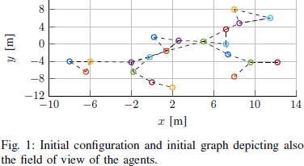
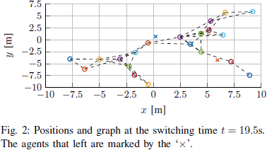
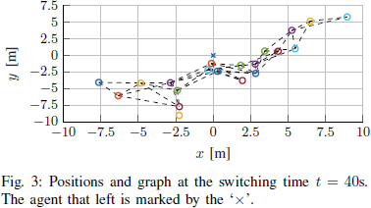
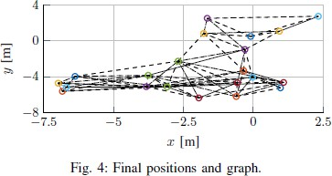
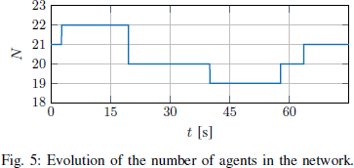
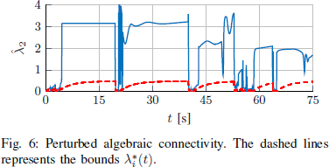
Numerical example: paper
6 Numerical example

Slide 21
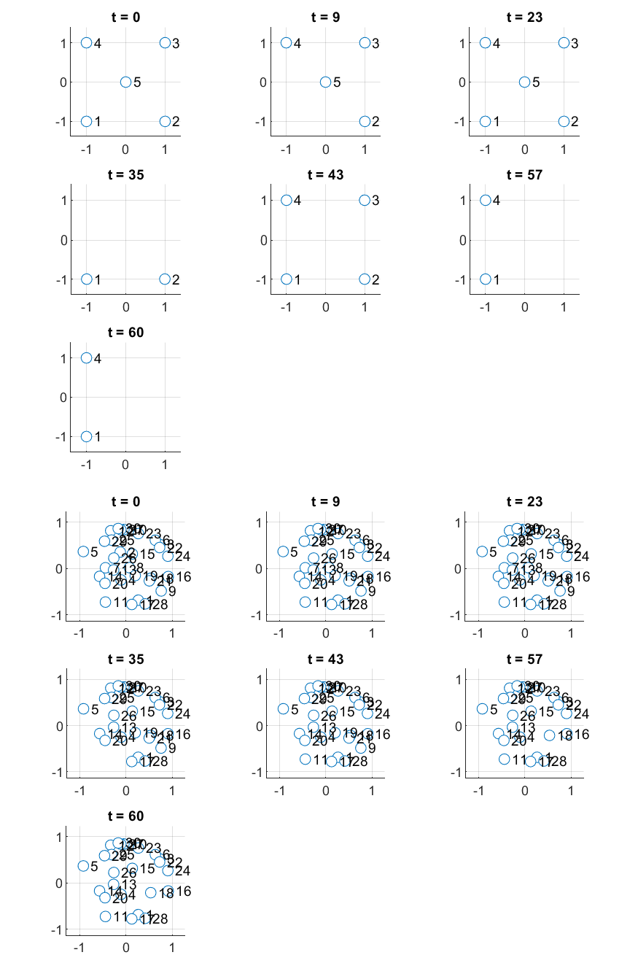
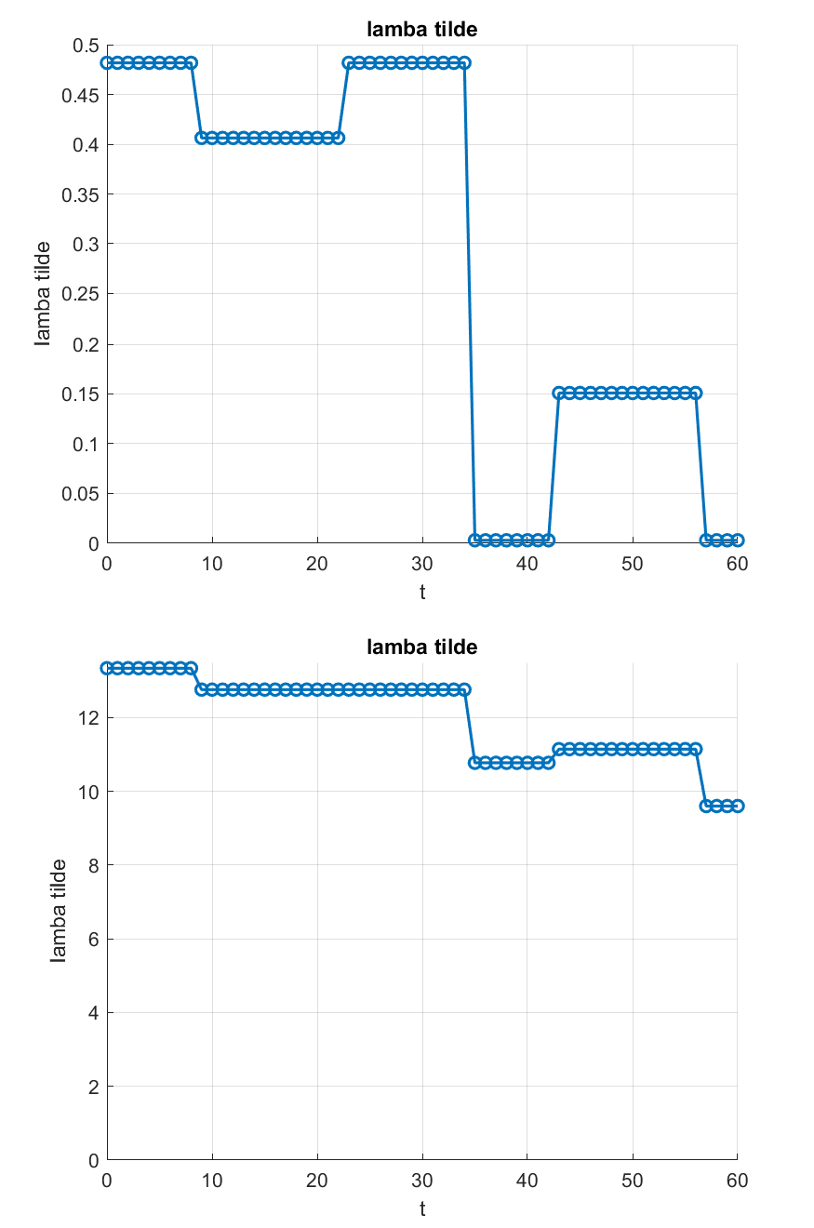
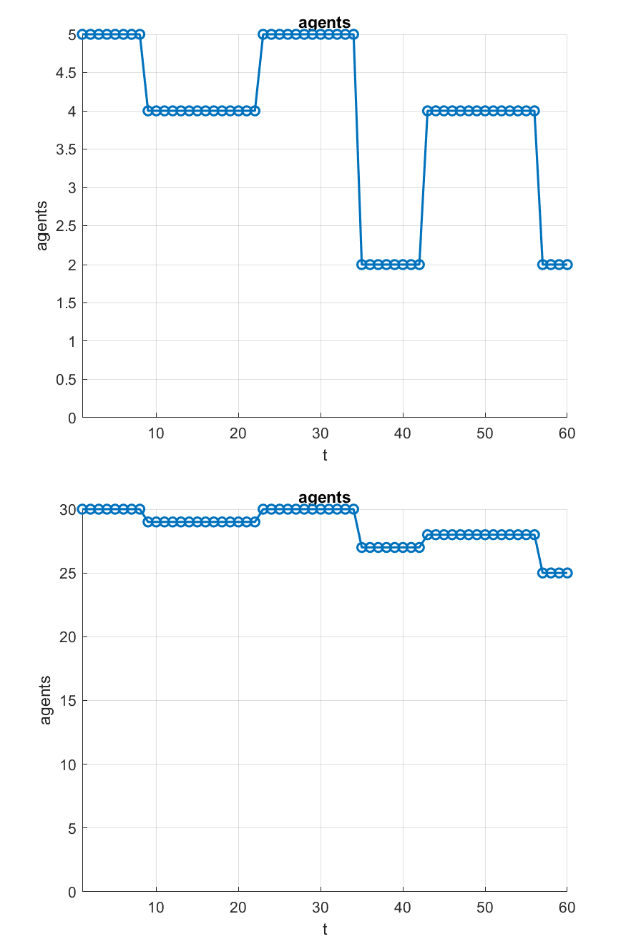
Numerical example: github
6 Numerical example
Simulation code and results in https://github.com/jacopotdsc/cams

Slide 22
Table of Contents
7 Conclusion and future works
Introduction
Preliminaries
Generalized connectivity
Generalized biconnectivity for OMRS
Multi mode multi-dimensional switched system
Numerical example
Conclusion and future works
References

Slide 23
Conclusion and future works
7 Conclusion and future works
Distributed approach to acquire and preserve generalized global biconnectivity in OMRS
Ensures the graph remains connected after agent addition/removal
Interactions among robots are sensor-based
Biconnectivity measure incorporates additional constraints:
Limited inter-robot communication range
Limited field-of-view (FOV)
Desired inter-agent distances
Collision avoidance
Passivity established via Port-Hamiltonian (PH) representation w.r.t external inputs
Focus on persistent shared control scenarios in OMRS

Slide 24
Table of Contents
8 References
Introduction
Preliminaries
Generalized connectivity
Generalized biconnectivity for OMRS
Multi mode multi-dimensional switched system
Numerical example
Conclusion and future works
References

Slide 25
References
8 References
Main papers
A Distributed Strategy for Generalized Biconnectivity Maintenance in Open Multi-robot
Systems, 2024 IEEE 63rd Conference on Decision and Control (CDC), Dec. 16-19, 2024, MiCo, Milan, Italy. Authors: Esteban Restrepo and Paolo Robuffo Giordano
Stability of Multi-Dimensional Switched Systems with an Application to Open
Multi-Agent Systems, Mengqi Xue, Yang Tang, Wei Ren, Feng Qian. Affiliations: East China University of Science and Technology, Shanghai, China; University of California, Riverside, USA
References
M. Ji and M. Egerstedt, “Distributed coordination control of multiagent systems while preserving connectedness,” IEEE Trans. Robot., vol. 23, no. 4, pp. 693–703, Aug. 2007.
3 Y. Shang, “Resilient consensus in multi-agent systems with state constraints,”
Automatica, vol. 122, p. 109288, 2020.
7 C. Ghedini, C. Ribeiro, and L. Sabattini, “Toward fault-tolerant multirobot networks,” Networks, vol. 70, no. 4, pp. 388–400, 2017.
9 J. Panerati, M. Minelli, C. Ghedini, L. Meyer, M. Kaufmann, L. Sabattini, and G. Beltrame,
24/25
“Robust connectivity maintenance for fallible robots,” Autonomous Robots, vol. 43, pp.

Slide 26
Thank you for your attention!
25/25

