Slide 1

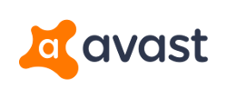
Avast Urlinfo Service
Jacob Leung
October 2018
Notes:
Sorry for no whiteboard

Slide 2
Agenda
Internet security situation
Avast Urlinfo Service introduction
What benefits come with this service?
Compare to similar solutions in the market
Implement Scans for Urlinfo service
Why Avast is the best to you?
Questions.

Slide 3
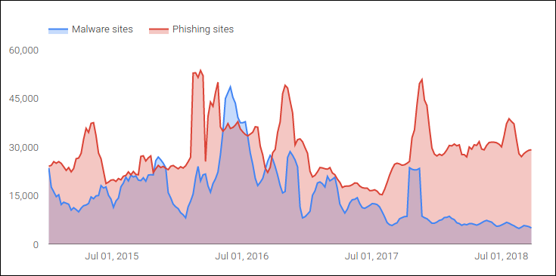
Internet security situation(1)
50,000+ sites hacked daily
10,000+ new blacklisted siteds daily( in our DB )
85%+ websites include at least one remote JS library.
(ad, sns, tracking, web analytics)
Source: google safe browsing, https://hostingfacts.com/internet-facts-stats/
Notes:
2 sites/ a second,
1/5 of them was doing further bad things.
third party, DNS hijack
when a website was hacked, after webmaster get notifiacation, it took him...

Slide 4
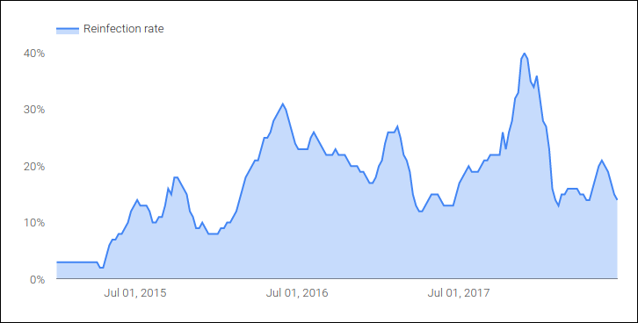
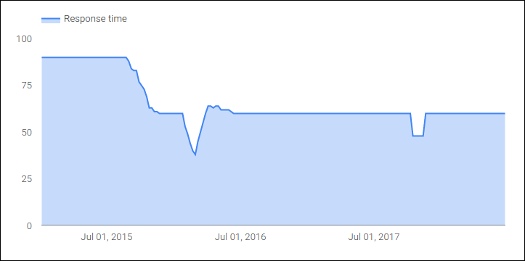
Internet security situation(2)
Long response time for compromised notification. (60 days)
High reinfection rate. (20%)
Notes:
Long response time after webmasters receiving notifications that their sites have been compromised. (60 days)
Even after a site has been cleaned, it can become reinfected if an underlying vulnerability remains.
I hear a lot people say...
This do help to protect....
But you can NEVER say....
Even us know many ways...
Really?

Slide 5

Attacking vectors - client side
Phishing
Social engineering
Trafffic sniffer, even HTTPS
Browser vulnerability
and so on..

Slide 6
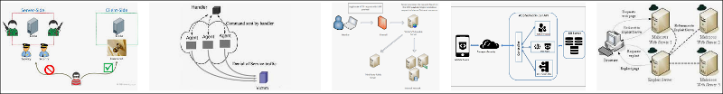
Attacking vectors - server side
Application, system bugs
Brute force password, account, path
CSRF
Web applications vulnerabilities
Poor security policies
etc..

Slide 7
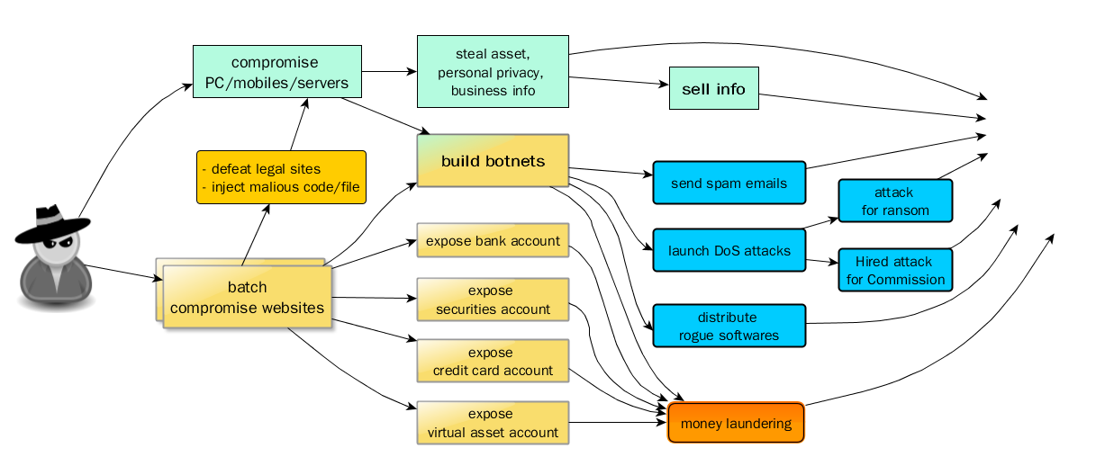

Impacts after being compromised
Server/workstation controlled by hackers for APT
Notes:
What can happen if your device or a website was hacked.
Let's imagine, you visit your company website everyday
Hackers have thousands of ways to use your device, more than you know..

Slide 8


You need a solution to against web threats
VS
Notes:
So, security should be not only your PC or mobile protection or only bowser client side's thing, it should be a set of solution.
And first of all, you need a well defined, widly used, and high organized mechanism to tell you what is right and what is wrong from web access origin.

Slide 9
Agenda
Internet security situation
Avast Urlinfo Service introduction
What benefits come with this service?
Compare to similar solutions in the market
Implement Scans for Urlinfo service
Why Avast is the best to you?
Questions.

Slide 10
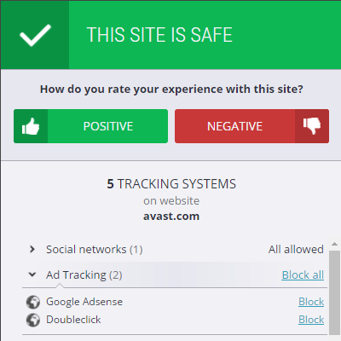
AVAST URLINFO SERVICE
INTRODUCTION
Avast powered engine to detect and protect your web security.
Scan URL and IP address to determine if they are harmful or unwanted in our cloud.
Protect Endpoints, Network appliances, and Cloud infrastructures base on our fingerprint system.

Slide 11
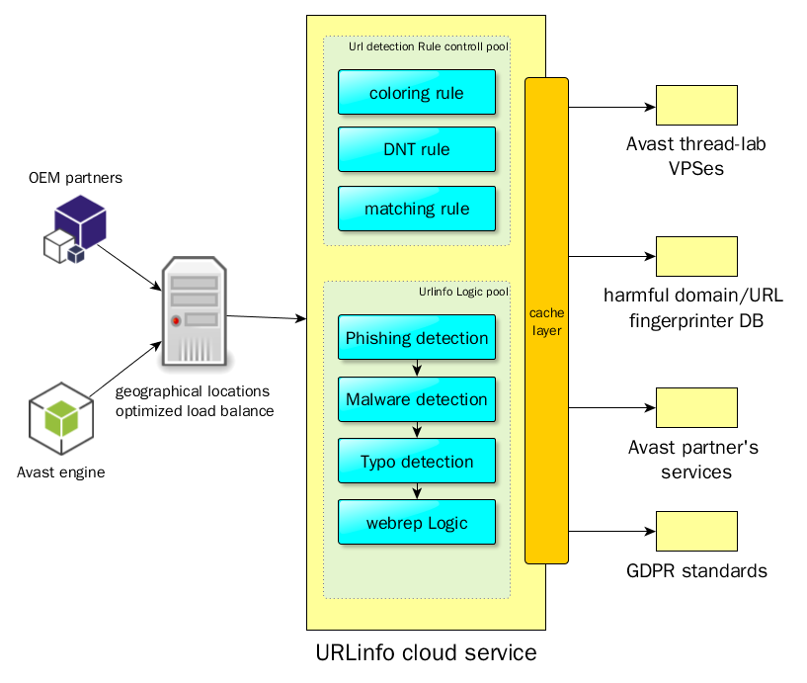
Feature overview
Check both IP address and whole Url.
Identify malicious, phishing, fraudulent websites in real-time.
Check domain reputation.
Cloud frontend of Avast VPS engine.
Provide simple HTTPS API for integration. Multi-proto support.
Notes:
IP, the whole URL
Check URLs to determine if they are harmful, typo, tracking or unwanted spam, Identify malicious, phishing, and fraudulent websites in real-time.
Check domain reputation based on massive Avast users voting

Slide 12
Our advantages
10+ million harmful URL fingerprints from Avast ourself ThreatLab.
Multiple URL fingerprint feeds.
Distributed service. multiple DC. GEO optimized.
High performance. RT at minisecond level.
High accuracy, local optimized feed sources.
Local OEM support team.
Malicious feeds real time update, at second level.
Notes:
service distribute on multiple datacenters, include 7 data zones and 38 Data center.
high performance, low latence, geographical locations optimized.
high accuracy, low FP, the best data feed from local partners.
Local OEM support team
malicious feeds real time update, in second level.
multiple blacklist sources, includes scaned result from Avast ThreatLab VPS

Slide 13
Agenda
Internet security situation
Avast Urlinfo Service introduction
What can it help me? What benefits come with this service?
Compare to similar solutions in the market
Implement Scans for Urlinfo service
Why Avast is the best to you?
Questions.
Notes:
Sound good right?
Along these years, We cooprate with our partners in different environments, and we summarize the following scenarios for you to reference.

Slide 14








Use cases / Solutions(1)
Use to protect any endpoints, network appliances, and cloud infrastructure:
Client side web access hardening(Browser).
Mobile application hardening(App).
Url links status report for content hosting providers
(blog, wiki, message board, SNS, IM)
Search result links status for search engine providers.

Slide 15







Use cases / Solutions(2)
Use to protect and Endpoints, Network Appliances, and Cloud Infrastructure:
Firewall, router Url filtering.
Integrate/OEM as a cloud service of SaaS provider.
Use in sandbox for ongoing threatened behavior detection.
All other who needs for Url health check.

Slide 16

Benefit come from this service(Partners)
Integrating it into your product to generate revenue.
Create incremental revenue as an optional service to your clients.
Differentiates product from competitors.
More time to focus on your own business targets.
Harden your devices/applications/services, to keep a good reputation for your brand.
Notes:
Identifies all harmful sites, notifies user or administrator to stay away from online threats.

Slide 17

Benefit come from this service(End user)
Trust all URLs from your app/service/device.
Prevent from potential web-based security issues.
Webmasters receive notification for their compromised sites so that their visitors stay safer.

Slide 18
Agenda
Internet security situation
Avast Urlinfo Service introduction
What benefits come with this service?
Compare to similar solutions in the market
Implement Scans for Urlinfo service
Why Avast is the best to you?
Questions.

Slide 19
Similar solutions in the market
Norton - safeweb
Comodo - webinspector
Cyren
ESET
Bitdefender
Qihoo - 360 webscan (China local brand)

Slide 20
Difference comparison
 | License Mode | service performance | detection accuracy | localization feeds | Local support
Avast | Multiple - SDK integration - Bundling | Very Fast | super | Yes | Yes
Norton | Online service | Very Fast | high | No | Yes
Comodo | Online service for website | On daemon | good | No | No
Cyren | Data feed | N/A | good | No | No
ESET | Data feed | N/A | high | unknown | No
BitDefender | Multiple - SDK integration - Bundling - ReBranding | Fast | super | No | No
360 webscan | Online service | On daemon | high in China | Yes in China | Yes in China
Notes:
Compare in 5 dimensions, I can say, no matter which dimension, Avast URLinfo is the best.

Slide 21
Agenda
Internet security situation
Avast Urlinfo Service introduction
What benefits come with this service?
Compare to similar solutions in the market
Implement Scans for Urlinfo service
Why Avast is the best to you?
Questions.

Slide 22
Implementing - In short
Apply AccessKey
Try our service with the access key on provided demo codes, to query what URLs you want.
Get Url health result
Contact our local team, get an API access key
Get Url health status result in miniseconds, then do your further processing.
Send Request with the key

Slide 23

Implementing - Details/Demonstration
API Doc tour
Demo request
Sample harmful URLs
Measurement

Slide 24
Agenda
Internet security situation
Avast Urlinfo Service introduction
What benefits come with this service?
Compare to similar solutions in the market
Implement Scans for Urlinfo service
Why Avast is the best to you?
Questions.
Notes:
So, in conclusion,

Slide 25
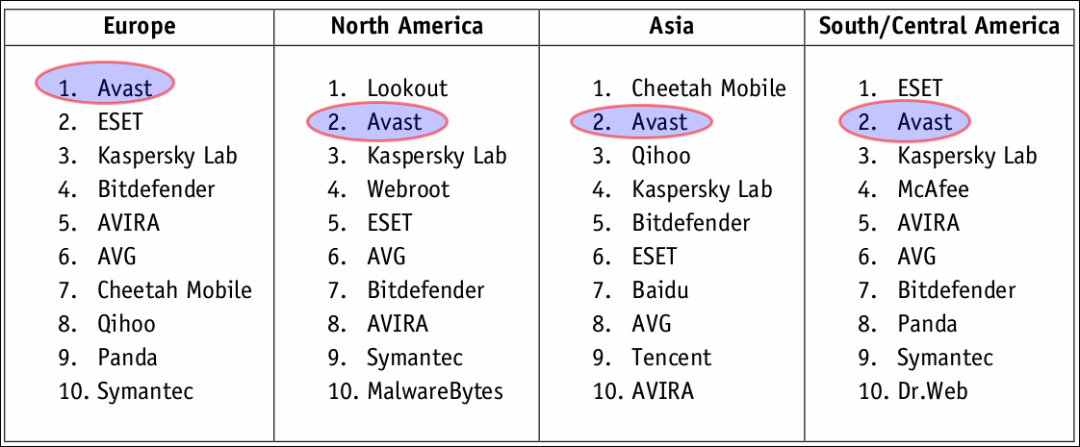

So why Avast is the best to you?
Top technology, Most user trust brand.
Source: http://www.av-comparatives.org/wp-content/uploads/2015/02/security_survey_2015_en.pdf
Notes:
1. High performance,
2. High accuracy,
3. most user chosen mobile security solution on smartphone.

Slide 26


So why Avast is the best to you?
Local data feeds, Local team support, Local language, local requirement
Notes:
local team, local language
local data, local datacenter
to guarantee our product beyond good..

Slide 27

So why Avast is the best to you?
We value win-win - multiple OEM licensing mode.
SDK integration
Bundling
etc.. Contact our sales
Notes:
we are not those who sell you a product then go away,
we want our solution really can help your business, from short term to long cooperation, but of course, we want to be great together with you

Slide 28
Thanks & Questions?

