Slide 1


Avast Urlinfo Service
Jacob Leung
October 2018

Slide 2
Agenda
Internet security situation
Avast Urlinfo Service introduction
Benefits come with the service
Compare to similar solutions in the market
Implement Scans for Urlinfo service
Why Avast is the best to you?
Questions.

Slide 3
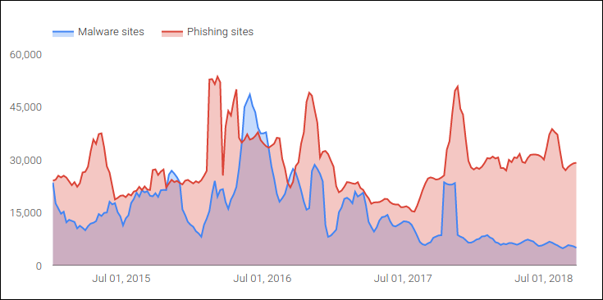
Internet security situation(1)
50,000+ sites hacked daily
10,000+ new blacklisted siteds daily
85%+ websites include at least one remote JS library.
(ad, sns, tracking, web analytics)
Source: google safe browsing, https://hostingfacts.com/internet-facts-stats/

Slide 4
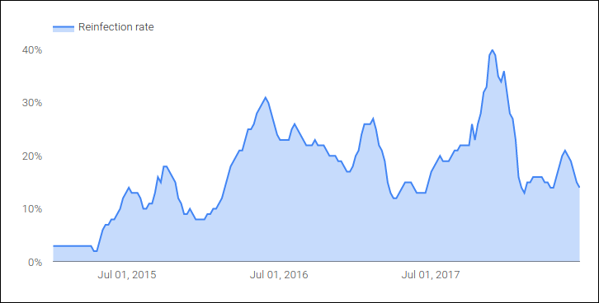
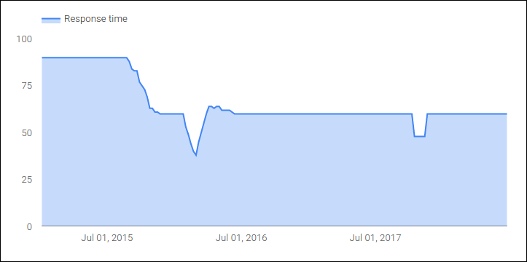
Internet security situation(2)
Long response time for compromised notification. (60 days)
High reinfection rate. (20%)
Notes:
Long response time after webmasters receiving notifications that their sites have been compromised. (60 days)
Even after a site has been cleaned, it can become reinfected if an underlying vulnerability remains.

Slide 5

Attacking vectors - client side
Phishing
Social engineering
Trafffic sniffer, even HTTPS
Browser vulnerability
etc..

Slide 6
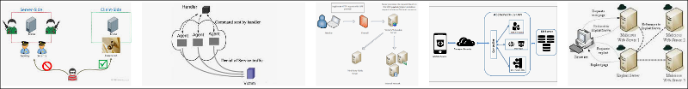
Attacking vectors - server side
Application, system bugs
Brute force password
CSRF
Web applications vulnerabilities
Poor security policies
etc..

Slide 7
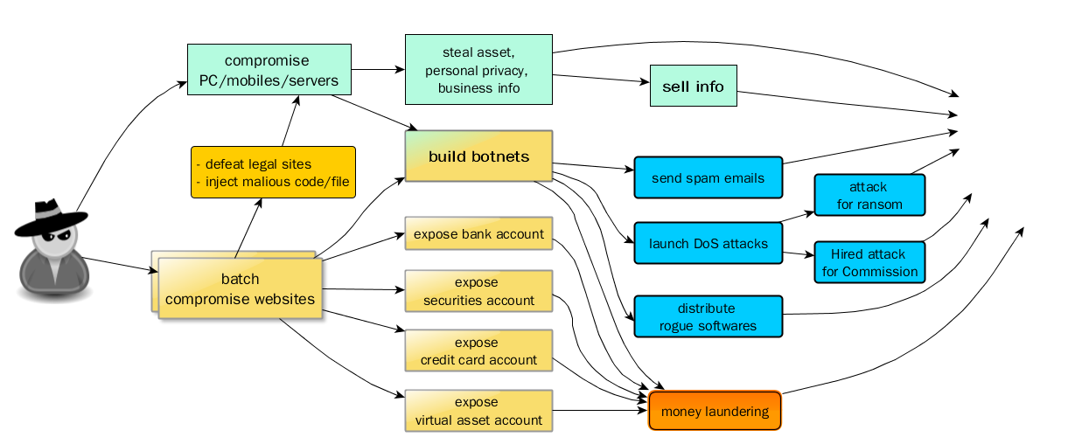

Impacts after being compromised
Server/workstation controlled by hackers for APT
Notes:
What can happen if your device or a website was hacked.

Slide 8


You need a solution to against web threats
VS

Slide 9
Agenda
Internet security situation
Avast Urlinfo Service introduction
Benefits come with the service
Compare to similar solutions in the market
Implement Scans for Urlinfo service
Why Avast is the best to you?
Questions.

Slide 10
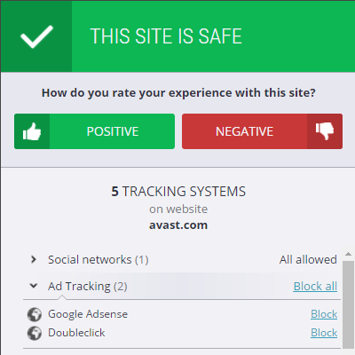
AVAST URLINFO SERVICE
INTRODUCTION
Avast powered engine to detect and protect your web security.
Scan URL and IP address to determine if they are harmful or unwanted in our cloud.
Protect Endpoints, Network appliances, and Cloud infrastructures base on our fingerprint system.

Slide 11
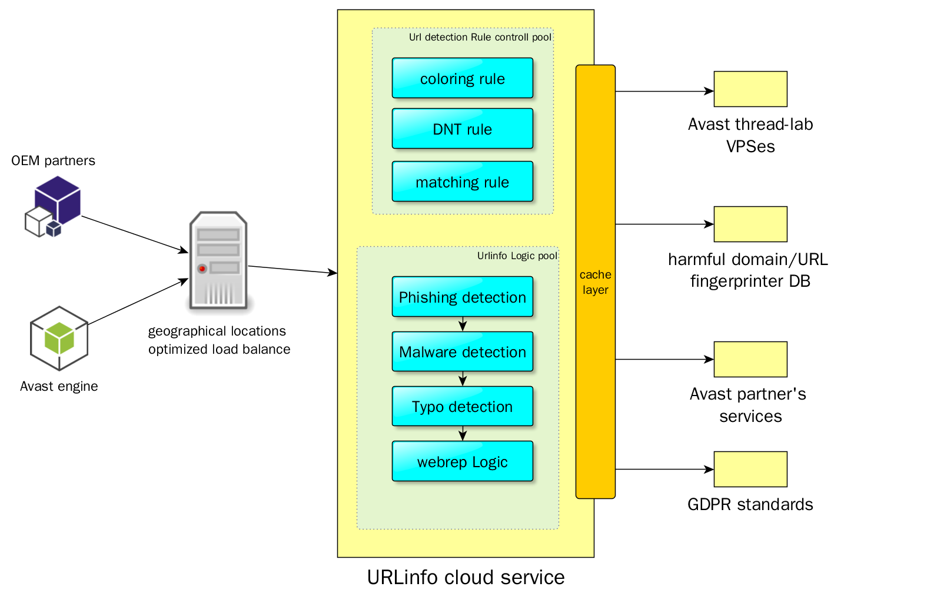
Architecture overview

Slide 12

Feature: scan Urls for all threats
Check both IP address and whole URL.
Identify malicious, phishing, fraudulent websites in real-time.
Check domain reputation.
Cloud service frontend.
Provide simple HTTPS API for integration. Multi-proto.
Notes:
Check URLs or IP addresses to determine if they are harmful, typo, tracking or unwanted spam, Identify malicious, phishing, and fraudulent websites in real-time.
Check domain reputation based on massive Avast users voting
cloud service frontend for Avast backend virus lab service
provide simple HTTP/HTTPS web API for integration, support JSON/GPB protocol.

Slide 13
Our advantages
Distributed service. multiple DC.
High performance. GEO optimized. RT at Minisecond level.
Local OEM support team.
Multiple feed sources, not only from Avast ThreatLab.
High accuracy, local feed sources.
Malicious feeds real time update, at second level.
10+ million harmful URL fingerprints.
Notes:
service distributed on multiple datacenters, service distributed in 7 zone and 38 dc center.
high performance, low latence, geographical locations optimized.
high accuracy, low FP, the best data feed from local partners.
Local OEM support team
malicious feeds real time update, in second level.
multiple blacklist sources, includes scaned result from Avast ThreatLab VPS
10 million bad URLs (1m if only from safebrowsing, 800k ph, 200k mal)

Slide 14
Agenda
Internet security situation
Avast Urlinfo Service introduction
Benefits come with the service
Compare to similar solutions in the market
Implement Scans for Urlinfo service
Why Avast is the best to you?
Questions.

Slide 15







Use cases / Solutions(1)
Use to protect and Endpoints, Network Appliances, and Cloud Infrastructure:
Client side web access hardening(Browser).
Mobile application hardening(App).
Url links status report for content hosting providers
(blog, wiki, message board, SNS)
Search result links status for search engine providers.

Slide 16







Use cases / Solutions(2)
Use to protect and Endpoints, Network Appliances, and Cloud Infrastructure:
Firewall, router Url filtering.
Integrate/OEM as a cloud service of SaaS provider.
Use in sandbox for ongoing threatened behavior detection.
All other who needs for Url health check.

Slide 17

Benefit come from this service(Partners)
Integrating it into your product to generate revenue.
Create incremental revenue as an optional service to your clients.
Differentiates product from competitors.
More time to focus on your own business targets.
harden your devices/applications/services, to keep a good reputation for your brand.
Notes:
Identifies all harmful sites, notifies user or administrator to stay away from online threats.

Slide 18

Benefit come from this service(End user)
Trust all URLs from your app/service/device.
Prevent from potential web-based security issues.
Webmasters receive notification for their compromised sites so that their visitors stay safer.

Slide 19
Agenda
Internet security situation
Avast Urlinfo Service introduction
Benefits come with the service
Compare to similar solutions in the market
Implement Scans for Urlinfo service
Why Avast is the best to you?
Questions.

Slide 20
Similar solutions in the market
Norton - safeweb
Comodo - webinspector
Cyren
ESET
Bitdefender
360 webscan

Slide 21
Difference comparison
 | License Mode | service performance | detection accuracy | localization feeds | Local support
Avast | Multiple - SDK integration - Bundling | Very Fast | super | Yes | Yes
Norton | Online service | Very Fast | high | No | Yes
Comodo | Online service for website | On daemon | good | No | No
Cyren | Data feed | N/A | good | No | No
ESET | Data feed | N/A | high | unknown | No
BitDefender | Multiple - SDK integration - Bundling - ReBranding | Fast | super | No | No
360 webscan | Online service | On daemon | high in China | Yes in China | Yes in China

Slide 22
Agenda
Internet security situation
Avast Urlinfo Service introduction
Benefits come with the service
Compare to similar solutions in the market
Implement Scans for Urlinfo service
Why Avast is the best to you?
Questions.

Slide 23
Implementing - In short
Get AccessKey
Try our service with your license mode, access key and provided demo.
Get Url health result
Contact our local team, get API access key
Get Url health status result, and do further processing.
That's it.
Send Request with the key

Slide 24

Implementing - Details/Demonstration
API Doc tour & Demo

Slide 25
Agenda
Internet security situation
Avast Urlinfo Service introduction
Benefits come with the service
Compare to similar solutions in the market
Implement Scans for Urlinfo service
Why Avast is the best to you?
Questions.

Slide 26
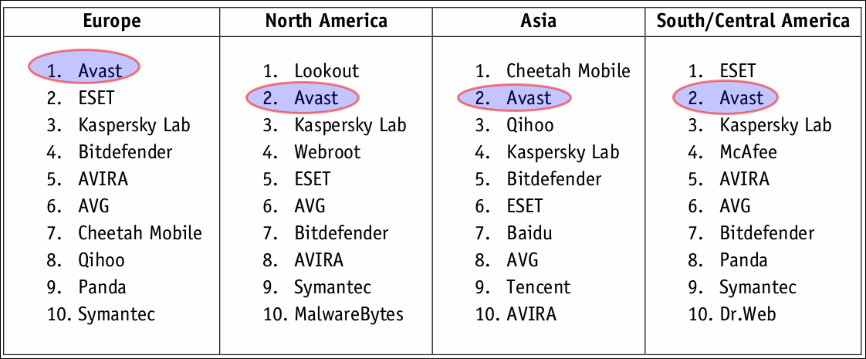

So why Avast is the best to you?
Top technology, Most user trust brand.
Source: http://www.av-comparatives.org/wp-content/uploads/2015/02/security_survey_2015_en.pdf
Notes:
Which mobile anti-malware security solution do you primarily use on your smartphone?
High performance, high accuracy, most user chosen mobile security solution on smartphone.

Slide 27


So why Avast is the best to you?
Local data feeds, Local team support

Slide 28

So why Avast is the best to you?
We value win-win - multiple OEM licensing mode.
SDK integration
Bundling
etc.. Contact our sales

Slide 29
Thanks & Questions?

